Slide 1

If you want something you've never had before. You must do something you've never done before it's taking

Slide 2

me years of tragedy of losing myself inside only to realize what i must have always known that

Slide 3
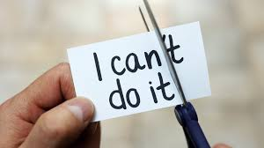
you can be anything you dream dream dream dream dream until your dreams come true act on your

Slide 4

passion and when you're taking it look for in the face and embrace it the time is now

Slide 5

the moment is now believe in yourself like i believe this to be true the world needs more

Slide 6

of you.

