Slide 1

How did apple reduce its global taxes using an irish structure to understand this you'll need a basic understanding of corporate taxation a company pays taxes based on where it's located where its employees are located and where is profits are made also known as tax residency. For example. Is liable for taxes in the united states. Well let's add one layer of complexity. What happens if the irish company is a subsidiary of the us corporation which effectively means that the

Slide 2
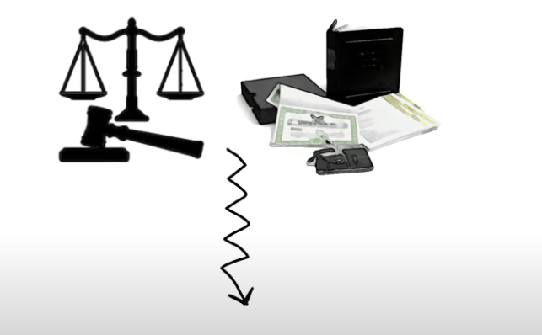
us company controls and owns the irish company does uncle sam get a cut of the irish prophet yes. Corporate taxes forever why do you think apple kept so much cash in ireland. This was true until 2017 before the new rules were introduced by this man. Today on repatriated profits can still be taxed in the us. Go back to the video now that you understand how taxes work let's take a look at why ireland. None of the above. Irish

Slide 3

corporate tax rate is 12.5%. Enough friends in australia charge 30%. Ireland has had a long-standing reputation of heavily favoring corporations. In fact it was once called a tax haven by the us internal revenue service. Decided to set up operations in ireland due to its highly accommodative corporate tax and economic policies but if you ask them many companies will probably deny that establishing an irish company was motivated by tax savings. But now you know why. The next question is.

Slide 4
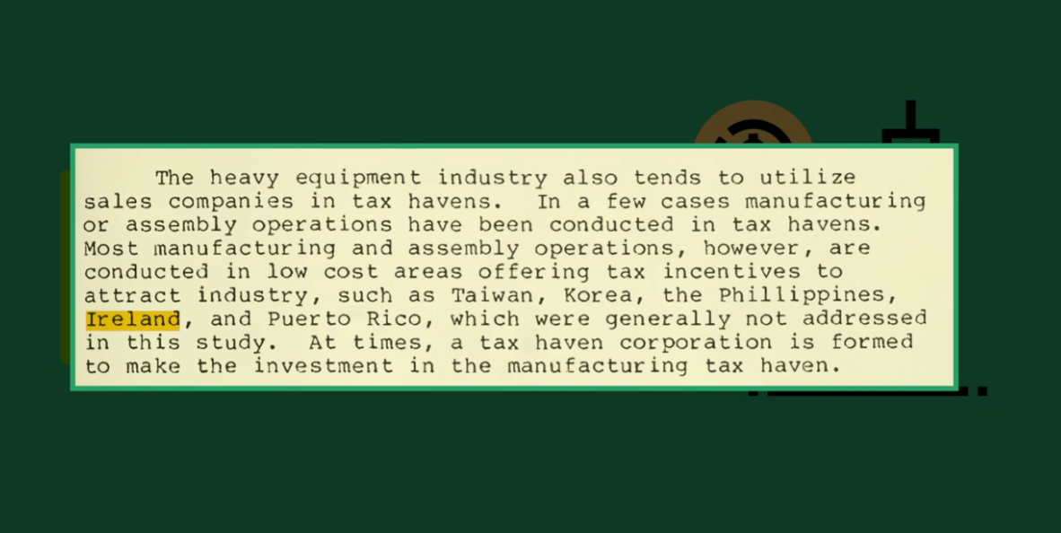
Got an idea. Rather than 21% in the us that would be a huge tax savings. Not bad. But i think we can do better. How about 0%. A company could be considered a non-tax resident of ireland if it is centrally managed and controlled outside of ireland. Even where the company is legally registered in the country. Individuals as directors of the irish subsidiary. Usb director to meet the definition of managed and controlled outside of ireland. This means that earnings

Slide 5
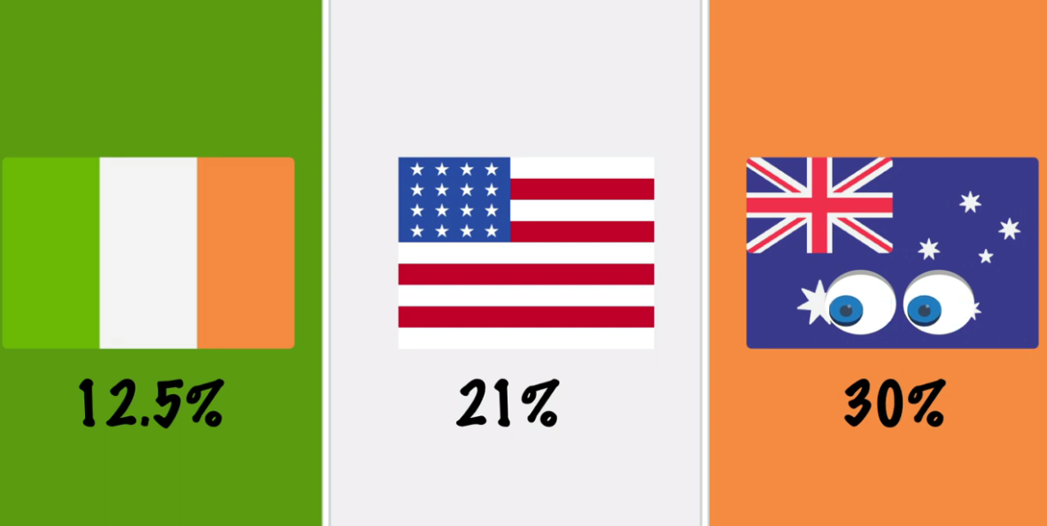
from the irish subsidiary would not be taxed in ireland and the us would also not be able to tax his profits until they are ultimately repatriated. The european commission refer to the sanity as stateless for residency purposes. Now you may be wondering. Does certainly attracted a lot of attention including that of the us senate and the european commission. In fact. The european commission initiated a probe into apples arrangement with ireland. Which arguably is the more offensive matter was

Slide 6

not challenged. And this is likely because apple structure was perfectly legal and well within the irish tax rules. Do european commission's focus was in a very specific issue that probably deserves a whole video on its own in 2020. Do european commission's tax decision was ultimately struck down by the general court ruling in favor of apple the european commission has appealed the decision and the outcome is yet to be determined but it is not uncommon for multinational companies to

Slide 7

take advantage of the hybridity and mismatch between different countries tax law to achieve a lower global effective tax rate. Tax evasion is illegal and could result in jail time tax avoidance is perfectly legal. And what is multinational companies are doing is simply practicing some form of tax avoidance. Let me know if you think this is fair in the comment section below. This will let me know if i should continue to make these type of videos. See you next

Slide 8

one.

