Slide 1
Agile Workshop 1
Estimation, Test-Driven Development and Pair Programming

Slide 2
Overview for today
Estimation of stories
Short talk about:
Pair Programming Roles
Test-Driven Development example
You work in pairs to develop some codes using TDD
We will have a short retrospective at the end

Slide 3
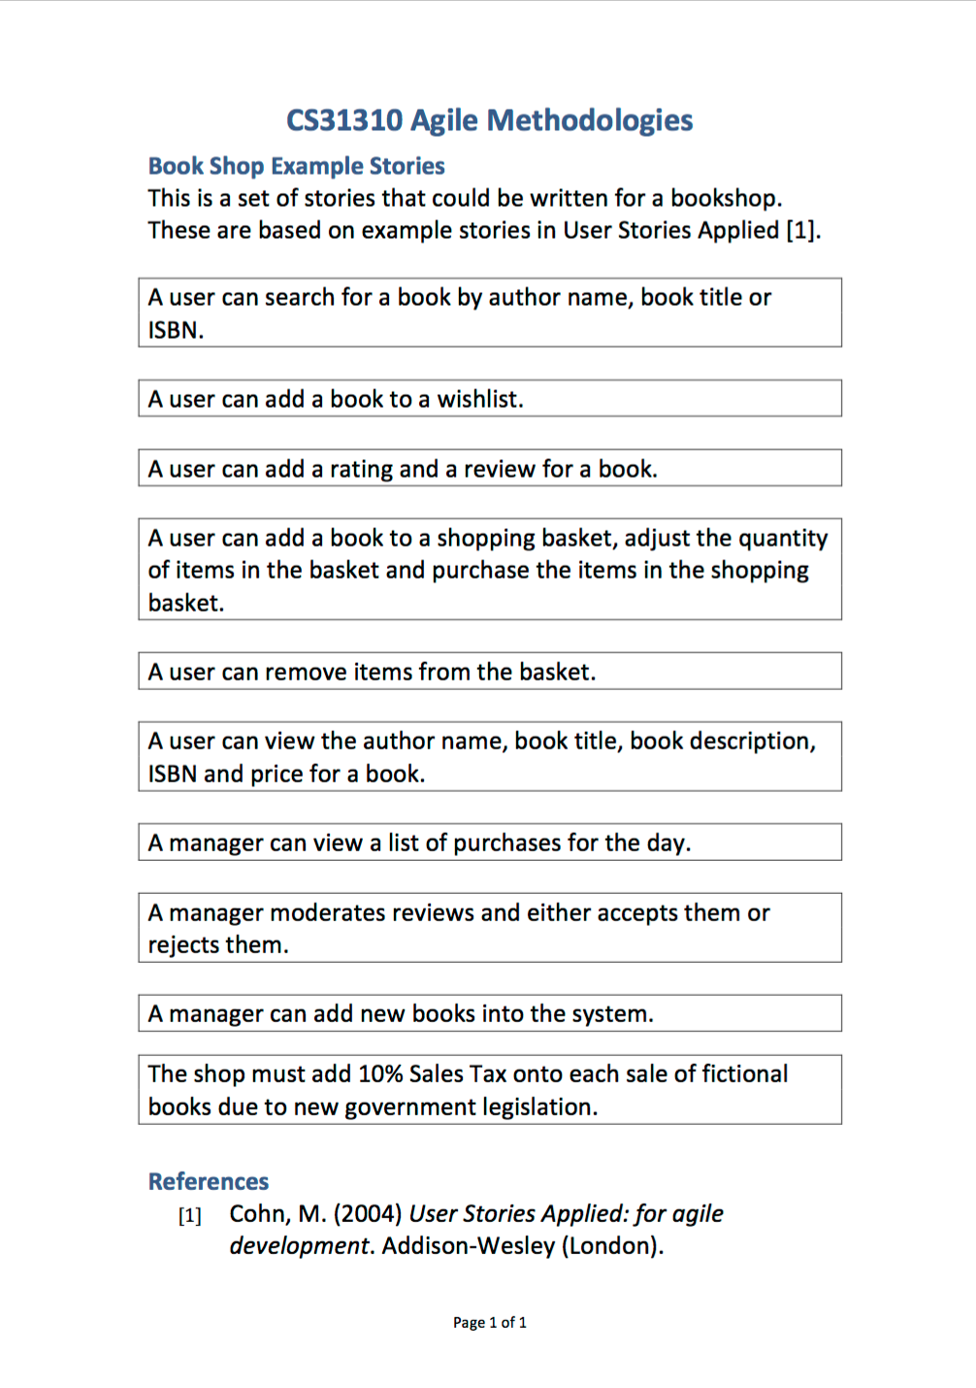
Estimation
You have a list of stories for the book shop.
Discuss each one in small groups (about 6 people). Talk though what might be involved.
For each story, write an estimate on your sheet. For now, use numbers in the range 1 to 10, where 1 is easier and quicker to implement and 10 is more complex and will take longer.

Slide 4
Pair Programming
Driver
Decides what to do and type
Listens to the navigator for advice
Makes sure the navigator understands what you’re doing
Navigator
Asks questions to clarify
Suggests alternative approaches
Needs to understand fully what is being done
Prepared to take over if the driver gets stuck
Swap the roles regularly to help keep both developers involved

Slide 5
The XP Day with Test-Driven Development
Stand-up
Meeting at 9am
Pair Up – Quick
Design
Write Test
Run
Test
Code
Refactor
Integrate (plus regression test) or throw
Leave at 5pm

Slide 6
Red
Green
Refactor

Slide 7
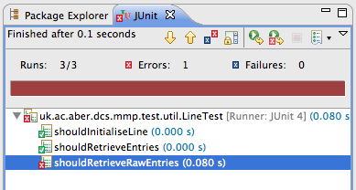
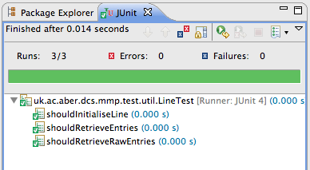
1
2
3
Refactor

Slide 8
Characteristics of XP Test-Driven Development (TDD)
Write tests before writing code implementation
Unit tests: written by programmer to define what it means for the code to work
Acceptance tests: written by customer to test that system behaves as required
Write minimum amount of code to pass the test
Use your tests as a safety net that allows change
Use tests as documentation

Slide 9
TDD Movie Example
Taken from Test Driven Development, David Astels, Prentice Hall.
XP Story. Movie List:
As a Manager, I want a way to create a list of movies and a way to add movies to it. Ordering of the list isn’t a concern.
One of the tasks derived from this story:
Task 1-1. Make a container for movies with a way to add to it. Doesn’t have to be ordered or sorted.

Slide 10
Your task
Spend a few minutes to discuss the stories again with your pair-programmer. Which ones will you commit to complete in the next 50 minutes?
Develop the code for your selected stories, using TDD.
Remember:
Red – write a failing test
Green – write (just) enough code to make the test pass
Refactor – consider possible improvements (Don’t spend much time on refactoring this week. We will talk about it in a couple of weeks).
Make sure you swap over the pair roles regularly.

Slide 11
Retrospective
What went well
What could be better?

Slide 12
Questions?

