Slide 1
Taufik Rendi Anggara, S.Si, M.T, LA (IRCA), PAPC, PCEP, CIBIA
Pemrograman Web
Chap 1
Course Contract, Introduction to Mobile Programming

Slide 2
VISI
Menjadi perguruan tinggi kelas dunia berbasis intelektualitas, kreatifitas dan kewirausahaan, yang unggul dalam mutu pengelolaan dan hasil pelaksanaan Tridarma Perguruan Tinggi.
MISI
Menyelenggarakan pendidikan tinggi yang bermutu dan relevan
Menciptakan suasana akademik yang kondusif
Memberikan pelayanan prima kepada seluruh pemangku kepentingan

Slide 3
Tools That you Need to Install!
IDEA Platform – Recommended tool is Android Studio
Mobile Programming Framework – recommended is Flutter
Git Account (Github or Gitlab)
I don’t serve the student with installation trouble at chapter 3 or more
If You are not follow this, you will be lag behind on the class!

Slide 4
Rule of The Class
Don’t disturb at the class! or you will be kick out from the class!
E-mail Permit must be same with the template!
No Remedial!
You will get A Score if you are learn and follow this class intensively!
Cheating will punished with Big Zero Point!
Insulting the Lecturer, your exam will be not graded!

Slide 5
Template of Email Permit
To : lordrendi@gmail.com
Subject Email : <NIM>_<Name>_<date>_<code of classes>
Body Email must include :
NIM
Name
Date of Permit
Reason
Different Template is not Accepted!
Late of Sending Email Permit is not Accepted! Max Date of Sending Email is Day + 7

Slide 6
Scoring Systems
Mid Exam (40%)
Final Exam (40%)
Assignment (15%)
Absent (5%)

Slide 7
What you will be learn
Course Contract & Web Programming Introduction
Preparing Mobile Apps Environment
Slicing Technique
Basic of Flutter Template Scripting Part 1
Basic of Flutter Template Scripting Part 2
Basic of Flutter Template Scripting Part 3.
Review Course

Slide 8
Continued
Network Mapping
Introduction to API & Git Introduction
API Programmatically (Part 1) Method Post
API Programmatically (Part 2) Method Get
API Programmatically (Part 3) Combination Method
Deploying & Obfuscate
Review Course

Slide 9
Reading Recommendation
Main Books
The Essential Guide to User Interface Design: An Introduction to GUI Design 3rd Edition By Wilbert O. Galitz
Design Patterns Elements of Reusable Object-Oriented Software, Erich Gamma
Beginning Flutter: A Hands On Guide to App Development Marco L. Napoli 2019
Additional Reading Recommendation
https://docs.flutter.dev

Slide 10
Key Principles of Good Architecture
Separation of Concerns: Different parts of the app should be responsible for different aspects, reducing interdependencies.
Scalability: The architecture should allow the app to grow without becoming unmanageable.
Testability: Components should be easily testable, allowing for robust testing strategies.
Maintainability: Code should be easy to understand and modify.

Slide 11
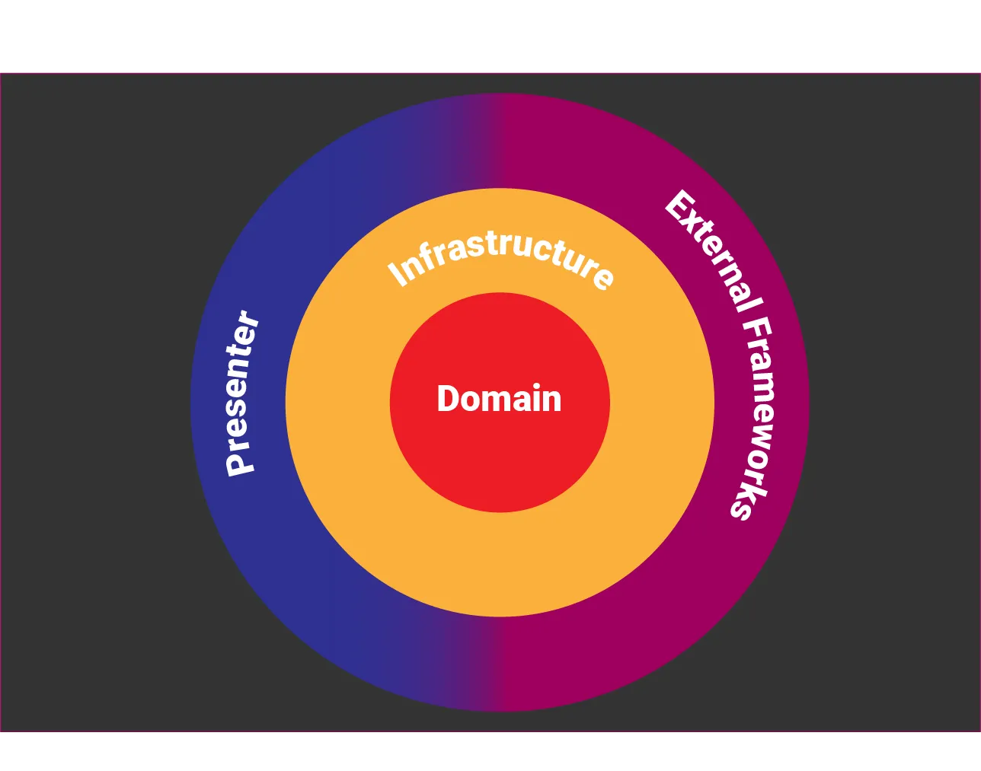
Clean Architecture
Presenter — Our UI components, basically everything that it’s a widget or a widget’s controller.
Domain — The app’s core. All entities and business logic will be held here.
Infra — Support the Domain layer by adapting the data coming from the external layer through models, repositories, and services.
External — Classes to wrap functionalities from third-party libraries, sensors, SO, storage, and any other external dependency of our app.

Slide 12
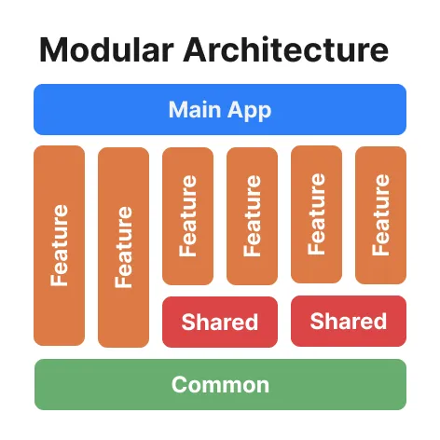
Clean arch + Modular arch = Happy developer

Slide 13
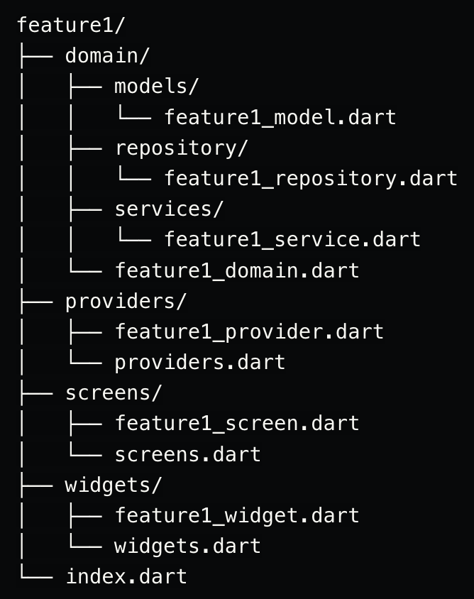
Flutter Folder Pattern Best Practice

Slide 14
Terima Kasih

