Slide 1
Taufik Rendi Anggara, S.Si, M.T, LA (IRCA), PAPC, PCEP, CIBIA
Pemrograman Web
Chap 2
Preparing Mobile Apps Environment

Slide 2
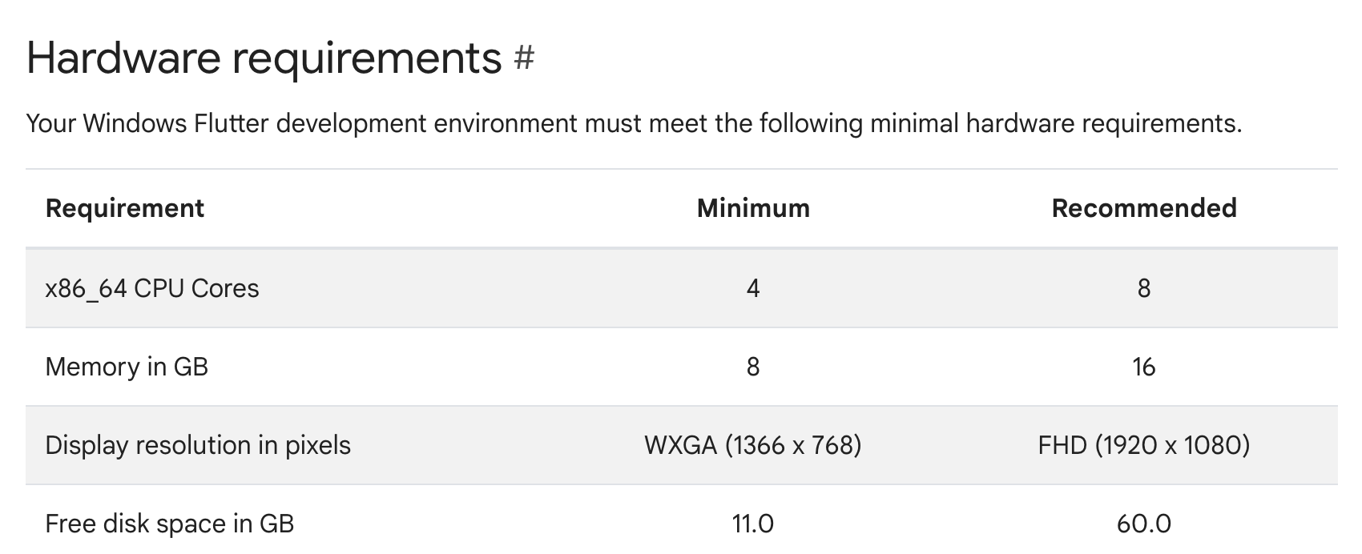

Slide 3
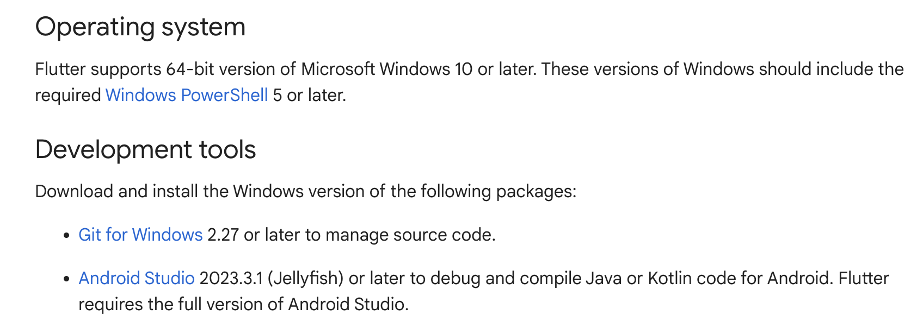

Slide 4
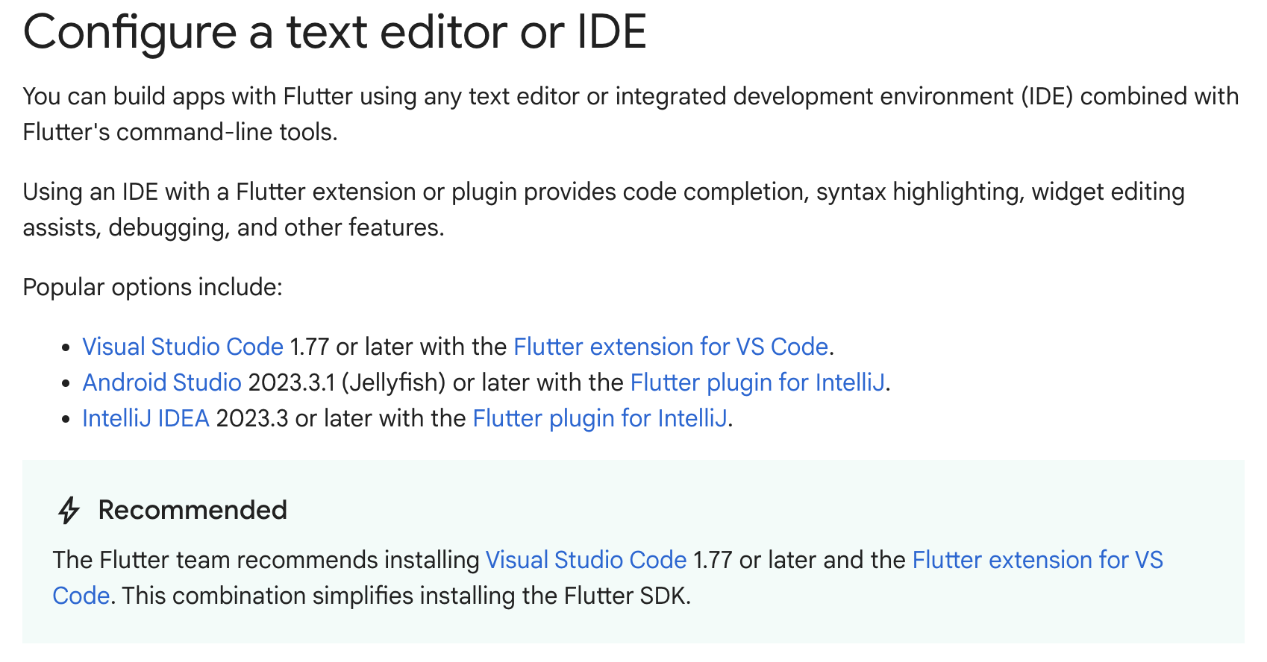

Slide 5
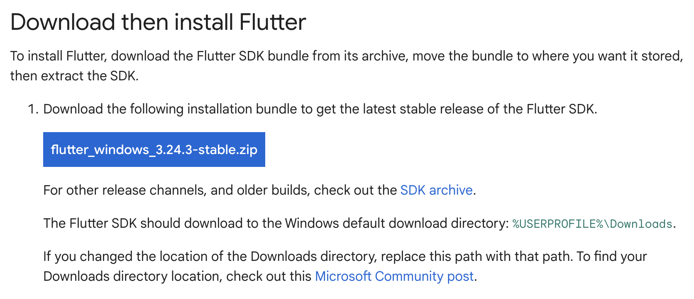
https://docs.flutter.dev/get-started/install/windows/mobile

Slide 6
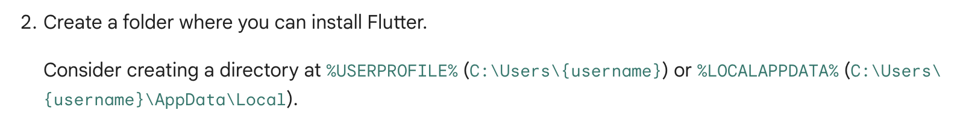
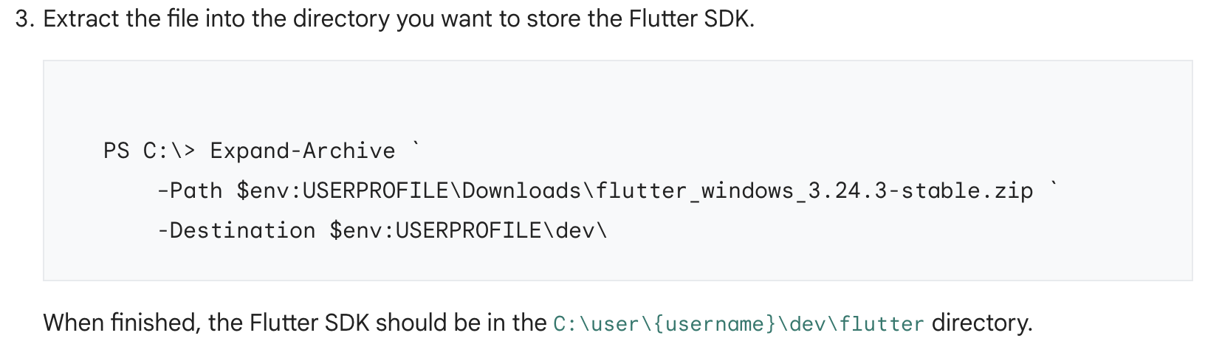

Slide 7
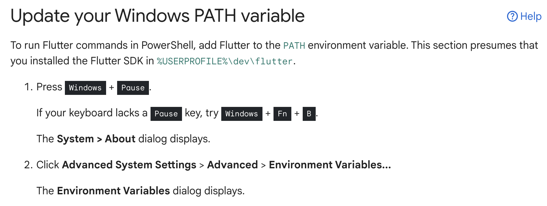

Slide 8
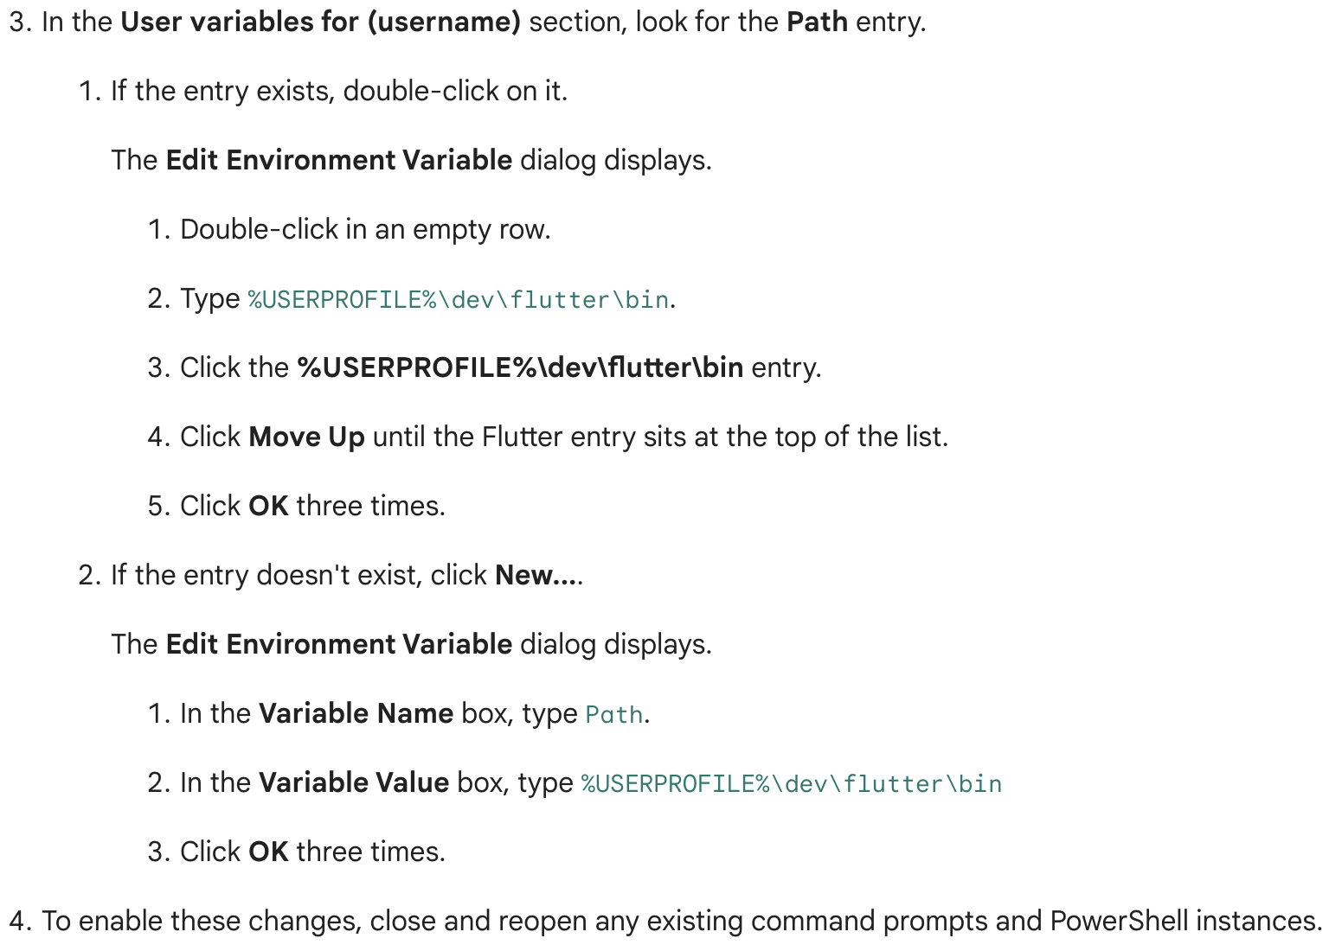

Slide 9
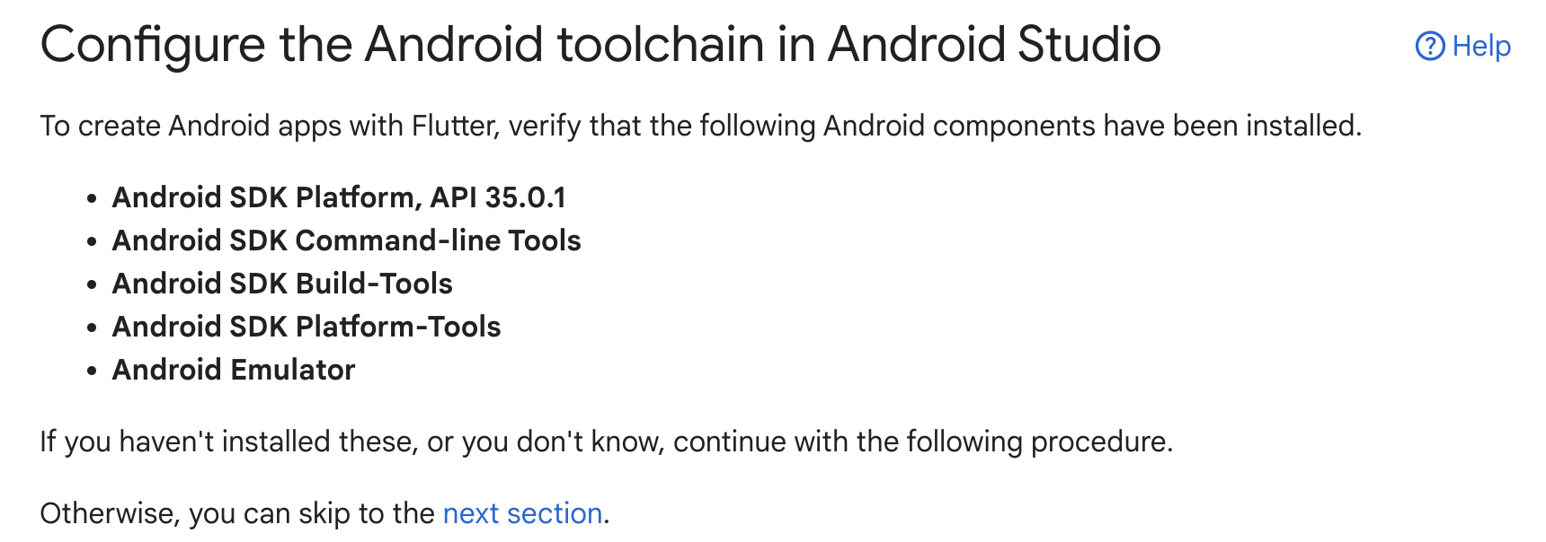

Slide 10
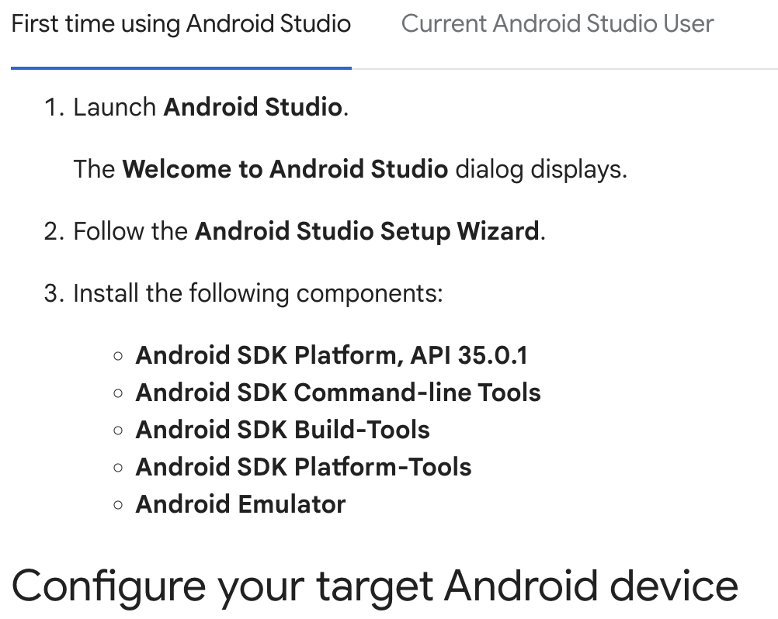

Slide 11
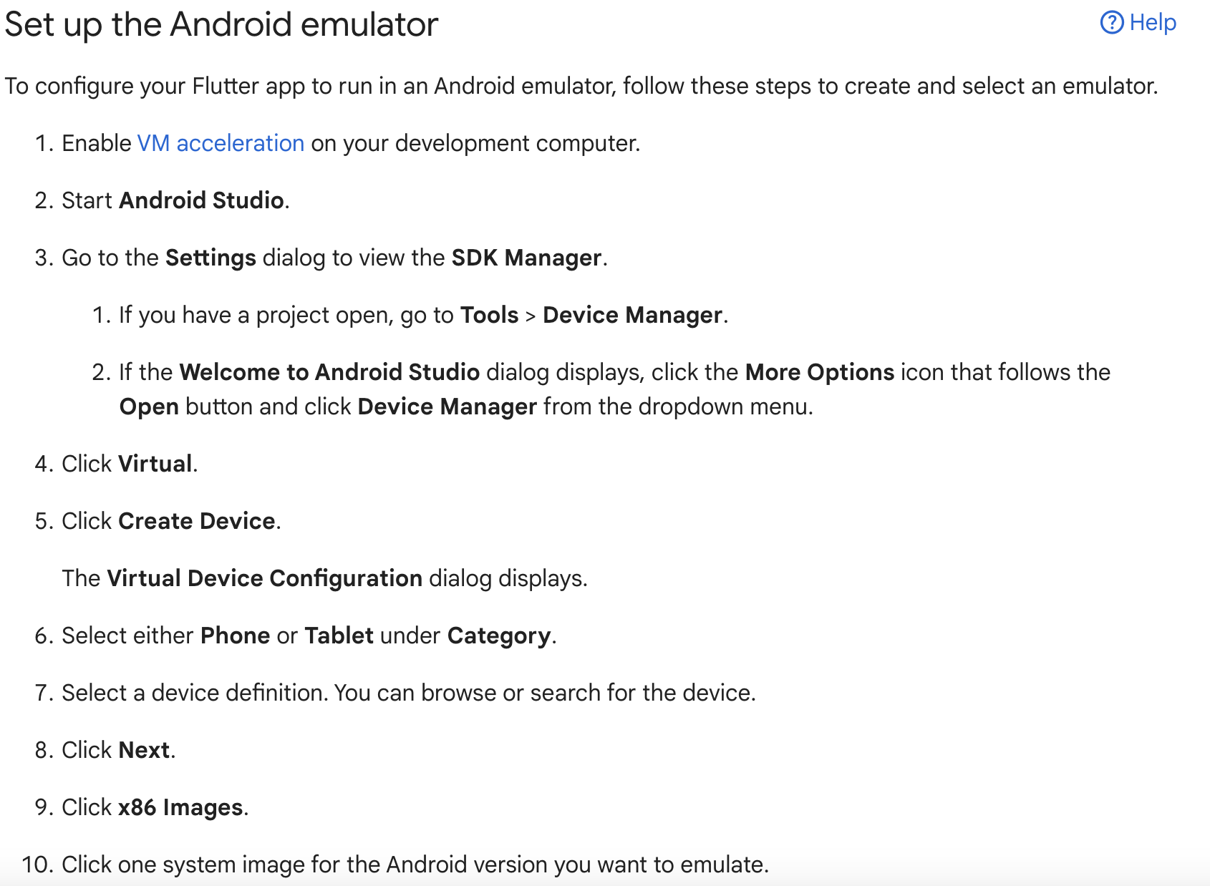

Slide 12
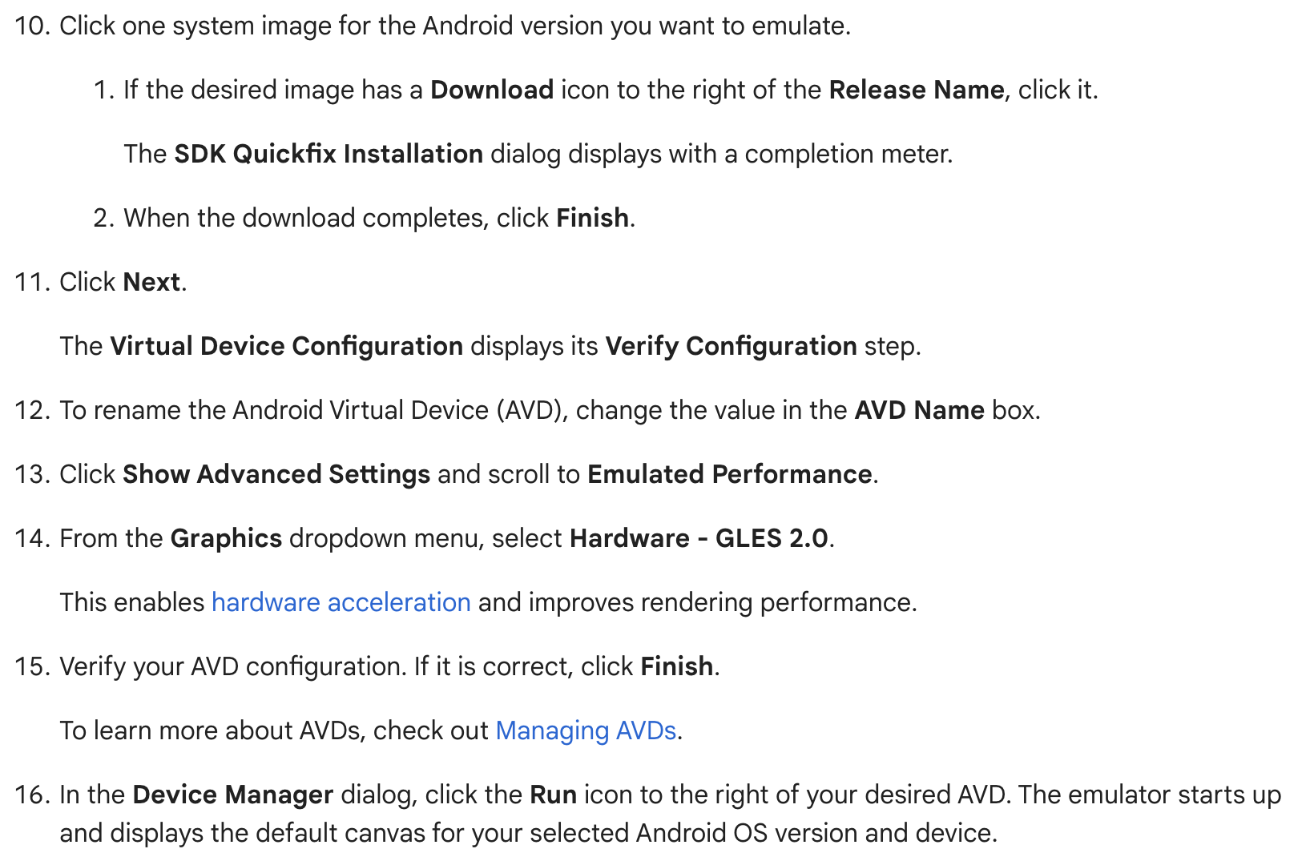

Slide 13
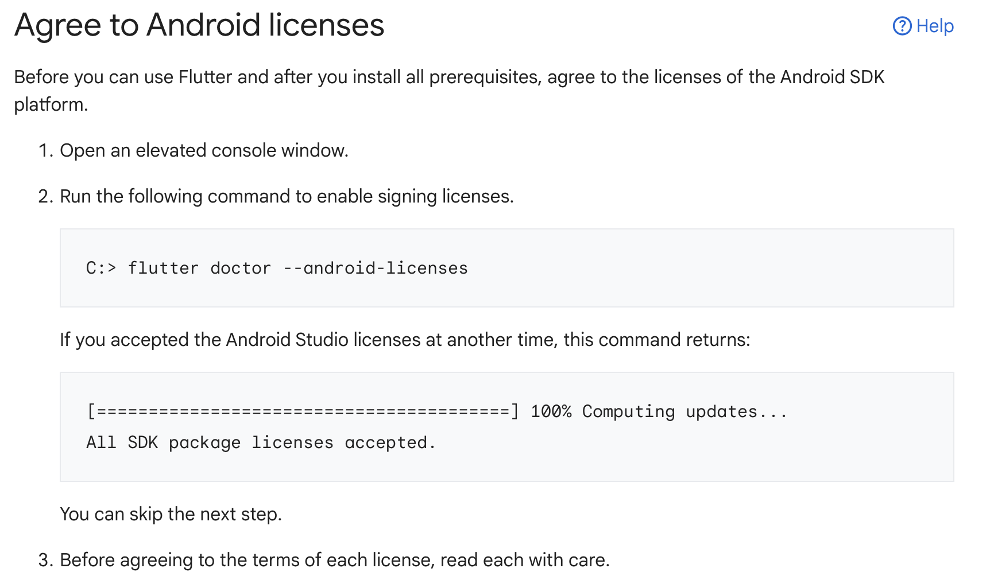

Slide 14
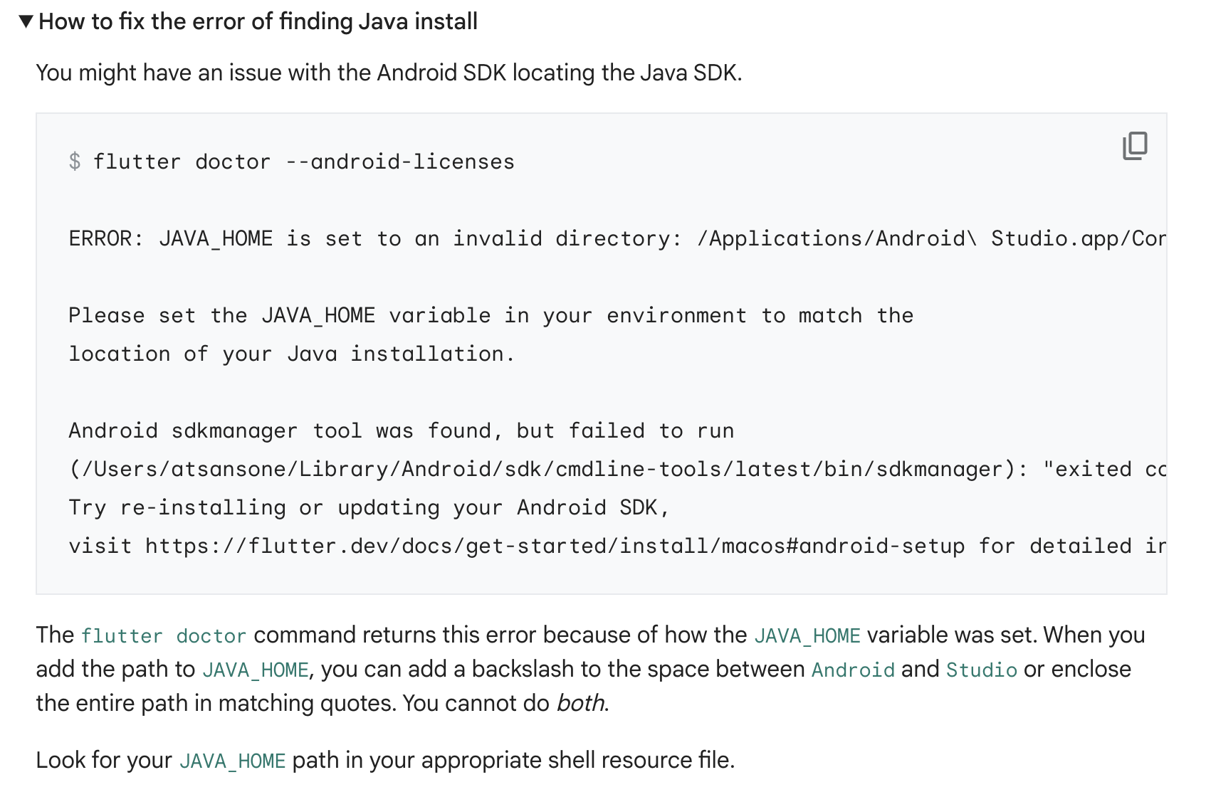
Troubleshooting licensing issues

Slide 15
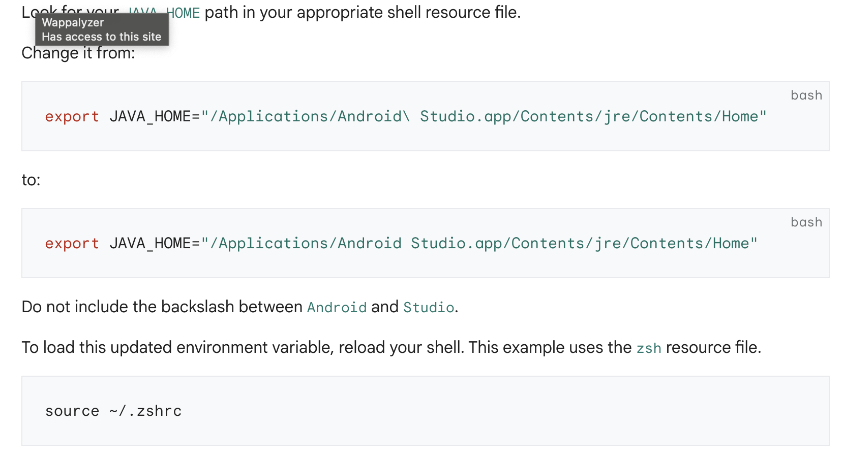

Slide 16
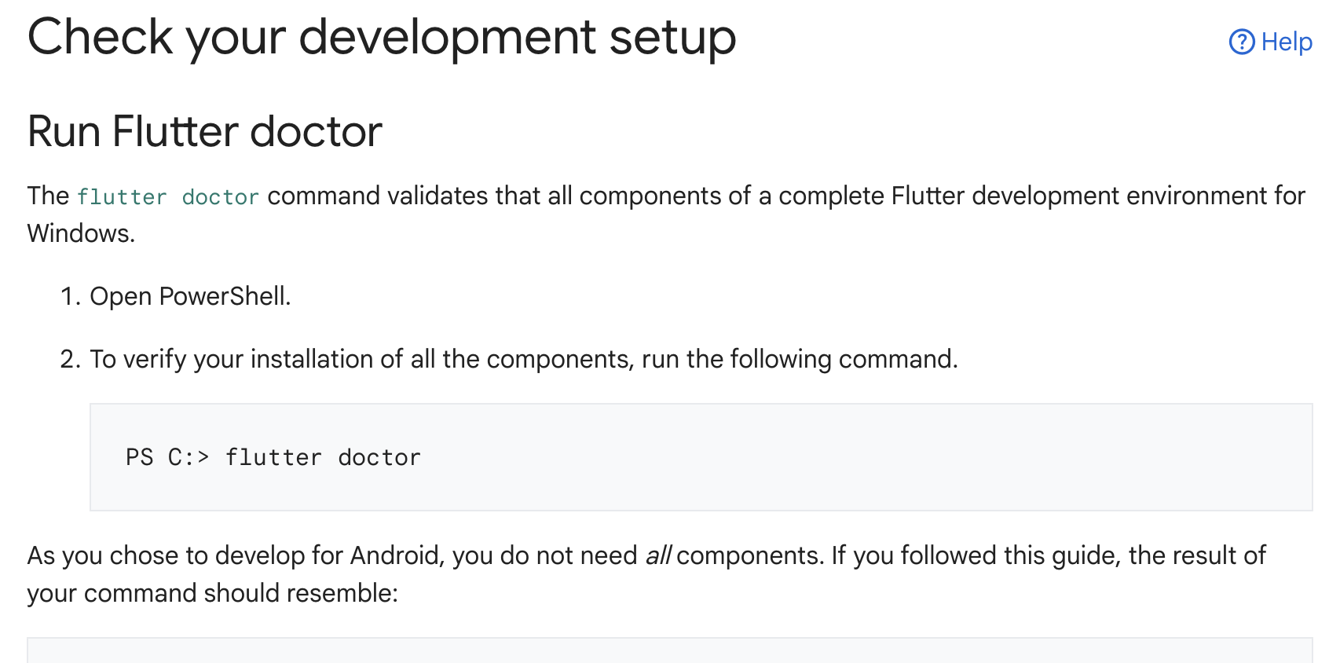

Slide 17
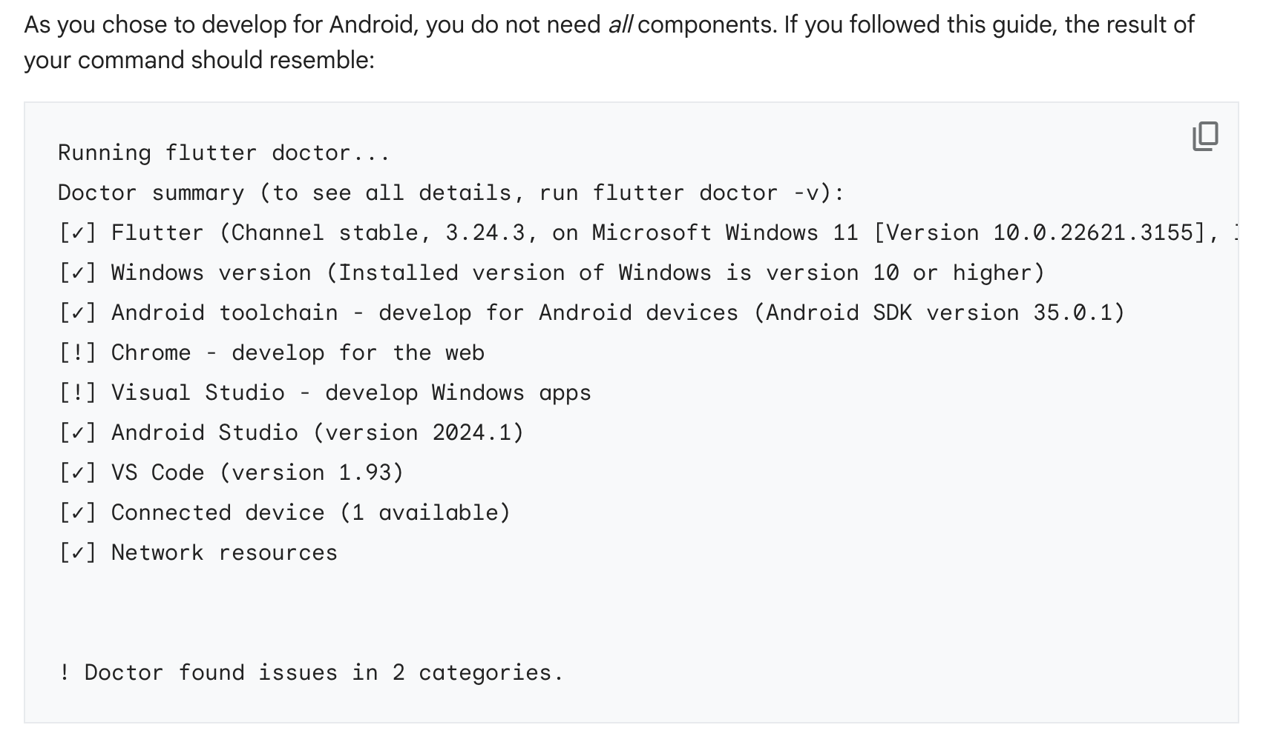

Slide 18
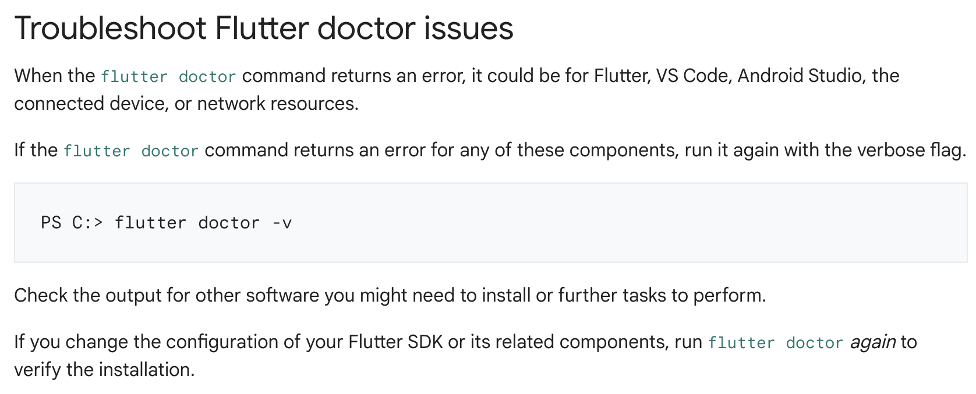
https://docs.flutter.dev/get-started/install/windows/mobile#manage-your-flutter-sdk

Slide 19
Terima Kasih

