Slide 1


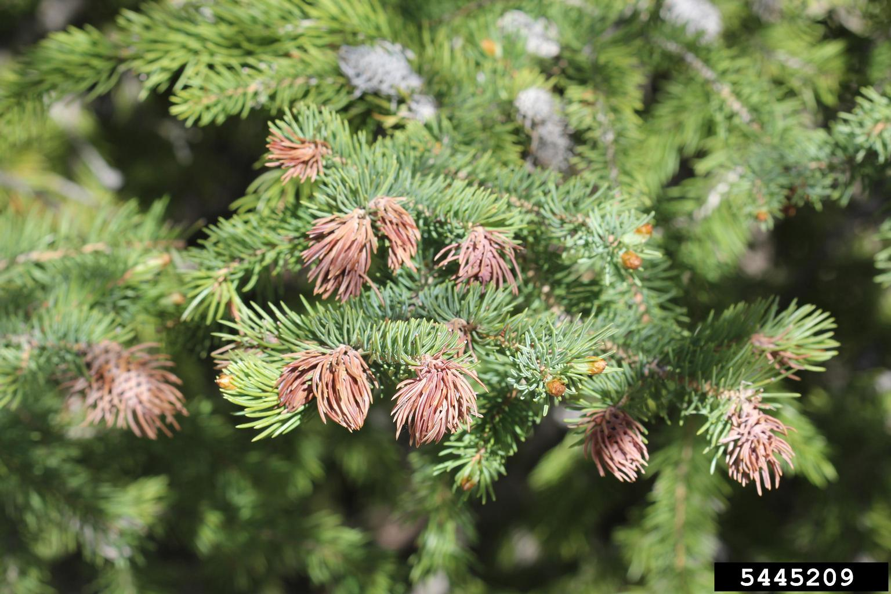


PnET-Succession v.4 (and earlier)
Cohorts within a layer are stacked
Light is filtered through upper layers.

Slide 2

However, Canopies generally do not overlap. (i.e, light is available equally to two identical sized cohorts)

Slide 3
PnET-Succession v.5
Assumes that within a single layer, light is available to all cohorts equally in
Separate “cylinders”)

Slide 4
Accounting

Slide 5
Example 1

Slide 6
Previous Method (assumes site is full by each cohort)
2000 g/m2
3000 g/m2
Site Total=
12,000 g/m2
1000 g/m2
6000 g/m2

Slide 7
Weighted Average Method
All cohorts in same layer
6000 g/m2 *(50%)= 3000g/m2
Site Total=
12000 g/m2
4167 g/m2
1000 g/m2 *(8%)=
83 g/m2
2000 g/m2 *(17%)=
333 g/m2
3000 g/m2
*(25%)=
750 g/m2

Slide 8
Weighted Average Method
Cohorts in 2 layers
Top layer:
Cohort1 = 6000 g/m2
Layer Total = 6000g/m2
Bottom layer:
Cohort1 = 1000 *(.17) = 170 g/m2
Cohort2 = 2000 *(.33) = 660 g/m2
Cohort3 = 3000 *(.50) = 1500 g/m2
Layer Total=2330 g/m2
Site total= 8330 g/m2
Site Total=
12000 g/m2
8330 g/m2

Slide 9
Example 2 New Cohorts added

Slide 10
Timestep 1: One cohort with 2000g/m2
Site total = 2000 g/m2
Timestep 2: Initial cohort:2000g/m2 *(67%)=1333 g/m2
New cohort: 1000 g/m2 *(33%)=333 g/m2
Site total= 1667 g/m2
Problem? Site lost biomass by adding a cohort.

Slide 11
Example 3 multiple layers

Slide 12
Site with four cohorts within TWO LAYERS
Top layer:
Cohort1 = 6000 g/m2
Layer Total = 6000g/m2
Bottom layer:
Cohort1 = 1000 *(.17) = 170 g/m2
Cohort2 = 2000 *(.33) = 660 g/m2
Cohort3 = 3000 *(.50) = 1500 g/m2
Layer Total=2330 g/m2
Site total= 8330 g/m2

Slide 13
If second largest cohort jumps up…
Top layer:
Cohort1 =6000 *(.6)=3600 g/m2
Cohort2=4000* (.4)=1600 g/m2
Layer Total=6000 5200 g/m2
Bottom layer:
Cohort1 = 2000
Layer Total= 3333 2000 g/m2
Site total= 9333 7200 g/m2

Slide 14
Weighted Average Method
6000 g/m2 *(50%)= 3000g/m2
Site Total=
4167 g/m2
1000 g/m2 *(8%)=
83 g/m2
2000 g/m2 *(17%)=
333 g/m2
3000 g/m2
*(25%)=
750 g/m2

Slide 15
Weighted Average Method
6000 g/m2 *(60%)= 3600g/m2
Site Total=
4200 g/m2
1000 g/m2 *(10%)=
100 g/m2
2000 g/m2 *(20%)=
400 g/m2
1000 g/m2
*(10%)=
100 g/m2

Slide 16
Weighted Average Method
Using MaxBiomass for layer proportion
6000 g/m2 *(50%)= 3000g/m2
Site Total=
3666 g/m2
1000 g/m2 *(8%)=
83 g/m2
2000 g/m2 *(17%)=
333 g/m2
1000 g/m2 [3000 g/m2]
*(25%)=
250 g/m2

Slide 17
Equal Proportion Method
6000 g/m2 *(25%)= 1500g/m2
Site Total=
3000 g/m2
1000 g/m2 *(25%)=
250 g/m2
2000 g/m2 *(25%)=
500 g/m2
3000 g/m2
*(25%)=
750 g/m2

Slide 18
Equal Proportion Method
6000 g/m2 *(25%)= 1500g/m2
Site Total=
2500 g/m2
1000 g/m2 *(25%)=
250 g/m2
2000 g/m2 *(25%)=
500 g/m2
1000 g/m2
*(25%)=
250 g/m2

