Slide 1


KOLABORASI ASIK
pake GIT

Slide 2

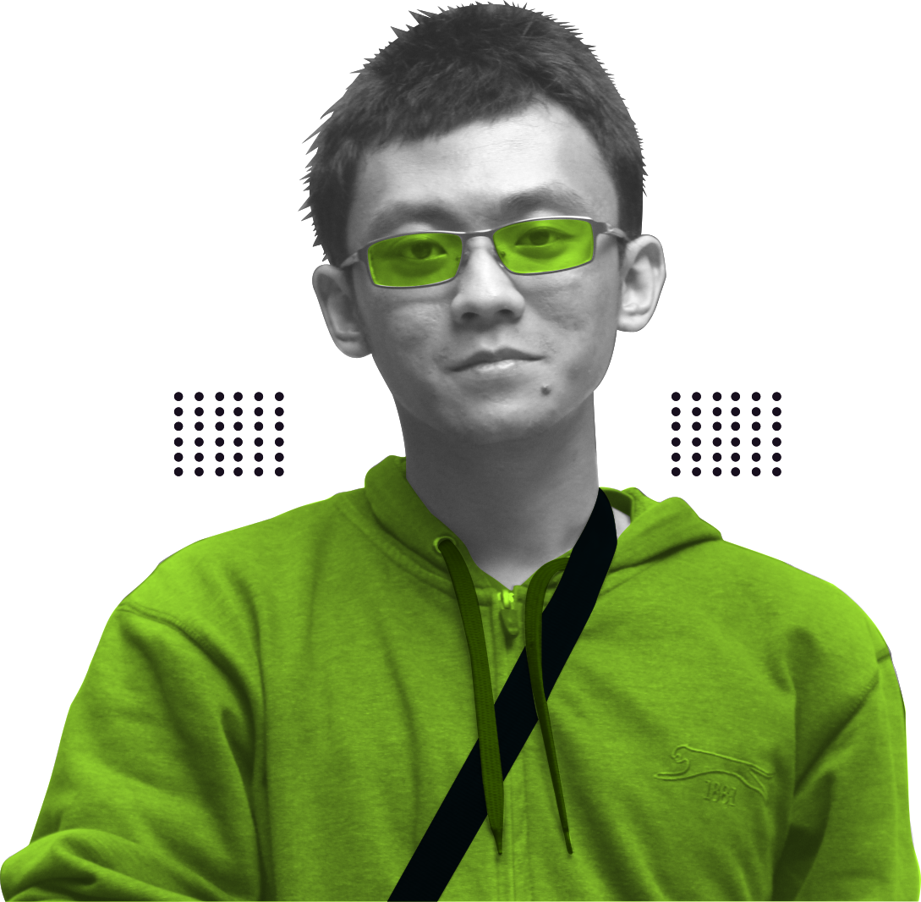







Pelatihan GIT / Perkenalan
PEndidikan
S1 – Sistem Informasi UNEJ (2015)
S2 – Magister Ilmu Komputer UGM (2020)
KOMUNITAS OPEN SOURCE
Linux and Open Source (LAOS) – 2016
Gimpscape - 2017
The Document Foundation – 2019
LibreOffice Indonesia - 2019
Stanislaus Jiwandana P.
Linux Enthusiasm, Former Professional Student
2022 HACKTOBERFEST. ALL RIGHTS RESERVED

Slide 3
Pelatihan GIT / Apa Itu Git?
APA ITU GIT?
2022 HACKTOBERFEST. ALL RIGHTS RESERVED

Slide 4

Pelatihan GIT / Apa itu GIT?
“
This is a stupid (but extremely fast) directory content manager. It doesn't do a whole lot, but what it does do is track directory contents efficiently.
”
Linus torvalds
dalam README repo GIT di Github
Penemu GIT dan Bapak Kernel Linux
2022 HACKTOBERFEST. ALL RIGHTS RESERVED

Slide 5
Pelatihan GIT / Gunanya GIT
GUNANYA GIT?

Menyimpan kenangan mantan berkas

Perkakas untuk versioning

Perkakas manajemen proyek
2022 HACKTOBERFEST. ALL RIGHTS RESERVED

Slide 6


Pelatihan GIT / Konsep GIT
Konsep GIT
Upstream
Downstream
Local Repo
fork
clone
Melakukan perubahan
Pull / merge request
push
2022 HACKTOBERFEST. ALL RIGHTS RESERVED

Slide 7
TERIMA KASIH
SEKIAN

Slide 8
Pelatihan GIT / Getting Started
Getting Started
Bikin akun Github / Gitlab
Pasang git pada sistem
Atur ssh
Bikin repo
2022 HACKTOBERFEST. ALL RIGHTS RESERVED

Slide 9
Pelatihan GIT / Getting Started / Bikin Akun GIT
Bikin akun git

Daftar, verifikasi email, tinggal pakai :D
2022 HACKTOBERFEST. ALL RIGHTS RESERVED

Slide 10
Pelatihan GIT / Getting Started / Pasang GIT
PASANG GIT

Pasang git pada sistem
$ sudo apt install git

Atur username git
$ git config user.name “username-Anda”
Konfirmasi username
$ git config user.name
2022 HACKTOBERFEST. ALL RIGHTS RESERVED

Slide 11
Pelatihan GIT / Getting Started / Atur SSH
Atur SSH

Cek keberadaan SSH
$ ls -al ~/.ssh
Jenis ssh yang mendukung kunci publik Github :
id_rsa.pub
id_ecdsa.pub
id_ed25519.pub
2022 HACKTOBERFEST. ALL RIGHTS RESERVED

Slide 12
Pelatihan GIT / Getting Started / Atur SSH
Atur SSH

Jika tidak ada, bikin ssh
$ ssh-keygen -t ed25519 -C "emailmu@example.com"
> Generating public/private ALGORITHM key pair
> Enter a file in which to save the key (/home/YOU/.ssh/ALGORITHM):[Press enter]
> Enter passphrase (empty for no passphrase): [Type a passphrase]
> Enter same passphrase again: [Type passphrase again]
2022 HACKTOBERFEST. ALL RIGHTS RESERVED

Slide 13
Pelatihan GIT / Getting Started / Atur SSH
Atur SSH

Aktifkan ssh-agent di background

$ eval "$(ssh-agent -s)"
Tambahkan kunci private ke ssh-agent

$ ssh-add ~/.ssh/id_ed25519
Salin kunci publik ssh
$ cat ~/.ssh/id_ed25519.pub
2022 HACKTOBERFEST. ALL RIGHTS RESERVED

Slide 14
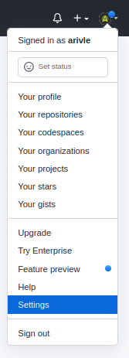
Pelatihan GIT / Getting Started / Atur SSH
Atur SSH

Buka github, klik icon kanan atas lalu pilih setting
2022 HACKTOBERFEST. ALL RIGHTS RESERVED

Slide 15
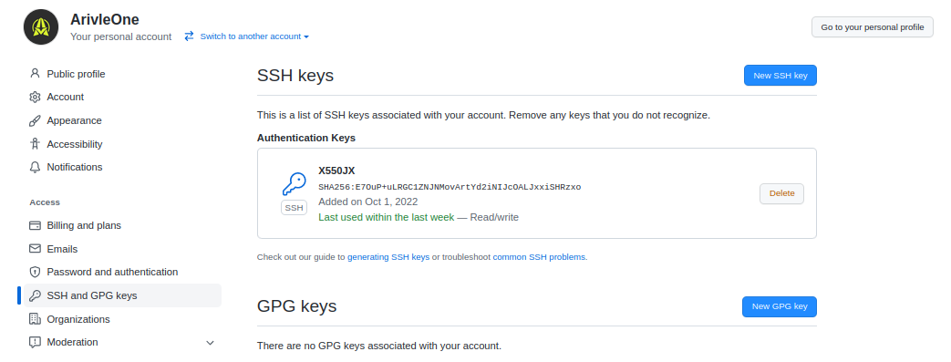
Pelatihan GIT / Getting Started / Atur SSH
Atur SSH

Pilih list “SSH dan GPG keys” lalu klik “New SSH Keys”
2022 HACKTOBERFEST. ALL RIGHTS RESERVED

Slide 16
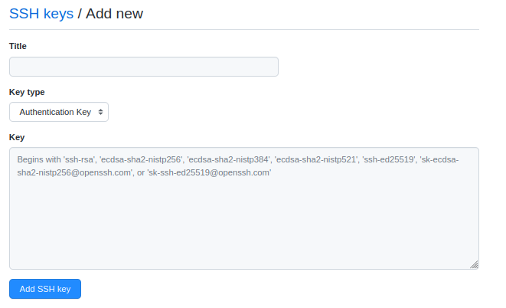
Pelatihan GIT / Getting Started / Atur SSH
Atur SSH

Isi judul dan masukkan kunci yang telah dicopy pada kolom “Key”
Jangan lupa tombol “Add SSH key” ini diklik ya :”))
2022 HACKTOBERFEST. ALL RIGHTS RESERVED

Slide 17
Pelatihan GIT / Tugas Utama / Kontributor
Untuk kontributor
Fork
Clone
Push
Turu Pull Request
2022 HACKTOBERFEST. ALL RIGHTS RESERVED

Slide 18

Pelatihan GIT / Tugas Utama / Kontributor
Untuk kontributor
fork
Clone ke repo lokal
Bikin branch baru
Bikin perubahan di repo lokal
$ git add .
$ git commit -m “pesan commit”
$ git pull upstream
$ git push origin [nama_branch]
Bikin Pull Request
(kalau sudah di-merge)
2022 HACKTOBERFEST. ALL RIGHTS RESERVED

Slide 19
Pelatihan GIT / Tugas Utama / Maintainer
Untuk MAINTAINER
Review change
Merge
2022 HACKTOBERFEST. ALL RIGHTS RESERVED

Slide 20
Pelatihan GIT / Tips Penting
TIPS Penting

Selalu cek status repo
$ git status

Sebelum melakukan perubahan, tarik dari repo upstream (fetch atau pull)
$ git fetch
$ git merge [cabang_target_pull / upstream]
$ git pull [cabang_target_pull / upstream]
2022 HACKTOBERFEST. ALL RIGHTS RESERVED

Slide 21
Pelatihan GIT / Tips Penting
TIPS Penting

Bikin cabang baru setelah clone

$ git checkout -b “namacabang”
Tambah remote URL repo upstream
$ git remote add upstream [URL_upstream]
2022 HACKTOBERFEST. ALL RIGHTS RESERVED

Slide 22
TERIMA KASIH
SEKIAN
Kalo sekarang beneran selesai :D

