Slide 1
QIIME2
How to run the analyses

Slide 2
We will analyse the Earth Microbiome Project
Dataset - Earth Microbiome Project
We will analyse it with QIIME2 workflow

Slide 3
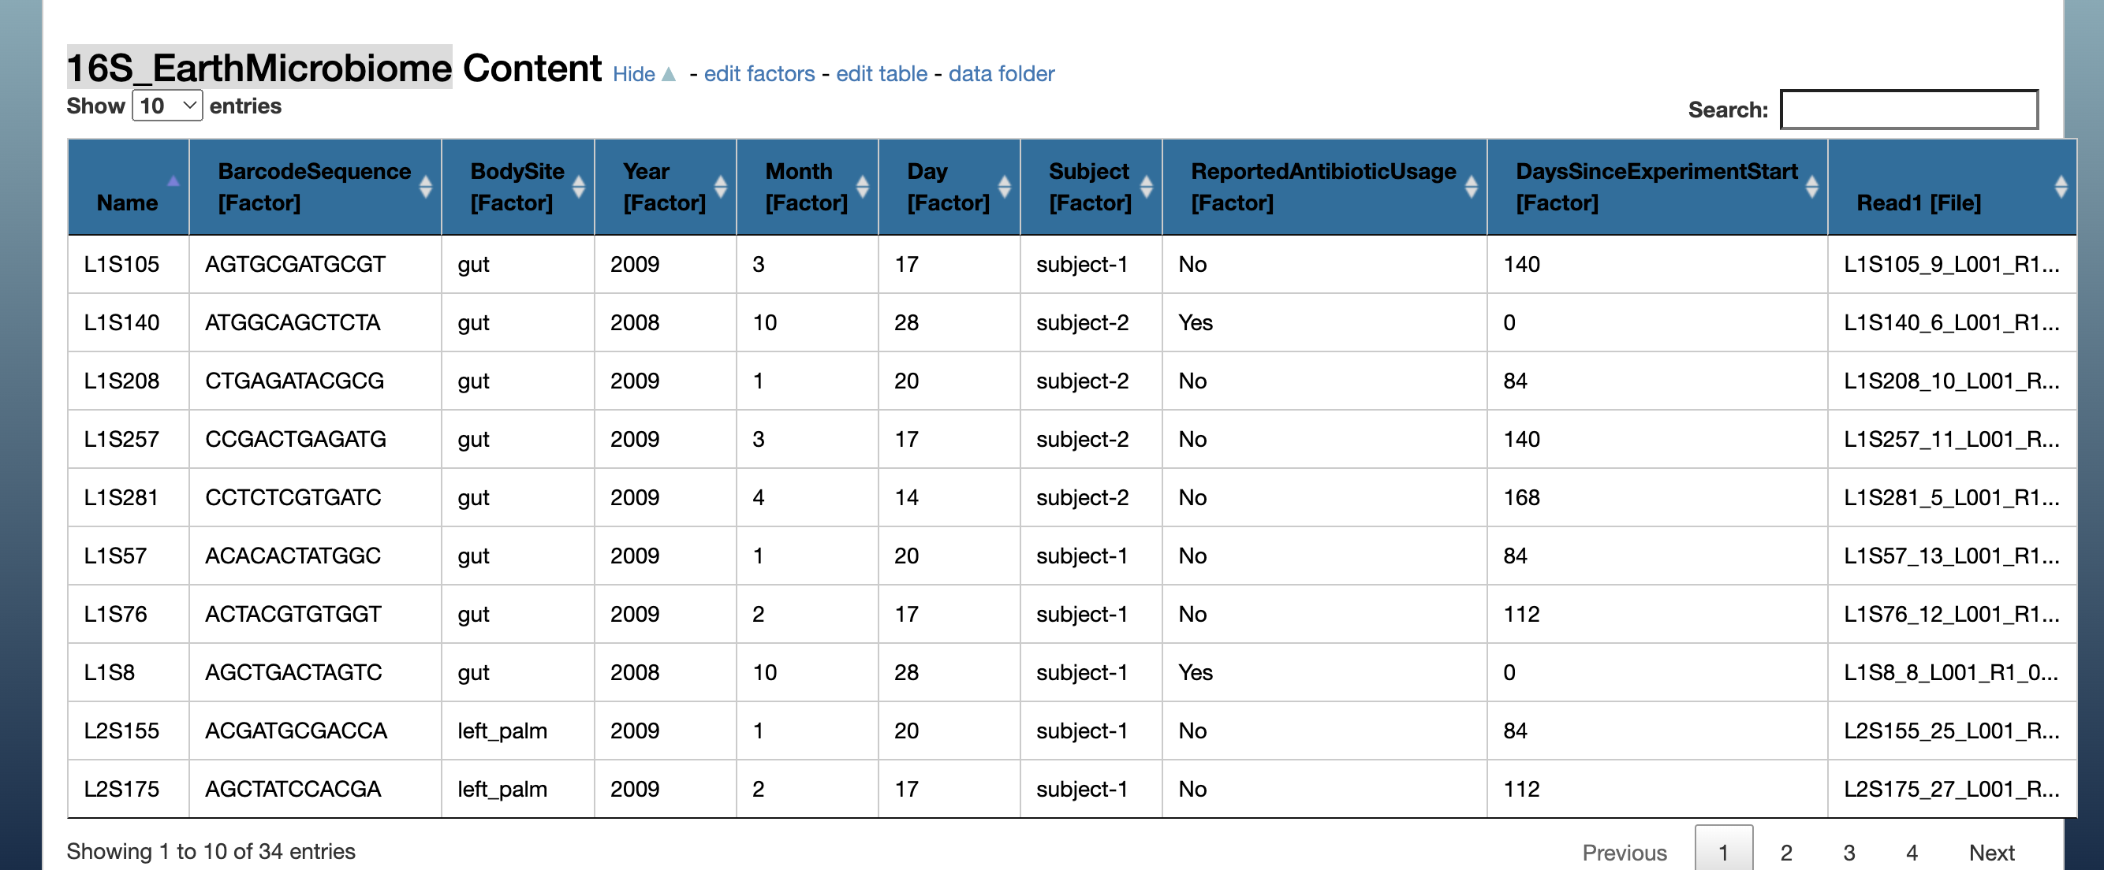
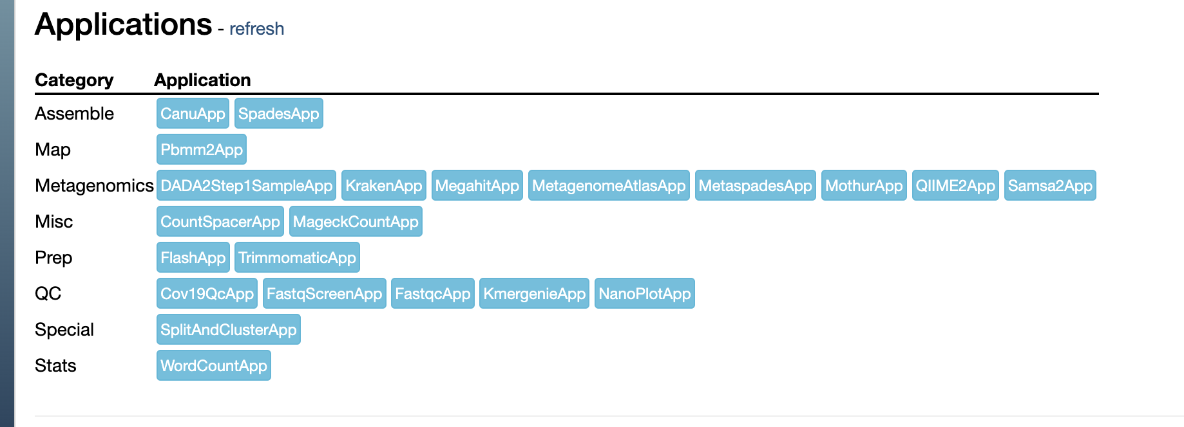
1. QIIME2
Enter a dataset called: 16S_EarthMicrobiome. You will see the following:
1. Run QIIME2 app

Slide 4
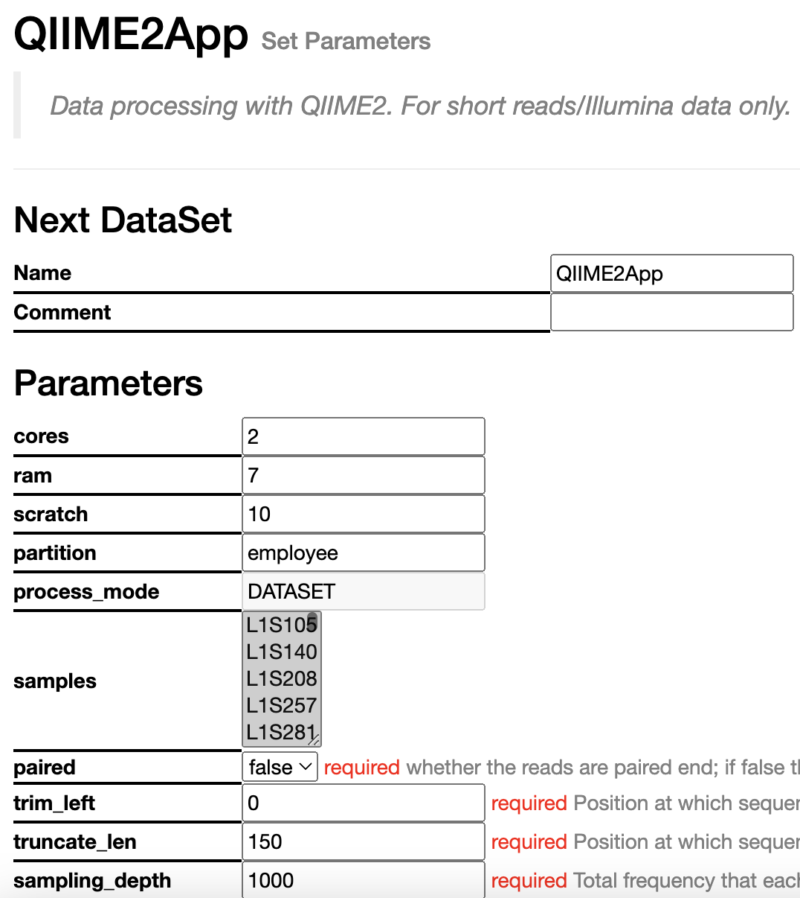
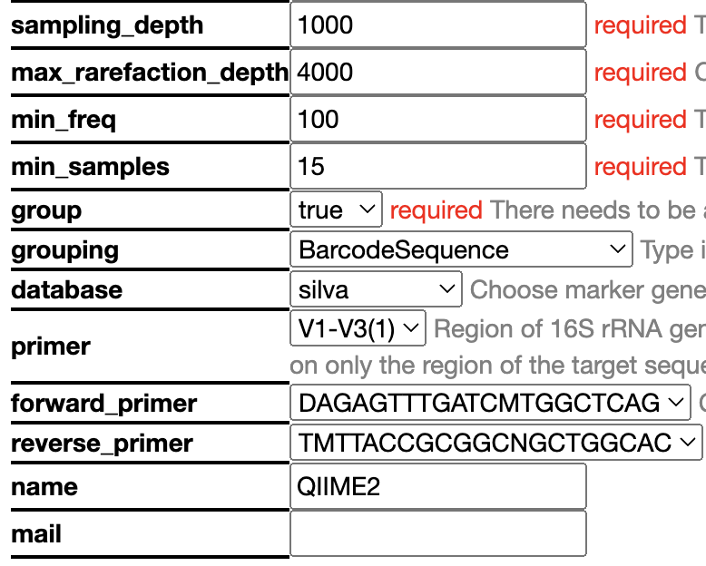
Parameters
Lets talk about parameters!
Have a detailed read-through the parameters and decide on them based on what we discussed before!

Slide 5
Results
In the directory you will find the following files:
Statis Report – this is a combined report of all analysis with fixed/non interactive graphs
Demux Report – a QIIME2 interactive report of demultiplexed sequence counts and data quality
Denoising Stats – a QIIME2 table on the filtered reads at each step
Feature Table – a QIIME2 interactive report on ASV summary
Rep Seqs - a QIIME2 table on all features – if you click a feature it will take you to BLAST
Taxonomy Barplot - a QIIME2 interactive barplot showing the taxonomy
Taxonomy - a QIIME2 table of all the ASVs and their taxonomic classification
Shannon Diversity - a QIIME2 interactive report of alpha diversity
Jaccard diversity - a QIIME2 interactive report of beta diversity (jaccard)
Bray Curtis Diversity - a QIIME2 interactive report of beta diversity (bray curtis)
Jaccard Emperor Plot - a QIIME2 interactive 3D PCA based on Jaccard Matrix
Bray Curtis Emperor Plot - a QIIME2 interactive 3D PCA based on Bray Curtis Matrix
Alpha Rarefaction - a QIIME2 interactive plot showing rarefaction curve
Differential abundance - a QIIME2 interactive report on results of ANCOM
Have a look at all the reports. Inspect!

