Slide 1
SUSHI - FastQC
How to run the analyses

Slide 2
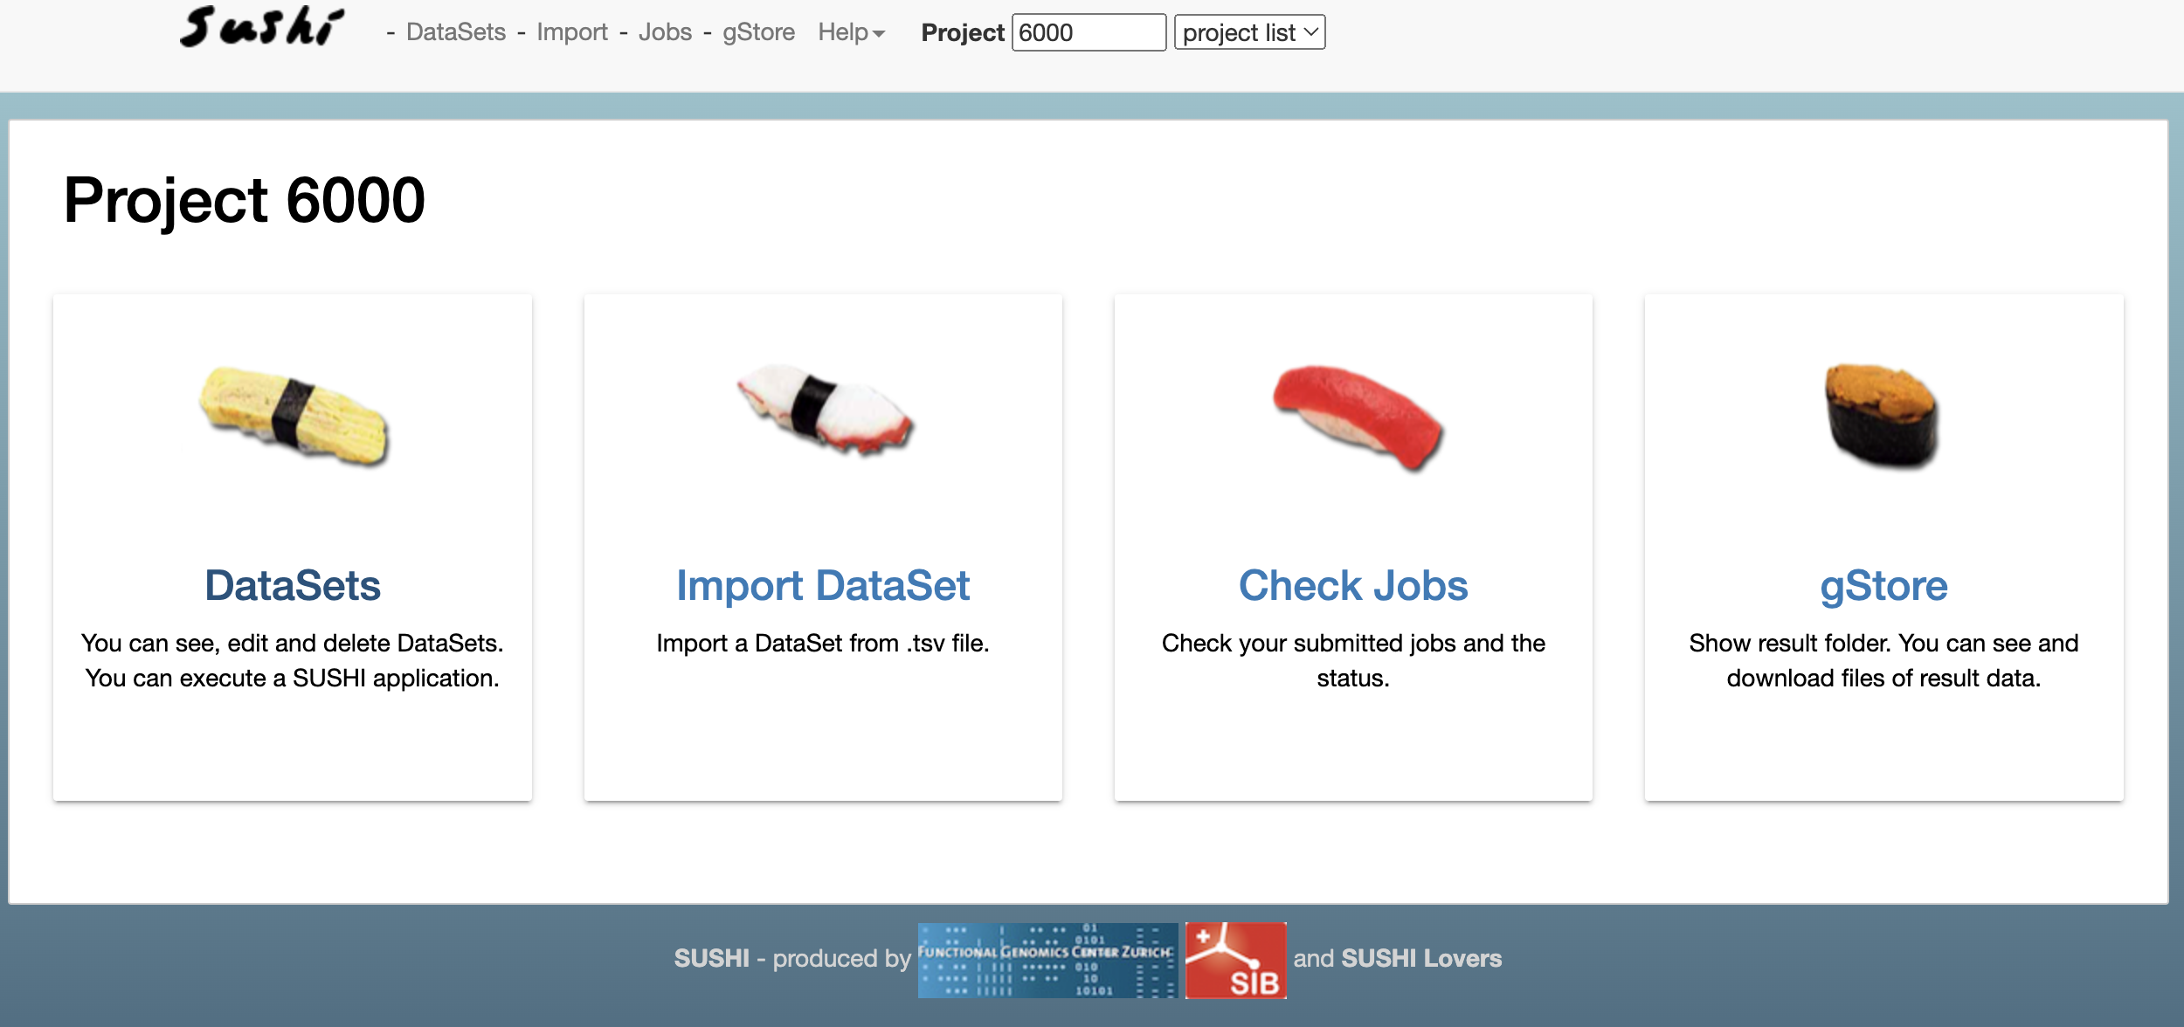
SUSHI – find your data
This is what you see when you enter except that the project ID is different. GO TO DataSets

Slide 3
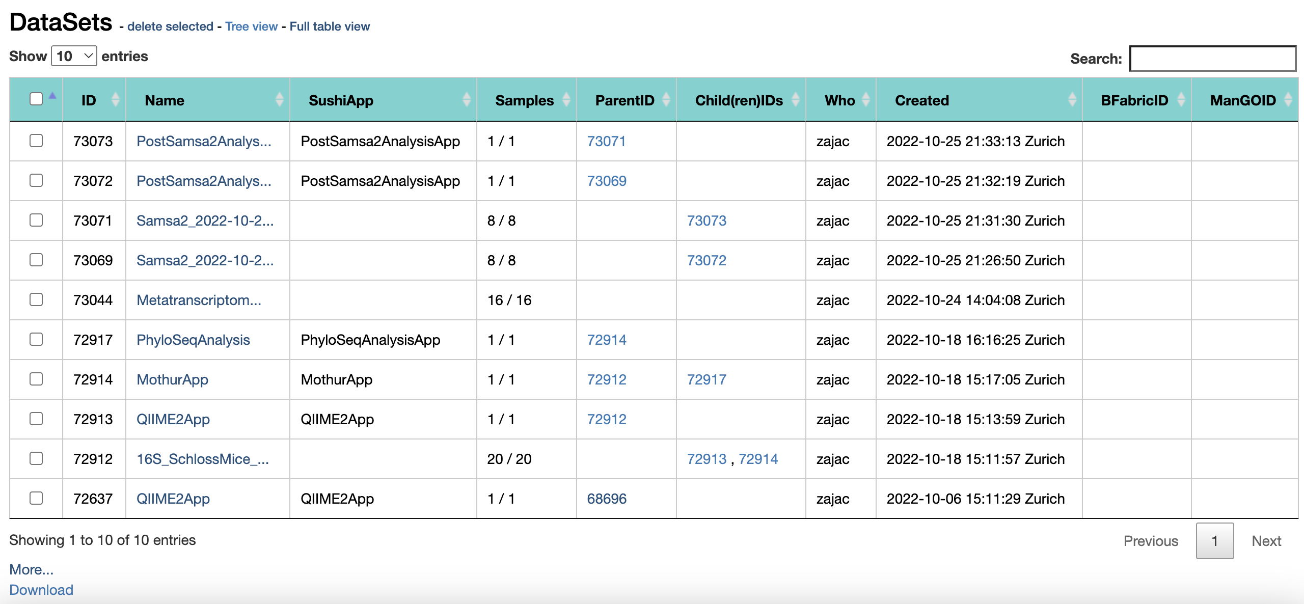
SUSHI: Select a dataset
If you have followed the instructions correctly, you have entered a project folder (YOUR PERSONAL project folder) that looks like this – not exactly like this but it has datasets listed.
Select a dataset that says Monday_June2024– click on it to enter.

Slide 4
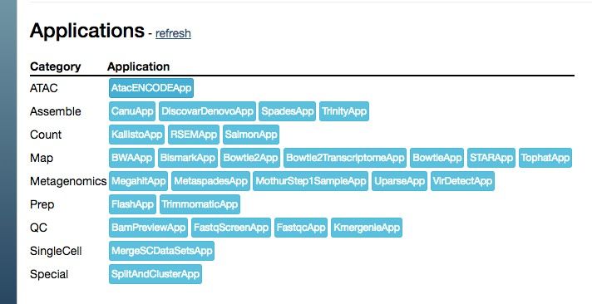

1. Fastqc
8
Scroll to the bottom of the page
•
On the resulting datasets, run FastQC and see if we need to preprocess the data

Slide 5
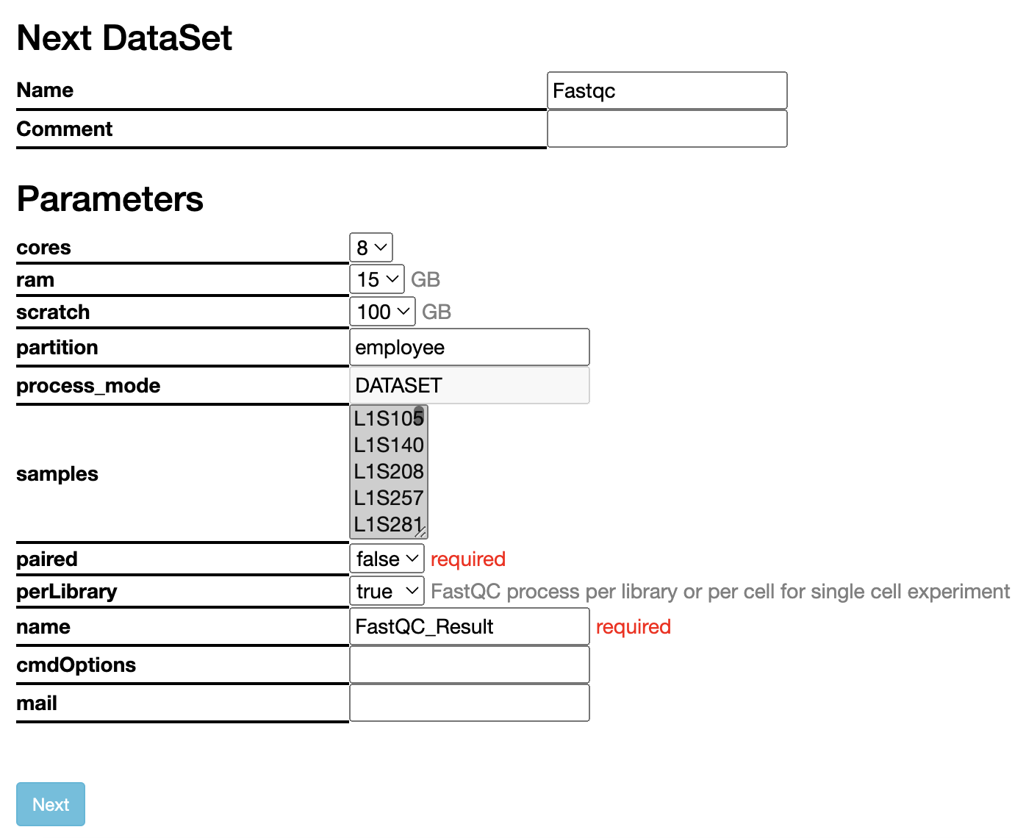
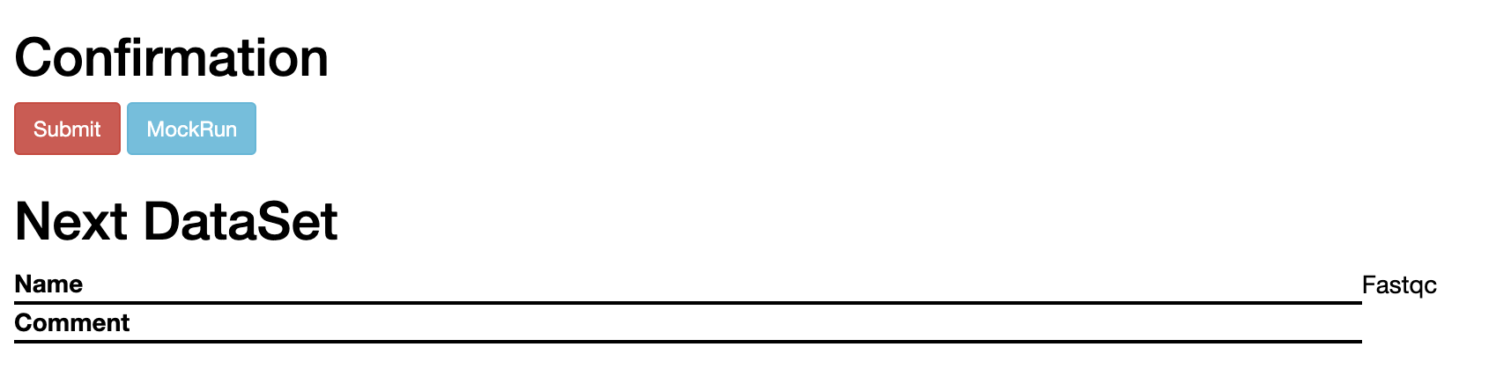
Parameters
CORES: 4
RAM: 15 GB
SCRATCH: 10 GB
Submit a job and wait
It should automatically select whether the reads are paired end or not but make sure its correct

Slide 6
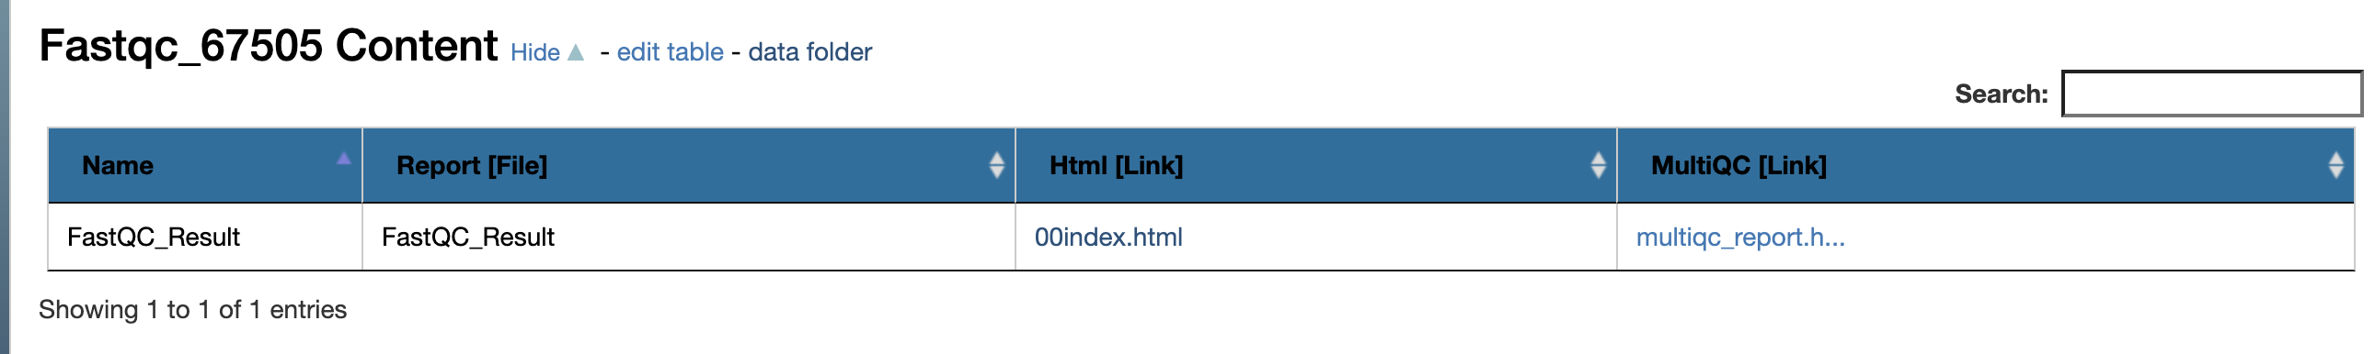
Once the job has finished
Look at the reports:
You have both the FastQC and the MultiQC reports
After you looked at the reports, go back to the original dataset

Slide 7

7
2. Run Trimmomatic
If you think the dataset is not of good quality at the ends or not overally across all the reads, run TrimmomaticApp to preprocess YOUR SAMPLE (or a randomly chosen sample)
See next page for parameters

Slide 8
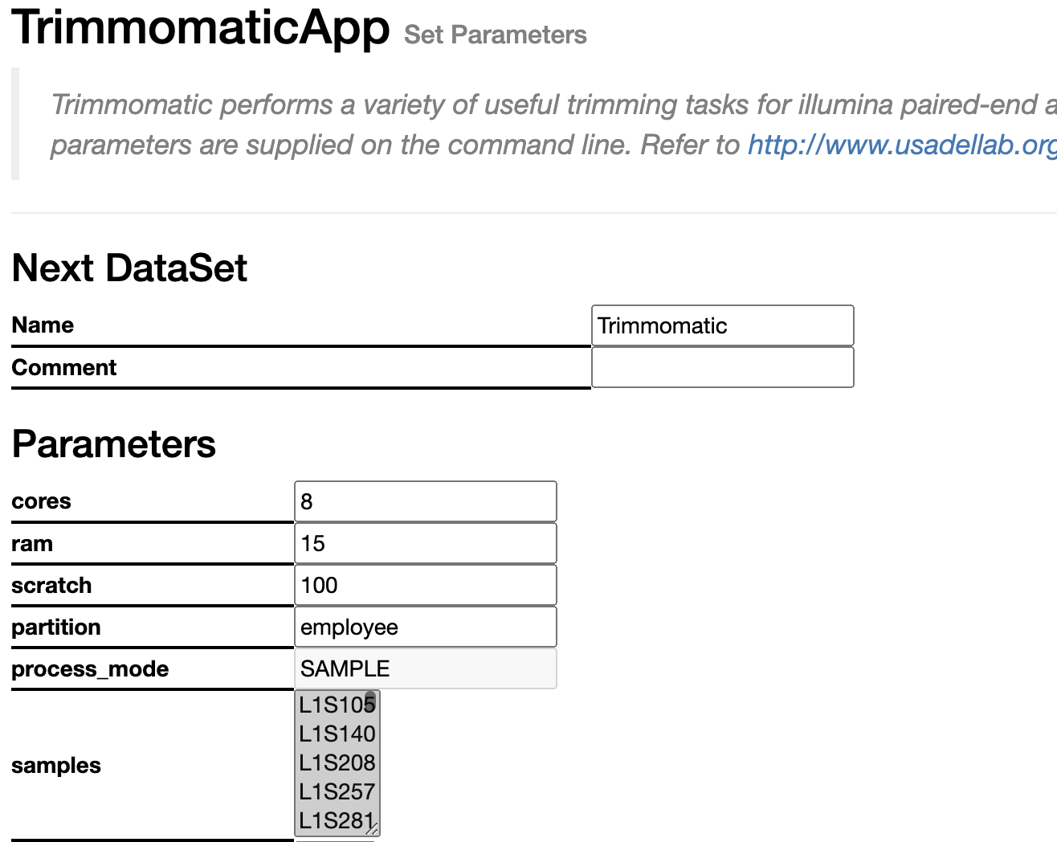
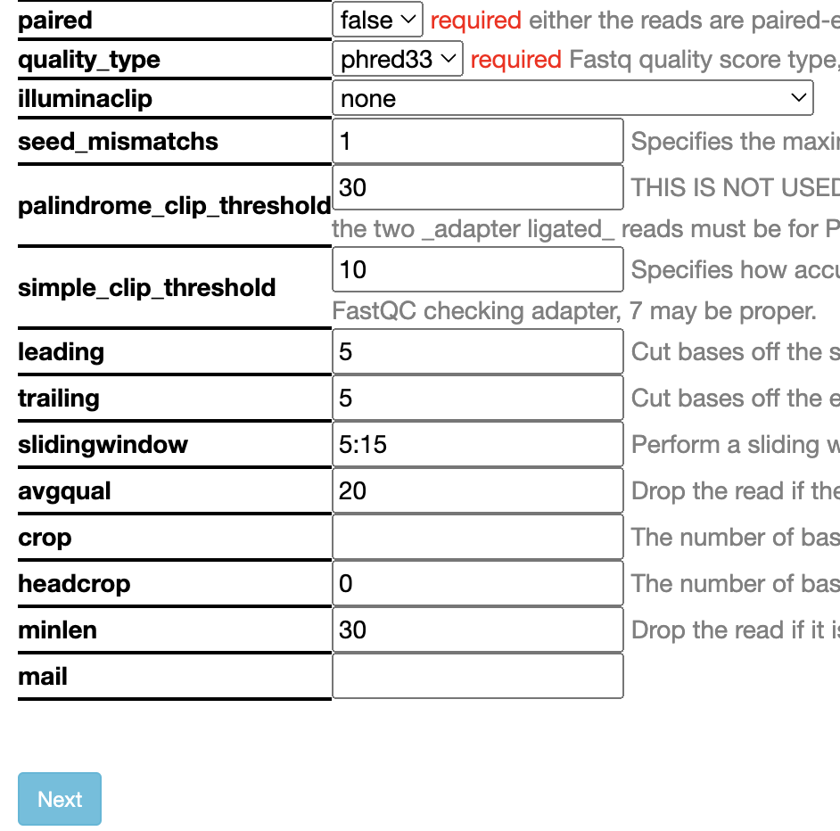
7
2. Trimmomatic
Make some decision regarding the parameters:
Phred quality for Illumina: 33+
Leading: cut how many bases from the front if they don’t meet quality threshold
Trailing: cut how many bases from the back if they don’t meet quality threshold
Sliding window windows of how many base pairs: what quality needs to be met
Avgqual: average quality of the whole read
Headcrop: how many bases cut off from the front
Minlen: minimum length to keep
CORES: 4
RAM : 15 GB
SCRATCH: 15 GB
Choose a single sample

Slide 9
1. Rerun fastqc
8
Now that you have an edited datataset, scroll to the bottom of the page of the Trimmomatic dataset
On the resulting datasets, rerun FastQC and see what is the difference
Use the same parameters as in slide 4

Slide 10
Once the job has finished
Look at the reports:
You have both the FastQC and the MultiQC reports
Do you see any difference? Lets discuss

