Slide 1
SUSHI - Kraken
How to run the analyses

Slide 2
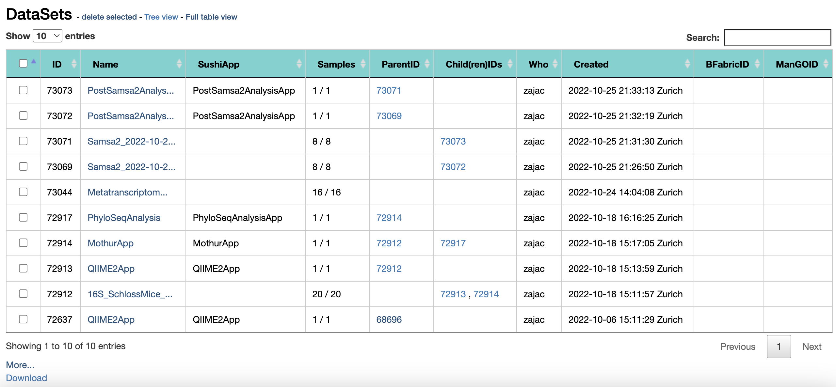
SUSHI: Select a dataset
If you have followed the instructions correctly, you have entered a project folder (YOUR PERSONAL project folder) that looks like this – not exactly like this but it has datasets listed.
Select a dataset that says MetaAtlas_data – click on it to enter.

Slide 3
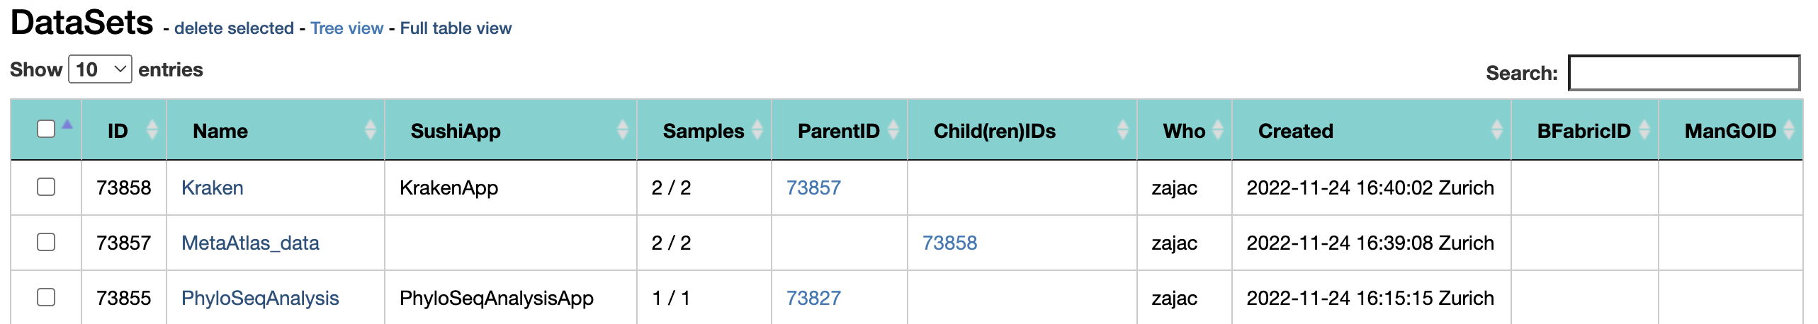
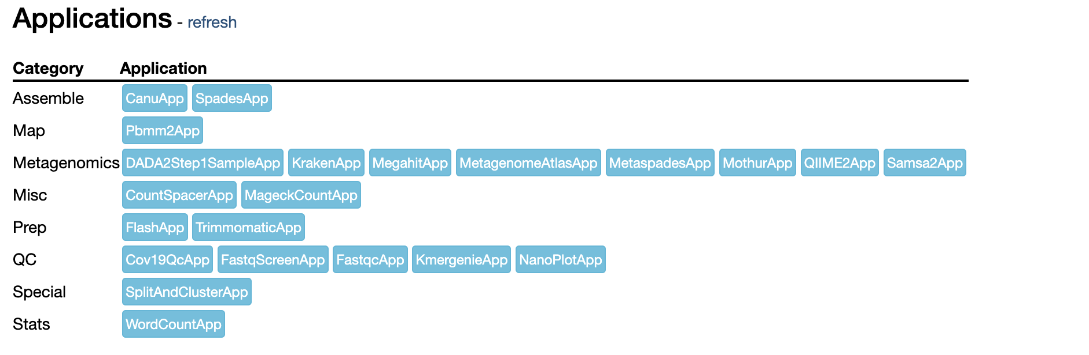
Kraken
Run Kraken
See next page for parameters

Slide 4
Choosing parameters
Paired -> TRUE
krakenDBopt –> bacteria
RAM = 30
CORES = 8
SCRATCH = 30
Otherwise do not change anything, the rest of the parameters allow you to trim and filter the reads but we don’t need to do that.

