Slide 1
SUSHI – Samsa2
How to run the analyses

Slide 2
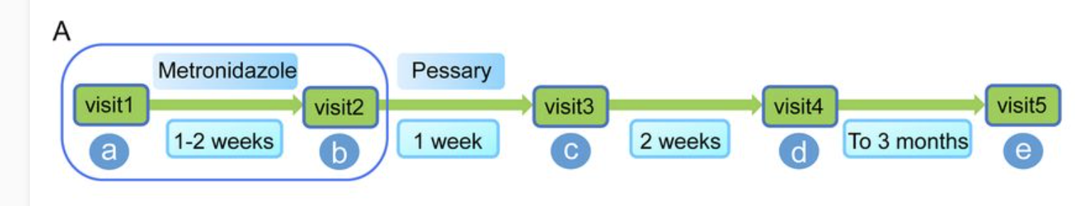
Tutorial – Bacterial Vaginosis
multifactorial disease characterized by a shift from the Lactobacillus species-dominated microbial community toward a taxonomically diverse anaerobic community
8 women diagnosed with BV
4 successfully treated, 4 not
Paired-end seq performed on a HiSeq 2500 Sequencer to yield 2 × 110-bp
https://journals.asm.org/doi/full/10.1128/mSphereDirect.00262-18

Slide 3
You have two datasets in your project folder
Metatranscriptomics_VaginalMicrobiome_noresponse
Metatranscriptomics_VaginalMicrobiome_response
The datasets are outputs from running samsa2. You will need to run postsamsa2 analysis on it to produce reports. Please see details on the following page

Slide 4
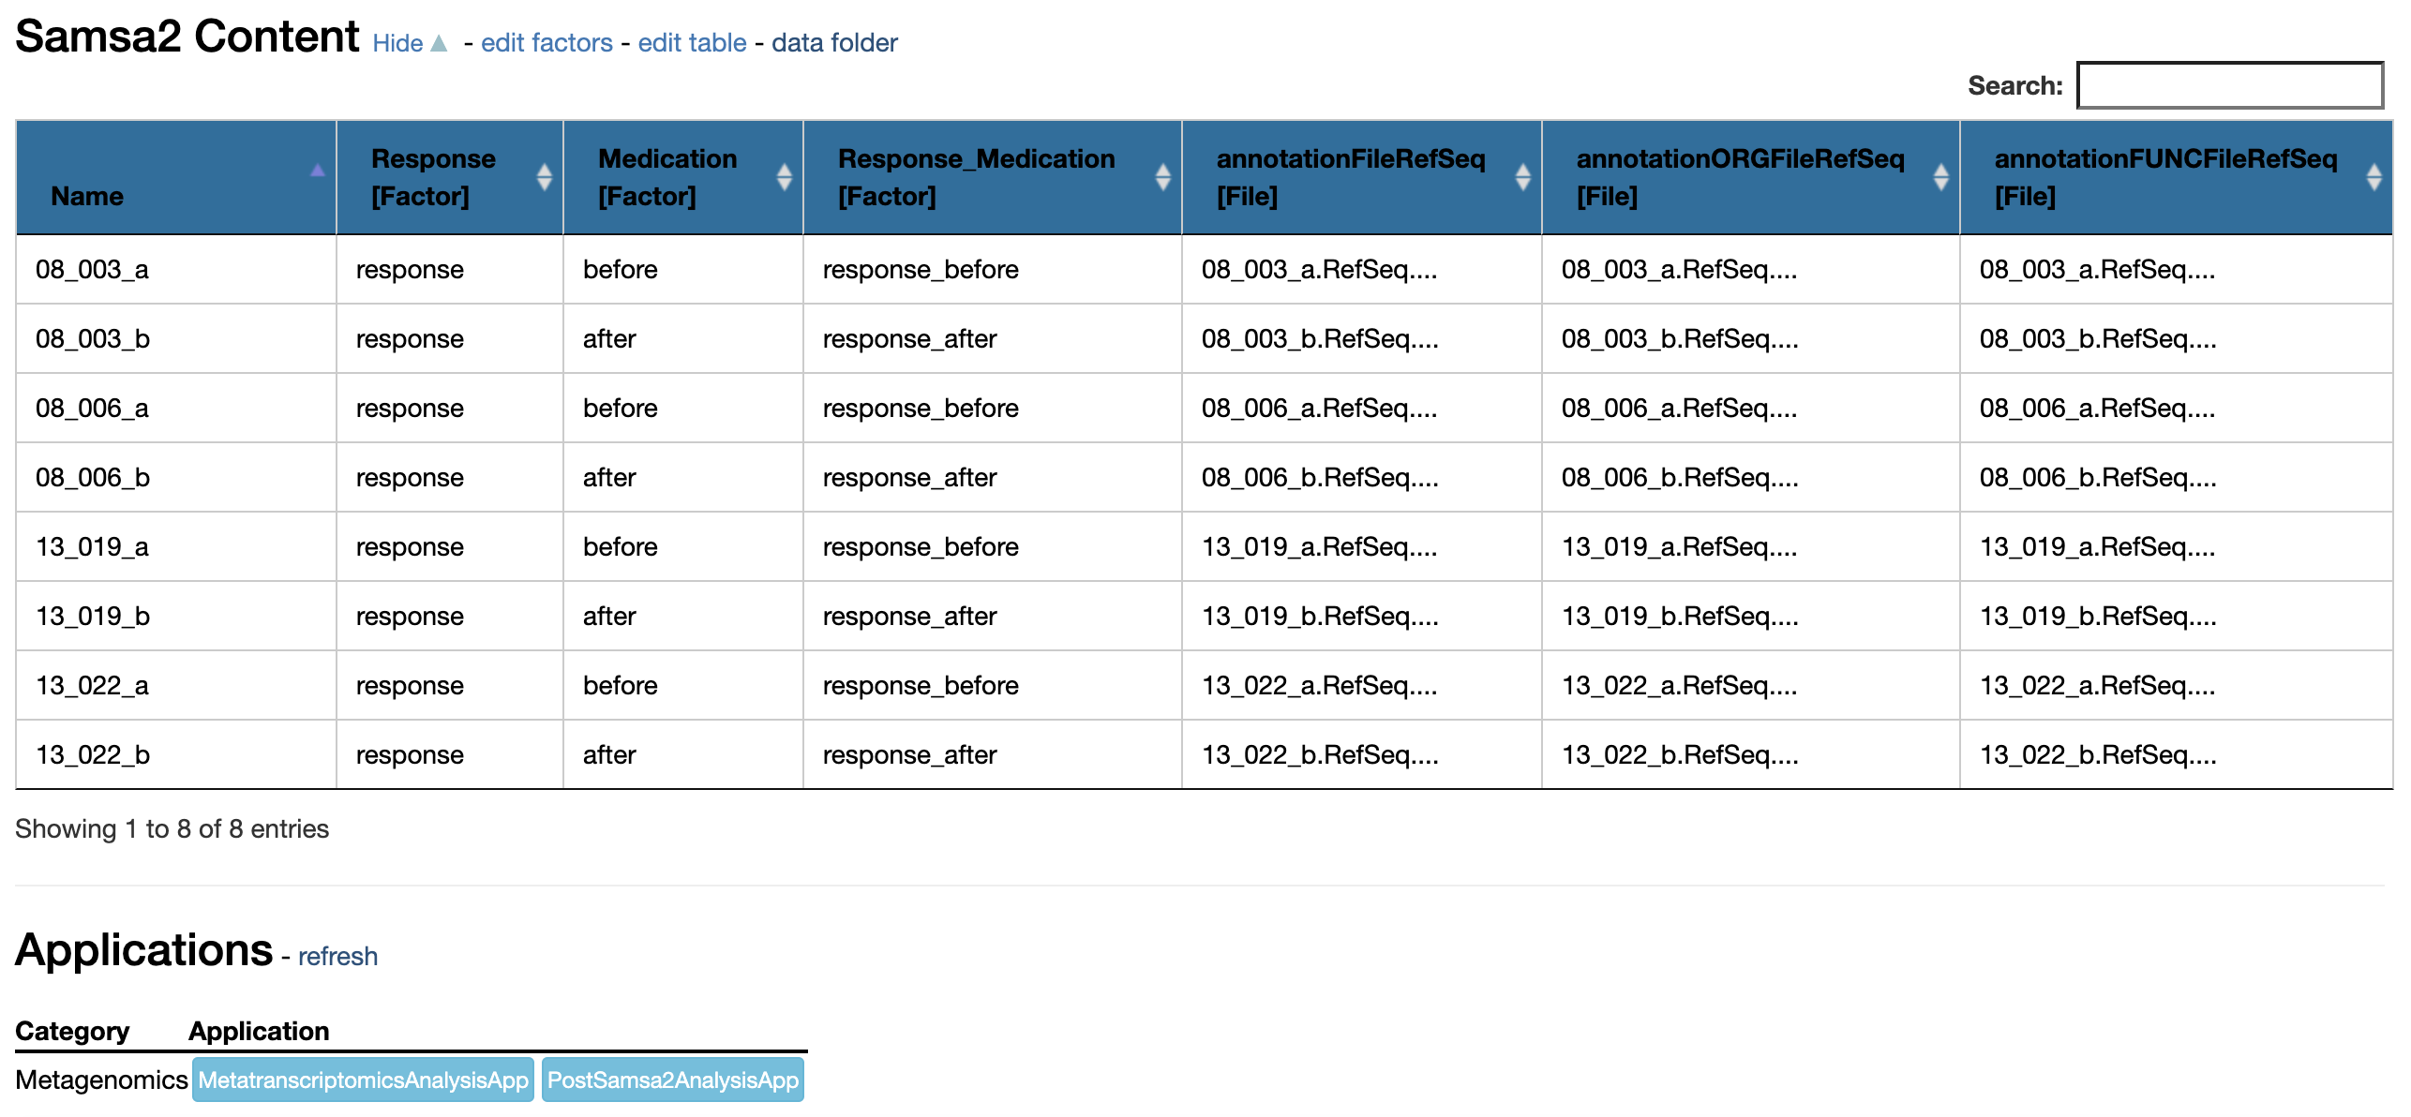
PostSamsa2 analysis
Because Samsa2 takes some time to run I have already run it for you. Here we will run the report on the files produced by Samsa2
Run the PostSamsa2 analysis
You will need to run it on each dataset separately. Please see next page for parameters

Slide 5
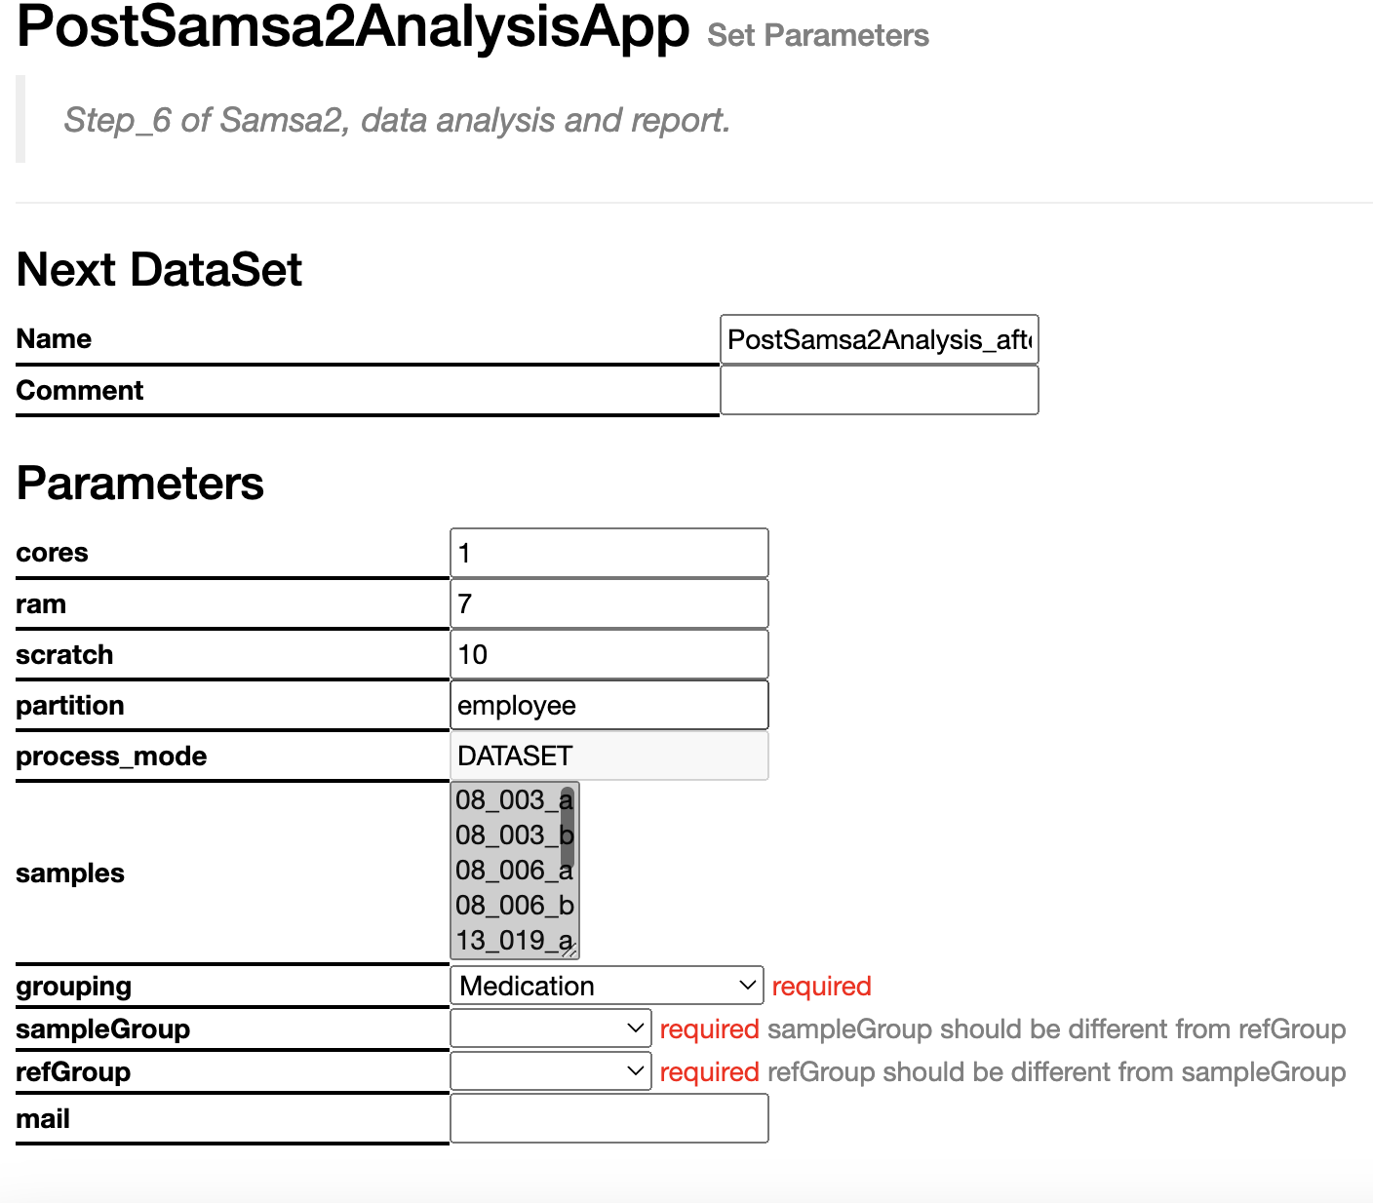
Parameters
In terms of parameters do not forget to specify:
Grouping - > Medication
sampleGroup -> after
referenceGroup -> before
SUBMIT!

