Slide 1
Kraken2: Quick introduction
Dr. Natalia Zajac
Metagenomics,12.2024

Slide 2
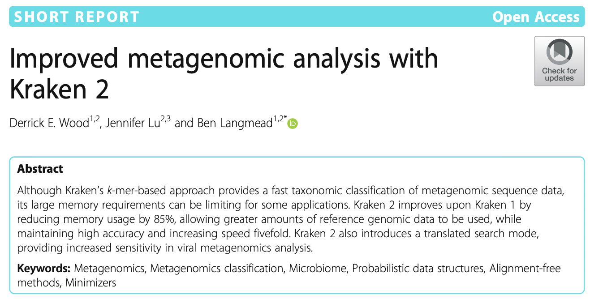
Kraken2
Building Kraken database
Classification of reads
Visualisation of results

Slide 3
Kraken2: Building database
K-mers
Taxonomic ids
518
2890
3450
689
756
789
1130
1890
1230
3005
2891

Slide 4
Kraken2: Building database
The complete Max database is 75Gb large and contains Archea, Bacteria and Viral genomes
It can also have a version with Eukaryotes which is > 100Gb
The Mini version is only 8Gb and contains a subset
You can also build a custom database for things you are interested in and when you add something to the database it needs to be in the fasta format with an NCBI accession number or a taxonomic ID

Slide 5
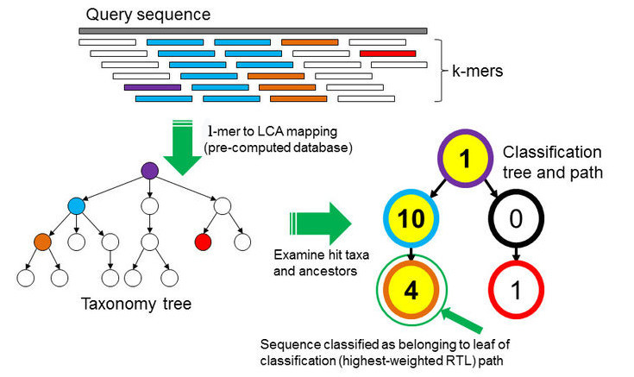
Kraken2: Classification
Query read
K-mers
Mapping k-mers to the lowest common ancestor in the taxonomic tree
Builds a taxonomic tree
https://training.galaxyproject.org/archive/2020-12-01/topics/metagenomics/tutorials/nanopore-16S-metagenomics/tutorial.html
https://www.coursera.org/lecture/metagenomics/demo-of-metagenomic-classification-using-kraken-7GIn6

Slide 6

Kraken2: Classification
Determine highest weighted root-to-leaf path
3
3
6
3
5
https://training.galaxyproject.org/archive/2020-12-01/topics/metagenomics/tutorials/nanopore-16S-metagenomics/tutorial.html
https://www.coursera.org/lecture/metagenomics/demo-of-metagenomic-classification-using-kraken-7GIn6

Slide 7
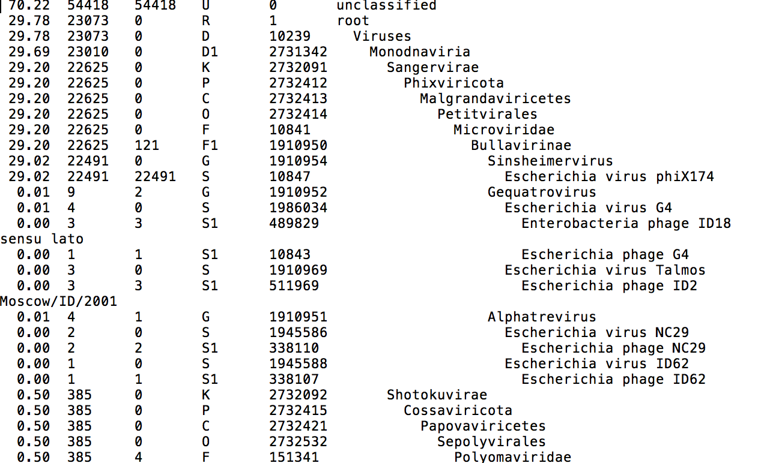
Percentage of reads covered by the clade rooted at this taxon
Number of reads covered by the clade rooted at this taxon
Number of reads assigned directly to this taxon
A rank code, indicating (U)nclassified, (D)omain, (K)ingdom, (P)hylum, (C)lass, (O)rder, (F)amily, (G)enus, or (S)pecies. All other ranks are simply '-'.
NCBI taxonomy ID
indented scientific name

Slide 8
Kraken2: Summary
Chops all genomes into k-mers and links them to a taxonomic ID
With your query you search for exacts hits in the database
Searches for highest weighted root-to-leaf paths and assignes taxonomic IDs of the lowest node to read
Tutorial: SUSHI: MetaAtlas_data – which species do you find?

Slide 9
