Slide 1
SUSHI - FastQC
How to run the analyses

Slide 2
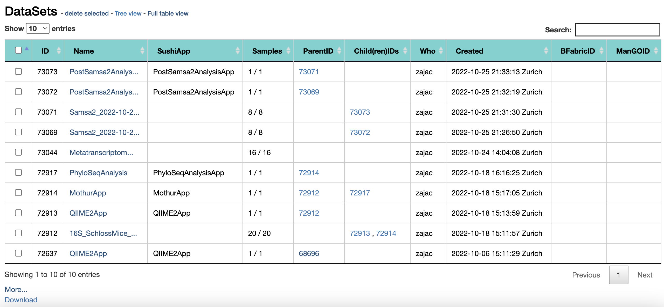
SUSHI: Select a dataset
If you have followed the instructions correctly, you have entered a project folder (YOUR PERSONAL project folder) that looks like this – not exactly like this but it has datasets listed.
Select a dataset that says YourData_March2023 – click on it to enter.

Slide 3
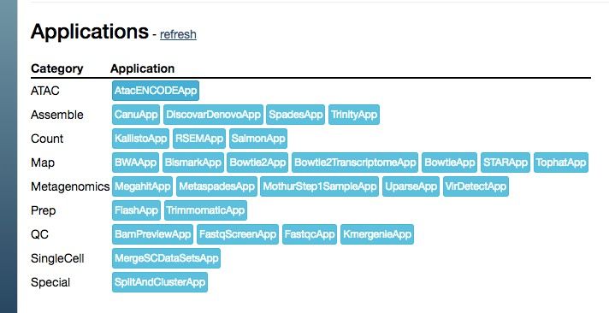

1. Fastqc
8
Scroll to the bottom of the page
•
On the resulting datasets, run FastQC and see if we need to preprocess the data

Slide 4
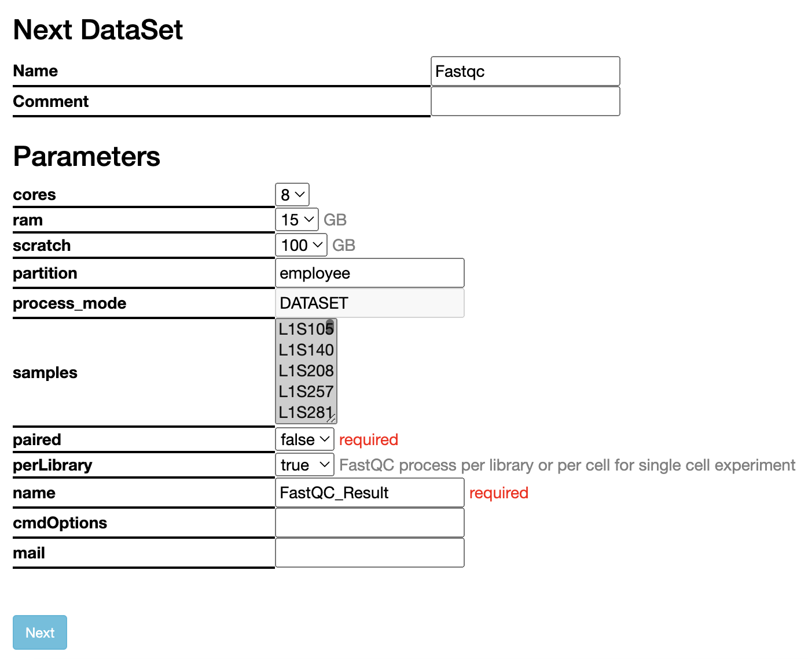
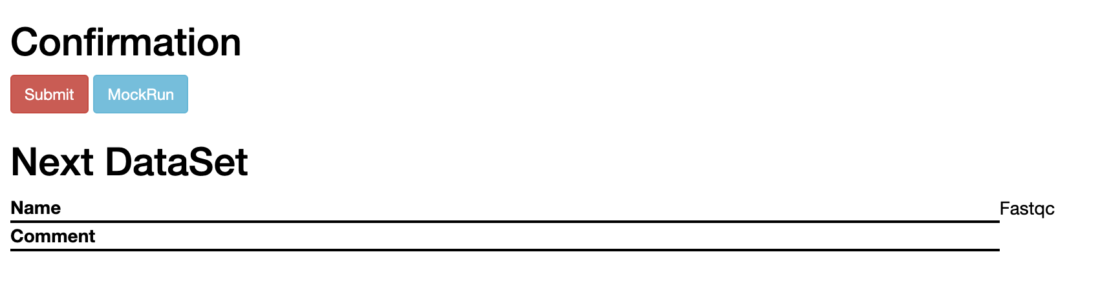
Parameters
Submit a job and wait

Slide 5
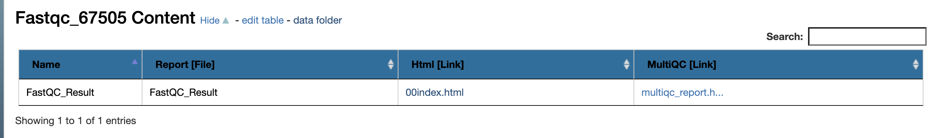
Once the job has finished
Look at the reports:
You have both the FastQC and the MultiQC reports
After you looked at the reports, go back to the original dataset

Slide 6

7
2. Run Trimmomatic
Run TrimmomaticApp to preprocess the data

Slide 7
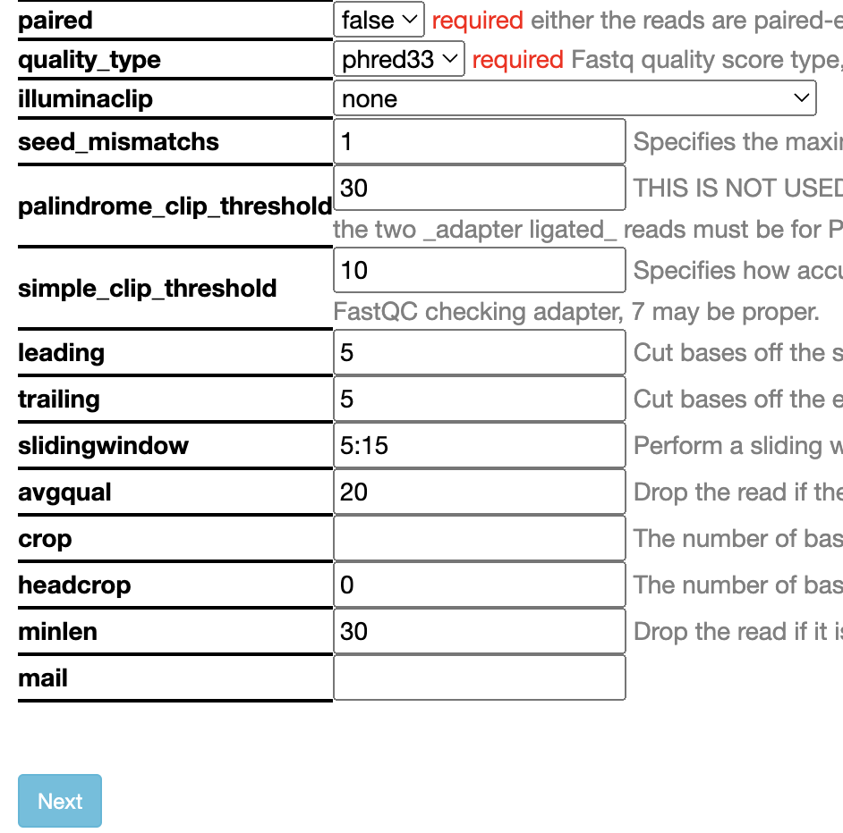
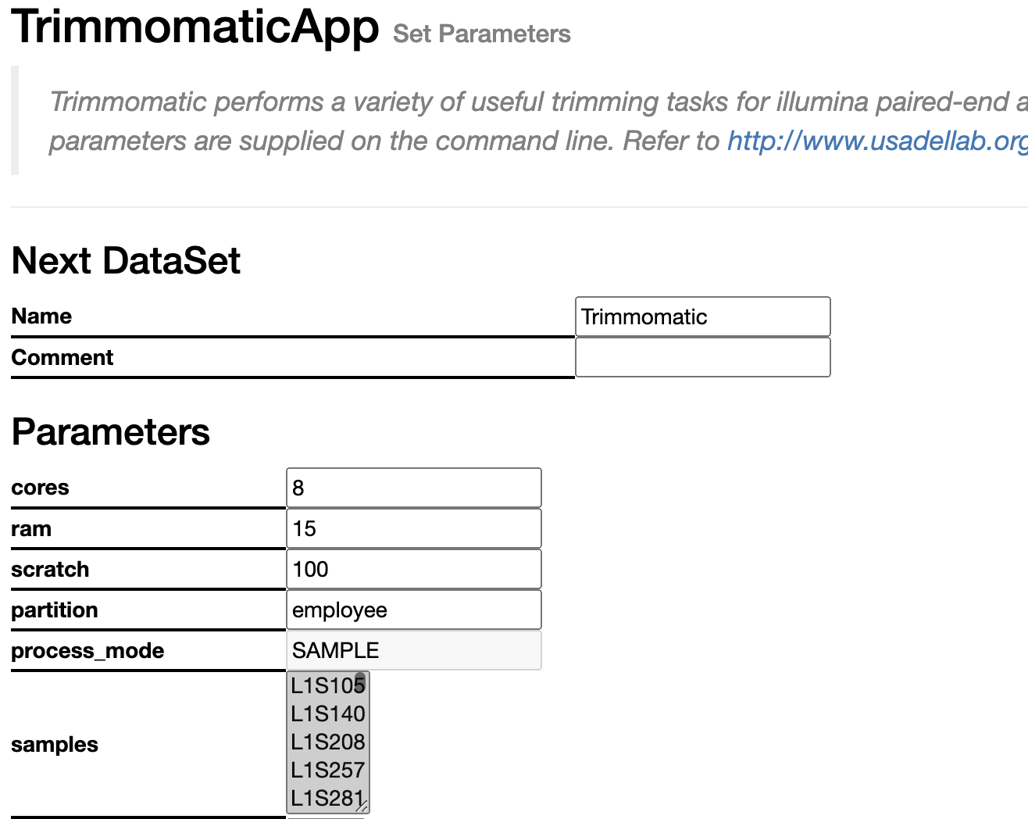
7
2. Trimmomatic
Make some decision regarding the parameters:
Phred quality for Illumina: 33+
Leading: how many bases from the front if they don’t meet quality threshold
Trailing: How many bases from the back if they don’t meet quality threshold
Sliding window how many base pairs: what quality
Avgqual: average quality of the whole read
Headcrop: how many bases cut off from the front
Minlen: minimum length to keep

Slide 8
1. Rerun fastqc
8
Scroll to the bottom of the page of the Trimmomatic dataset
•
On the resulting datasets, rerun FastQC and see what is the difference

Slide 9
Once the job has finished
Look at the reports:
You have both the FastQC and the MultiQC reports
Do you see any difference? Lets discuss

