Slide 1
SUSHI – Samsa2
How to run the analyses

Slide 2
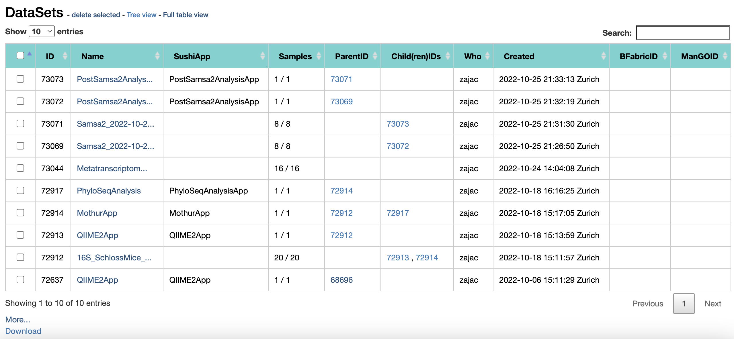
SUSHI: Select a dataset
If you have followed the instructions correctly, you have entered a project folder (YOUR PERSONAL project folder) that looks like this – not exactly like this but it has datasets listed.
Select a dataset that says Metatranscriptomics_VaginalMicrobiome_response– click on it to enter.

Slide 3
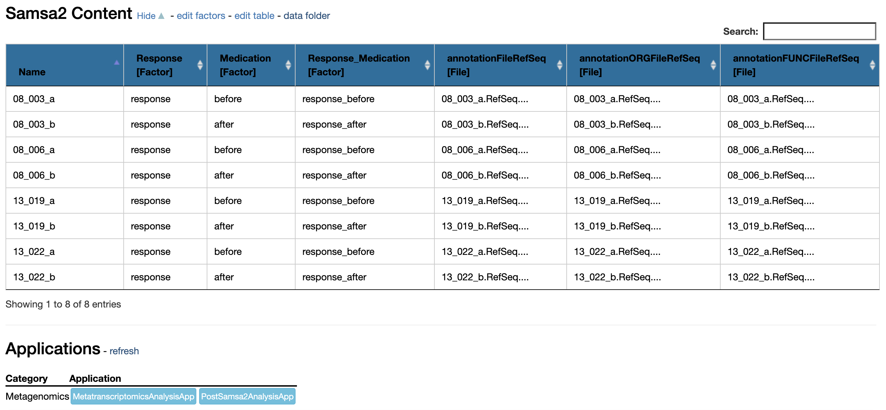
PostSamsa2 analysis
Because Samsa2 takes some time to run I have already run it for you. Here we will run the report on the files produced by Samsa2
Run the analysis after Samsa2

Slide 4
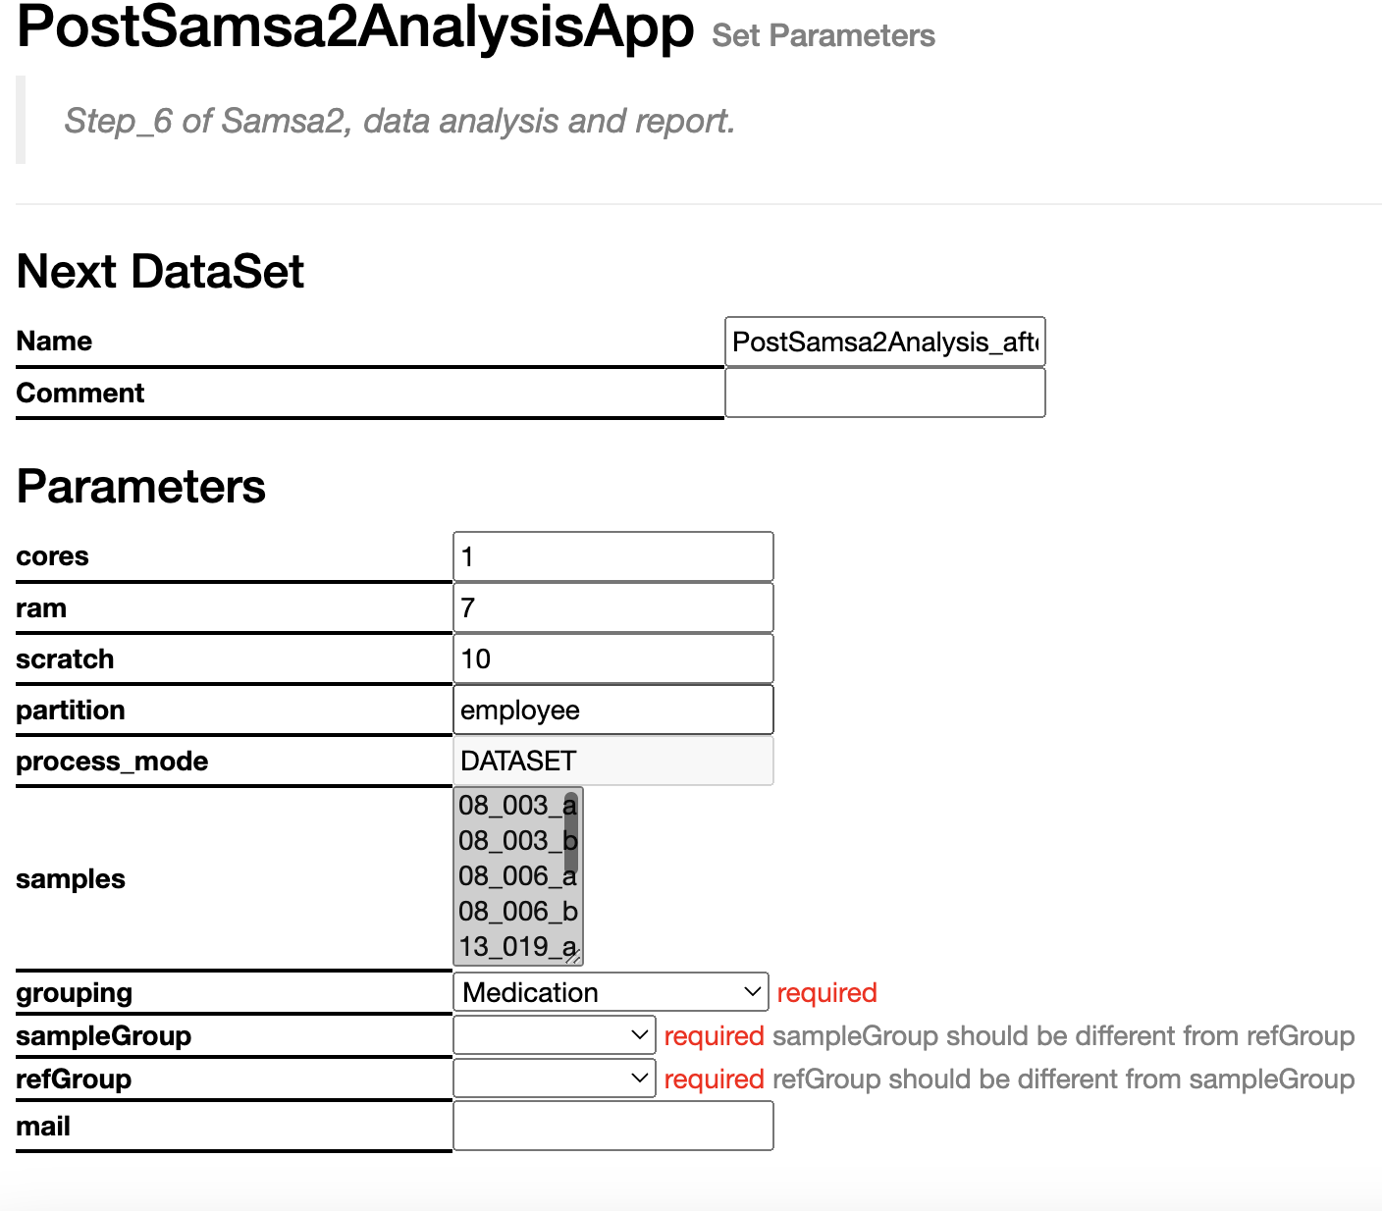
Parameters
In terms of parameters do not forget to specify:
Grouping - > Medication
sampleGroup -> after
referenceGroup -> before

