Slide 1
QIIME2 Bonus
How to run the analyses

Slide 2
We will analyse data on mice gut microbiome
Dataset – Schloss Mice
We will analyse it with QIIME2 workflow

Slide 3
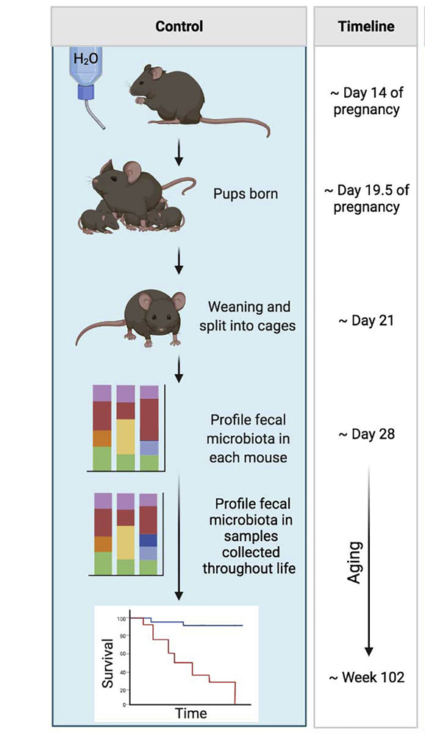
Does gut microbiome change over time? The effect of aging on gut microbiome
Schloss mice
sequenced hypervariable region 4 (V4) 16S rRNA
analysis of mice gut microbiome post-weaning
Original study is from Schloss et al. 2012
https://www.tandfonline.com/doi/full/10.4161/gmic.21008

Slide 4
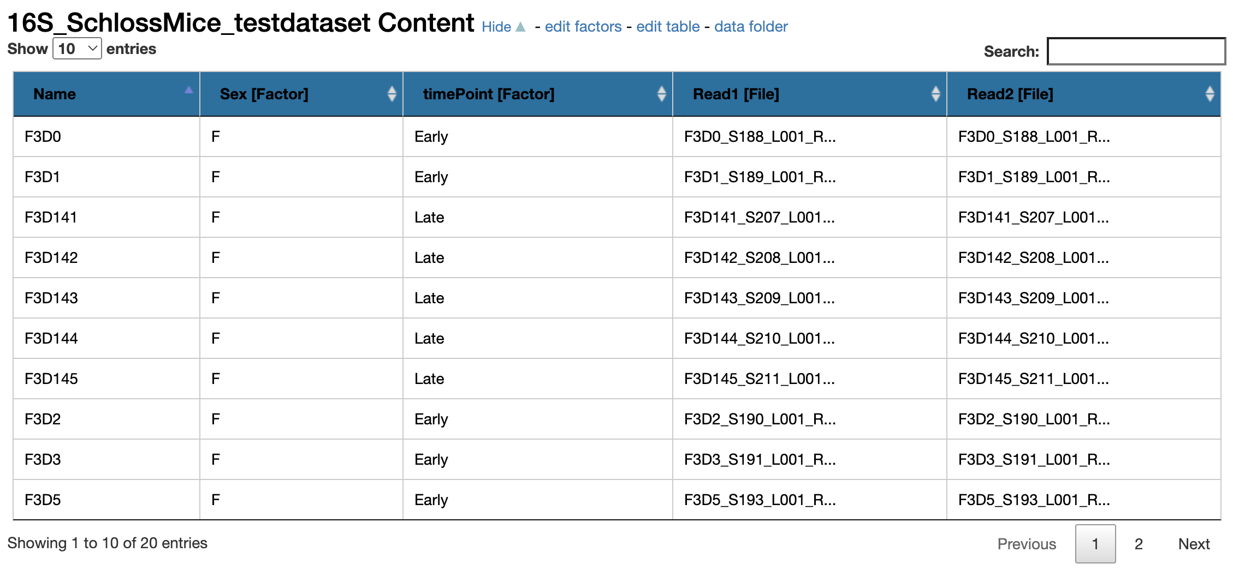
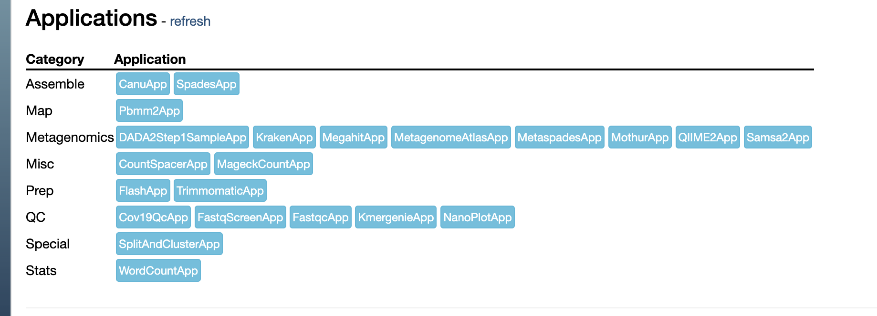
1. QIIME2
Enter a dataset called: 16S_EarthMicrobiome. You will see the following:
1. Run QIIME2 app
Please see the next page for parameter specification

Slide 5
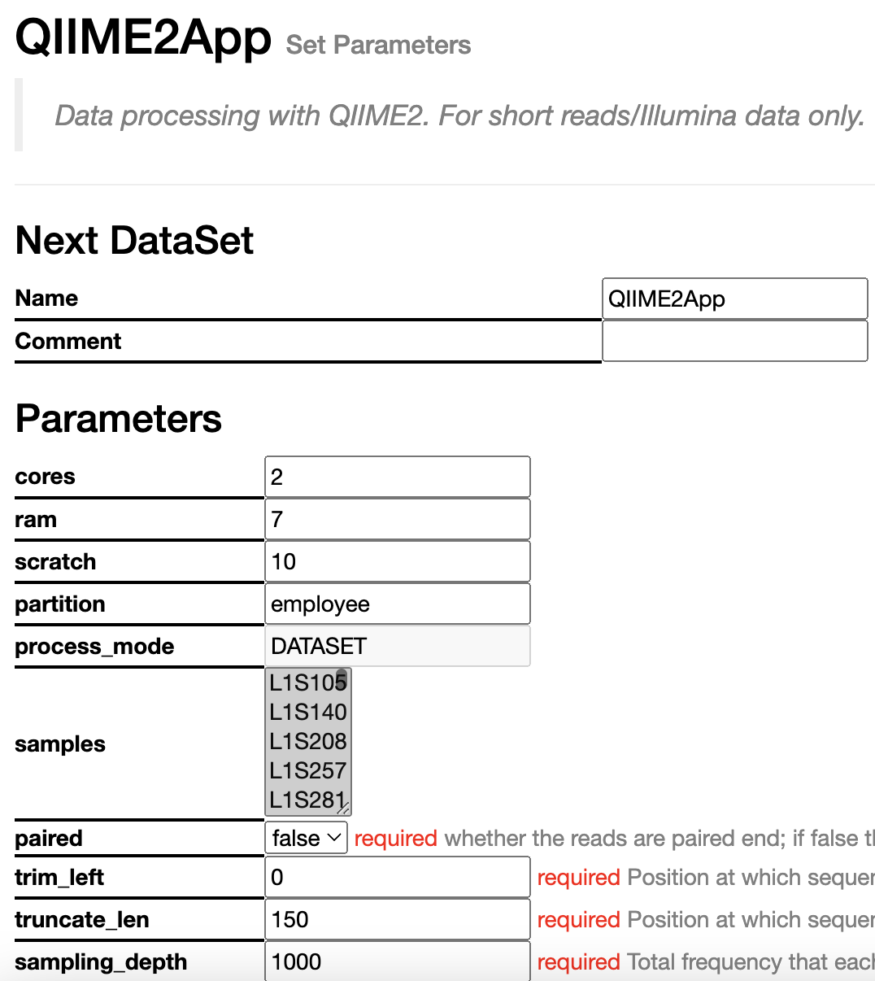
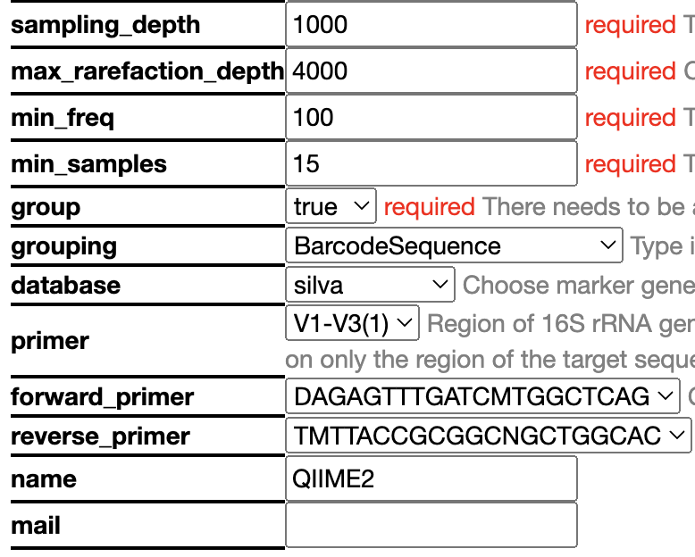
Parameters
Lets talk about parameters!
Have a detailed read-through the parameters and decide on them based on what we discussed before! For solutions on whats advised see next page.

Slide 6
Parameters you need to specify
Make sure the following parameters are set before submitting the job:
CORES: 4
RAM: 10
SCRATCH: 10
Trim_left: 0
Truncate_len: 150
Sampling_depth: 1100
Max_rarefaction_depth: 4000
Min_freq: 1
Min_samples: 3
Group: True
Grouping: Sex
Database:Greengenes
Primer: V4
Forward_primer: 4th from the top
Reverse_primer: 4th from the top
Here is where the two of you will differ. One of you needs to choose Sex and the second one will choose timePoint!!!
Press SUBMIT!

Slide 7
Results
In the directory you will find the following files:
Statis Report – this is a combined report of all analysis with fixed/non interactive graphs
Demux Report – a QIIME2 interactive report of demultiplexed sequence counts and data quality
Denoising Stats – a QIIME2 table on the filtered reads at each step
Feature Table – a QIIME2 interactive report on ASV summary
Rep Seqs - a QIIME2 table on all features – if you click a feature it will take you to BLAST
Taxonomy Barplot - a QIIME2 interactive barplot showing the taxonomy
Taxonomy - a QIIME2 table of all the ASVs and their taxonomic classification
Shannon Diversity - a QIIME2 interactive report of alpha diversity
Jaccard diversity - a QIIME2 interactive report of beta diversity (jaccard)
Bray Curtis Diversity - a QIIME2 interactive report of beta diversity (bray curtis)
Jaccard Emperor Plot - a QIIME2 interactive 3D PCA based on Jaccard Matrix
Bray Curtis Emperor Plot - a QIIME2 interactive 3D PCA based on Bray Curtis Matrix
Alpha Rarefaction - a QIIME2 interactive plot showing rarefaction curve
Differential abundance - a QIIME2 interactive report on results of ANCOM
Have a look at all the reports. Inspect! Now go back to the github page and click on the link to the tutorial to answer a few questions. You will need your partner’s information in order to answer all the questions.

