Slide 1
SUSHI – Samsa2
How to run the analyses

Slide 2
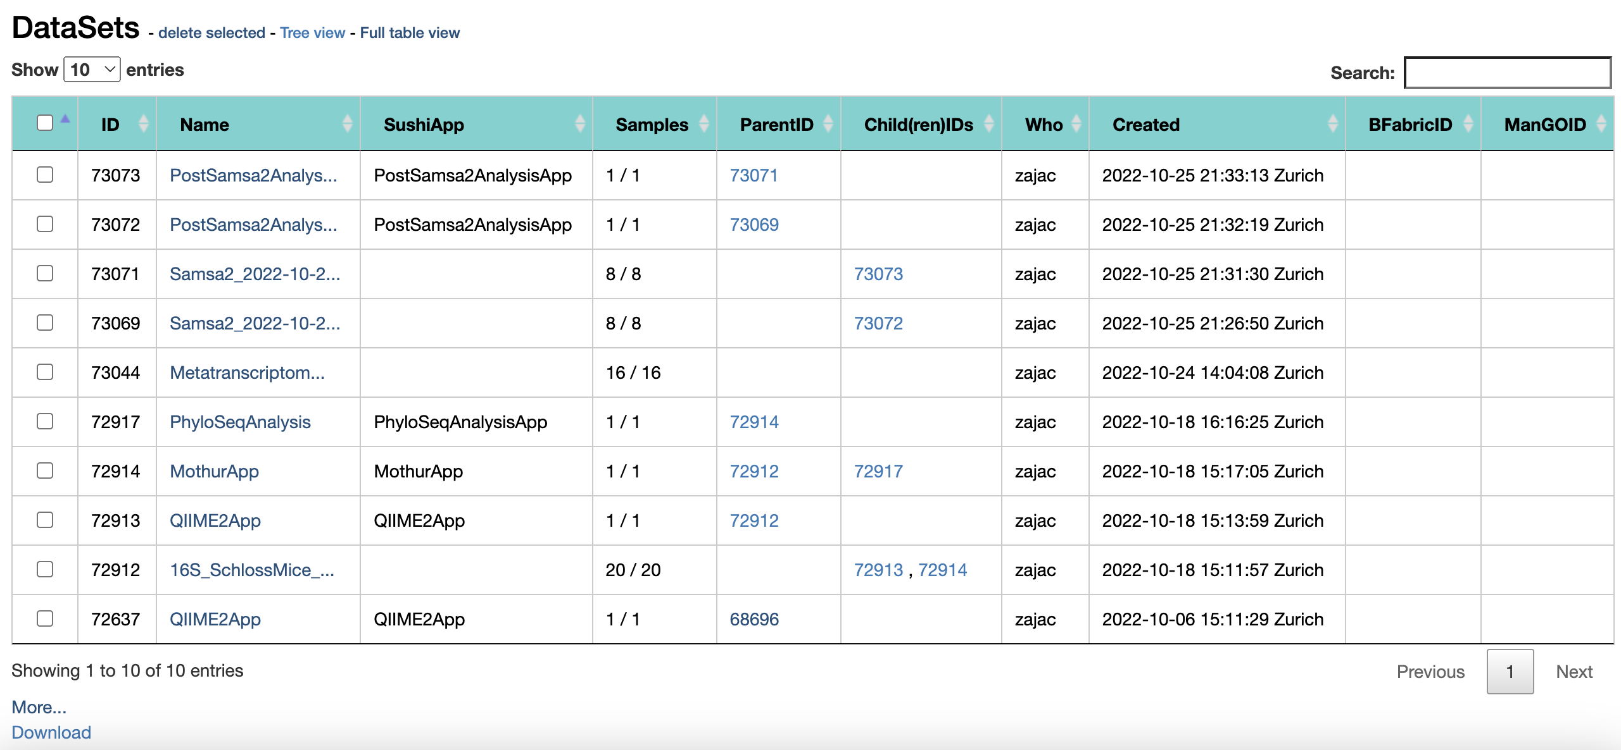
SUSHI: Select a dataset
If you have followed the instructions correctly, you have entered a project folder (YOUR PERSONAL project folder) that looks like this – not exactly like this but it has datasets listed.
Select a dataset that says Metatranscriptomics_VaginalMicrobiome_response– click on it to enter.

Slide 3
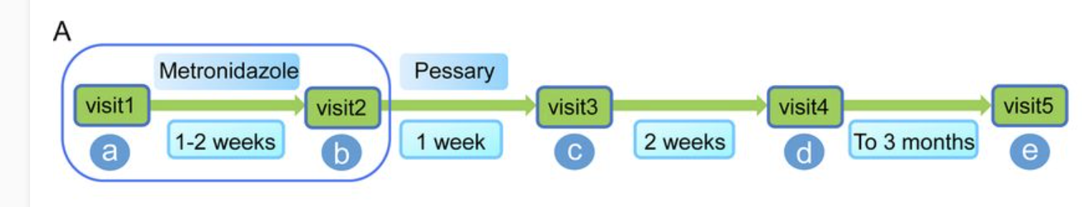
Tutorial – Bacterial Vaginosis
multifactorial disease characterized by a shift from the Lactobacillus species-dominated microbial community toward a taxonomically diverse anaerobic community
8 women diagnosed with BV
4 successfully treated, 4 not
Paired-end seq performed on a HiSeq 2500 Sequencer to yield 2 × 110-bp
https://journals.asm.org/doi/full/10.1128/mSphereDirect.00262-18

Slide 4
You have two datasets in your project folder
Samsa2_metatranscriptomics_VaginalMicrobiome_noresponse
Samsa2_metatranscriptomics_VaginalMicrobiome_response

Slide 5
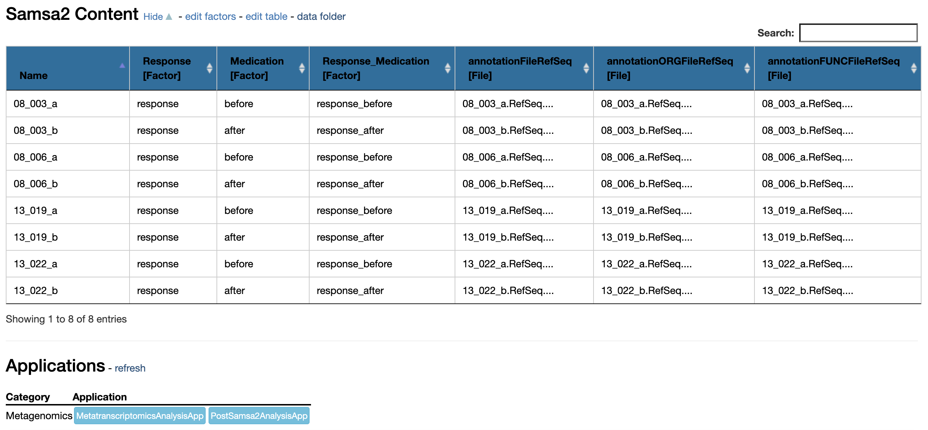
PostSamsa2 analysis
Because Samsa2 takes some time to run I have already run it for you. Here we will run the report on the files produced by Samsa2
Run the PostSamsa2 analysis
You will need to run it on each dataset separately. Please see next page for parameters

Slide 6
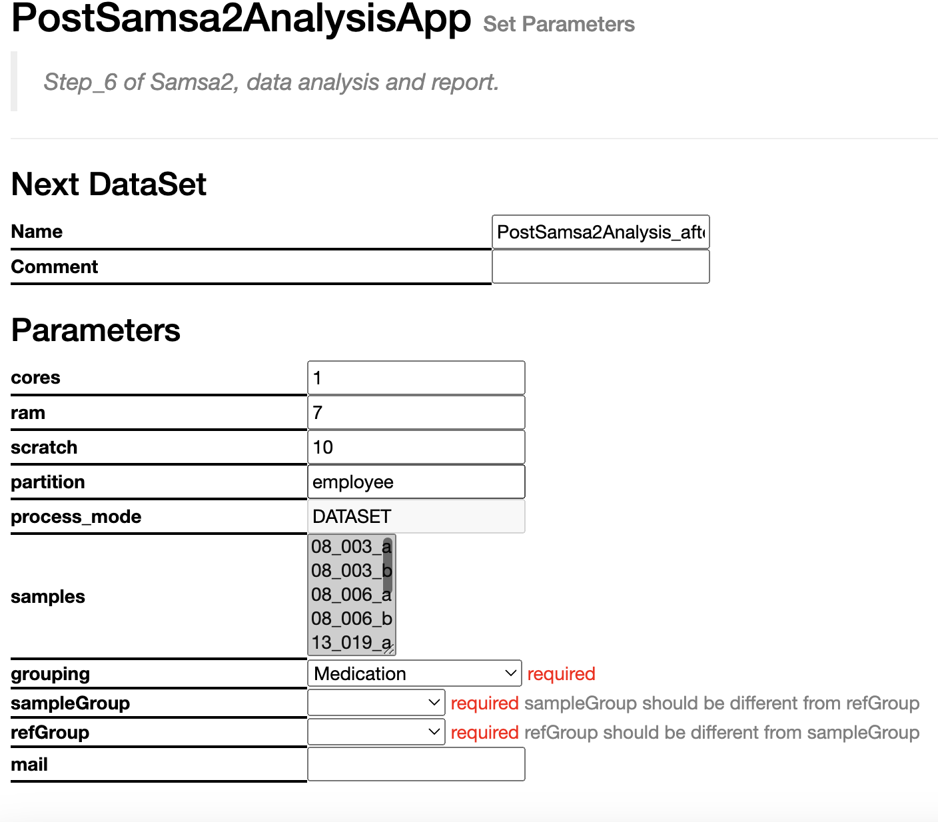
Parameters
In terms of parameters do not forget to specify:
Grouping - > Medication
sampleGroup -> after
referenceGroup -> before

