Slide 1
Rodent Issues in New York City
Evan Esplin, Zach Jorgensen, Gavin Weber, and Morgan Weyland

Slide 2
What characteristics of a City Council district are associated with higher rodent reporting rates and higher rodent confirmed issue rates?
Higher rodent issue rates are associated with the lower-middle class and multi-family apartments.

Slide 3
Our Datasets
Where did our data come from?
1. 311 Rodent Calls
Confirmed Issue Methodology :
Confirmed: DoH found violations and will follow up, minor violations found, violations identified, owner is responsible, investigation performed
Not Confirmed: Passed Inspection, no Determination, inaccessible site, duplicate complaint
NA (These could all lead to possible error in the data): Could not locate address, referred to another agency/Not in jurisdiction, no further updates, could not inspect
*This dataset only accounts for reported problems. It may not completely represent all rodent problems if people don't report them
We used this to calculate reported and confirmed rodent rates by percent per thousand people.
2. City Council District Context
Info on NYC demographic variables sorted by district
Includes:
Income
Education
Ethnicity
Etc.
We were able to combine this data with the 311 Rodent Calls data to see how the rodent reports and confirmations vary by district
3. PLUTO
The Primary Land Use Tax Lot Output Dataset, publicly available
Includes:
Tax lot data
Land use/zoning data
Geospatial data
We used this to find which building type count has the most problems.

Slide 4
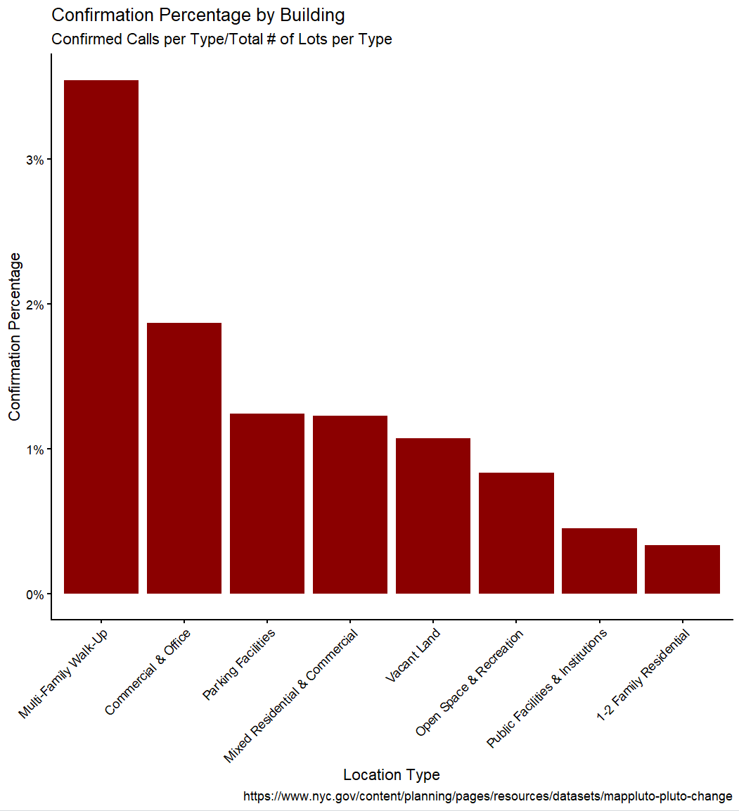
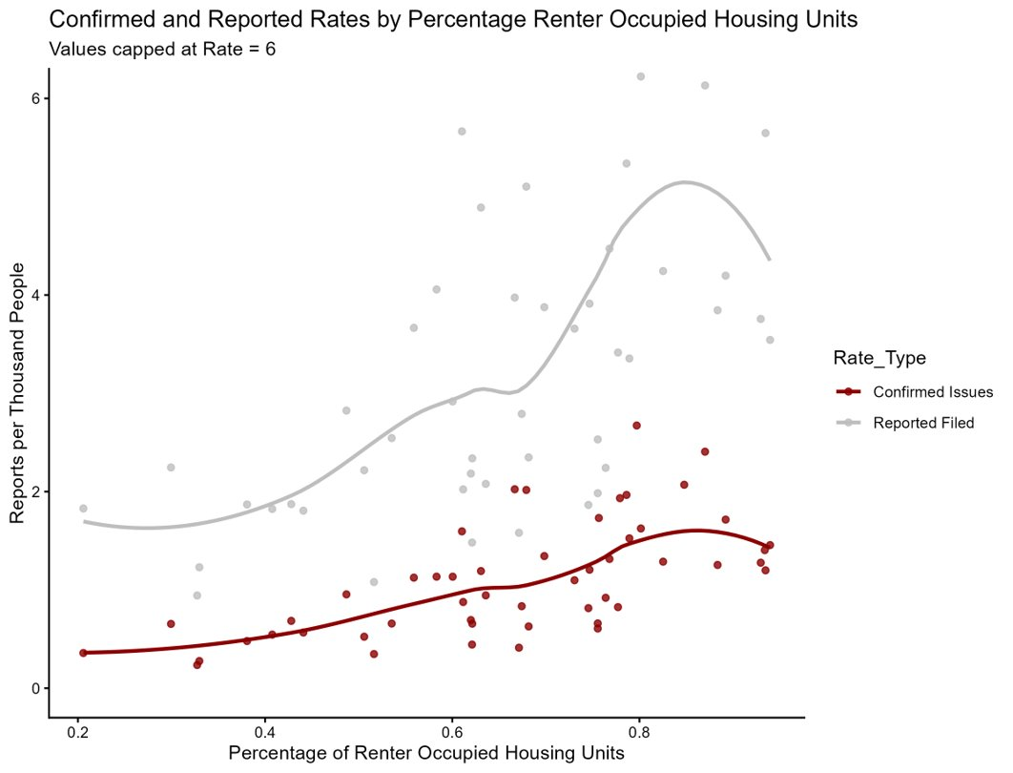
Renter Occupied Units
Multi-Family Walk-Ups are the primary drivers of confirmed issues
Positive correlation between ROU & Confirmed Issue Rate (Spearman's Rank Correlation, p < .001)
Top Confirmation Rates in ROU Upper quartile:
District 36 – 2.67
District 34 – 2.41
District 9 - 2.07
District 22 – 1.97
District 17 – 1.72

Slide 5
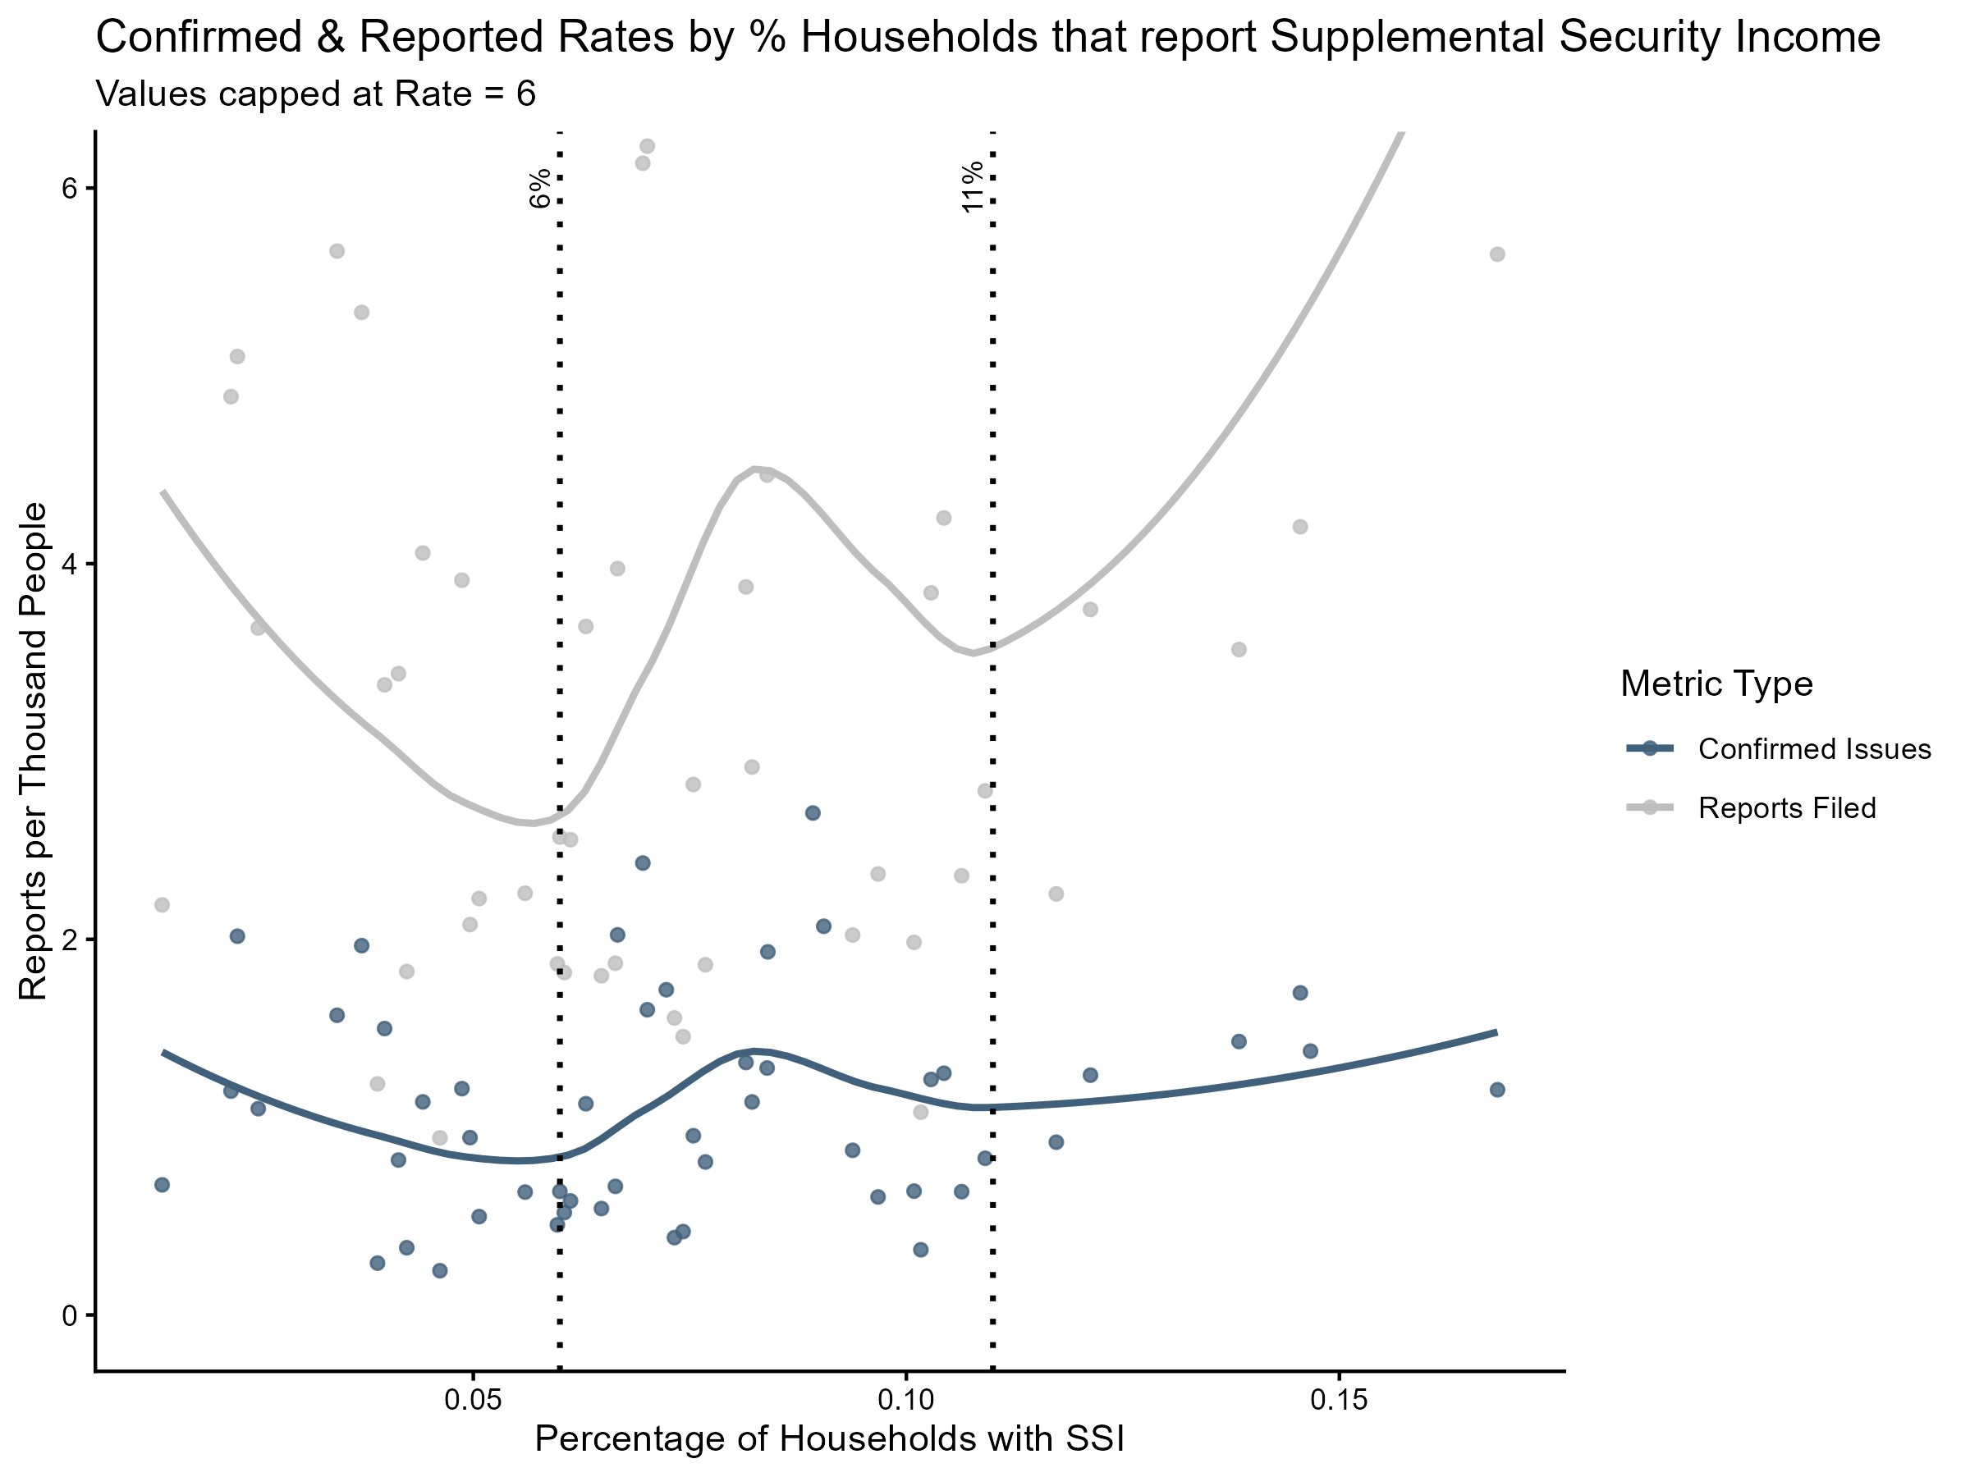
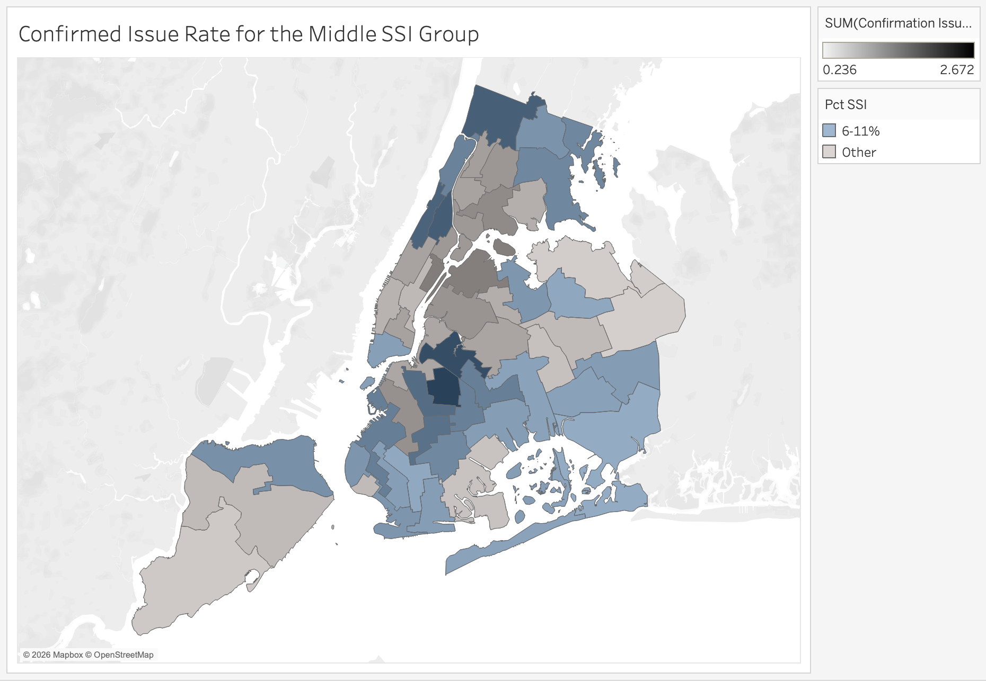
Supplemental Security Income
Reported and confirmed rates spiked in districts where between 6-11% of residents receive SSI
This rate is associated with the lower-middle class, who are more prone to renting
Top Confirmation Rates
in the SSI middle range:
District 36: 2.67
District 34: 2.41
District 9: 2.07
District 11: 2.02
District 7: 1.93

Slide 6
Solution
The districts with 6-11% receiving SSI and a higher percentage of renters have higher rodent issue rates.
Potential actions:
  Send exterminators to the apartments in these districts (Short term solution)
  Educating tenants and apartment owners on cleanliness, 311, rat prevention (Long term solution).
  Create/enforce stricter laws/rules on tenant stay. .
  When people apply for SSI, include educational prevention and elimination strategies on the page, and a link to extermination and prevention resources.
Districts 36, 34 and 9 have high confirmation rates and appear in both the SSI and high renter percentage groups. We suggest you start your efforts there.

