Slide 1


Source
Stage
DataWarehouse
Azure SQL DB
Isolated MicroServices
Combined data from diff MicroServices
BackEnd
Books
Azure SQL Data Warehouse
Table1
Table2
Table3
Azure Data Lake
BackEnd
Users
Data Marts
Table1
Table2
Table3
BackEnd\Books\Table1\2019\01\..csv
Stg.BooksTable1
Stg.BooksTable2
…
Stg.Users.Table1
Stg.UsersTable2
…
Hist.BooksTable1
Hist.BooksTable2
…
Hist.UsersTable1
Hist.UsersTable2
…
Dim.Book
Fact.UserDailySnapshot
…
BackEnd\Books\Table1\Latest\..orc
Stored Procedure
T-SQL
Stored Procedure
T-SQL
…
ExternalTable
PolyBase
BackEnd
Accounts
BackEnd\Users\Table1\2019\01\..csv
BackEnd\Users\Table1\Latest\..orc
Table1
Table2
Table3
…
Azure Storage
BackEnd
…
…
…
…
…
Notes:
We have a standardised flow in Data Factory for different Source Systems (BackEnd MicroServices). They are all set up pretty much the same. There is one pipeline per Source Table. These pipelines are grouped by BackEnd MicroServices. Each group of pipelines resides in own Repository in BitBucket. This allows us to deploy changes isolated and therefore speed up the development and delivery. When we have read and historized data from all MicroServices we start generating data for our Data Marts – dimensions and fact tables. Data Marts are the final destination in our DataWarehouse. When the data are refreshed in the Data Marts we use it for the following purposes:
refresh Power BI reports and Analysis Services cubes which are used by business users at BookBeat to make tactical and strategical decisions
generate recommendations (DataBricks) for the end users of the BookBeat app
update end users data in MailChimp (marketing automation platform). Marketing campaigns at BookBeat are datadriven and customized based on each customer’s behaviour
Export consumption data to Publishers (BookBeat pays for the consumption of the books our end users listen to)
Export of the financial transactions to the economy system

Slide 2
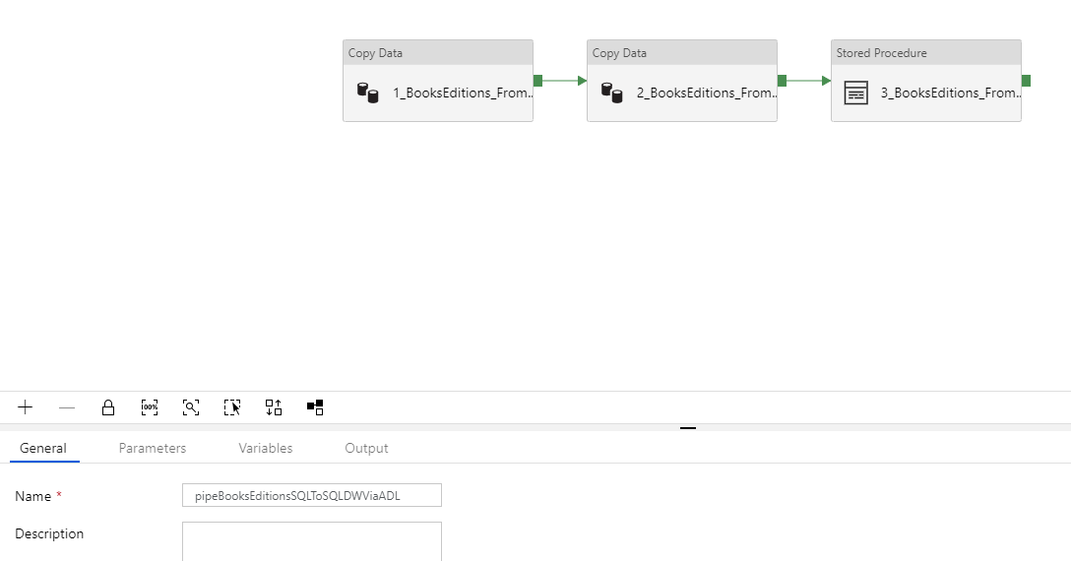
Notes:
Here is a standard pipeline that moves data from a table in the source database and historisize it to a table in the DataWarehouse (see pipeBooksEditionsSQLToSQLDWViaADL.json):
Copy Data activity – get all rows all columns from the source table dbo.Editions and create a daily snapshot (.csv file) in Data Lake for archiving. Standard path in DataLake – BackEnd\Books\Editions\2019\01\bookseditions_20190101.csv
Copy Data activity – copy data from step 1 to .orc file in DataLake with overwrite. Standard path in DataLake – BackEnd\Books\Editions\Latest\bookseditions_DailySnapshot.orc
Stored Procedure activity – run a stored procedure that will get data from the .orc file in step 2 (PolyBase), find changes compared to the previous day and historize those changes in hist.BooksEditions table
You get a definition of the external table (step 2) and hist table in 0.BooksEditions.DDL.sql. The stored procedure for historization is also pretty standard, we change only table names and columns. You find the stored procedure in spHandleHistoryBooksEditions.sql.
You already received mock data for BooksEditions and should be able to create this flow in your environment.

Slide 3
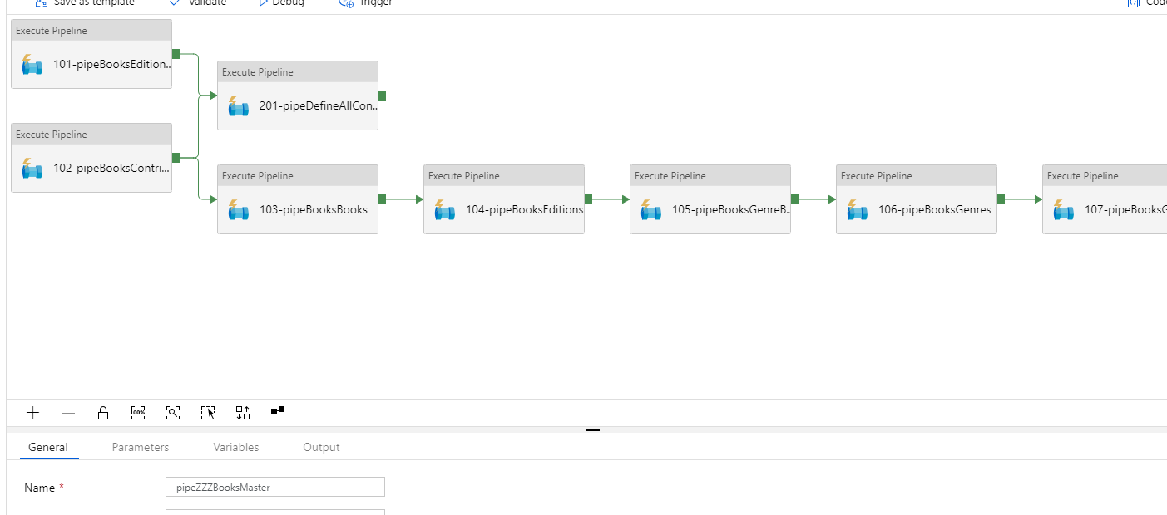
Notes:
As I said earlier we have one pipeline per source table. All the pipelines that get data from the same BackEnd Microservices are grouped together and are executed from one ”master” pipeline. Here you see how such ”master” pipeline is set up. It basically executes othe pipelines in a specific order.
You find a definition of the ”master” pipeline in pipeZZZBooksMaster.json. One of the pipelines that it will execute is pipeBooksEditionsSQLToSQLDWViaADL.json from the previous slide. You can make copy same pipeline and rename it if you want to simulate the whole ”master” pipeline.

Slide 4
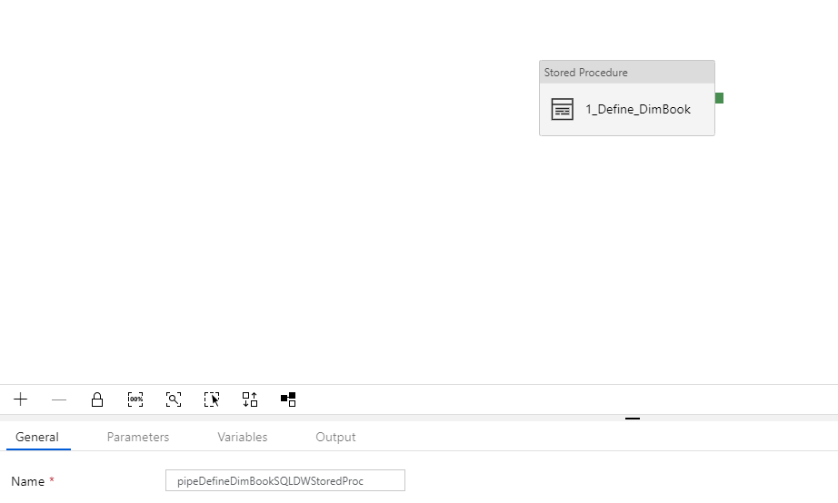
Notes:
When data are extracted from the source system and historisized can we refresh our Data Marts. This is done by executing a stored procedure in the DataWarehouse and therefore a pipeline for this purpose is very simple – only one Stored Procedure activity.
You find this pipeline in pipeDefineDimBookSQLDWStoredProc.json and the stored procedure in spLoadAndDefineBookDimension.sql. DDL for dim.Book is in 0.DimBook.DDL.sql

Slide 5
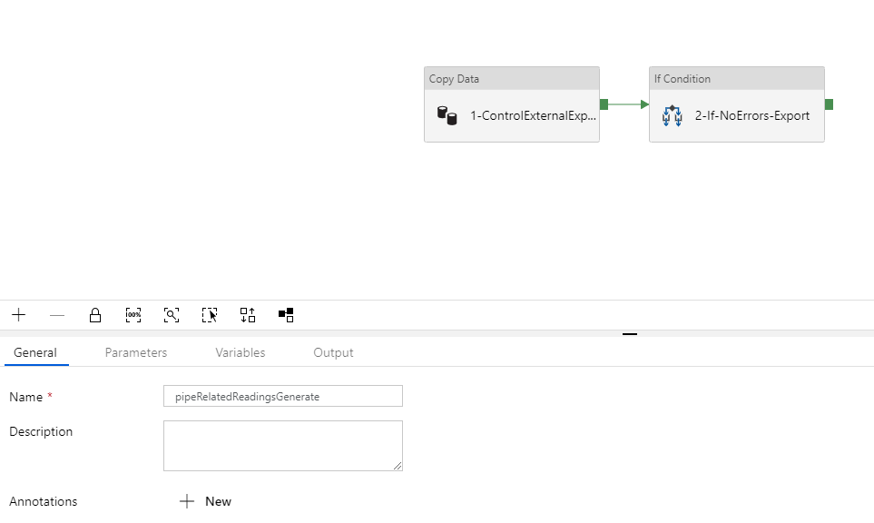
Notes:
When the Data Marts are refreshed can we start generating recommendations for the end users of BookBeat app. The recommendations are generated in DataBricks with Python. We execute a DataBricks notebook from Data Factory. We have some data quality controls before we use the data produced in Data Marts for refreshing PowerBI, SSAS, generate recommendations etc. These controls you see in the flow above. If the controls are not returning any errors can we start the DataBricks job.
You find this pipeline in pipeRelatedReadingsGenerate.json, DataBricks notebook in RelatedReadingsPy.py. You find mockdata for this notebook in CubeRelatedReadingsInput.csv.

Slide 6
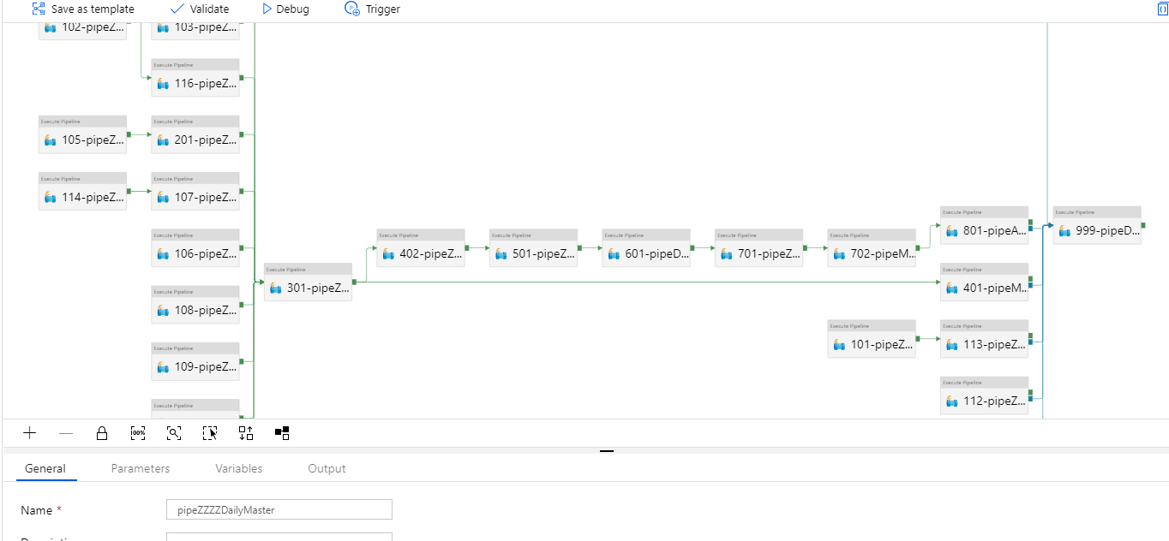
Notes:
We refresh Data Warehouse once per day. In order to orchestrate in which order the pipelines will be executed we have one daily master pipeline which is executed by a trigger every night. This pipeline makes sure that we first extract data from the source systems and when this is done we execute pipelines that refresh our Data Marts (dimensions and fact tables). When the Data Marts are refreshed we execute pipelines that will export data to external systems, run DataBricks, refresh PowerBI and Analysis Services. All these steps are done by Data Factory in a particular order that you see above.
You find definition of this pipeline in pipeZZZZDailyMaster.json. You can copy same pipeline or make dummy pipelines with the names from (pipeZZZZDailyMaster) if you want to simulate this flow.

