Slide 1




BookBeat Mobile App Users
BookBeat BackEnd
BookBeat Datawarehouse
Users
DataWarehouse
Consumption
DataBricks
Which Books and how long users listen to
Which Books users listen to
Related Books
How Users use BookBeat App (clicks on recommendation lists)
Events
Related Books
Related Books
Lists
Power BI – which lists are popular (most clicks)
Notes:
Here is an example of how behaviour of BookBeat End Users changes their experience in the BookBeat Mobile App:
End User listens to a Book in BookBeat App
Information about who listened to the Book, which Book and how long (percent of the books length) registered in BookBeat BackEnd systems live
BookBeat Datawarehouse refreshes every night by reading all registered events, consumptions etc from BackEnd systems
Information about which Books are listened to and by whom goes to DataBricks for analysis and generation of recommendations (RelatedReadingsPy.py) – we make lists for every book in the BookBeat service with other books that users also listened to (related books)
The generated Book Lists are exported from the DataWarehouse to the BackEnd system
When EndUsers click on the book in the BookBeat app they will see ”Others Also Listen To” list in the end of the page
When EndUsers click on a book in the list ”Others Also Listen To” BackEnd will register an event with information who clicked on what list and what book
Event about clicks in the BookBeat app are fetched to the DataWarehouse every hour and we have a PowerBI report that shows what lists are popular in the BookBeat app
This is one example of the recommendations we produce in the DataWarehouse. We have even personal recommendations that are based on all books that an EndUser listened to, we have lists with newly published books etc. You will find the PowerBI analysis of which lists are popular in Book list popularity.pbix. Source data for this report is in Book List Popularity.xlsx.

Slide 2
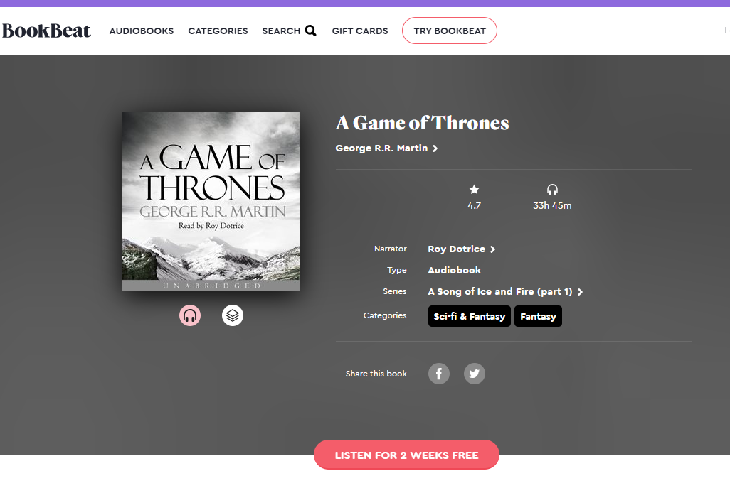
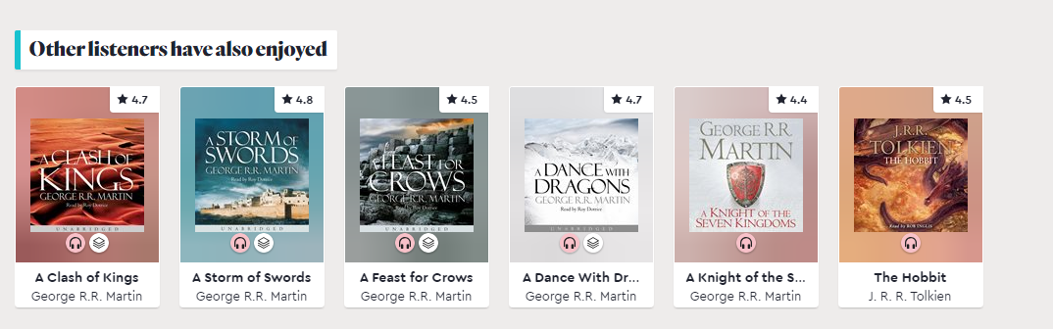
Notes:
Here is the ”Others Also Listen To” list you will see on bookbeat.com if you choose A Game of Thrones. The same list will be shown even in the BookBeat Mobile App.

Slide 3
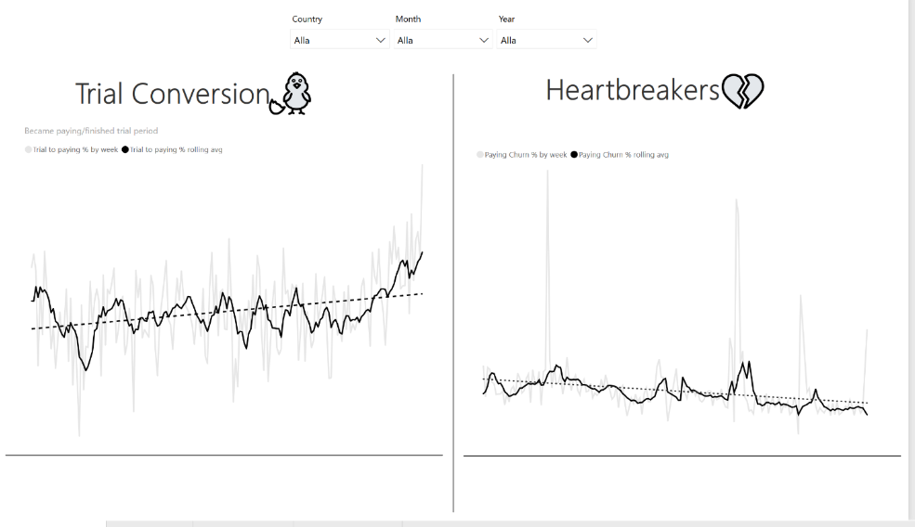
Notes:
Here is another PowerBI report that we developed for our business users (primarily Customer Journey manager). This report shows:
Trial conversion - how many of our End Users convert from trial (free) version of BookBeat to paying
Heartbreakers – how many of our paying EndUsers become inactive

