Slide 1

Forecasting Google Stock data by Regression
Zakarea Mosa
Major: Management Information System

Slide 2
outline
Project objective
Tools used and justification
Data analysis
Conclusion

Slide 3


Project objective
This project will forecast the closing price of Google stock prices using , regression analysis to do the forecasting.

Slide 4
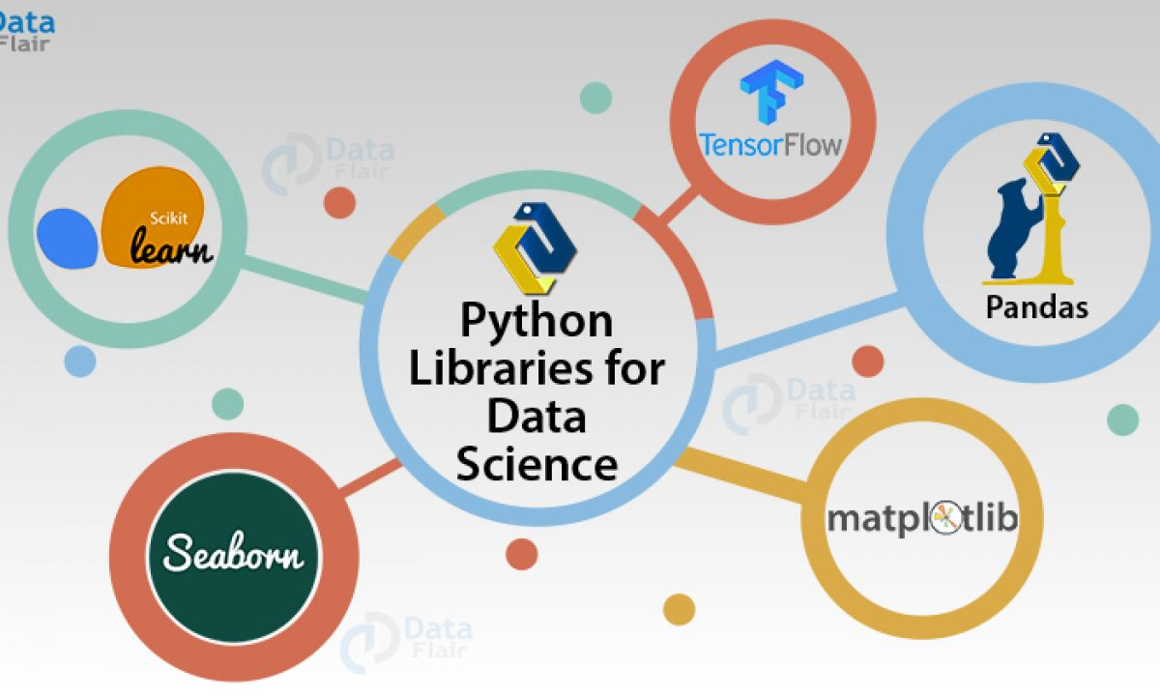
Tools used and justification
Python programming language will be used to gain complete insight for dataset have more than 1000 rows.

Slide 5

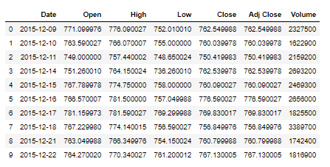
Data analysis
This the first 9 rows from the dataset contain from more than 1000 rows,
created regression model that has 4 independent variables and one dependent .

Slide 6
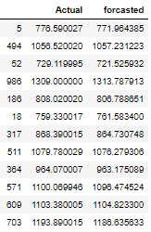
Regression analysis results
the forecasted close price versus the actual to compare how the deference.

Slide 7
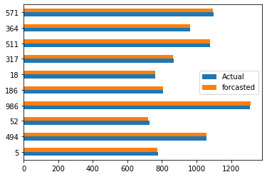
Plot of actual close price versus forecasted close price.

Slide 8


