Slide 1
11:47 PM
3 blocks away.
Your biggest financial decision.
Your neighbor. 22 years on this block. Knows everything.
Scrolling alone. No warnings. No neighbor. Just the listing.
Has never met you. Has the answer you need.
They've never met. One is about to make a $1.4M mistake.
gwak gwak

Slide 2
Something We Lost
We used to know our neighbors.
The front porch. The block party. The neighbor who'd warn you.
Someone would warn you before you signed.
Someone at the block party knew which landlord ghosts tenants.
Someone's lived on that block for 22 years and has opinions.
That neighborhood truth used to be free.
Now it's buried.
gwak gwak brings it back.
gwak gwak
your favorite local real estate.

Slide 3
“
I've been frustrated by this problem for over 10 years.
Every listing I scrolled, I had something to say.
A warning. A co-sign. A question.
But there was nowhere to put it.
You'd share the link and complain to a friend. Or just eat the thought.
gwak gwak is what I needed every single time.
— Founder, gwak gwak
gwak gwak

Slide 4
gwak gwak
the comment section real estate never had.
gwak gwak ● Silver Lake
Flooded twice. Insurance won't cover it. Run.
verified_silverlake_91 · 2h · 📍 Silver Lake, CA
Best block in the neighborhood. Kids grew up here. Buy it.
→ Verified by zip code — your address is your credential.
longtime_local_34 · 5h · 📍 Los Feliz, CA
→ Real neighbors. Real takes. Zero anonymous noise.
Seller is divorcing. Price dropped $80K in 3 weeks. That's why.
→ The conversation every listing deserves.
nosy_neighbor_90026 · 1d · 📍 Echo Park, CA
Anyone can browse. Only verified locals can drop takes.
gwak gwak
your favorite local real estate.

Slide 5
$190,000
“
One comment. 30 seconds. $190,000.
saved in 30 seconds.
Maria was about to sign on a Silver Lake property.
A gwak gwak take from a verified neighbor flagged the
un-permitted back unit.
She walked. She saved $190K and avoided years of
legal liability.
Her neighbor had never met her.
They just knew the truth about that block.
This is what verified neighborhood knowledge is worth.
gwak gwak
your favorite local real estate.

Slide 6
Who This Is For
The Millennial First-Timer
The Long-Time Resident
The Gen Z Observer
Buying alone at 34. No family in the city. No neighborhood intel. Just Zillow and hope.
22 years on this block. Has opinions about every listing within 6 blocks.
Priced out. Paying attention. Watching the neighborhood change in real time.
Median first-time buyer age: 38 (all-time high)
Finally has somewhere to put them.
Only 26.1% of Gen Z own homes. 84% delaying life milestones.
gwak gwak gives everyone a voice. And a reason to come back.
gwak gwak

Slide 7
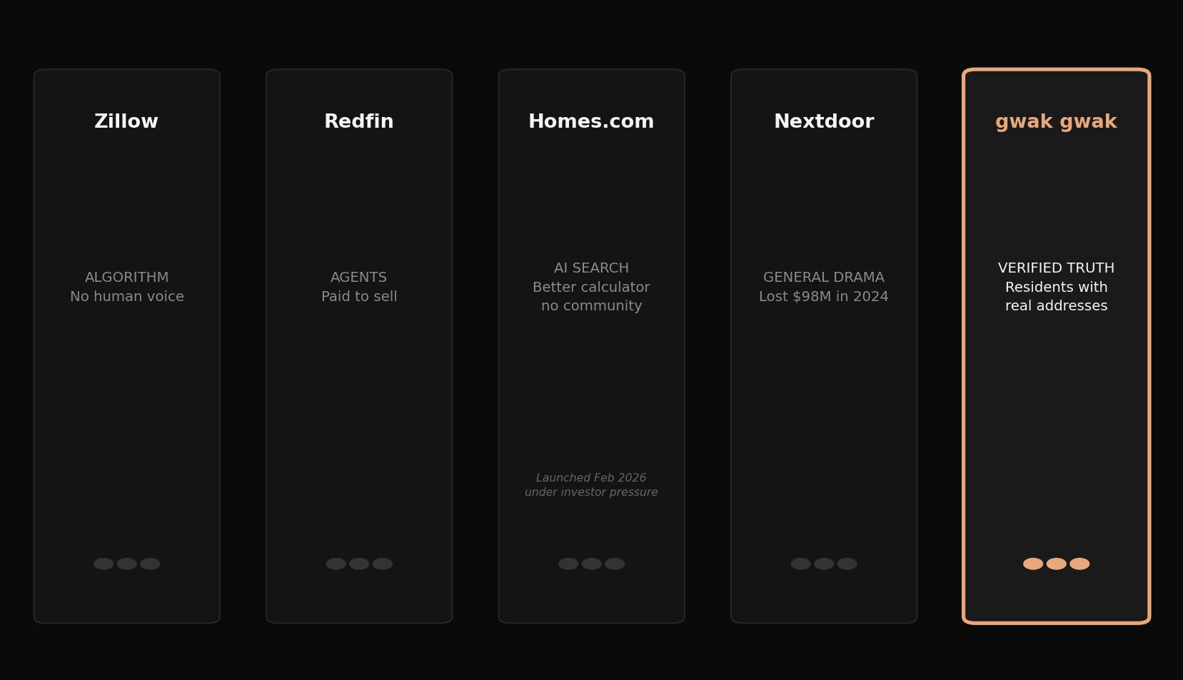
The Problem With Everything Else
gwak gwak
your favorite local real estate.

Slide 8
2026
The gap is real. The audience is real. The need is real.
The last honest voice in neighborhood journalism just went dark.
gwak gwak is the heir. Community-powered, not journalist-powered.
In early 2026, Vox Media erased 15 years of
Curbed's local reporting.
SF, LA, all city editions. Gone.
Called “an act of erasure” by The Architectural Papers.
15 years of hyperlocal neighborhood journalism erased overnight. The editorial layer is gone. The community remains. We give them the microphone.
gwak gwak
your favorite local real estate.

Slide 9
Zip-Verified Trust
Anyone can browse. Only verified locals can drop takes.
Your address is your credential.
01
02
03
Sign Up
→
Address Verified
→
Take Unlocked
Any device. No friction.
Zip code match. One-time check.
Your voice. Your block. Permanent.
This is not anonymous internet. This is your neighbor. With their name on it.
gwak gwak
your favorite local real estate.

Slide 10
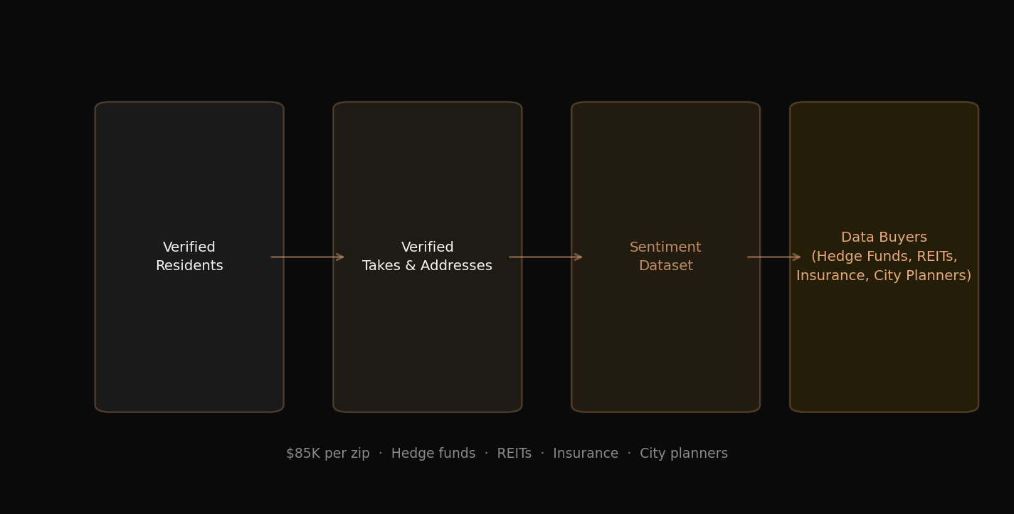
The Data Moat
Every address submitted is a data point.
$85K
per zip (PropTech comp)
Hedge Funds REITs Insurance City Planners
Data Buyers
No one else has this. Because no one else has the community.
gwak gwak
your favorite local real estate.

Slide 11
The AI Imagination Layer — The Beyond
What if the comment wasn't just words?
📸
🛋️
🏠
💡
SEE THE FULL STORY
REIMAGINE THE SPACE
BEFORE / AFTER TAKES
VISUAL TAKES
AI pulls historical MLS photos, Street View archives, public records. See a teardown's full life. What it looked like in 1991.
AI furniture removal. Apply your style. Post your version as a take. “Here’s how I’d do it.” — @silver_lake_22
Visual commentary. The flip vs. the original. Side-by-side community reactions.
A new content format. Comments evolve from text to visual stories. No platform has this.
No platform has community + AI visual imagination together. We’re small. We can move fast. We can do anything. (Coming Q3 2026)
gwak gwak
your favorite local real estate.

Slide 12
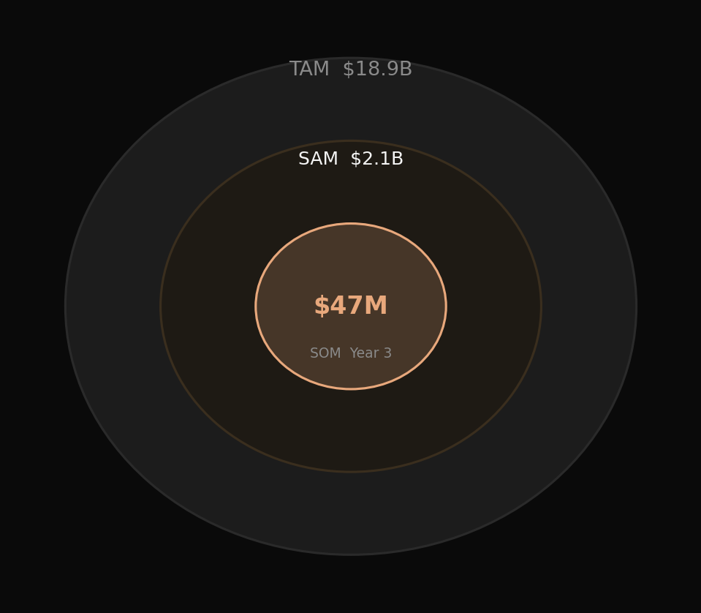
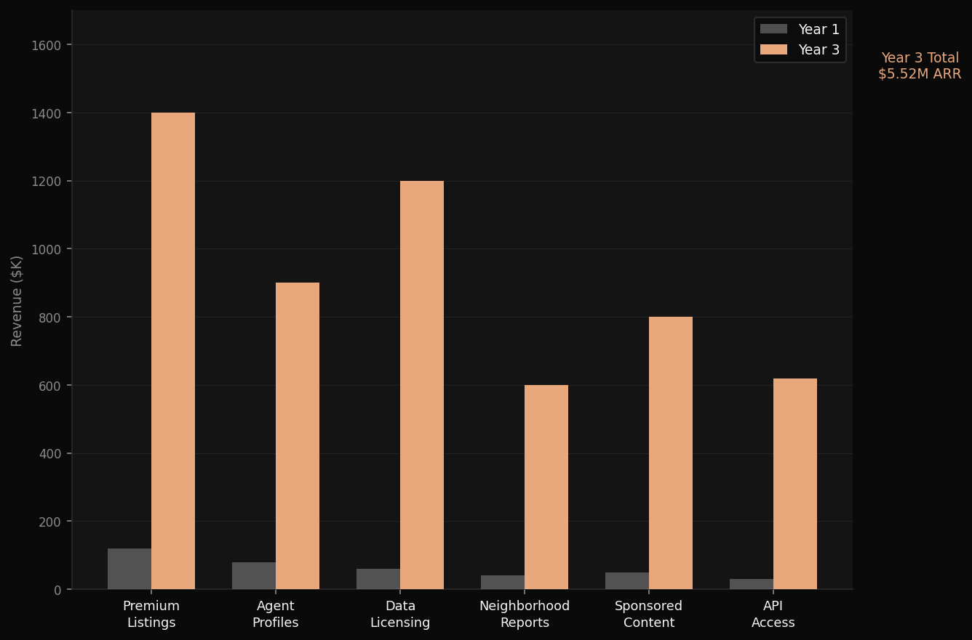
Market + Business
gwak gwak
your favorite local real estate.

Slide 13
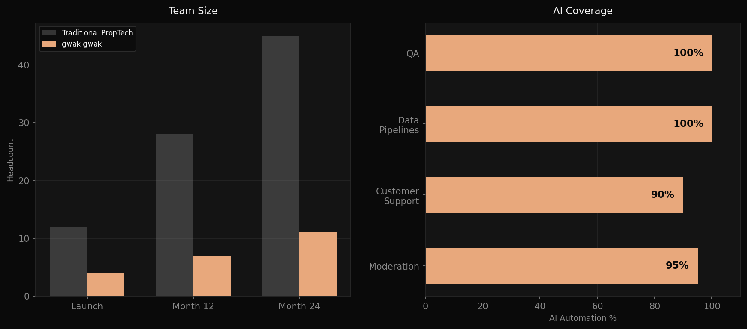
AI-Native Team
We built for 2026, not 2016.
Lean team. Massive output. No bloat.
gwak gwak
your favorite local real estate.

Slide 14
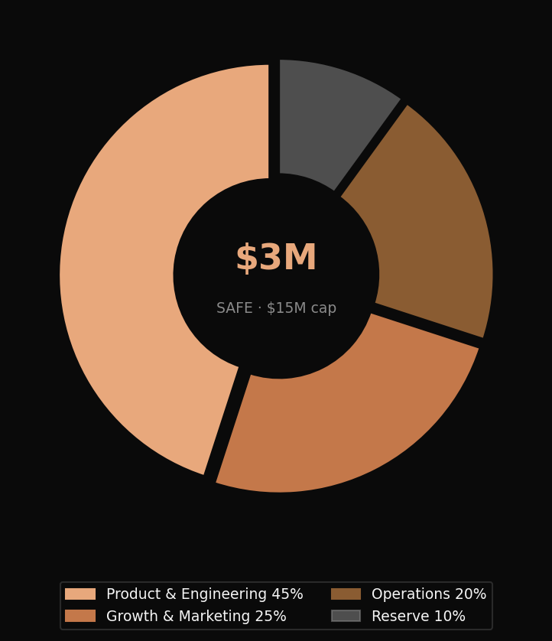
The Ask
$3M
Milestones
3 cities live
Launch markets in LA, SF, NYC
50K verified users
SAFE note · $15M post-money cap
Zip-verified residents, active
$500K ARR
Revenue milestone → Series A
24 months runway
Lean, focused, capital efficient
We are raising $3M. 24 months runway. Series A ready.
gwak gwak

Slide 15
Every neighborhood has a truth.
We're building the infrastructure to surface it.
This is not a listing site.
This is where your community lives.
gwak gwak
your favorite local real estate.

