Slide 1

Slicing-UPF/SMF-UEs)

Slide 2


Content
Introduction
Literature Review
Open5GS and 5G Core Networks
Key Components of Open5GS
Network Slicing in Open5GS
Architecture Overview
Milestones
Development and Deployment
Management and Orchestration
Testing & Validation Strategy
Conclusion
References

Slide 3
Introduction
Design, Initialization, and Verification of a Scalable 5G Slicing Platform
Key Points:
Objective: Implement network slicing to enable multiple virtual networks on a shared 5G infrastructure.
Tools & Technologies: Open5GS core network, UERANSIM for UE simulation, Docker for containerized deployment.
Project Highlights:
Seamless UE connectivity and monitoring
Automation, scaling, and resiliency
Step-by-step deployment and optimization techniques
Achieving resource efficiency, low latency, and high reliability

Slide 4
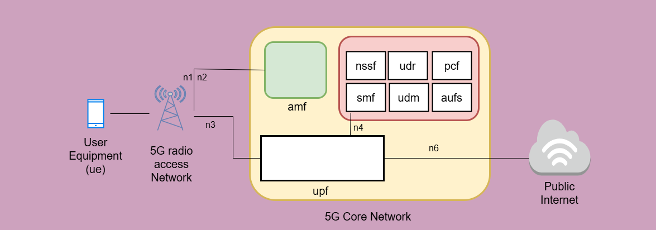

Literature Review
Open5GS and 5G Core Networks

Slide 5
Key Component of Open5GS
AMF
SMF
UPF
NRF
PCF
Connection Management & Mobility
Authentication Coordination
Security Context Management
Session Initiation, Modifying, and Closing
IP Address Assignment
Policy Enforcer.
Data Routing & Forwarding
Packet Handling & Inspection of QoS
Anchor Point to Mobility
NF Registration
Service Discovery.
Load Balance support
Policy Decision
Session Management Support
Charging Rules Provisioning

Slide 6
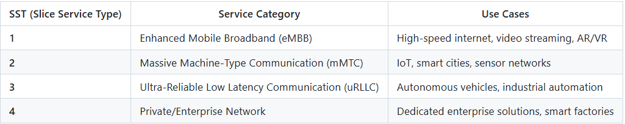

Network Slicing in Open5GS
Enables multiple virtual networks on a shared physical infrastructure.
Each slice is an end-to-end logical network tailored for specific services (e.g., IoT, autonomous vehicles, smart cities).
Key Term:
S-NSSAI (Single Network Slice Selection Assistance Information): Defines each slice using:
SST (Slice Service Type): Service type of the slice.
SD (Slice Differentiator): Differentiates slices within an SST

Slide 7
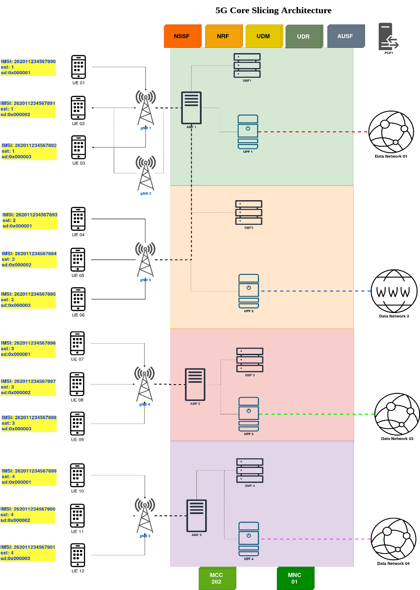
Architecture
SST & SD Configuration:
Specify UE profile with Slice Service Type (SST) and Slice Differentiator (SD) values.
Slice Mapping via NSSF:
Network Slice Selection Function (NSSF) maps SST/SD to the appropriate slice.
Connection Flow:
NSSF → AMF (Access and Mobility Management Function)
AMF allocates the suitable SMF (Session Management Function) and UPF (User Plane Function).
Data Network Targeting:
Establishes connection to the appropriate Data Network.

Slide 8
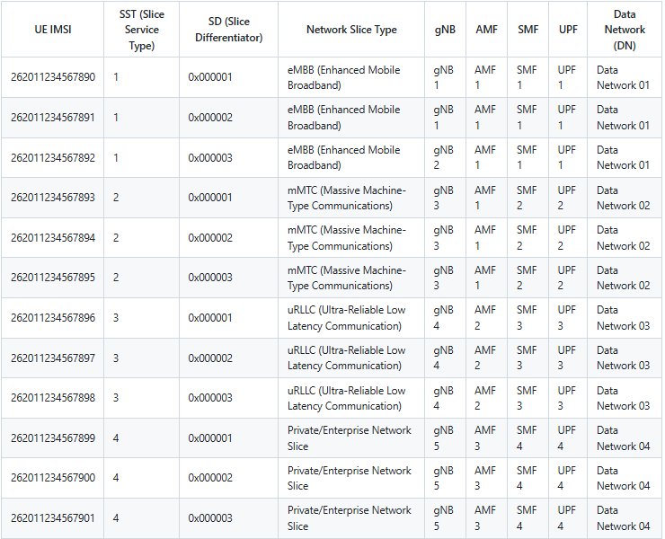
Architecture
UE IMSI
SST (Slice Service Type)
IMSI SD (Slice Differentiator) .
Network Slice Category.
gNB (Base Station)
SMF (Session Management Function)
UPF (User Plane Function)
Data Network (DN)

Slide 9
Development and Deployment
1. Environment Setup
Setting Up Docker Environment:
Installed Docker and Docker Compose for container orchestration.
Configured networks and volumes for persistent data management.
Repo Clone & Test Deployments:
Cloned the Open5GS repository and tested initial deployments.
Verified basic network function (NF) container readiness and logs.

Slide 10
Development and Deployment
Multiple NFs Creation:
Deployed critical NFs including AMF, SMF, UPF, NRF, and PCF.
Configured network functions to support network slicing.
PDU Session Creation:
Established PDU sessions to ensure data connectivity for UEs.
Validated session management and data routing through SMF and UPF.
Multiple Slicing:
Configured SST and SD values for distinct network slices.
Implemented slice selection mechanisms via NSSF and AMF.
Completion of Network Architecture:
Integrated all NFs into a cohesive 5G core network.
Enabled communication across slices with proper routing and policies.
2. Core Network Functions (NFs) Implementation

Slide 11
Development and Deployment
3. Monitoring & Alerting System
Prometheus & Grafana Integration:
Added Prometheus to monitor metrics for all NFs.
Created dynamic Grafana dashboards to visualize network performance.
Alert Manager Configuration:
Set up Prometheus Alert Manager to detect performance anomalies.
Defined custom alert rules based on network KPIs and metrics.
Webhook Integration:
Developed a webhook receiver using Python and Flask.
Automated scaling actions when alerts are triggered by Prometheus.

Slide 12
Development and Deployment
4. Automation & Optimization Strategies
Communication Between Dockers:
Configured Docker Compose networks for seamless container communication.
Validated data flow between NFs and monitoring containers.
Python Script & Flask Application:
Script designed to scale UPF and SMF dynamically.
Flask app served as a RESTful endpoint for alert-triggered actions.
Deploying Webhook Package:
Packaged the Python webhook into a Docker container.
Integrated the container within the existing 5G core network environment.
cAdvisor Deployment:
Implemented cAdvisor to monitor container resource usage.
Analyzed CPU, memory, and network usage for performance tuning.

Slide 13
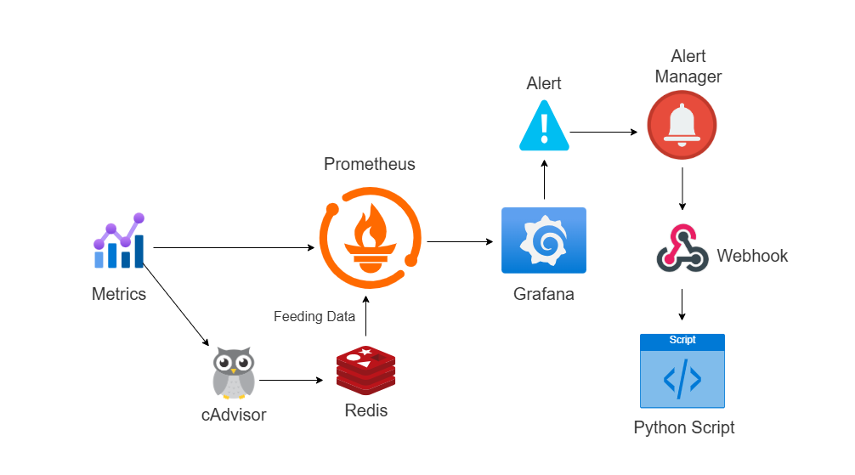
Management and Orchestration

Slide 14
Management and Orchestration
1. Monitoring & Visualization
Adding NFs to Prometheus:
Configured Prometheus to monitor all Network Functions (NFs).
Enabled metrics scraping from AMF, SMF, UPF, NRF, and PCF.
Set up service discovery for dynamic monitoring of new containers.
Grafana Dashboards:
Designed intuitive dashboards showcasing real-time metrics.
Displayed critical KPIs like latency, throughput, and container health.
Added alerts and triggers directly in the dashboards for better observability.

Slide 15
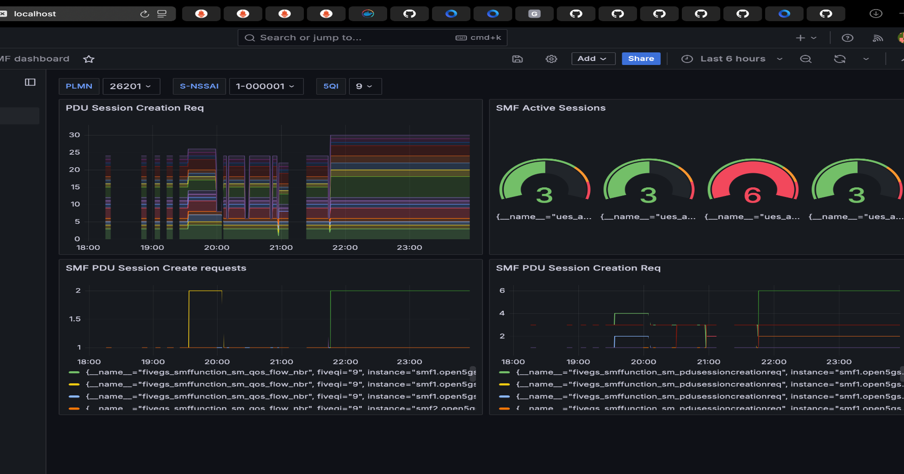
Grafana Dashboard

Slide 16
Management and Orchestration
2. Data Management & Alerting
Database Connectivity, Storage, and Processing:
Established persistent storage for metrics and logs.
Implemented data pipelines to process and analyze historical metrics.
Configured long-term data retention policies for performance analysis.
Creating & Managing Alerts:
Defined Prometheus alerting rules based on thresholds and anomalies.
Configured email/SMS notifications for critical alerts.
Triggering Alerts & Webhook Communication:
Implemented a webhook endpoint with Flask for alert management.
Automated scale-up or scale-down actions when specific alerts are triggered.

Slide 17
Management and Orchestration
3. Automation & Container Management
Python Script Container Deployment:
Packaged the Python script into a Docker container for scalability.
Connected the container with Prometheus alerts to automate responses.
Handling Docker Compose Limitations:
Identified constraints in scaling and orchestration with Docker Compose.
Explored advanced options like scaling only specific NFs.
Docker Swarm & Its Limitations:
Evaluated Docker Swarm for advanced orchestration and service scaling.
Assessed limitations in network policies and failover management.
Restart & Other Policies:
Set up container restart policies to handle crashes and reboots.
Implemented health checks and dependencies to ensure proper container startup order.

Slide 18
Management and Orchestration
4. Management & Orchestration Workflow
Workflow Strategy:
Automated deployment pipelines for fast and reliable NF provisioning.
Designed a robust workflow from monitoring to automated scaling.
Continuous Monitoring & Optimization:
Analyzed performance metrics to fine-tune container resource allocation.
Enhanced system resilience through dynamic orchestration and self-healing mechanisms.

Slide 19
Testing & Validation Strategy
1. Connectivity Testing
UERANSIM & Open5GS Core
2. Multi-UE Registration & PDU Sessions
Registering Multiple Ue’s
Establishing PDU Sessions
3. Network Slicing Validation
Slice Verification:
Metrics Collection:
4. Performance Testing
Throughput Testing
Latency Testing
5. Failure Recovery & Resilience

Slide 20
conclusion
Successful 5G Core Implementation:
Deployed a robust 5G network using Open5GS, Docker, and UERANSIM.
Demonstrated network slicing on a shared infrastructure.
Key Achievements:
Dynamic Network Slicing: Efficient resource allocation for eMBB, mMTC, and uRLLC.
Automation & Scalability: Automated scaling with Flask-based webhook and Alert Manager.
Enhanced Monitoring: Real-time insights via Prometheus and Grafana dashboards.
High Performance: Achieved low latency, high throughput, and effective failure recovery.
Impact:
Validated the use of containerized 5G core networks for flexible and efficient telecom infrastructure.
Supports broader adoption of network slicing in both enterprise and consumer applications.

Slide 21
References
3GPP TS 23.501: System Architecture for the 5G System.
Prometheus & Grafana Documentation.
Open5GS Documentation: https://open5gs.org/
UERANSIM Documentation: https://github.com/aligungr/UERANSIM
Docker Documentation: https://docs.docker.com/

Slide 22
Thank You!

