Slide 1
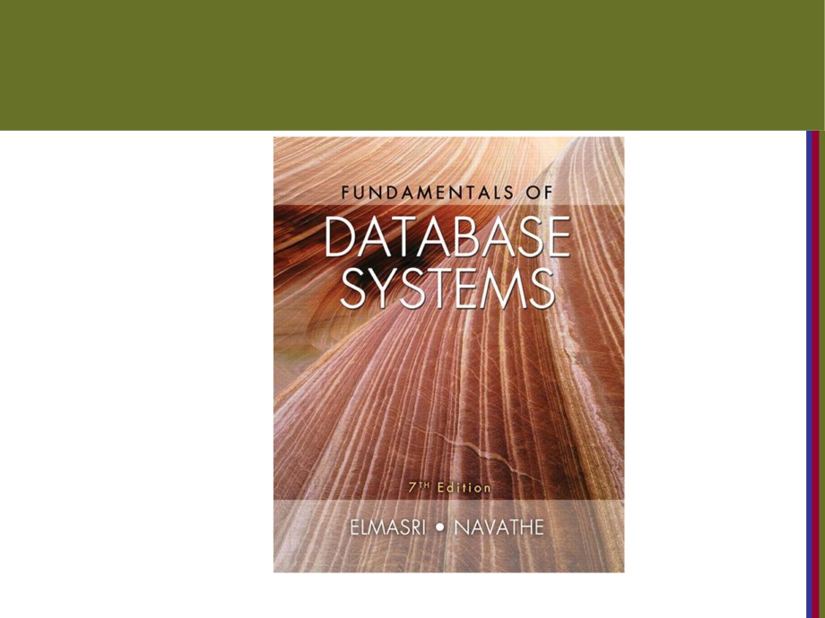
Copyright © 2016 Ramez Elmasri and Shamkant B. Navathe

Slide 2

CHAPTER 2
Database System Concepts
and Architecture
Copyright © 2016 Ramez Elmasri and Shamkant B. Navathe
Slide 1- 2

Slide 3
Outline
■ Data Models and Their Categories  History of Data Models
■ Schemas, Instances, and States  Three-Schema Architecture  Data Independence
■ DBMS Languages and Interfaces
■ Database System Utilities and Tools
■ Centralized and Client-Server Architectures  Classification of DBMSs
Copyright © 2016 Ramez Elmasri and Shamkant B. Navathe
Slide 2- 3

Slide 4
Data Models
■ Data Model:
■ A set of conceptsمفاهيم to describe the structure of a database, the operations for manipulatingمعالجه these structures, and constraintsالقيود that the database should obeyيلتزم.
■ Data Model Structure and Constraints:
■ Constructs are used to define the database structure
■ Constructs typically include elements (and their data
types) as well as groups of elements (e.g. entity, record, table), and relationships among such groups
■ Constraints specifyتحدد some restrictions on valid data; these constraints must be enforced at all times
Copyright © 2016 Ramez Elmasri and Shamkant B. Navathe
Slide 2- 4

Slide 5
Data Models (continued)
■ Data Model Operations:
■ These operations are used for specifying database retrievals and updates by referring to the constructsبنيات of the data model.
■ Operations on the data model may include basic model operations (e.g. generic insert, delete, update) and user-defined operations (e.g. compute_student_gpa, update_inventory)
Copyright © 2016 Ramez Elmasri and Shamkant B. Navathe
Slide 2- 5

Slide 6
Categories of Data Models فئات
■ Conceptual (high-level, semantic) data models:هون بنعمل الداتا ع شكل ديجرام
■ Provide concepts that are close of the way many users perceive data.بقدم مفاهيم قريبه من الطريقه التي ينظر بها المستخدمين للداتا
■
(Also called entity-based or object-based data models.)
■ Physical (low-level, internal) data models:يعني التفاصيل
■ Provide concepts that describe details of how data is stored in the computer. These are usually specified
through DBMS design and administration manuals  Implementation (representational) data models:هاد بين الثنتين
■ Provide concepts that fall between the above two, used by many commercial DBMS implementations (e.g. relational
data models used in many commercial systems).  Self-Describing Data Models:هاد ف الداتا الي ما فيها ستركتشر
■ Combine the description of data with the data values.
Examples include XML, key-value stores and some NOSQL
systems.
Copyright © 2016 Ramez Elmasri and Shamkant B. Navathe
Slide 2- 6

Slide 7
Schemasسكيماز versus Instances
■ Database Schema:الي هي الجدول وشو مكوناته
■ The description of a database.
■ Includes descriptions of the database structure, data types, and the constraints on the database.
■ Schema Diagram:
■ An السترتيفillustrativeعرض توضيحي display of a database schema.
Copyright © 2016 Ramez Elmasri and Shamkant B. Navathe
Slide 2- 7

Slide 8
Schemas versus Instances
■ Database State:هي نفسها الانستانس ويعني هون التفاصيل الي جوا الاسكيما
■ The actual data stored in a database at a
particular moment in time. This includes the collection of all the data in the database.
■ Also called database instance (or occurrence or snapshot).
■ The term instance is also applied to individual
database components, e.g. record instance, table instance, entity instance
Copyright © 2016 Ramez Elmasri and Shamkant B. Navathe
Slide 2- 8

Slide 9
Database Schema
vs. Database State
■ Database State:
■ Refers يشير to the contentمحتوى of a database at a moment in time.
■ Initialانيشيل Database State:
■ Refers to the database state when it is initially loaded into the system.
■ Valid State:
■ A state that satisfiesتتوافق with the structure and constraints of the database.
Copyright © 2016 Ramez Elmasri and Shamkant B. Navathe
Slide 2- 9

Slide 10
Database Schema
vs. Database State (continued)
■ Distinctionكيف نميز بينها
■ The database schema changes very infrequentlyنادرا.  The database state changes every time the database is updated.
يعني الاكثر تغير الستيت لانو لو عنا جدول طلاب كل يوم تقريبا رح تعدل عليه وشيف طلاب بينما مش كل يوم رح تغير الجدول وخصائصه
Copyright © 2016 Ramez Elmasri and Shamkant B. Navathe
Slide 2- 10

Slide 11
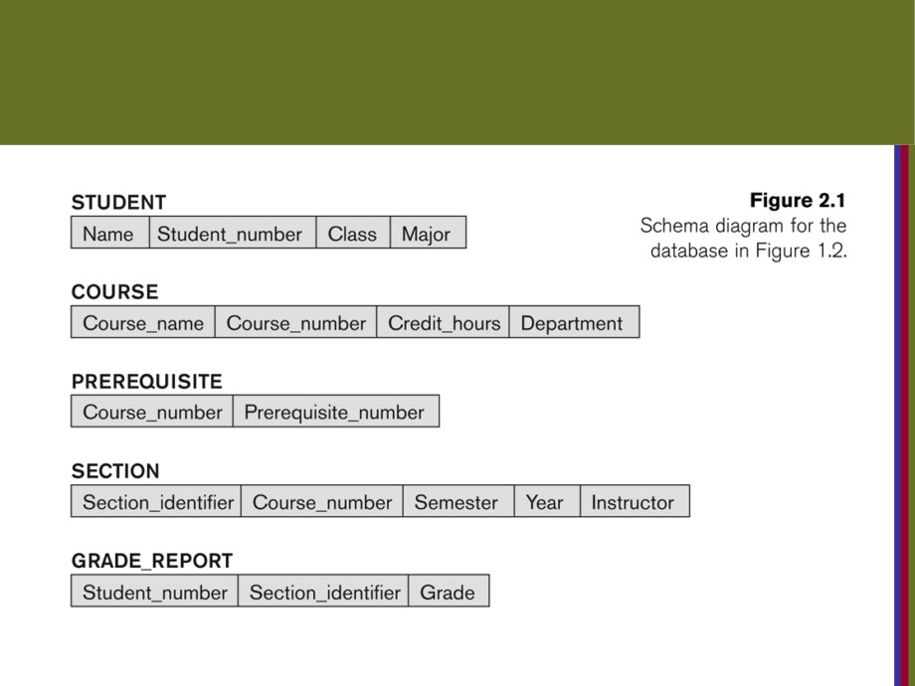
Example of a Database Schema
Copyright © 2016 Ramez Elmasri and Shamkant B. Navathe
Slide 2- 11

Slide 12
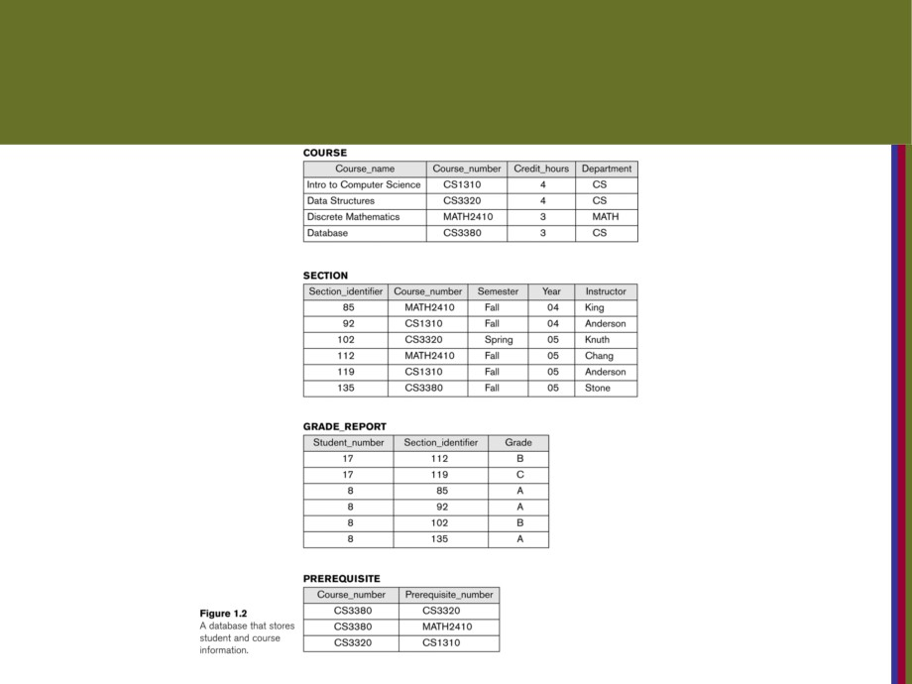
Example of a database state
Copyright © 2016 Ramez Elmasri and Shamkant B. Navathe
Slide 2- 12

Slide 13
Three-Schema Architecture
■ Proposed to support DBMS characteristics of:مقترح لدعم خصائص الداتا بيس
■ Program-data independence.
■ Support of multiple views of the data.
■ Not used in commercial DBMS products, but has been useful in explainingشرح database system organization
Copyright © 2016 Ramez Elmasri and Shamkant B. Navathe
Slide 2- 13

Slide 14
Three-Schema Architecture
■ Defines DBMS schemas at three levels:
■ Internal schema at the internal level to describe physical storage structures and access paths (e.g indexes).
■ Typically uses a physical data model.
■ Conceptual schema at the conceptual level to describe the structure and constraints for the whole database for a
community of users.
■ Uses a conceptual or an implementation data model.  External schemas at the external level to describe the various user views.يعني الفيو الي عندم مش زي الي عند فئه ثانيه
■ Usually uses the same data model as the conceptual schema.
Copyright © 2016 Ramez Elmasri and Shamkant B. Navathe
Slide 2- 14

Slide 15
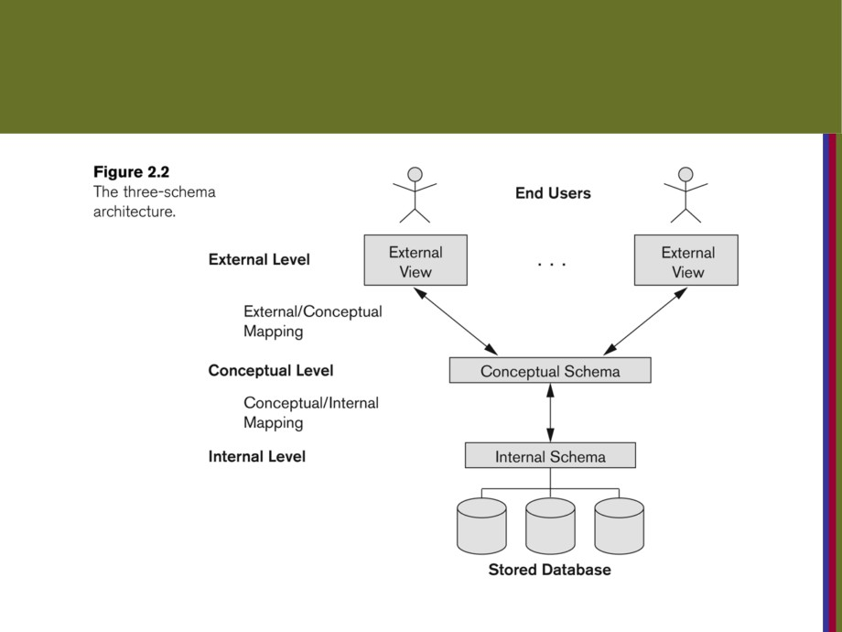
The three-schema architecture
Copyright © 2016 Ramez Elmasri and Shamkant B. Navathe
Slide 2- 15

Slide 16
Three-Schema Architecture
■ Mappingsاتطلع ع الشريحه يلي قبل هاي among schema levels are needed to transform requests and data.
■ Programs refer to an external schema, and are mapped by the DBMS to the internal schema for
execution.
■ Data extracted from the internal DBMS level is
reformatted to match the user’s external view (e.g. formatting the results of an SQL query for display
in a Web page)
Copyright © 2016 Ramez Elmasri and Shamkant B. Navathe
Slide 2- 16

Slide 17
Data Independence
■ Logical Data Independence:
■ The capacityالقدرة to change the conceptual schema without having to change the external schemas and their associatedمرتبطه application programs. يعني بنقدر نضيف ونوسع الداتا بدون ما ناثر ع الفيو بس مش ممكن احذف من الكونسبشال اشي لانو ح ياثر على الاكستيرنال
■ Physical Data Independence:
■ The capacity to change the internal schema
without having to change the conceptual schema.  For example, the internal schema may be changed when certain file structures are reorganizedيعني تحول البيانات من باينري تري لباينري تري بلس or new
indexes are created to improve database performanceالفهرس يستخدم لزيادة اداء الداتا بيس
Copyright © 2016 Ramez Elmasri and Shamkant B. Navathe
Slide 2- 17

Slide 18
DBMS Languages
■ Data Definition Language (DDL)مثل خلق جدول
■ Data Manipulation Language (DML)الابديت والانسيرت والدليت
■ High-Level or Non-proceduralبرسيجوال Languages: These include the relational language SQL
■ May be used in a standalone way or may be embeddedمضمن in a programming language
■ Low Level or Procedural Languages:
■ These must be embedded in a programming language
Copyright © 2016 Ramez Elmasri and Shamkant B. Navathe
Slide 2- 19

Slide 19
DBMS Languages
■ Data Definition Language (DDL):
■ Used by the DBAهاد بعمل كريت لاندكس and database designers to specify the conceptual schema of a database.
■ In many DBMSs, the DDL is also used to define internal and external schemas (views).
■
Copyright © 2016 Ramez Elmasri and Shamkant B. Navathe
Slide 2- 20

Slide 20
DBMS Languages
■ Data Manipulation Language (DML):
■ Used to specify database retrievals and updates  DML commands (data sublanguage) can be embedded in a general-purpose programming language (host language), such as COBOL, C,
C++, or Java.
■ A library of functions can also be provided to access the DBMS from a programming language
, stand-alone DML commands can be applied directly (called a query language).
Copyright © 2016 Ramez Elmasri and Shamkant B. Navathe
Slide 2- 21

Slide 21
Types of DML
■ High Level or Non-procedural Language:
■ For example, the SQL relational language
■ the sql Are orientedتوجيهها and specify what data to retrieve rather than how to retrieve يعني بنفذ مباشرة كيف مكان مش ع شكل متتاليه
■ Also called declarative languages.
■ Low Level or Procedural Language:
■ Retrieve data one record-at-a-time;بنفذ سطر سطر
■ Constructs such as looping are needed to retrieve multiple records, along with pointers.
Copyright © 2016 Ramez Elmasri and Shamkant B. Navathe
Slide 2- 22

Slide 22
DBMS Interfaces
■ Stand-alone query language interfaces
■ Example: Entering SQL queries at the DBMS interactive SQL interface (e.g. SQL*Plus in ORACLE)
■ Programmer interfaces for embedding DML in programming languages
■ User-friendly interfaces
■ Menu-based, forms-based, graphics-based, etc.  Mobile Interfaces:interfaces allowing users to perform transactions using mobile apps
Copyright © 2016 Ramez Elmasri and Shamkant B. Navathe
Slide 2- 23

Slide 23
DBMS Programming Language Interfaces
■ Programmer interfaces for embedding DML in a programming languages:
■ Embedded Approach: e.g embedded SQL (for C, C++, etc.), SQLJ (for Java)هاد ستاتيك فش فيه ايروربتكون قليله من الي تحت
■ Procedure Call Approach: e.g. JDBC for Java, ODBC (Open
Databse Connectivity) for other programming languages as API’s
(application programming interfaces)هون داينمك وبكون فيه اخطاء
■ Database Programming Language Approach: e.g. ORACLE has PL/SQL, a programming language based on SQL; language incorporates SQL and its data types as integral components
■ Scripting Languages: PHP (client-side scripting) and Python (server-side scripting) are used to write database programs.
Copyright © 2016 Ramez Elmasri and Shamkant B. Navathe
Slide 2- 24

Slide 24
User-Friendly DBMS Interfaces
■ Menu-based (Web-based): popular for browsing on the web
■ Forms-based: designed for naïve users used to filling in entries on a form
■ Graphics-based
■ Point and Click, Drag and Drop, etc.
■ Specifying a query on a schema diagram
■ Natural language: requests in written English  Combinations of the above:
■ For example, both menus and forms used
in Web database interfaces
Copyright © 2016 Ramez Elmasri and Shamkant B. Navathe
Slide 2- 25

Slide 25
Other DBMS Interfaces
■ Natural language: free text as a query
■ Speech : Input query and Output response  Web Browser with keyword search  Parametric interfaces, e.g., bank tellers using function keys.
■ Interfaces for the DBA:هاد غاليا بشتغل ع الشاشه السودا
■ Creating user accounts, granting authorizations  Setting system parameters
■ Changing schemas or access paths
Copyright © 2016 Ramez Elmasri and Shamkant B. Navathe
Slide 2- 26

Slide 26
Database System Utilitiesقدرات الداتا بيس شو بتسمحلي اسوي
■ To perform certain functions such as:
■ Loading data stored in files into a database. Includes data conversion tools.
■ Backing up the database periodicallyبشكل دروي on tape.  Reorganizing database file structures.  Performance monitoring utilities.بشوف الداتا سريعه او لا  Report generation utilities.
■ Other functions, such as sorting, user monitoring, data compression, etc.
Copyright © 2016 Ramez Elmasri and Shamkant B. Navathe
Slide 2- 27

Slide 27
Other Tools
■ Data dictionary / repository:
■ Used to store schema descriptions and other
information such as design decisions, application program descriptions, user information, usage
standards, etc.
■ Active data dictionary is accessed by DBMS software and users/DBA.الدزاينر هو الي بستخدمه
■ Passive data dictionary is accessed by users/DBA only.هاد يستخدم مشان اطول معلومات من داتا بيز موجودة ع داتا بيز ثانيه
Copyright © 2016 Ramez Elmasri and Shamkant B. Navathe
Slide 2- 28

Slide 28
Other Tools
■ Application Development Environments and CASE (computer-aided software engineering) tools:
■ Examples:
■ PowerBuilder يستعمل في (Sybase)  JBuilder (Borland)
■ JDeveloper 10G (Oracle)
Copyright © 2016 Ramez Elmasri and Shamkant B. Navathe
Slide 2- 29

Slide 29
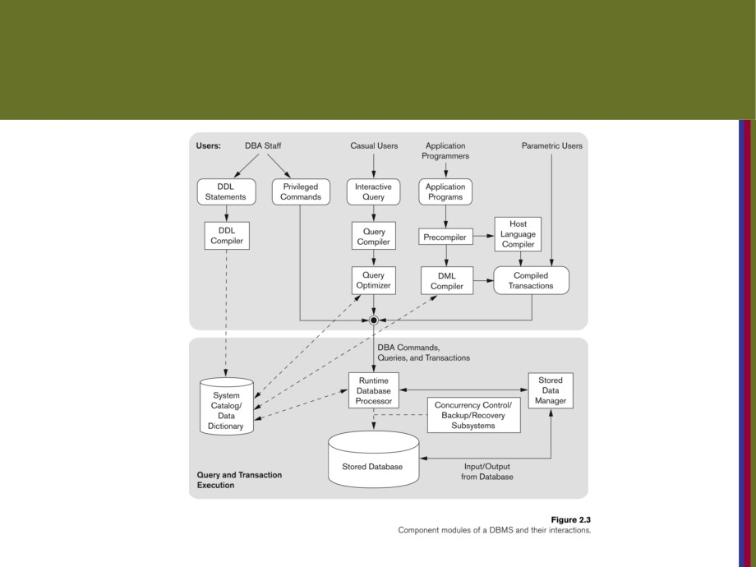
Typical DBMS Component Modules{سمه مهمه جدا
Copyright © 2016 Ramez Elmasri and Shamkant B. Navathe
Slide 2- 30

Slide 30
ملاحظات ع الرسمه:
Privileged commands هاي بس الي بعملها ال داتا بيس ادمن ستريتر
الا هن الصلاحيات الي بعطيها الداتا ادمن زي يخلق حساب للمستخدمين وكلمه سر والفيوز وهيك
Caucal user الي هو احنا المستخدمين العاديين
qureu compiler وهاد يعني انو بعمل تست للامر الي كتبنها هل فيه اخطاء املائيه هل فيه كلمات محجوز وزي هيك
Qureu optimaize هاد الو دور كبير لما مثلا دشوف كثير جداول فهاد بساعد على سرعه واداء البرنامج
ف الابلكيشن برجرام ف عمليه بري كومبايليشن وهاي وظيفتها تفصل اوامر الجافا مثلا عن اوامر الاس كيو ال وتحت هاد المربع بتم عمليه كمبايلنغ لاوامر الاس كيو وقبالها كمبايل اوامر الجافا وبعديها يتم دمجهن ثم ع الكمبايل ترانز اكشن يعني يتم تفيذها كلها مرة وحدة
الرن تايم داتا بيس برسسر هوالي بنفذ االاوامر بس هاد بقدرش يروح يتعامل مع الهاردسك الي تحته ففيعنده جزء الي هو ستورد داتا منجر هو بتعمال مع الاوبريتنغ سستم وبعطي التعليمات للتخزين
مربع الباك اب والسب سستم هاد بكون جوا الرن تايم

Slide 31
Centralized and
Client-Server DBMS Architectures
■ Centralized DBMS:هاد يعني انو انا بكون عندي التحكم وبصدر امر هاد الامر بروح لمنطقه ثانيه ع سيرفرات اقوى من الي عندي واحسن سوفتوير وبتنفذ هناك وبرجعلي الجواب بعد فترة
■ Combinesيجمع everything into single system including- DBMS software, hardware, application programs, and user interface processing software.
■ User can still connect through a remote terminalمحطه طرفيه - but , all processing is done at centralized site.
Copyright © 2016 Ramez Elmasri and Shamkant B. Navathe
Slide 2- 31

Slide 32
Basic 2-tier Client-Server Architecturesهس في جهازين كلينت وسيرفر
■ Specialized Servers with Specialized functions
■ Print server
■ File server
■ DBMS server  Web server  Email server
■ Clients can access the specialized servers as needed
Copyright © 2016 Ramez Elmasri and Shamkant B. Navathe
Slide 2- 33

Slide 33
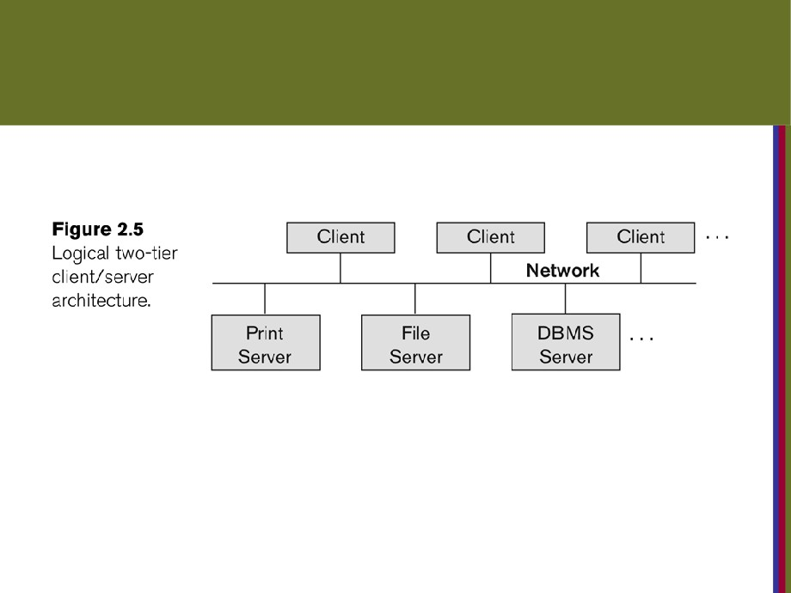
Logical two-tier client server architecture
Copyright © 2016 Ramez Elmasri and Shamkant B. Navathe
Slide 2- 34

Slide 34
Clients
■ Provide suitable interfaces through a client
software module to access and يوتالايزutilizeيستخددم the various server resources.
■ Clients may be diskless يعني جهاز الكلينت بددون هاردسك machines or PCs or Workstations with disks with only the client
software installed.
■ Connected to the servers via some form of a network.
■ (LAN: local area network, wireless network, etc.)
Copyright © 2016 Ramez Elmasri and Shamkant B. Navathe
Slide 2- 35

Slide 35
DBMS Server
■ Provides database query and transaction services to the clients
■ Relational DBMS servers are often called SQL servers, query servers, or transaction servers
■ Applications running on clients utilize an Application
Program Interface (API) to access server databases via standard interface such as:
■ ODBC: Open Database Connectivity standardمشان يشبك الكلينت ع الداتا بيس  JDBC: for Java programming accessهون الجافا تشبك ع الداتا
Copyright © 2016 Ramez Elmasri and Shamkant B. Navathe
Slide 2- 36

Slide 36
Three Tier Client-Server Architecture
■ Common for Web applications
■ Intermediate Layerالطبقه المتوسطه called Application Server or Web Server:
■ Stores the web connectivity software and the business logic part of the application used to access the opposite المقابله data from the database server
■ work like a tubeingقناه for sending partially processed data between the database server and the client.
■ Three-tier Architecture Can Enhanceتحسين Security:
■ Database server only accessible via middle tierالطبقه
■ Clients cannot directly access database server
■ Clients contain user interfaces and Web browsers
■ The client is usually a PC or a mobile device connected to the Web
Copyright © 2016 Ramez Elmasri and Shamkant B. Navathe
Slide 2- 38

Slide 37
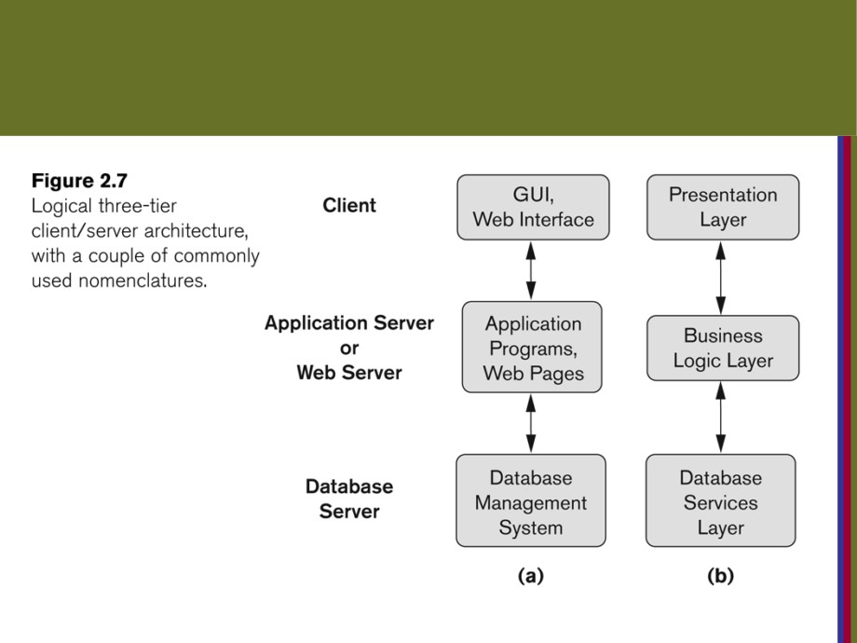
Three-tier client-server architecture
Copyright © 2016 Ramez Elmasri and Shamkant B. Navathe
Slide 2- 39

Slide 38
البرزنتيشن لير زي صفحه مثلا ع الفيس فيها فورم بتعبيه ومرات بيجيك حقول اجباري تعبيها فلما تخلص الفورم وتحط انتر مرات بيجيك انك مش معبي كل الحقول والمسؤل عن هاد الاشي الي هو البزنس لوجك لير فهو الي بفحص قبل لا يودي للداتا بيس فهاد بخفف الضغط ع الداتا بيس

Slide 39
Classification of DBMSs
■ Based on the data model used
■ Legacy: Network, Hierarchical.
■ Currently Used: Relational, Object-orientedلما اجا ما اكتسح الرليشنل, Object- relationalهاد زي الاوراكل
■ Recent Technologies: Key-value storage systems, NOSQL systems: document based, column-based,
graph-based and key-value based. Native XML DBMSs.
الصفحه مش مهمه كثير
2016 Ramez Elmasri and Shamkant B. Navathe
Slide 2- 40

Slide 40
Cost considerations for DBMSs
■ Cost Range: from free open-source systems to configurations costing millions of dollars
■ Examples of free relational DBMSs: MySQL, PostgreSQL, others
■ Commercial DBMS offer additional specialized modules, e.g. time-series module, spatial data module, document
module, XML module
■ These offer additional specialized functionality when purchased separately
■ Sometimes called cartridges (e.g., in Oracleبمصاري) or blades
■ Different licensing options: site license, maximum number of concurrent users (seat license), single user, etc.
Copyright © 2016 Ramez Elmasri and Shamkant B. Navathe
Slide 2- 42

Slide 41
History of Data Models
■ Relational Model:
■ Proposed in 1970 by E.F. Codd (IBM), first commercial system in 1981-82.
■ Now in several commercial products (e.g. DB2, ORACLE, MS SQL Server, SYBASE, INFORMIX).
■ Several free open source implementations, e.g. MySQL, PostgreSQL
■ Currently most dominant for developing database applications.
■ SQL relational standards: SQL-89 (SQL1), SQL-92 (SQL2), SQL-99, SQL3, …
■ Chapters 5 through 11 describe this model in detail
Copyright © 2016 Ramez Elmasri and Shamkant B. Navathe
Slide 2- 50

Slide 42
History of Data Models
■ Object-oriented Data Models:
■ Several models have been proposed for implementing in a database system.
■ One set comprises models of persistent O-O Programming Languages such as C++ (e.g., in OBJECTSTORE or
VERSANT), and Smalltalk (e.g., in GEMSTONE).
■ Additionally, systems like O2, ORION (at MCC - then ITASCA), IRIS (at H.P.- used in Open OODB).
■ Object Database Standard: ODMG-93, ODMG-version 2.0, ODMG-version 3.0.
■ Chapter 12 describes this model.
Copyright © 2016 Ramez Elmasri and Shamkant B. Navathe
Slide 2- 51

Slide 43
History of Data Models
■ Object-Relational Models:
■ The trend to mix object models with relational was started with Informix Universal Server.
■ Relational systems incorporated concepts from object databases leading to object-relational.
■ Exemplified in the versions of Oracle, DB2, and SQL Server and other DBMSs.
■ Current trend by Relational DBMS vendors is to
extend relational DBMSs with capability to process XML, Text and other data types.
■ The term “Object-relational” is receding in the
marketplace.
Copyright © 2016 Ramez Elmasri and Shamkant B. Navathe
Slide 2- 52

Slide 44
Chapter Summary
■ Data Models and Their Categories  Schemas, Instances, and States  Three-Schema Architecture  Data Independence
■ DBMS Languages and Interfaces
■ Database System Utilities and Tools  Database System Environment
■ Centralized and Client-Server Architectures  Classification of DBMSs
■ History of Data Models
Copyright © 2016 Ramez Elmasri and Shamkant B. Navathe
Slide 2- 53

