Slide 1
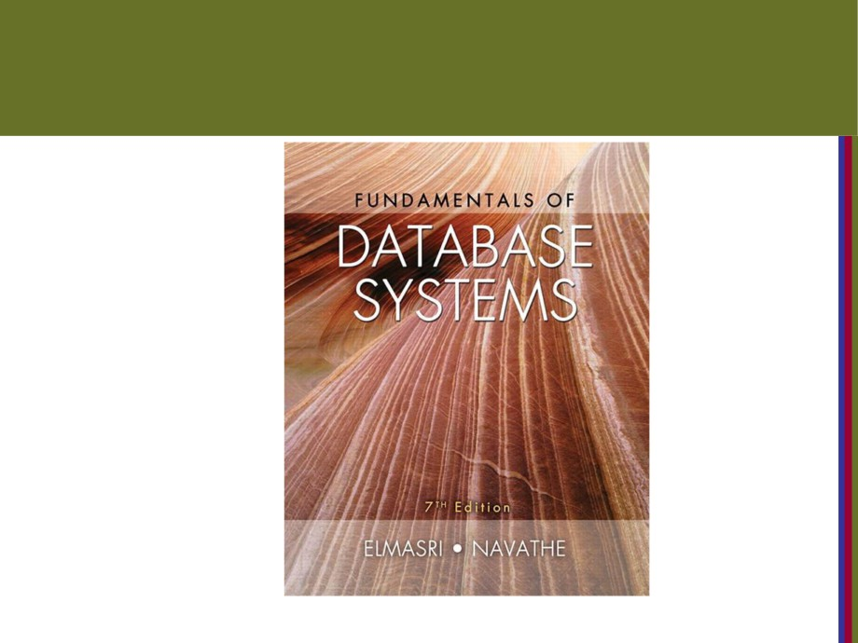
Copyright © 2016 Ramez Elmasri and Shamkant B. Navathe

Slide 2

CHAPTER 5
The Relational Data Model and
Relational Database Constraints
Copyright © 2016 Ramez Elmasri and Shamkant B. Navathe
Slide 1- 2

Slide 3
Chapter Outline
■ Relational Model Concepts
■ Relational Model Constraints and Relational Database Schemas
■ Update Operations and Dealing with Constraint Violations
Copyright © 2016 Ramez Elmasri and Shamkant B. Navathe
Slide 5- 3

Slide 4
Informal Definitions
■ Informally, a relation looks like a table of values.
■ A relation typically contains a set of rowsصف.
■ The data elements in each row represent entity مثل ستودنت اومعدلor relationshipالجدول الي السطر الي فيه ما بوصفه بل بوصف شغلات بجداول ثانيه
الاسم العلمي الفورمال مود, rows are called tuples
■ Each column has a column header that gives an indicationدلاله of the meaning of the data items in that column
■ In the formal model, the column header is called an attribute
Copyright © 2016 Ramez Elmasri and Shamkant B. Navathe
Slide 5- 6

Slide 5
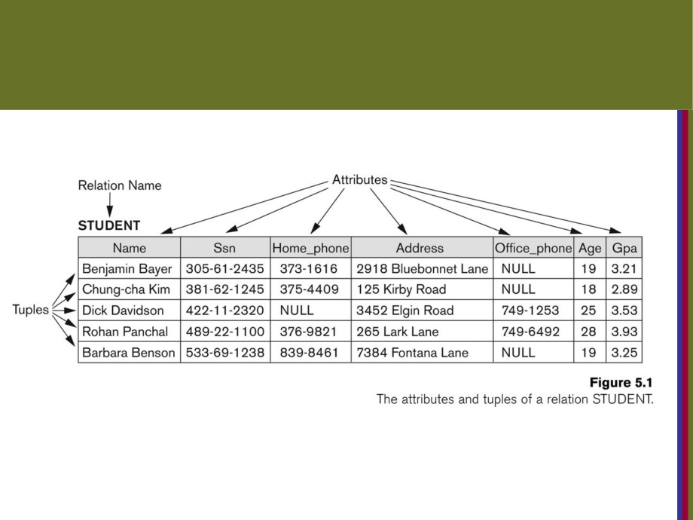
Example of a Relation
Copyright © 2016 Ramez Elmasri and Shamkant B. Navathe
Slide 5- 7

Slide 6
Informal Definitions
■ Key of a Relation:
■ Each row has a value of a data item (or set of items) that identifies that row in the tableزي الاس اس ان
■ Called the key
■ In the STUDENT table, SSN is the keyبكون الاساسان الومعناه ف الجدول
■ Sometimes row-ids or sequential numbers are assigned as keys to identify the rows in a table
■ Called artificialمصطنع key or surrogate keyبس هون لو عملنا عمود كل ستيودنت الو رقم من 0ل1 مرتبات هاد بنقدر نعتبر باريمري كي بس ما الوش معنى
Copyright © 2016 Ramez Elmasri and Shamkant B. Navathe
Slide 5- 8

Slide 7
Formal Definitions - Schema
■ The Schema (or description) of a Relation:كل رليشن الو سكيما
■ Denotedيرمزلها by R(A1, A2,
An)
■ R is the name of the relation
■ The attributes of the relation are A1, A2, ..., An  Example:
CUSTOMER (Cust-id, Cust-name, Address, Phone#)
■ CUSTOMER is the relation name
■ Defined over the four attributes: Cust-id, Cust-name, Address, Phone#
■ Each attribute has a domain or a set of valid values.
■ For example, the domain of Cust-id is 6 digit numbers.يعني لو عملنا عمود هويات لازم يحتوي على عدد ثابت من لارقام
Copyright © 2016 Ramez Elmasri and Shamkant B. Navathe
Slide 5- 9

Slide 8
Formal Definitions - Tuple
■ A tuple is an ordered setمجموعه مرتبه of values (enclosed in angled brackets ‘< … >’)
■ Each value is derivedمشتقه from an suitable domain.
■ A row in the CUSTOMER relation is a 4-tuple and would consist of four values, for example:
■
<632895, "John Smith", "101 Main St. Atlanta, GA 30332", "(404) 894-2000">
■ This is called a 4-tuple as it has 4 values  A tuple (row) in the CUSTOMER relation.  A relation is a set of tuples (rows)
Copyright © 2016 Ramez Elmasri and Shamkant B. Navathe
Slide 5- 10

Slide 9
Formal Definitions - Domain
■ A domain has a logical definition:
■ Example: “USA_phone_numbers” are the set of 10 digit phone numbers valid in the U.S.
■ A domain also has a data-type or a format defined for it.
■ The USA_phone_numbers may have a format: (ddd)ddd-dddd where each d is a decimal digit.
■ Dates have various formats such as year, month, date formatted as yyyy-mm-dd, or as dd mm,yyyy etc.
■ The attribute name designatesيحدد the role played by a domain in a relation: المثال الي تحت بوضح (اسم العمود هو الي بحدد شو الدور يلي بدو يلعبه الدومين جوا الجدول
■ Used to explain the meaning of the data elements correspondingالمقابله to that attribute
■ Example: The domain Date may be used to define two attributes named “Invoice-date” and “Payment-date” with different meanings
Copyright © 2016 Ramez Elmasri and Shamkant B. Navathe
Slide 5- 11

Slide 10
Formal Definitions - State
■ each domain contains the set of all possible values the attribute can take.
■ Example: attribute Cust-name is defined over the domain of character strings of maximum length 25
■ dom(Cust-name) is varchar(25)
.
Copyright © 2016 Ramez Elmasri and Shamkant B. Navathe
Slide 5- 12

Slide 11
Formal Definitions - Summary
,
■ R(A1, A2, …, An) is the schema of the relation  R is the name of the relation
■ A1, A2, …, An are the attributes of the relation
■ r(R): a specific state (or "value" or “population”) of relation R - this is a set of tuples (rows)
■ r(R) = {t1, t2, …, tn} where each ti is an n-tuple
■ ti = <v1, v2, …, vn> where each vj element-of dom(Aj)
Copyright © 2016 Ramez Elmasri and Shamkant B. Navathe
Slide 5- 13

Slide 12
Formal Definitions - Example
■ Let R(A1, A2) be a relation schema:
■ Let dom(A1) = {0,1}
■ Let dom(A2) = {a,b,c}
■ Then: dom(A1) X dom(A2) is all possible combinations:
{<0,a> , <0,b> , <0,c>, <1,a>, <1,b>, <1,c> }
■ The relation state r(R) = dom(A1) X dom(A2)
■ For example: r(R) could be {<0,a> , <0,b> , <1,c> }
■ this is one possible state (or “population” or “extension”) r of the relation R, defined over A1 and A2.
■ It has three 2-tuples: <0,a> , <0,b> , <1,c>
Copyright © 2016 Ramez Elmasri and Shamkant B. Navathe
Slide 5- 14

Slide 13

Definition Summary
Informal Terms
Formal Terms
Table
Relation
Column Header
Attribute
All possible Column
Domain
Values
Row
Tuple
Table Definition
Schema of a Relation
Populated Table
State of the Relation
Copyright © 2016 Ramez Elmasri and Shamkant B. Navathe
Slide 5- 15

Slide 14

Example - A relation STUDENT
Copyright © 2016 Ramez Elmasri and Shamkant B. Navathe
Slide 5- 16

Slide 15
Characteristics Of Relations
■ Ordering of tuples in a relation r(R):
■ The tuples are not considered to be orderedالصفوف لا تعتبر مرتبه , even though they appear تظهرto be in the tabular formبشكل مرتب.
■ Ordering of attributes in a relation schema R (and of values within each tuple):
■ We will consider the attributes in R(A1, A2, ..., An) and the values in t=<v1, v2, ..., vn> to be ordered .
■
■ Example: t= { <name, “John” >, <SSN, 123456789> }  This representation may be called as “self-describing”.
Copyright © 2016 Ramez Elmasri and Shamkant B. Navathe
Slide 5- 17

Slide 16
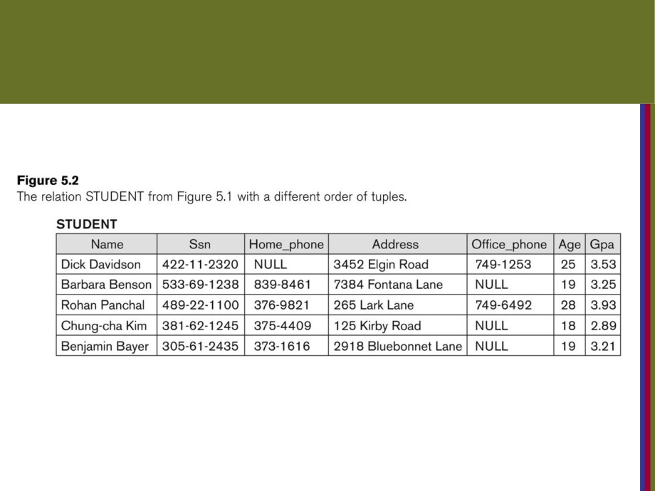
Same state as previous Figure (but with different order of tuples)
Copyright © 2016 Ramez Elmasri and Shamkant B. Navathe
Slide 5- 18

Slide 17
Characteristics Of Relations
■ Values in a tuple:
■ All values are considered atomic (indivisible).غير قابله للتجزئه
■ Each value in a tuple must be from the domain of the attribute for that column
■ If tuple t = <v1, v2, …, vn> is a tuple (row) in the relation state r of R(A1, A2, …, An)
■ Then each vi must be a value from dom(Ai)
■ A special null value is used to represent values
that are unknownقيمه غير معروفه or not availableالفيمه معروفه بس مش بحوزتنا or inapplicableزي جواز السفر لطفل صغير بكون فيه المهنه بس انه غير صالح ف هاي الخانه
In certain tuples.
Copyright © 2016 Ramez Elmasri and Shamkant B. Navathe
Slide 5- 19

Slide 18
Characteristics Of Relations
■ Notation:
■ We refer to component values of a tuple t byالقيم المكونه للصف:
■ t[Ai] or t.Ai
■ This is the value vi of attribute Ai for tuple t
■ Similarly, t[Au, Av, ..., Aw] refers to the subtuple of t containing the values of attributes Au, Av, ..., Aw, respectivelyريسبكتفلي يعني على التوالي in t
Copyright © 2016 Ramez Elmasri and Shamkant B. Navathe
Slide 5- 20

Slide 19
CONSTRAINTS
Constraints determine which values are permissible(allowed) and which are not in the database.
They are of three main types:
1. Inherent or Implicit Constraints: ألي بتطبقو تلقائيThese are based on
the data model itself. (E.g., relational model does not allow a
list as a value for any attribute)زي انو ف الجدول الاول أي مربع بس بحتوي قيمه وحدة
2. Schema-based or Explicit Constraints: They are
expressed inيتم التعبير عنها the schema by using the facilities المرافق provided by
the model. (E.g., max. cardinality ratio constraint in the ER model)
3. Application based or semantic constraints: These are beyondتتجاوز the expressive power القوه التعبيريهof the model and must be
specified and enforcedفرضها by the application programs.
Copyright © 2016 Ramez Elmasri and Shamkant B. Navathe
Slide 5- 21

Slide 20
Relational Integrity Constraintsهذول 4
■ Constraints are conditions that must hold on all valid relation states.
■ There are three main types of (explicit or schema-based )
constraints that can be expressed in the relational model:
■ Key constraints1
■ Entity integrity constraints2
■ Referential integrity constraints3
■ Another schema-based constraint is the domain constraint4 القيم المسموح فيها داخل فيلد معين
Copyright © 2016 Ramez Elmasri and Shamkant B. Navathe
Slide 5- 22

Slide 21
Key Constraints
■ Superkey of R:هو اتربيوت او عدة اتربيوت بتخلينا نفرق بين الروز جوا تيبل
يعني اذا في رو هو يعتبر كي ف هو سوبر كي واذا برضو اخذنا هاد الرو مع أي رو ثاني بنقدر نعتبرهن برضو سوبر كي
■ Is a set of attributes SKسوبر كي of R with the following condition:
■ No two tuples in any valid relation state r(R) will have the same value for SK
■ That is, for any distinct tuples t1 and t2 in r(R), t1[SK] not equal t2[SK]مثال  This condition must hold inيتمسك any valid state r(R)
■ Key of R:اقل عدد من الاتربيوتس الاعمدة يعني الذي يلزم للتفرقه بين التبلس
■ A "minimal" superkey
■ That is, a key is a superkey K such that removal of any attribute from K results in a set of attributes that is not a superkey (does not possess the superkey uniqueness property)
■ A Key is a Superkey but not vice versaلكن مش العكس
Copyright © 2016 Ramez Elmasri and Shamkant B. Navathe
Slide 5- 23

Slide 22
Key Constraints (continued)
■ Example: Consider the CAR relation schema:
■ CAR(State, Reg#هدول عن اول عمود, SerialNo, Make, Model, Year)  CAR has two keys:
■ Key1 = {State, Reg#}  Key2 = {SerialNo}
■ Both are also superkeys of CAR
■
{SerialNo, Make} is a superkey but not a key.
■ In general:
■ Any key is a superkey (but not vice versa)
■ Any set of attributes that includes a key is a superkey  A minimal superkey is also a key
Copyright © 2016 Ramez Elmasri and Shamkant B. Navathe
Slide 5- 24

Slide 23

Key Constraints (continued)
■ If a relation has several candidate keysمشان نعرف فيلد ع انه كانديديت بنعطيه صفه اليونيك, one is chosen to be the primary key.اذا في عنا جدول في اكثر من كي يعني فيه سوبر كي بنختار واحد برايمر والباقي يسمى كانديديت وهذول الثنتين بتفرعن من كلمه كي بالسلايد يلي قبل
■ The primary key attributes are underlined.
■ Example: Consider the CAR relation schema:
■ CAR(State, Reg#, SerialNo, Make, Model, Year)اتربيوت بجدول ف السلايد الجاي  We chose SerialNo as the primary key اخترنا السيريال بدالهن كلهن بالرغم من انهن يعتبرن كييز لان السيريال اقل اتربيوتس
■ The primary key value is used to uniquely بشكل فريدidentifyيحدد each tuple in a relation
■ Provides the tuple identity
■ Also used to reference the tuple from another tupleللاشارة من صف الى صف اخر
■ General rule: Choose as primary key the smallest of the candidate keys (in terms of size)
■ Not always applicable - choice is sometimes subjectiveسبجكتت يعني يمكن اني اختار أي اشي غير السيريال بس اخترنا السيريال لانه اقل واسرع ف البحث واسهل فقط
Copyright © 2016 Ramez Elmasri and Shamkant B. Navathe
Slide 5- 25

Slide 24
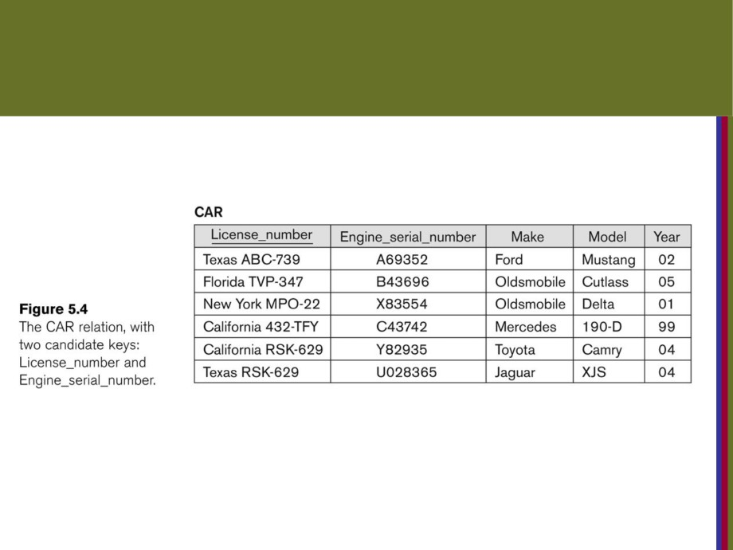
CAR table with two candidate keys -
LicenseNumber chosen as Primary Key
Copyright © 2016 Ramez Elmasri and Shamkant B. Navathe
Slide 5- 26

Slide 25
Relational Database Schemaيعني انو الجداول فقط عناوين
■ Relational Database Schema:الاسكيما بتعبر عن الستركتشر تبعت الجدول
■ A set S of relation schemas that belong to the same database.مش مفهوم
■ S is the name of the whole database schema  S = {R1, R2, ..., Rn}ار الا هي الجداول and a set IC of integrity constraints.
■ R1, R2, …, Rn are the names of the individual relation schemas within the database S
■ Following slide shows a COMPANY database schema with 6 relation schemas
Copyright © 2016 Ramez Elmasri and Shamkant B. Navathe
Slide 5- 27

Slide 26
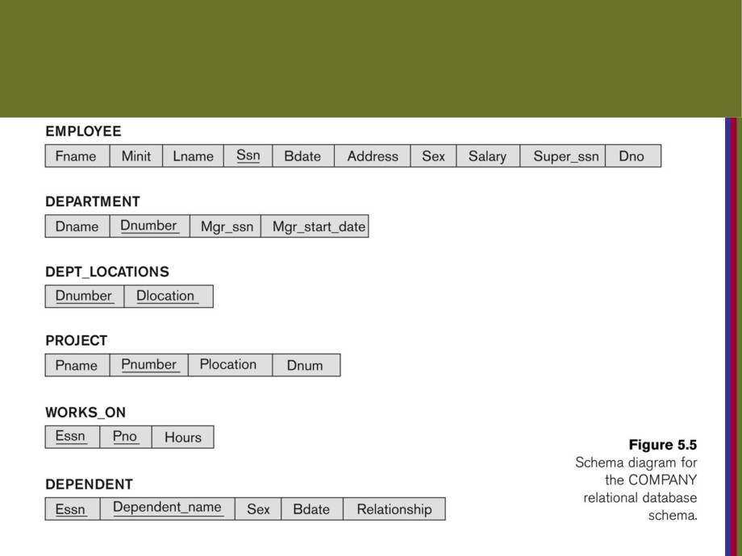
COMPANY Database Schema
Copyright © 2016 Ramez Elmasri and Shamkant B. Navathe
Slide 5- 28

Slide 27
Relational Database Stateالا هي الكرنت داتا الموجودة جوا الداتا بيس كلها
يعني انو الجداول ما تكون بس عناوين لا برضو فيها بيانات
■ A relational database state DB of S is a set of
relation states DB = {r1, r2, ..., rm} such that each ri is a state of Ri and such that the ri relation states satisfy the integrity constraints specified in IC.مش مفهموم
■ A relational database state is sometimes called a relational database snapshot or instanceاسماء ثانيه للستيت.
■ We will not use the termمصطلح instance since it also applies to single tuples.
■ A database state that does not meetلا يجمع the constraints is an invalid state
Copyright © 2016 Ramez Elmasri and Shamkant B. Navathe
Slide 5- 29

Slide 28
Populated database state
■ Each relation will have many tuples in its current relation state
■ The relational database state is a union of all the individual relation states
■ Whenever the database is changed, a new state arisesارايزس يعني تنشا  Basic operations for changing the database:
■ INSERT a new tuple in a relation
■ DELETE an existingموجود tuple from a relation  MODIFY an attribute of an existing tuple
■ Next slide (Fig. 5.6) shows an example state for the COMPANY database schema shown in Fig. 5.5.
Copyright © 2016 Ramez Elmasri and Shamkant B. Navathe
Slide 5- 30

Slide 29
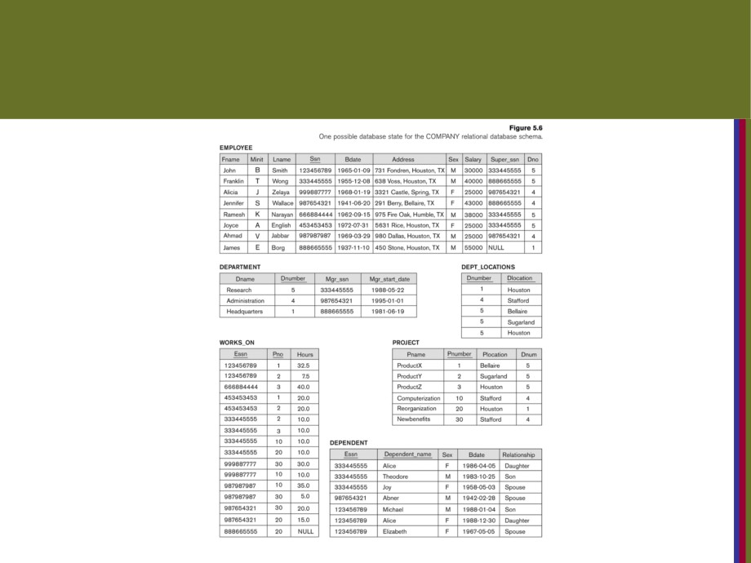
Populated database state for COMPANY
Copyright © 2016 Ramez Elmasri and Shamkant B. Navathe
Slide 5- 31

Slide 30
Entity Integrity
■ Entity Integrity:يعني انو البرايمري كي ممنوع يبكا فيه نل
■ The primary key attributes PKباريمر كي of each relation schema R in S cannot have null values in any tuple of r(R).
■ t[PK] not equal to null for any tuple t in r(R)
■ If PK has several attributes, null is not allowed in any of these attributes هاد مجرد حكي
■ Note: Other attributes of R may be constrained to disallow null values, even though they are not members of the primary key.بحكي انو بنقر نخلي عمود ما يسمح بالقيم الفاضيه حتى لو انه مش برايمر كي
Copyright © 2016 Ramez Elmasri and Shamkant B. Navathe
Slide 5- 32

Slide 31
Referential Integrity
■ A constraint involving two relations
■ The previous constraints involve a single relation.  Used to specify a relationship among tuples in two relations:
■ The referencing relation and the referenced relation.
معلومات عادي الشرح بعدها
Copyright © 2016 Ramez Elmasri and Shamkant B. Navathe
Slide 5- 33

Slide 32
Referential Integrity
■ Tuples in the referencing relation R1 have
attributes FK (called foreign key attributes) that reference the primary key attributes PK of the referenced relation R2.
■ A tuple t1 in R1 is said to reference a tuple t2 in R2 if t1[FK] = t2[PK].
■ A referential integrity constraint can be displayed in a relational database schema as a directed arc from R1.FK to R2.يعني انو بنعبر عنها ف الداتا ع شكل اقواس واشاراتت
Copyright © 2016 Ramez Elmasri and Shamkant B. Navathe
Slide 5- 34

Slide 33

Referential Integrity (or foreign key) Constraint
■ Statement of the constraint
■ The value in the foreign key column (or columns) FK of the the referencing relation R1 can be either:
■ (1) a value of an existing primary key value of a correspondingمقابله primary key in the referenced relation R2,
■ (2) a null.
■ In case (2), the FK in R1 should not be a part of its own primary key.
Copyright © 2016 Ramez Elmasri and Shamkant B. Navathe
Slide 5- 35

Slide 34
Displaying a relational database schema and its constraints
■ Each relation schema can be displayed as a row of attribute names
■ The name of the relation is written aboveفوق the attribute names
■ The primary key attribute (or attributes) will be underlined  A foreign key (referential integrity) constraints is displayed as a directed arc (arrow) from the foreign key attributes to the referenced table
■ Can also point the the primary key of the referenced relation for clarityبطيخ
■ Next slide shows the COMPANY relational schema diagram with referential integrity constraints
Copyright © 2016 Ramez Elmasri and Shamkant B. Navathe
Slide 5- 36

Slide 35
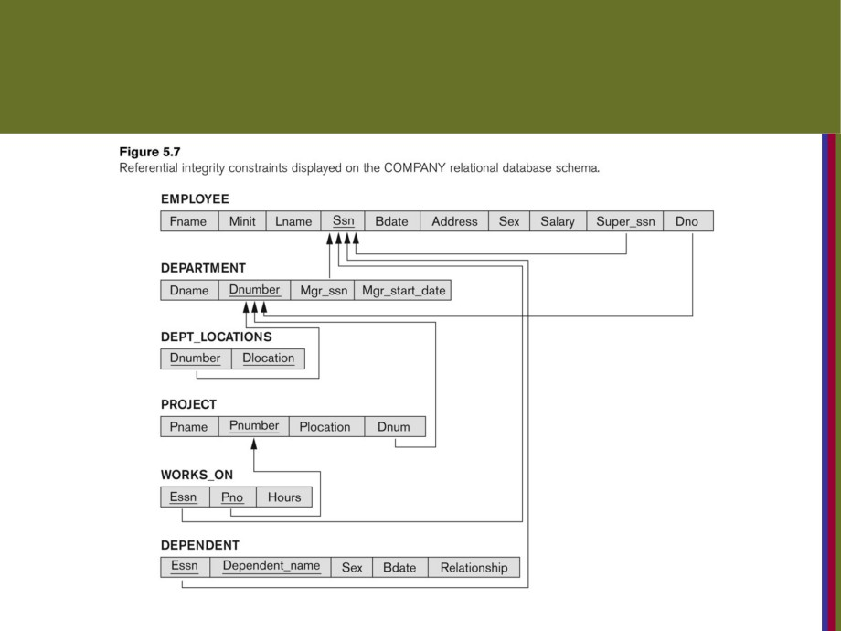
Referential Integrity Constraints for COMPANY database
Copyright © 2016 Ramez Elmasri and Shamkant B. Navathe
Slide 5- 37

Slide 36
Other Types of Constraints
■ Semantic Integrity Constraints:
■ based on application semantics and cannot be expressedالتعبير عنها by the model per se
■ Example: “the max. no. of hours per employee for all projects he or she works on is 56 hrs per week”
■ A constraint specification language may have to be used to express theseمشان نعمل المثال لازم نستخدم السبسفكيشن كونسترينس
■ SQL-99 allows CREATE TRIGGER هاد برنامج بخلينا نعمل اكثر من كنستريت على اكثر من فيلد بنفس الوقتand CREATE ASSERTION to express some of these semantic constraints
■ Keys, Permissibility of Null values, Candidate Keys
(Unique in SQL), Foreign Keys, Referential Integrity etc.
are expressed by the CREATE TABLE statement in SQL.قصدو انو كل هذول الشغلات بنحددهن لما بنكون نخلق التيبل
Copyright © 2016 Ramez Elmasri and Shamkant B. Navathe
Slide 5- 38

Slide 37
Update Operations on Relations
■ INSERT a tuple.
■ DELETE a tuple.  MODIFY a tuple.
■ Integrity constraints should not be violatedانتهكت by the update operations.
■ Several update operations may have to be grouped together.
■ Updates may propagate نشرto causeاحداث other updates automatically. This may be necessary to maintain
integrity constraints.
Copyright © 2016 Ramez Elmasri and Shamkant B. Navathe
Slide 5- 39

Slide 38
Update Operations on Relations
■ In case of integrity violation, several actions can be taken:
■ Cancel the operation that causes the violation (RESTRICT or REJECT option)
■ Perform the operation but inform the user of the violation
■ Triggerتشغيل additional updates so the violation is
corrected (CASCADEكاسكيد تتالي option, SET NULL option)  Execute a user-specified error-correction routineتنفيذ روتين المستخدم لتصيحي الخطا
Copyright © 2016 Ramez Elmasri and Shamkant B. Navathe
Slide 5- 40

Slide 39
Possible violations for each operation
■ INSERT may violate any of the constraints:اذا عملنا انسرت رح ناثر على هدول
■ Domain constraint:يعني ان ادخلنا علامه مش ضمن النطاق
■ if one of the attribute values provided for the new tuple is not of the specified attribute domain
■ Key constraint: دخلنا رقم متشابه
■ if the value of a key attribute in the new tuple already exists in another tuple in the relation
■ Referential integrity:اذا ادخلنا فورن كي مش موجود ف البرايمر كي
■ if a foreign key value in the new tuple references a primary key value that does not exist in the referenced relation
■ Entity integrity:
■ if the primary key value is null in the new tuple
Copyright © 2016 Ramez Elmasri and Shamkant B. Navathe
Slide 5- 41

Slide 40
Possible violations for each operation
■ DELETE may violate only referential integrity:
■ If the primary key value of the tuple being deleted is referenced from other tuples in the database
■ Can be remedied اصلاحهby several actions: RESTRICT, CASCADE, SET NULL (see Chapter 6 for more details)
■ RESTRICT option: reject the deletion
■ CASCADE option: propagate the new primary key value into the foreign keys of the referencing tuples
■ SET NULL option: set the foreign keys of the referencing tuples to NULL
■ One of the above options must be specified during database design for each foreign key constraint
Copyright © 2016 Ramez Elmasri and Shamkant B. Navathe
Slide 5- 42

Slide 41
Possible violations for each operation
■ UPDATE may violate domain constraint and NOT NULL constraint on an attribute being modified
■ Any of the other constraints may also be violated, depending on the attribute being updated:
■ Updating the primary key (PK):
■ Similar to a DELETE followed by an INSERT  Need to specify similar options to DELETE  Updating a foreign key (FK):
■ May violate referential integrity
■ Updating an ordinary attribute (neither PK nor FK):
■ Can only violate domain constraints
Copyright © 2016 Ramez Elmasri and Shamkant B. Navathe
Slide 5- 43

Slide 42
Summary
■ Presented Relational Model Concepts
■ Definitions
■ Characteristics of relations
■ Discussed Relational Model Constraints and Relational Database Schemas
■ Domain constraints  Key constraints  Entity integrity  Referential integrity
■ Described the Relational Update Operations and Dealing with Constraint Violations
Copyright © 2016 Ramez Elmasri and Shamkant B. Navathe
Slide 5- 44

Slide 43

In-Class Exercise
(Taken from Exercise 5.15)
Consider the following relations for a database that keeps track of student
enrollment in courses and the books adopted for each course:
STUDENT(SSN, Name, Major, Bdate) ssnبرايمر كي
COURSE(Course#, Cname, Dept)الكورس برايمر
ENROLLيسجل(SSN, Course#, Quarter, Grade) الاس اس ان فورن كي للستيودنت و الكورس فورن كي للكورس ف الكورس بما انا ربطنا هاد الجدول فورن كي مع الي فوقه بزبطش اربطه فورن مع جدول ثاني هس هون الثلثاث هدول مع بض يعتبرن برايمركي لانو مستحيل الطالي ينزل كورس نفس الكورس مرتين
BOOK_ADOPTIONاسم كتاب(Course#, Quarter, Book_ISBN)الكورس فورن كي في كورس الي ف كورس بزبطش احكي فورن كي للكورس الي ف ان رول لانو ان رول و البوك ما الهن علاقه او بيانات مترابطه مع بعض غير الاسم هس البوك اس بي ان فورن كي باشر ع البوك اس بي ان الي ف التست و الكوارتر TEXT(Book_ISBN, Book_Title, Publisher, Author) الي تحتو خط برايمر كي
Draw a relational schema diagram specifying the foreign keys for this schema.
الكوارتر ما بزبطو يكون برايمر كي لانهم بتكررو ف عشان هيك برضو ما بعتبرهم فورن كي لبعض لانو فش ولا واحد فيهم برايمركي لانو في احتمال الكوارتر ف احد الجداول يكون مكرر
Copyright © 2016 Ramez Elmasri and Shamkant B. Navathe
Slide 5- 45

Slide 44
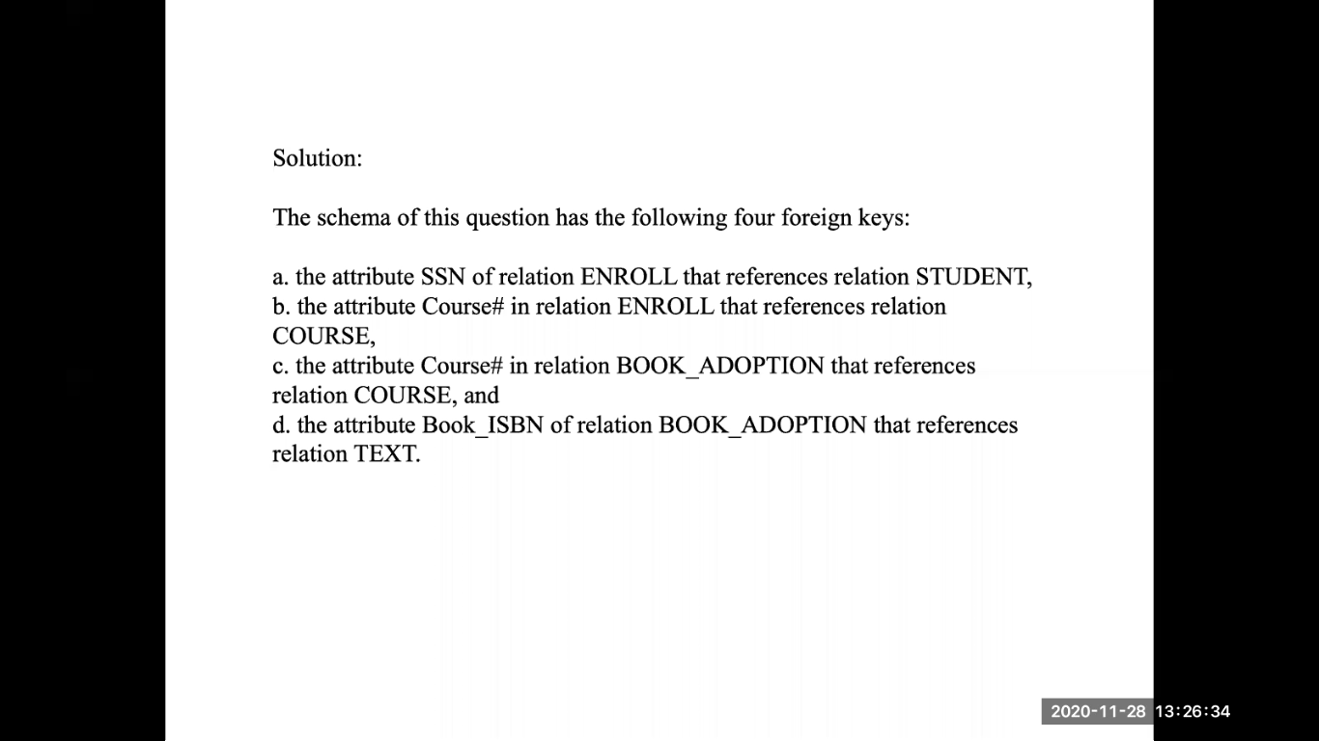

Slide 45
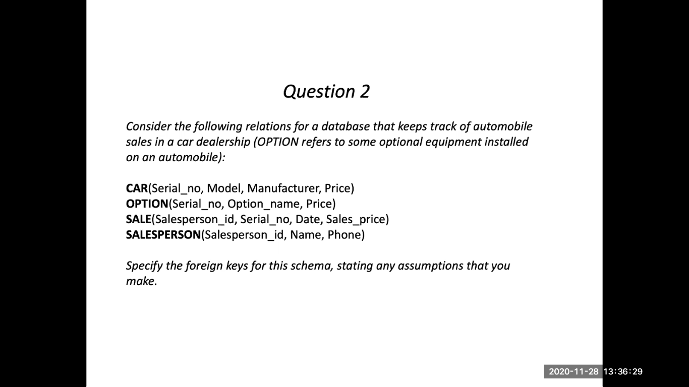

Slide 46
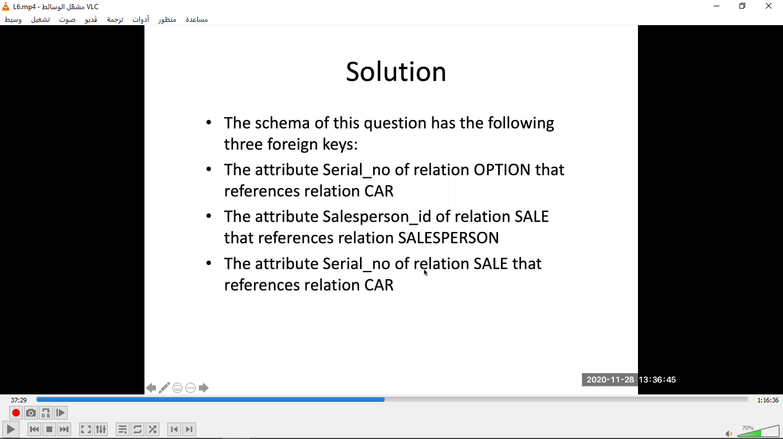

Slide 47
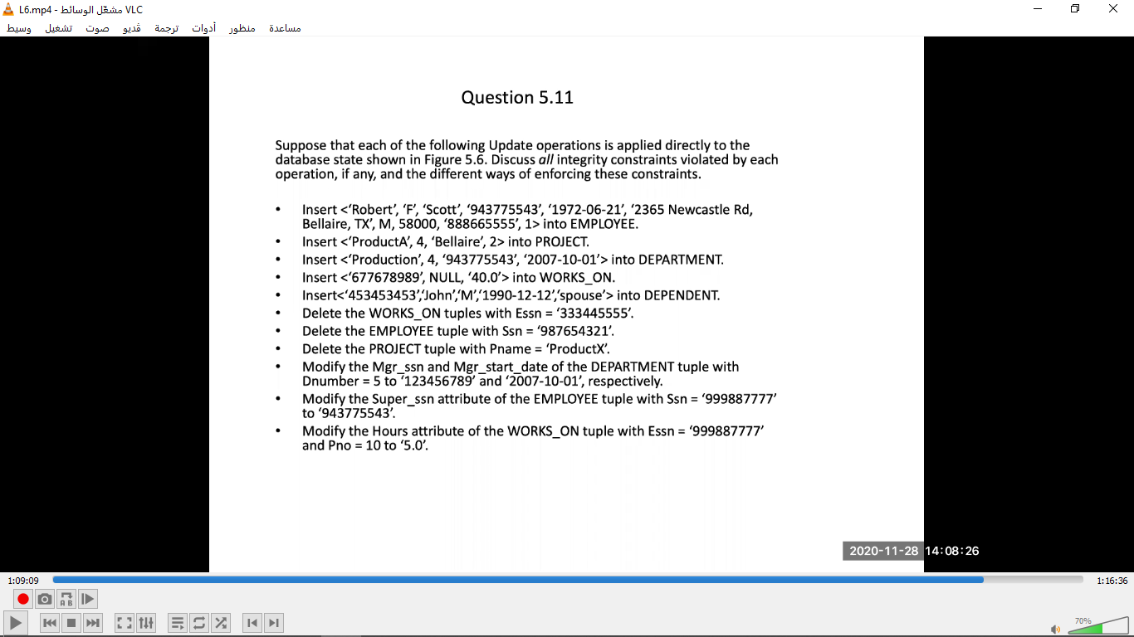

Slide 48
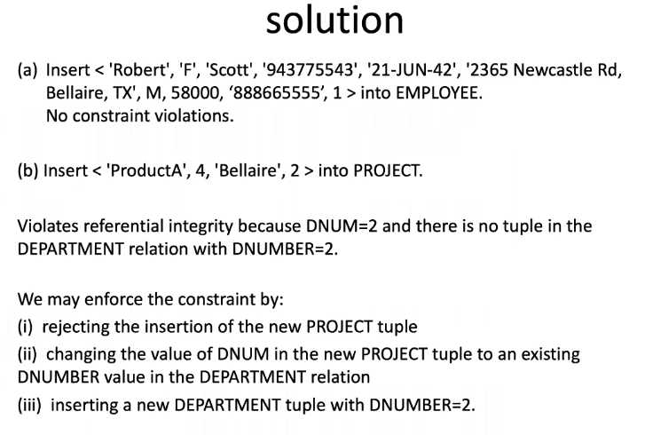

Slide 49
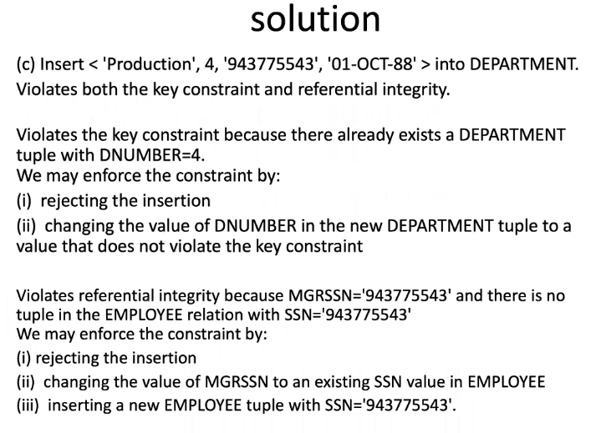

Slide 50
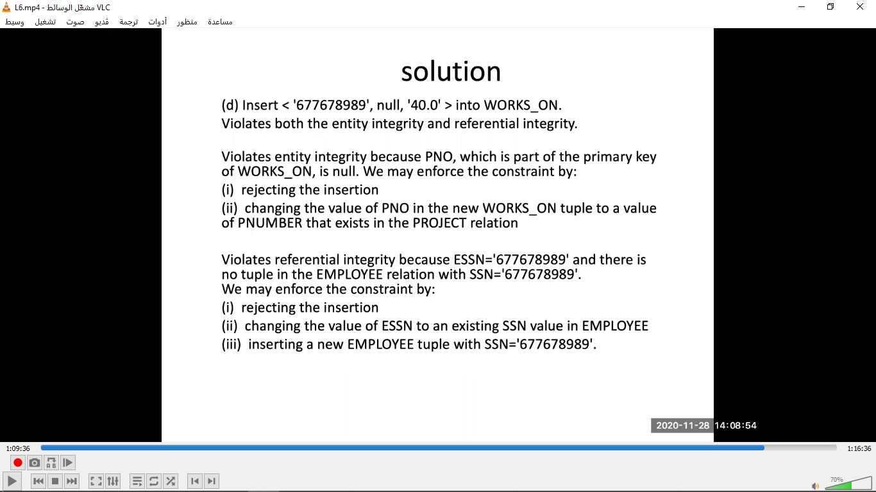

Slide 51
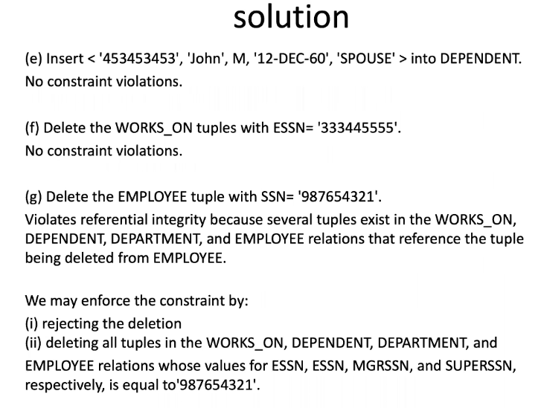

Slide 52
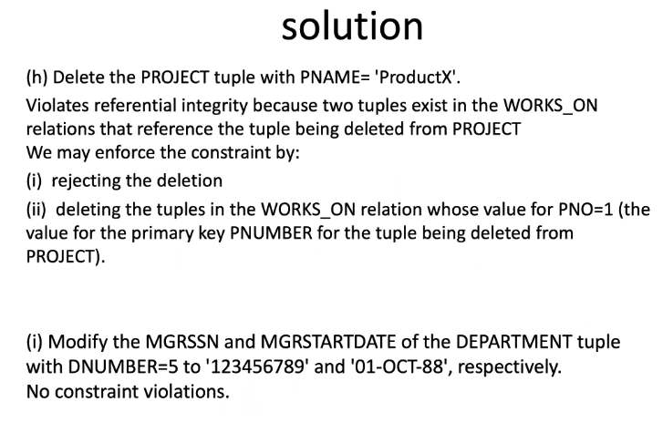

Slide 53
