Slide 1
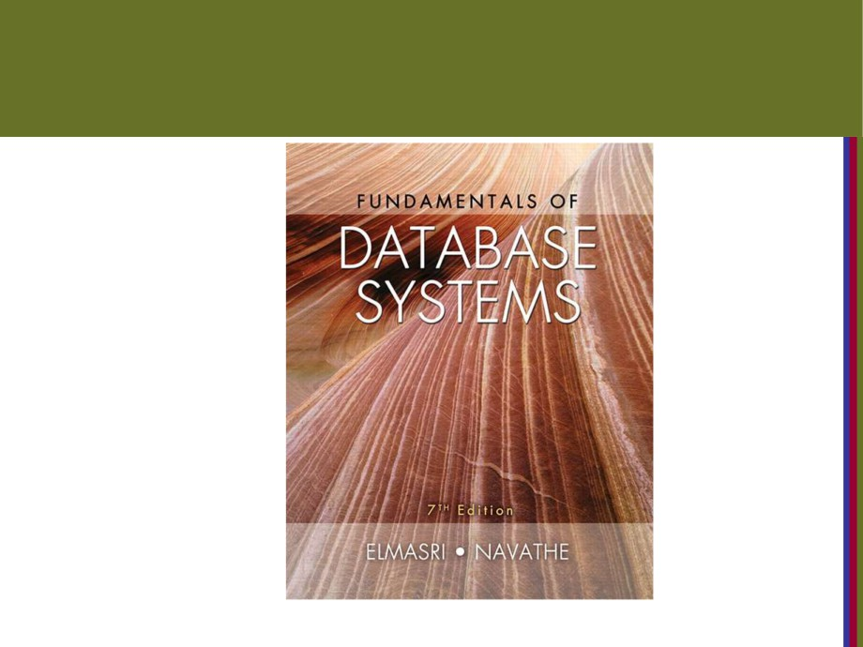
Copyright © 2016 Ramez Elmasri and Shamkant B. Navathe

Slide 2

CHAPTER 6
Basic SQL
Copyright © 2016 Ramez Elmasri and Shamkant B. Navathe
Slide 6- 2

Slide 3
Chapter 6 Outline
■ SQL Data Definition and Data Types  Specifying Constraints in SQL  Basic Retrieval Queries in SQL
■ INSERT, DELETE, and UPDATE Statements in SQL
■ Additional Features of SQL
Copyright © 2016 Ramez Elmasri and Shamkant B. Navathe
Slide 6- 3

Slide 4
SQL Data Definition, Data Types,
Standards
■ Terminology:
■ Table, row, and column used for relational model terms relation, tuple, and attribute
■ CREATE statement
■ Main SQL command for data definition
■ The language has features for : Data definition, Data Manipulation, Transaction control (Transact-SQL, Ch.
20), Indexing (Ch.17), Security specification (Grant
and Revoke- see Ch.30), Active databases (Ch.26),
Multi-media (Ch.26), Distributed databases (Ch.23) etc.
Copyright © 2016 Ramez Elmasri and Shamkant B. Navathe
Slide 6- 5

Slide 5
The CREATE TABLE Command in
SQL
■ Specifying a new relation
■ Provide name of table
■ Specify attributes, their types and initial constraints
■ Can optionally specify schema:
■ CREATE TABLE COMPANY.EMPLOYEE ... or
■ CREATE TABLE EMPLOYEE ...
Copyright © 2016 Ramez Elmasri and Shamkant B. Navathe
Slide 6- 9

Slide 6
The CREATE TABLE Command in
SQL (cont’d.)
■ Base tables (base relations)
■ Relation and its tuples are actually created and stored as a file by the DBMS
■ Virtual relations (views)
■ Created through the CREATE VIEW statement. Do not correspond to any physical file.
Copyright © 2016 Ramez Elmasri and Shamkant B. Navathe
Slide 6- 10

Slide 7
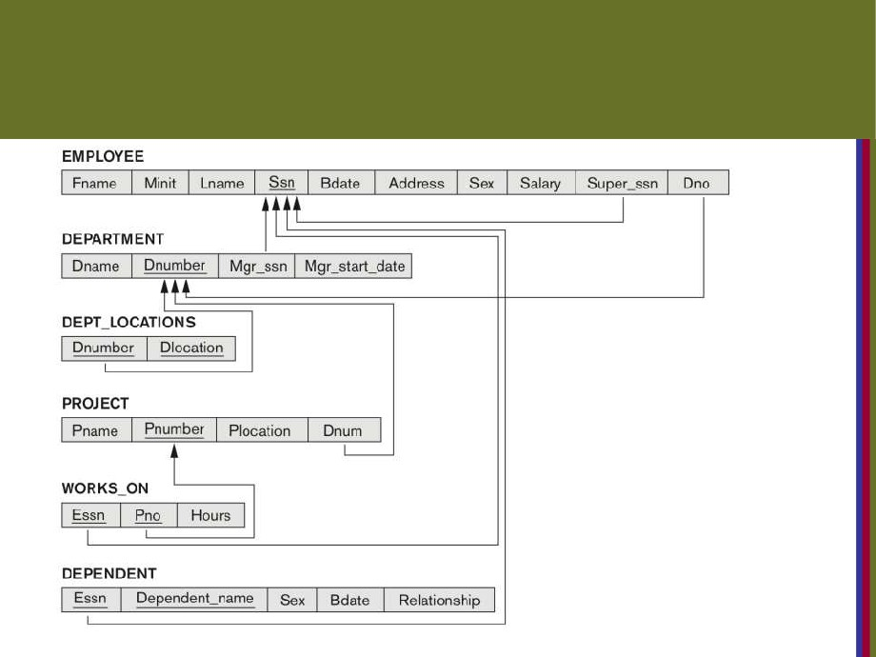
COMPANY relational database
schema (Fig. 5.7)
Copyright © 2016 Ramez Elmasri and Shamkant B. Navathe
Slide 6- 11

Slide 8
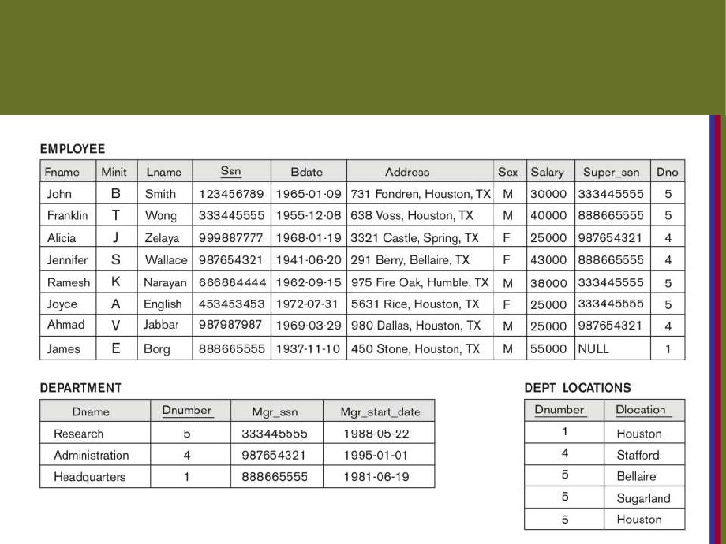
One possible database state for the
COMPANY relational database schema
(Fig. 5.6)
C
Slide 6- 12

Slide 9
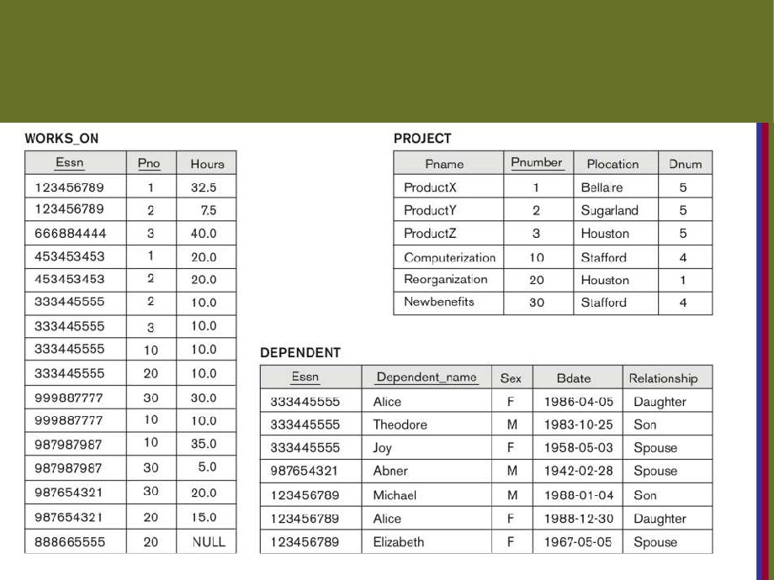
One possible database state for the
COMPANY relational database schema -
continued (Fig. 5.6)
Copyright © 2016 Ramez Elmasri and Shamkant B. Navathe
Slide 6- 13

Slide 10
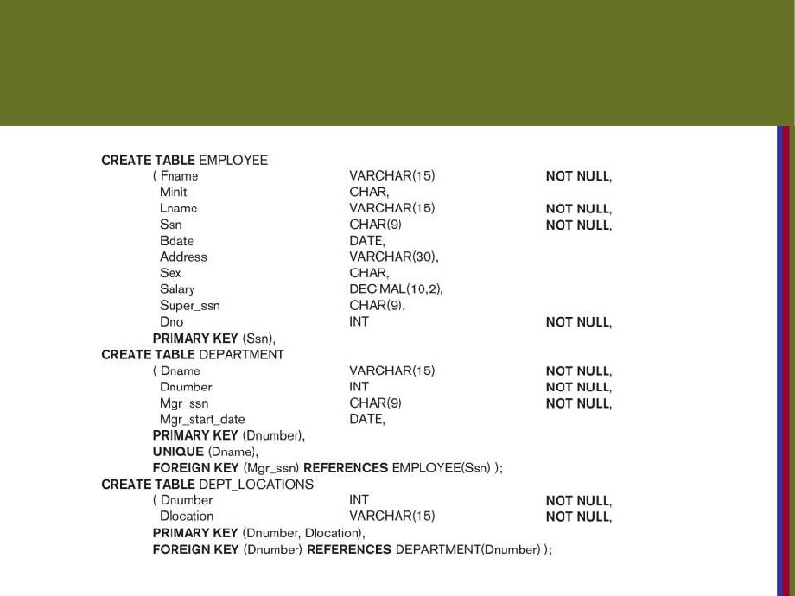
SQL CREATE TABLE data definition statements for defining the COMPANY schema from Figure
5.7 (Fig. 6.1)
continued on next slide
Copyright © 2016 Ramez Elmasri and Shamkant B. Navathe
Slide 6- 14

Slide 11
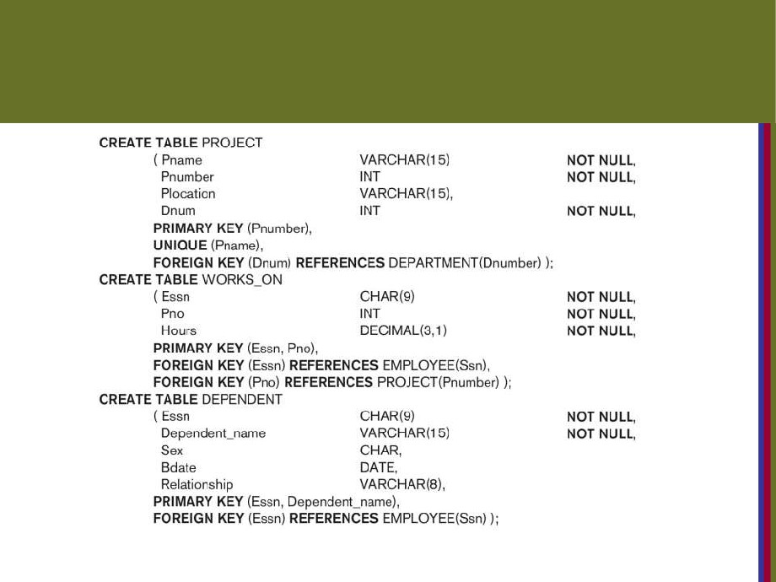
SQL CREATE TABLE data definition
statements for defining the COMPANY
schema from Figure 5.7 (Fig. 6.1)-continued
Copyright © 2016 Ramez Elmasri and Shamkant B. Navathe
Slide 6- 15

Slide 12
Specifying Constraints in SQL
Basic constraints:
■ Relational Model has 3 basic constraint types that are supported in SQL:
■ Key constraint: A primary key value cannot be duplicated
■ Entity Integrity Constraint: A primary key value cannot be null
■ Referential integrity constraints : The “foreign key “ must have a value that is already present as a
primary key, or may be null.
Copyright © 2016 Ramez Elmasri and Shamkant B. Navathe
Slide 6- 21

Slide 13
Specifying Attribute Constraints
Other Restrictions on attribute domains:  Default value of an attribute
DEFAULT <value>
NULL is not permitted for a particular attribute (NOT NULL)
■ CHECK clause
Dnumber INT NOT NULL CHECK (Dnumber >
0 AND Dnumber < 21);
Copyright © 2016 Ramez Elmasri and Shamkant B. Navathe
Slide 6- 22

Slide 14
Specifying Key and Referential
Integrity Constraints
■ PRIMARY KEY clause
■ Specifies one or more attributes that make up the primary key of a relation
■ Dnumber INT PRIMARY KEY;  UNIQUE clause
■ Specifies alternate (secondary) keys (called CANDIDATE keys in the relational model).  Dname VARCHAR(15) UNIQUE;
Copyright © 2016 Ramez Elmasri and Shamkant B. Navathe
Slide 6- 23

Slide 15
Specifying Key and Referential
Integrity Constraints (cont’d.)
■ FOREIGN KEY clause
■ Default operation: reject update on violation  Attach referential triggered action clause
■ Options include SET NULL, CASCADE, and SET DEFAULT
■ Action taken by the DBMS for SET NULL or SET DEFAULT is the same for both ON DELETE and ON UPDATE
■ CASCADE option suitable for “relationship” relations
Copyright © 2016 Ramez Elmasri and Shamkant B. Navathe
Slide 6- 24

Slide 16
Giving Names to Constraints
■ Using the Keyword CONSTRAINT
■ Name a constraint
■ Useful for later altering
Copyright © 2016 Ramez Elmasri and Shamkant B. Navathe
Slide 6- 25

Slide 17
Specifying Constraints on Tuples
Using CHECK
■ Additional Constraints on individual tuples within a relation are also possible using CHECK
■ CHECK clauses at the end of a CREATE TABLE statement
■ Apply to each tuple individually
■ CHECK (Dept_create_date <= Mgr_start_date);
Copyright © 2016 Ramez Elmasri and Shamkant B. Navathe
Slide 6- 27

Slide 18
Basic Retrieval Queries in SQL
■ SELECT statement
■ One basic statement for retrieving information from a database
■ SQL allows a table to have two or more tuples that are identical in all their attribute values
■ Unlike relational model (relational model is strictly set-theory based)
■ Multiset or bag behavior
■ Tuple-id may be used as a key
Copyright © 2016 Ramez Elmasri and Shamkant B. Navathe
Slide 6- 28

Slide 19
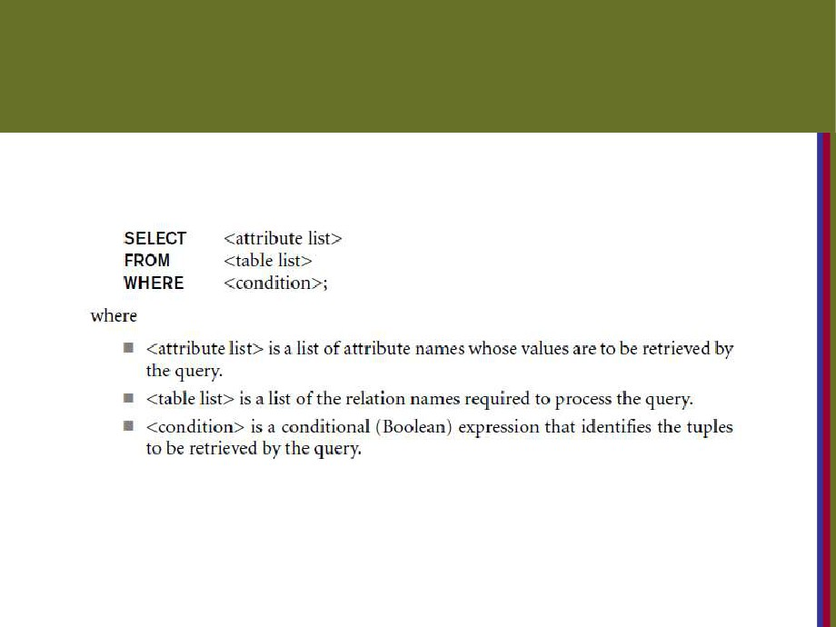
The SELECT-FROM-WHERE
Structure of Basic SQL Queries
■ Basic form of the SELECT statement:
Copyright © 2016 Ramez Elmasri and Shamkant B. Navathe
Slide 6- 29

Slide 20
The SELECT-FROM-WHERE Structure of Basic SQL Queries (cont’d.)
■ Logical comparison operators
■ =, <, <=, >, >=, and <>  Projection attributes
■ Attributes whose values are to be retrieved  Selection condition
■ Boolean condition that must be true for any
retrieved tuple. Selection conditions include join
conditions (see Ch.8) when multiple relations are
involved.
Copyright © 2016 Ramez Elmasri and Shamkant B. Navathe
Slide 6- 30

Slide 21
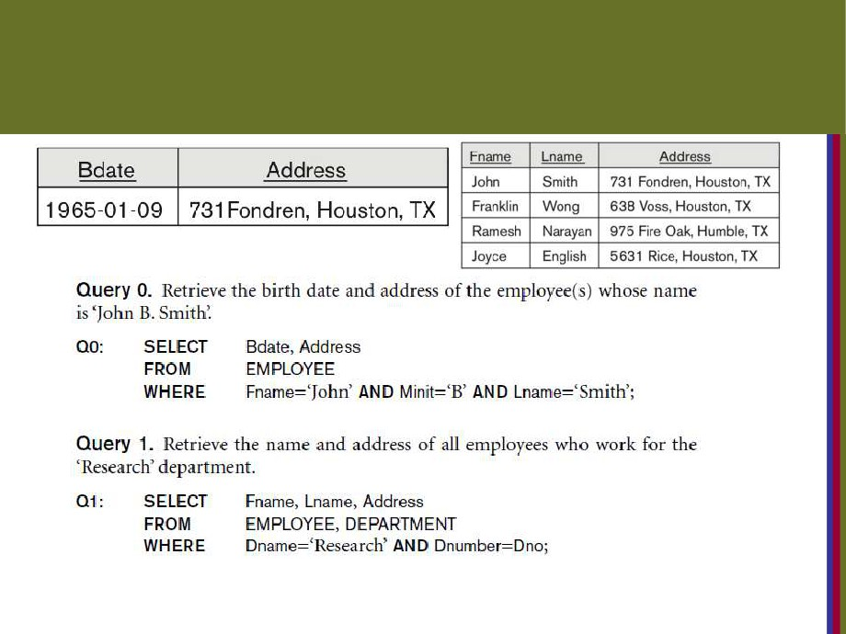
Basic Retrieval Queries
Copyright © 2016 Ramez Elmasri and Shamkant B. Navathe
Slide 6- 31

Slide 22
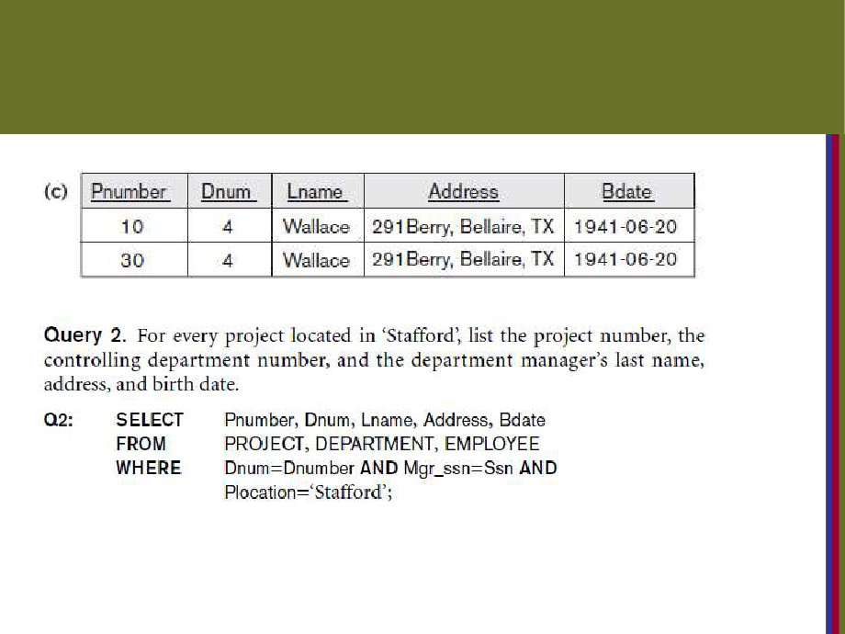
Basic Retrieval Queries (Contd.)
Copyright © 2016 Ramez Elmasri and Shamkant B. Navathe
Slide 6- 32

Slide 23
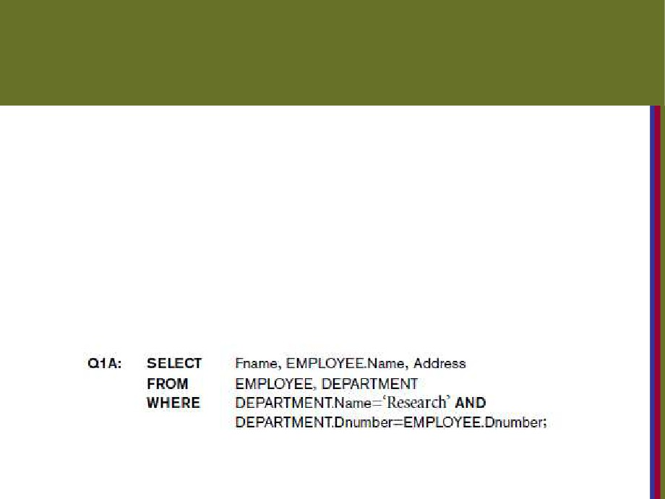
Ambiguous Attribute Names
■ Same name can be used for two (or more) attributes in different relations
■ As long as the attributes are in different relations  Must qualify the attribute name with the relation name to prevent ambiguity
Copyright © 2016 Ramez Elmasri and Shamkant B. Navathe
Slide 6- 33

Slide 24
Aliasing, and Renaming
■ Aliases or tuple variables
■ Declare alternative relation names E and S to refer to the EMPLOYEE relation twice in a query:
Query 8. For each employee, retrieve the employee’s first and last name and the first and last name of his or her immediate supervisor.
SELECT E.Fname, E.Lname, S.Fname, S.Lname FROM EMPLOYEE AS E, EMPLOYEE AS S
■
WHERE E.Super_ssn=S.Ssn;
■ Recommended practice to abbreviate names and to prefix same or similar attribute from multiple
tables.
Copyright © 2016 Ramez Elmasri and Shamkant B. Navathe
Slide 6- 34

Slide 25
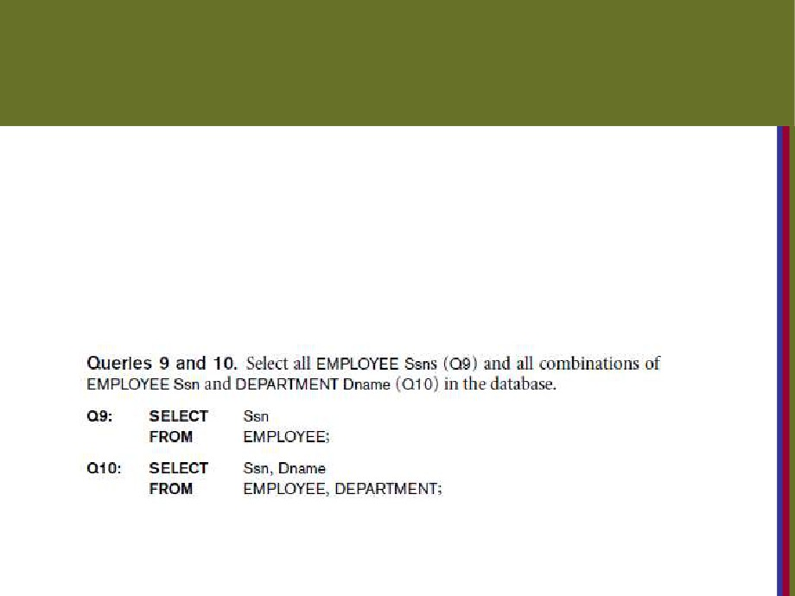
Unspecified WHERE Clause
and Use of the Asterisk
■ Missing WHERE clause
■ Indicates no condition on tuple selection  Effect is a CROSS PRODUCT
■ Result is all possible tuple combinations (or the
Algebra operation of Cartesian Product- see Ch.8)
Copyright © 2016 Ramez Elmasri and Shamkant B. Navathe
Slide 6- 36

Slide 26
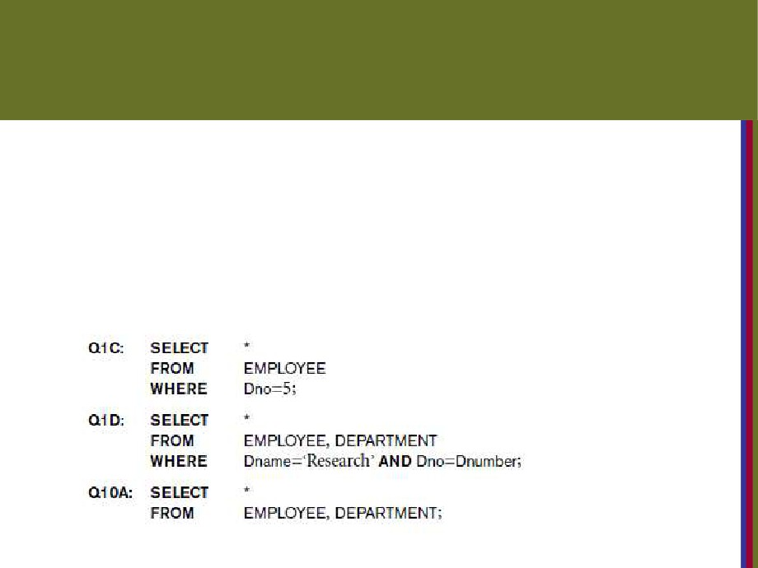
Unspecified WHERE Clause
and Use of the Asterisk (cont’d.)
■ Specify an asterisk (*)
■ Retrieve all the attribute values of the selected tuples
■ The * can be prefixed by the relation name; e.g., EMPLOYEE *
Copyright © 2016 Ramez Elmasri and Shamkant B. Navathe
Slide 6- 37

Slide 27
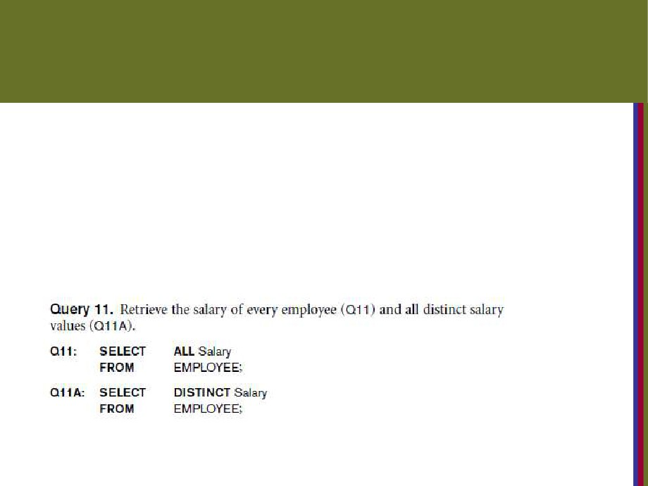
Tables as Sets in SQL
■ SQL does not automatically eliminate duplicate tuples in query results
■ For aggregate operations (See sec 7.1.7) duplicates must be accounted for
■ Use the keyword DISTINCT in the SELECT clause
■ Only distinct tuples should remain in the result
Copyright © 2016 Ramez Elmasri and Shamkant B. Navathe
Slide 6- 38

Slide 28
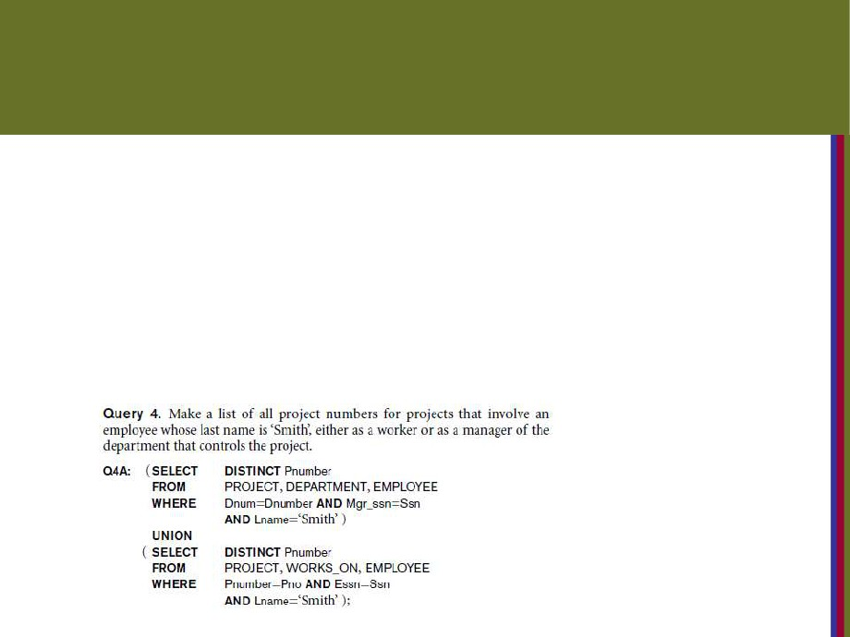
Tables as Sets in SQL (cont’d.)
■ Set operations
■ UNION, EXCEPT (difference), INTERSECT
■ Corresponding multiset operations: UNION ALL, EXCEPT ALL, INTERSECT ALL)
■ Type compatibility is needed for these operations to be valid
Copyright © 2016 Ramez Elmasri and Shamkant B. Navathe
Slide 6- 39

Slide 29
Substring Pattern Matching and
Arithmetic Operators
■ LIKE comparison operator
■ Used for string pattern matching
■ % replaces an arbitrary number of zero or more characters
■ underscore (_) replaces a single character
■ Examples: WHERE Address LIKE ‘%Houston,TX%’;  WHERE Ssn LIKE ‘_ _ 1_ _ 8901’;
■ BETWEEN comparison operator
E.g., in Q14 :
WHERE(Salary BETWEEN 30000 AND 40000)
AND Dno = 5;
Copyright © 2016 Ramez Elmasri and Shamkant B. Navathe
Slide 6- 40

Slide 30
Arithmetic Operations
■ Standard arithmetic operators:
■ Addition (+), subtraction (-), multiplication (*), and division (/) may be included as a part of SELECT
■ Query 13. Show the resulting salaries if every employee working on the ‘ProductX’ project is given a 10 percent raise.
SELECT E.Fname, E.Lname, 1.1 * E.Salary AS Increased_sal FROM EMPLOYEE AS E, WORKS_ON AS W, PROJECT AS P WHERE E.Ssn=W.Essn AND W.Pno=P.Pnumber AND
P.Pname=‘ProductX’;
Copyright © 2016 Ramez Elmasri and Shamkant B. Navathe
Slide 6- 41

Slide 31
Ordering of Query Results
■ Use ORDER BY clause
■ Keyword DESC to see result in a descending order of values
■ Keyword ASC to specify ascending order explicitly  Typically placed at the end of the query
ORDER BY D.Dname DESC, E.Lname ASC,
E.Fname ASC
Copyright © 2016 Ramez Elmasri and Shamkant B. Navathe
Slide 6- 42

Slide 32
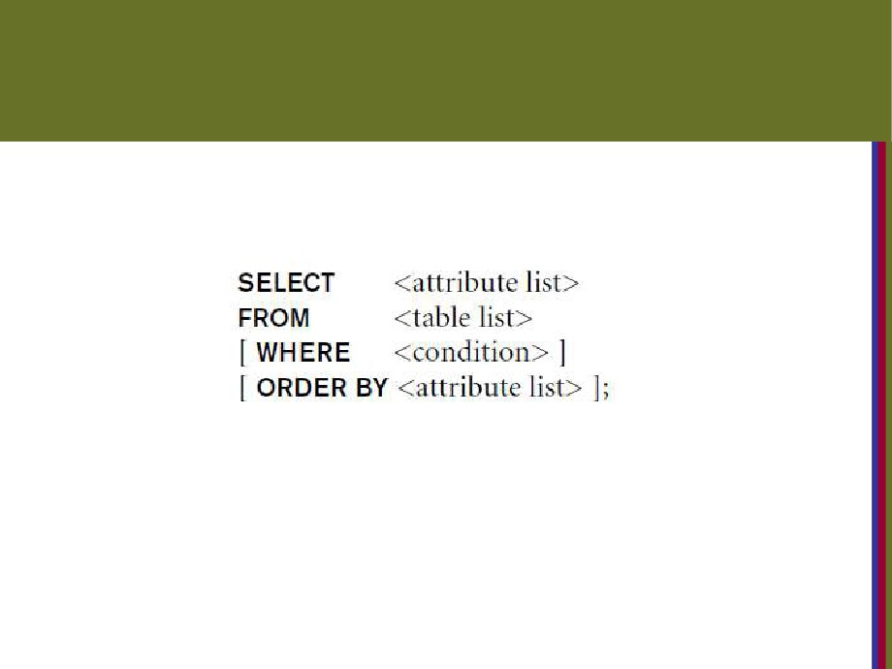
Basic SQL Retrieval Query Block
Copyright © 2016 Ramez Elmasri and Shamkant B. Navathe
Slide 6- 43

Slide 33
INSERT, DELETE, and UPDATE
Statements in SQL
■ Three commands used to modify the database:
■ INSERT, DELETE, and UPDATE
■ INSERT typically inserts a tuple (row) in a relation (table)
■ UPDATE may update a number of tuples (rows) in a relation (table) that satisfy the condition  DELETE may also update a number of tuples (rows) in a relation (table) that satisfy the
condition
Copyright © 2016 Ramez Elmasri and Shamkant B. Navathe
Slide 6- 44

Slide 34
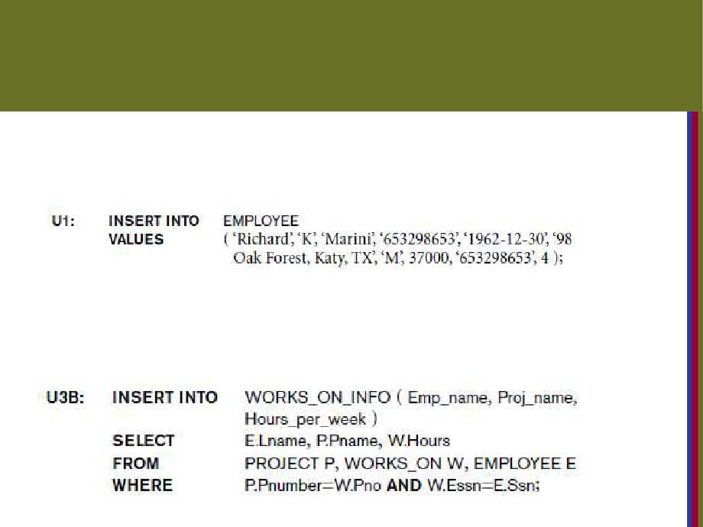
The INSERT Command
■ Specify the relation name and a list of values for the tuple. All values including nulls are supplied.
■ The variation below inserts multiple tuples where a new table is loaded values from the result of a
query.
Copyright © 2016 Ramez Elmasri and Shamkant B. Navathe
Slide 6- 46

Slide 35
DELETE
■ Removes tuples from a relation
■ Includes a WHERE-clause to select the tuples to be deleted
■ Referential integrity should be enforced
■ Tuples are deleted from only one table at a time
(unless CASCADE is specified on a referential integrity constraint)
■ A missing WHERE-clause specifies that all tuples in the relation are to be deleted; the table then becomes
an empty table
■ The number of tuples deleted depends on the number of tuples in the relation that satisfy the WHERE-clause
Copyright © 2016 Ramez Elmasri and Shamkant B. Navathe
Slide 6- 48

Slide 36
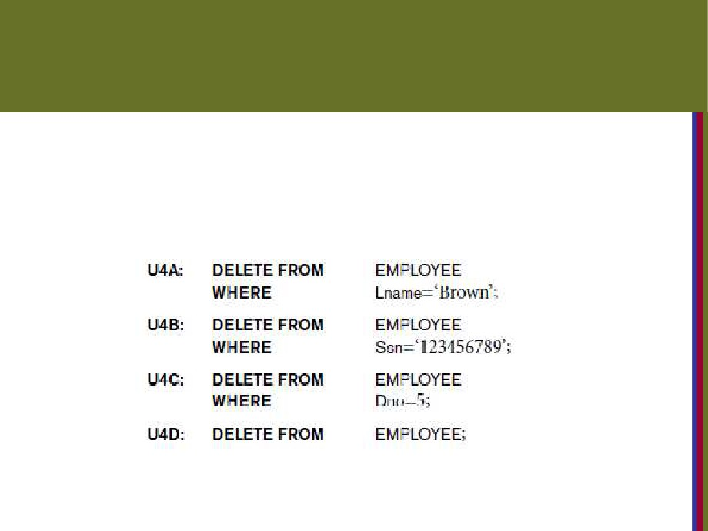
The DELETE Command
■ Removes tuples from a relation
■ Includes a WHERE clause to select the tuples to be deleted. The number of tuples deleted will vary.
Copyright © 2016 Ramez Elmasri and Shamkant B. Navathe
Slide 6- 49

Slide 37
UPDATE
■ Used to modify attribute values of one or more selected tuples
■ A WHERE-clause selects the tuples to be modified
■ An additional SET-clause specifies the attributes to be modified and their new values
■ Each command modifies tuples in the same relation
■ Referential integrity specified as part of DDL specification is enforced
Copyright © 2016 Ramez Elmasri and Shamkant B. Navathe
Slide 6- 50

Slide 38
UPDATE (contd.)
■ Example: Change the location and controlling department number of project number 10 to
'Bellaire' and 5, respectively
U5:
UPDATE PROJECT
SET
PLOCATION = 'Bellaire',
DNUM = 5
WHERE PNUMBER=10
Copyright © 2016 Ramez Elmasri and Shamkant B. Navathe
Slide 6- 51

Slide 39
UPDATE (contd.)
■ Example: Give all employees in the 'Research' department a 10% raise in salary.
U6:UPDATE
EMPLOYEE
SET
SALARY = SALARY *1.1
WHERE
DNO IN (SELECT DNUMBER FROM DEPARTMENT
WHERE DNAME='Research')
■ In this request, the modified SALARY value depends on the original SALARY value in each tuple
■ The reference to the SALARY attribute on the right of = refers to the old SALARY value before modification
■ The reference to the SALARY attribute on the left of = refers to the new SALARY value after modification
Copyright © 2016 Ramez Elmasri and Shamkant B. Navathe
Slide 6- 52

Slide 40
Summary
■ SQL
■ A Comprehensive language for relational database management
■ Data definition, queries, updates, constraint specification, and view definition
■ Covered :
■ Data definition commands for creating tables  Commands for constraint specification  Simple retrieval queries
■ Database update commands
Copyright © 2016 Ramez Elmasri and Shamkant B. Navathe
Slide 6- 55

