Slide 1

RL Algorithms
Zakaria Narjis
Anouar Nechi

Slide 2
Table of contents
Taxonomy of RL algorithms
Algorithms
Key papers in Deep RL
Ressources
Other Key Concepts

Slide 3
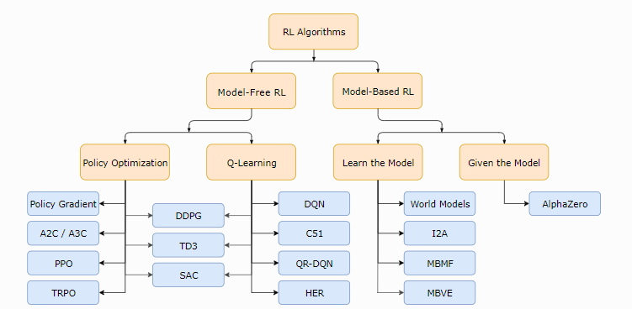
Taxonomy of RL algorithms

Slide 4
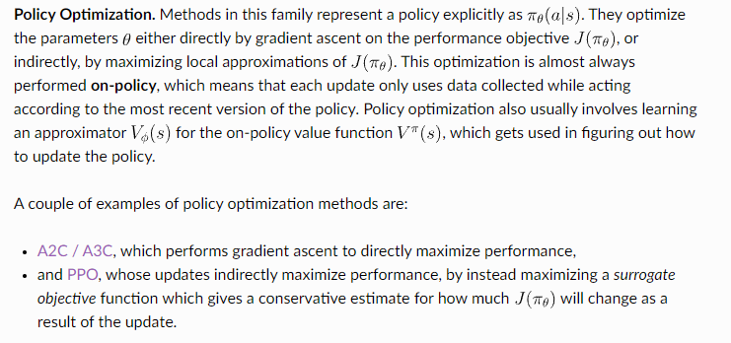
What to Learn in Model-Free RL
There are two main approaches to representing and training agents with model-free RL:

Slide 5
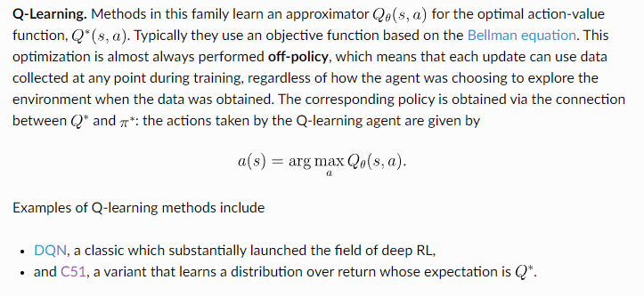

Slide 6
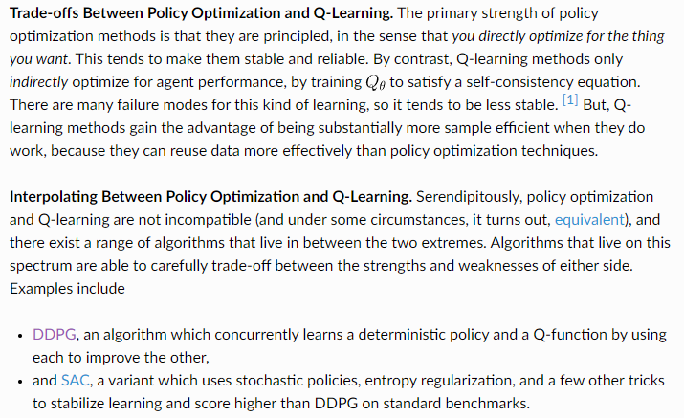
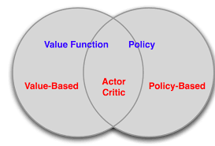

Slide 7
Algorithms

Slide 8
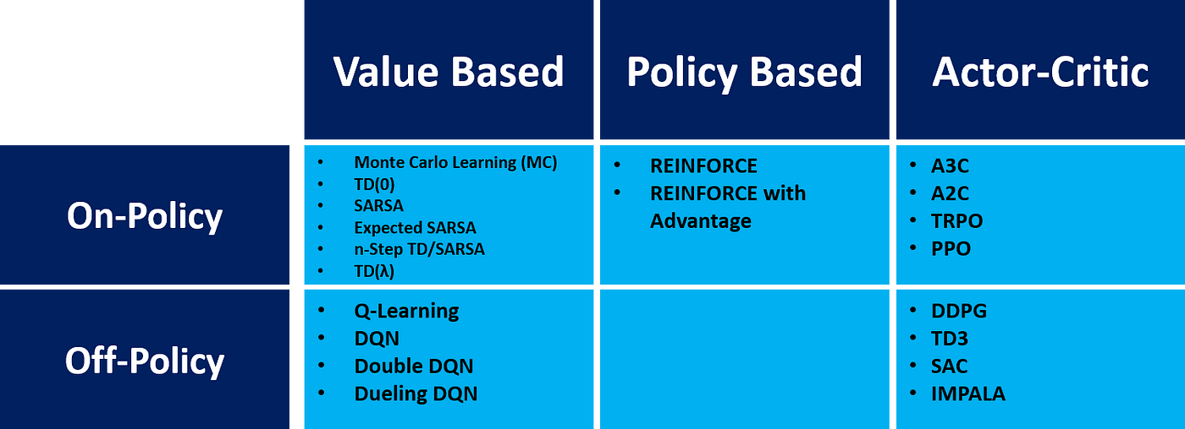
Classification of algorithms

Slide 9
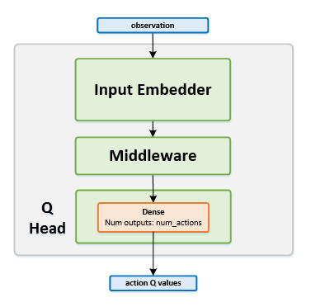
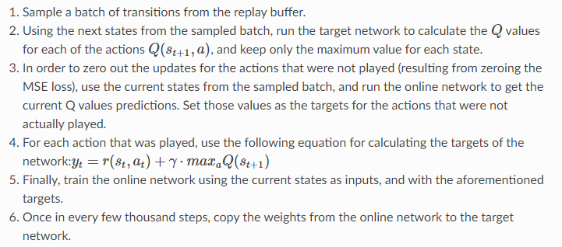
DQN
Network Structure
Training the network

Slide 10
DDQN(double DQN)
A Double Deep Q-Network, or Double DQN utilizes Double Q-learning to reduce overestimation by decomposing the max operation in the target into action selection and action evaluation. We evaluate the greedy policy according to the online network, but we use the target network to estimate its value.

Slide 11
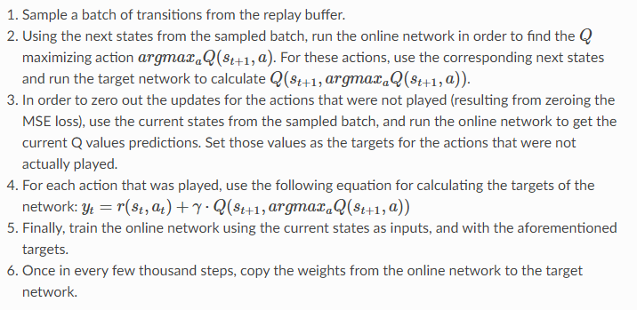
DDQN(double DQN)
Network Structure
Training the network

Slide 12
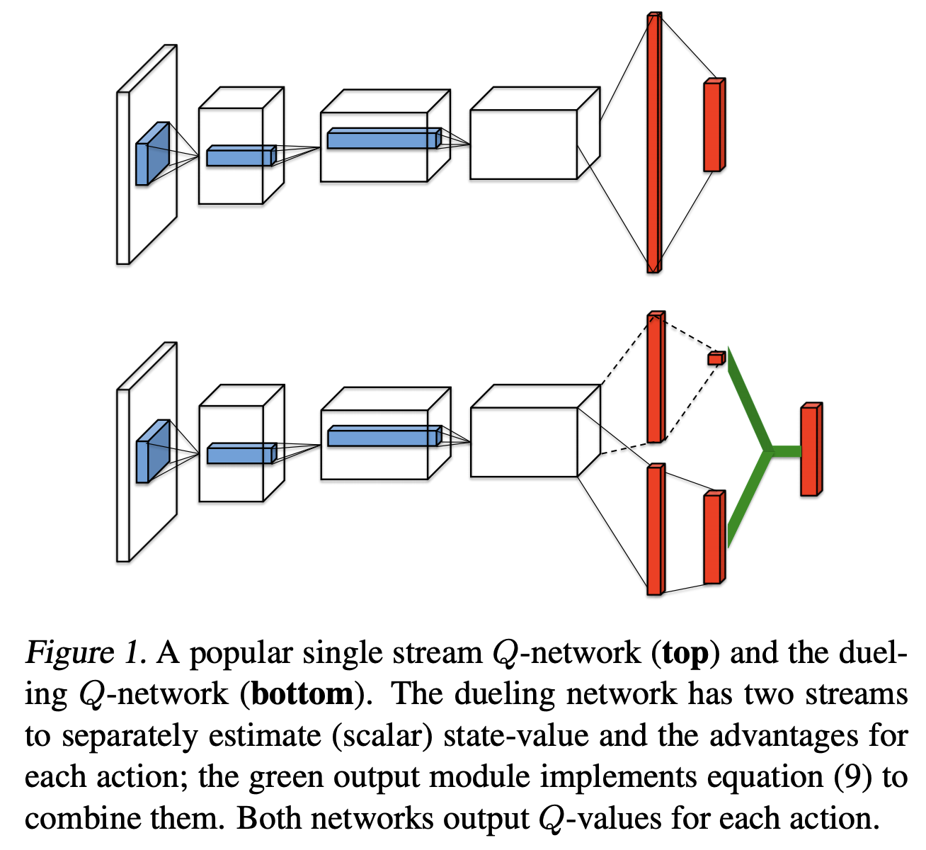

Dueling DQN
A Dueling Network is a type of Q-Network that has two streams to separately estimate (scalar) state-value and the advantages for each action. Both streams share a common convolutional feature learning module. The two streams are combined via a special aggregating layer to produce an estimate of the state-action value function Q as shown in the figure to the right.
This formulation is chosen for identifiability so that the advantage function has zero advantage for the chosen action, but instead of a maximum we use an average operator to increase the stability of the optimization.

Slide 13
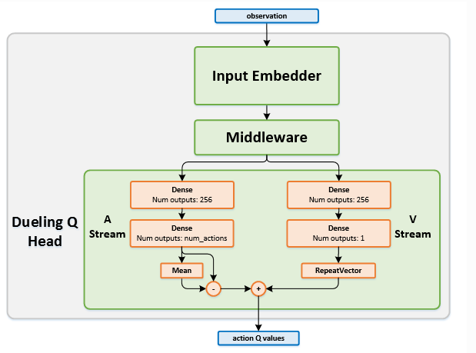
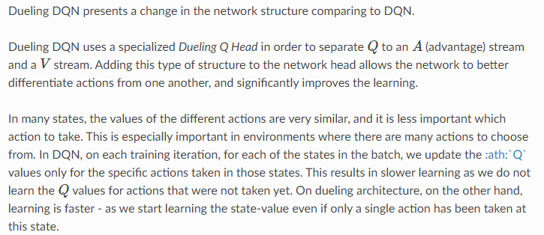
Dueling DQN
Network Structure
Training the network

Slide 14
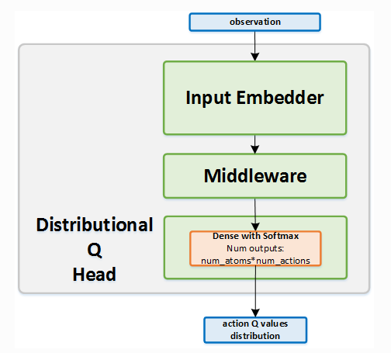
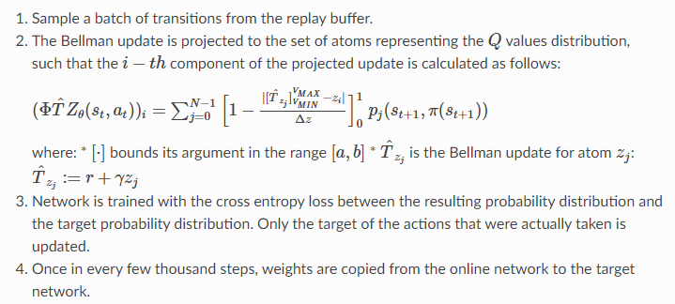
Categorical DQN
Network Structure
Training the network

Slide 15
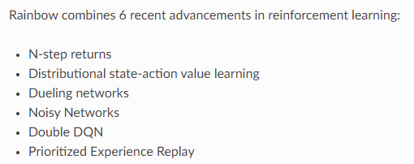
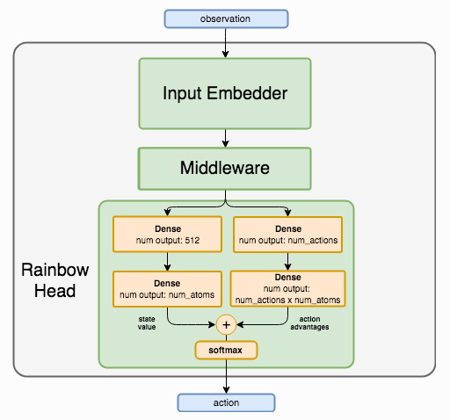
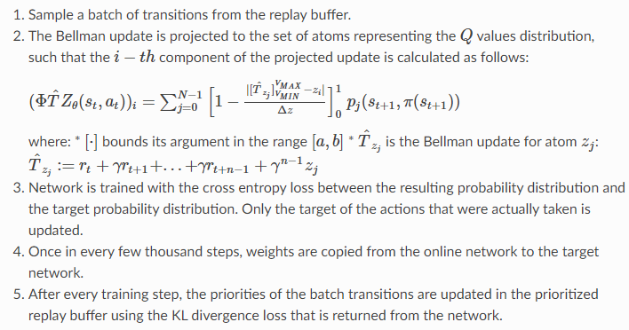
Rainbow
Network Structure
Training the network

Slide 16
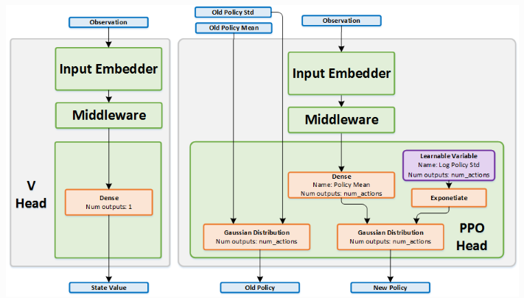
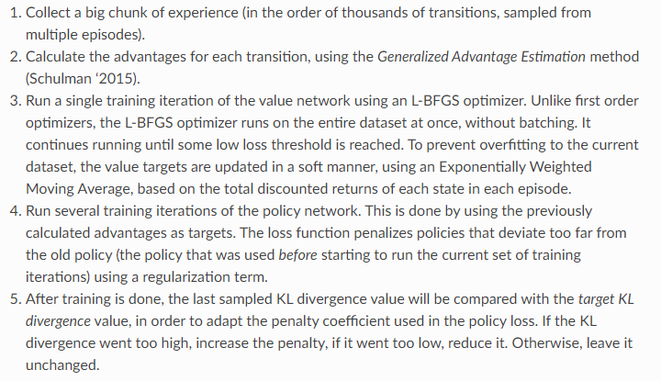
Proximal Policy Optimization (PPO)
Network Structure
Training the network

Slide 17
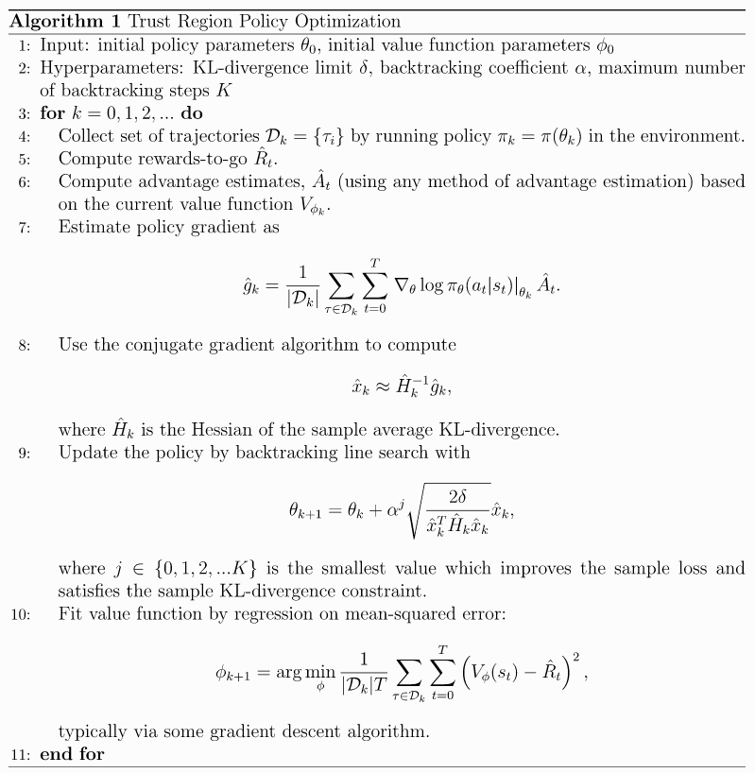
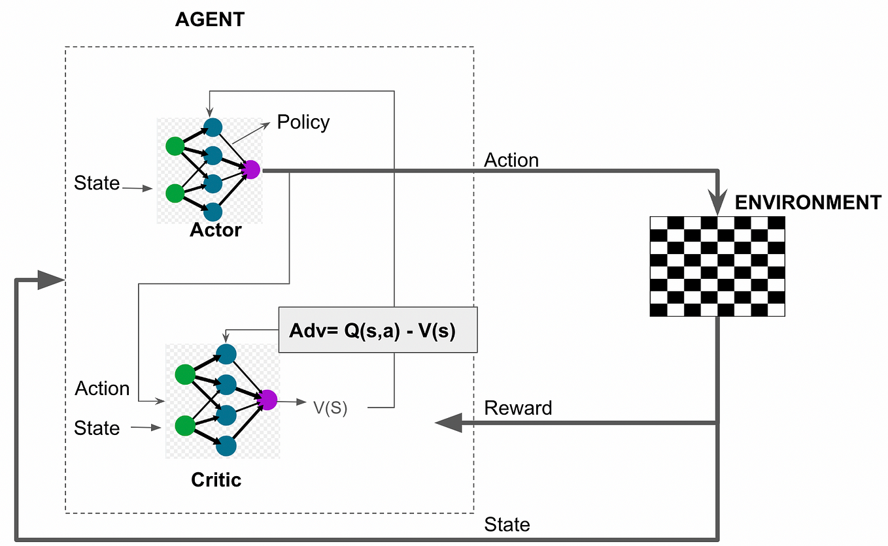
Trust region policy optimization (TRPO)
Network Structure
Training the network

Slide 18
Other key concepts

Slide 19
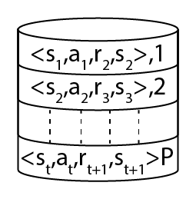
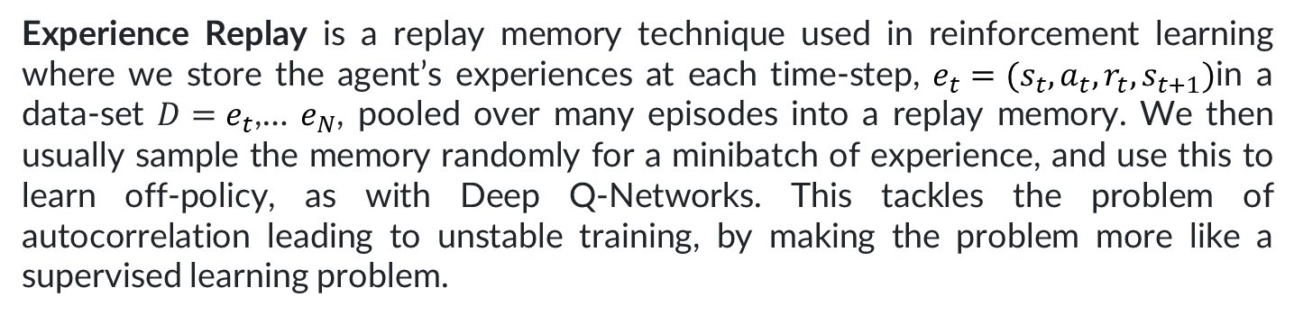
Experience Replay
Experience Replay is a replay memory technique used in reinforcement learning where we store the agent’s experiences at each time-step, $e_{t}=(s_{t},a_{t},r_{t},s_{t+1})$in a data-set $D=e_{t}$,… $e_{N}$, pooled over many episodes into a replay memory. We then usually sample the memory randomly for a minibatch of experience, and use this to learn off-policy, as with Deep Q-Networks. This tackles the problem of autocorrelation leading to unstable training, by making the problem more like a supervised learning problem.

Slide 20
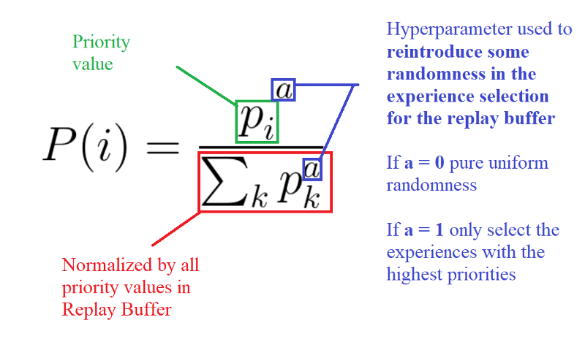
Prioritized Experience Replay
Prioritized Experience Replay is a type of experience replay in reinforcement learning where we more frequently replay transitions with high expected learning progress, as measured by the magnitude of their temporal-difference (TD) error. This prioritization can lead to a loss of diversity, which is alleviated with stochastic prioritization, and introduce bias, which can be corrected with importance sampling.
where $P\left(i\right)>0$ is the priority of transition $i$. The exponent $a$ determines how much prioritization is used, with $a=0$corresponding to the uniform case.

Slide 21
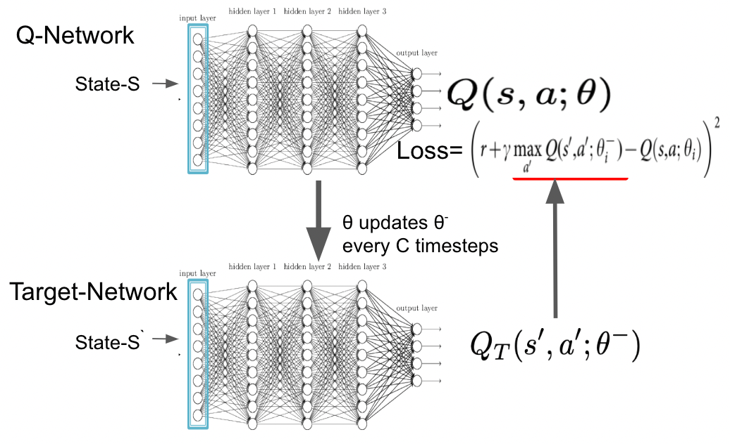
Target network

Slide 22
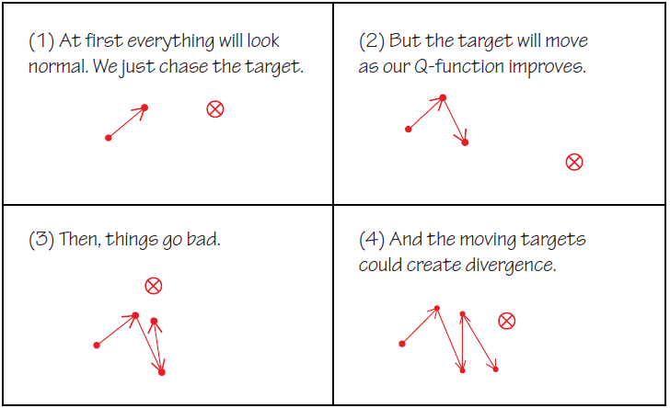
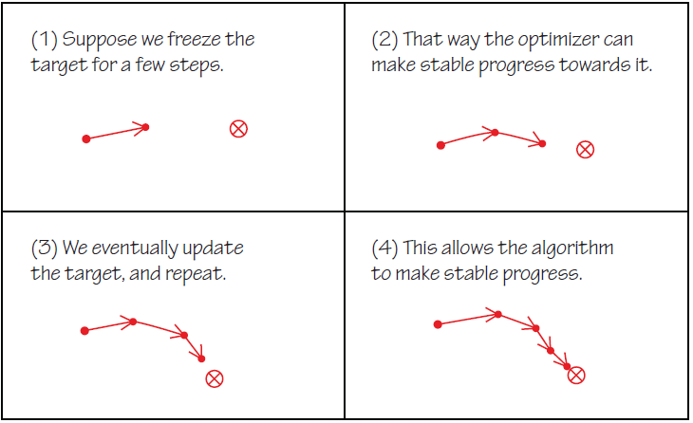
Target network
Without target network
With target network

Slide 23
Key papers in Deep RL
https://spinningup.openai.com/en/latest/spinningup/keypapers.html

Slide 24
Ressources
https://spinningup.openai.com/en/latest/spinningup/rl_intro.html (educational resource produced by OpenAI)
https://intellabs.github.io/coach/components/agents/index.html (educational resource and RL library produced by Intel)

