Slide 1
Customer Analysis

Slide 2
Team members
Amany Ehab
Ahmed Refaat
Ahmed Mohamed
Esraa Zidan
Moner Mohamed
Malk Younis
Zakaria Shaban

Slide 3
Agenda
1-Introduction
2- Tools
3-Datasets
4-Analysis
5-Conclusion
6-References

Slide 4
goals
Understand Customer Behavior
Track Product and Brand Performance
Measure Store Efficiency
Monitor Order Fulfillment and Staff Performance
Generate Strategic Insights for Business Growth

Slide 5
overview

Slide 6
Introduction
Objective:
This project aims to analyze and optimize customer sales performance by utilizing structured datasets, including information on customers, products, orders, and stores. The focus is on extracting actionable insights to drive business decisions.
Scope:
The project explores sales trends, customer behaviors, product performance, and operational efficiencies across multiple stores. This involves identifying top-performing stores, customers, and products, as well as detecting bottlenecks or inefficiencies in order fulfillment.

Slide 7
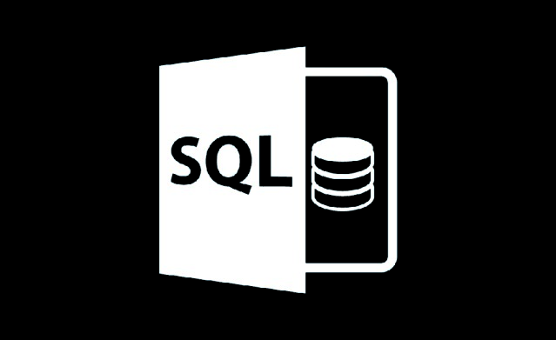
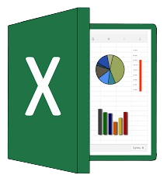
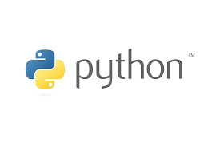
Tools

Slide 8
Dataset Overview
In this project, we work with a relational dataset designed to capture the dynamics of a sales process, including information about customers, stores, products, orders, and the staff involved. The dataset is structured across multiple tables, each containing specific information critical for the sales workflow.
The data reflects real-world business scenarios, such as:
Customer purchases and order tracking.
Store performance in handling inventory and customer orders.
Product and brand management to meet customer demands.
This relational setup allows us to join and aggregate data from various angles, leading to meaningful insights that can inform business strategies.

Slide 9
Main Tables

Slide 10
Data exploration
Understand Dataset Structure
Inspect size and shape of each table , Identify Data types.
Check Data Completeness and Quality
Analyze Data Distribution and Relationships
Explore summary statistics, Check for outliers
Identify missing values ,Detect and correct inconsistent entries
It is a fundamental stage in data analysis aimed at understanding the structure and nature of a data set before starting deep analysis or building models.
During this phase, the data is carefully studied to get a comprehensive overview of its content, detect initial patterns, and identify missing or anomalous values.

Slide 11
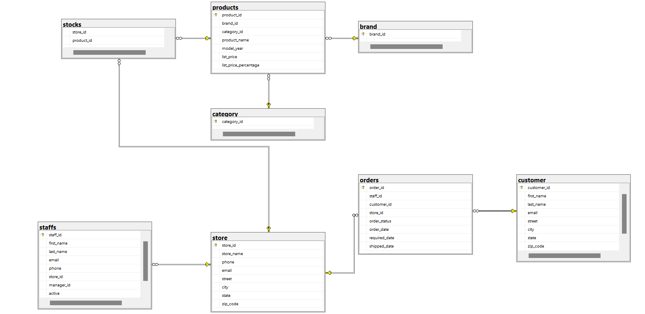

Slide 12
Analysis and Insights
The analysis phase aims to extract meaningful patterns, trends, and relationships from the dataset. It helps answer critical business questions, such as:
Which products or brands are driving the most revenue?
What are the key factors influencing customer purchasing behavior?
How efficiently are stores managing inventory and fulfilling orders?
By examining the dataset from multiple angles, the goal is to uncover strategic insights that can inform decision-making in areas such as pricing strategies, product assortment, customer segmentation, and operational improvements.
At this point, SQL was used to extract basic data from linked tables, such as sales data by stores and customers , Python was used to perform advanced statistical analysis on the data then Clustering provided a deeper understanding of patterns in the data, allowing for more precise segmentation and strategy development. By grouping customers, products, and stores based on behavior and performance, we were able to design targeted interventions to improve sales, increase efficiency, and enhance customer engagement.
This helps detect important patterns and trends in store sales and identify factors affecting the financial performance of each store.

Slide 13
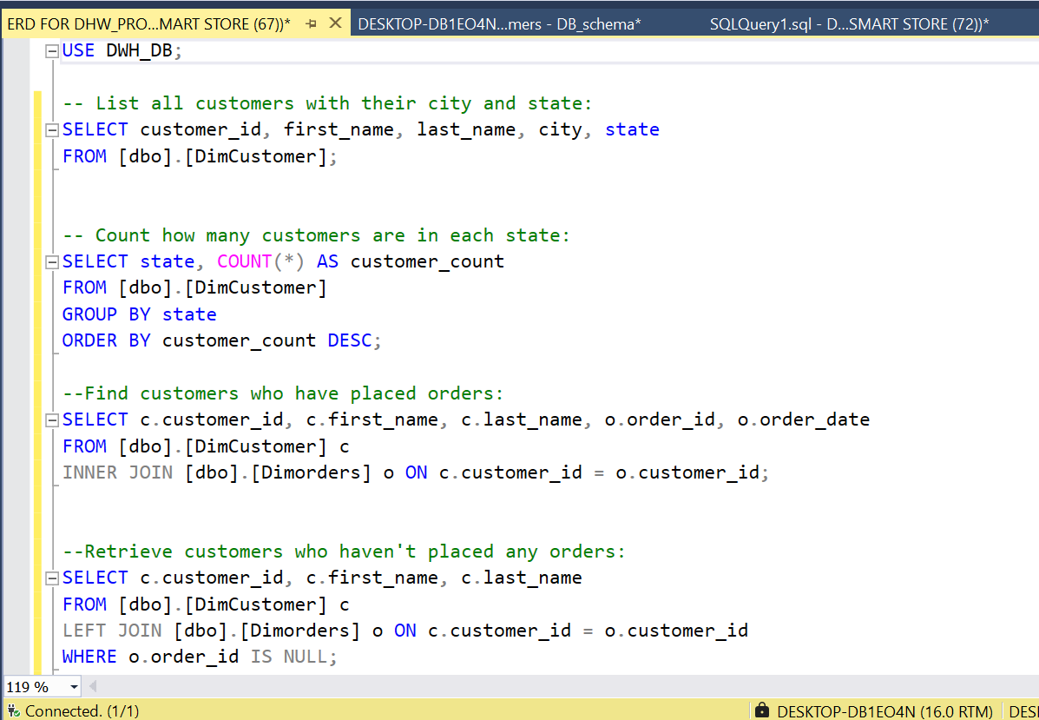
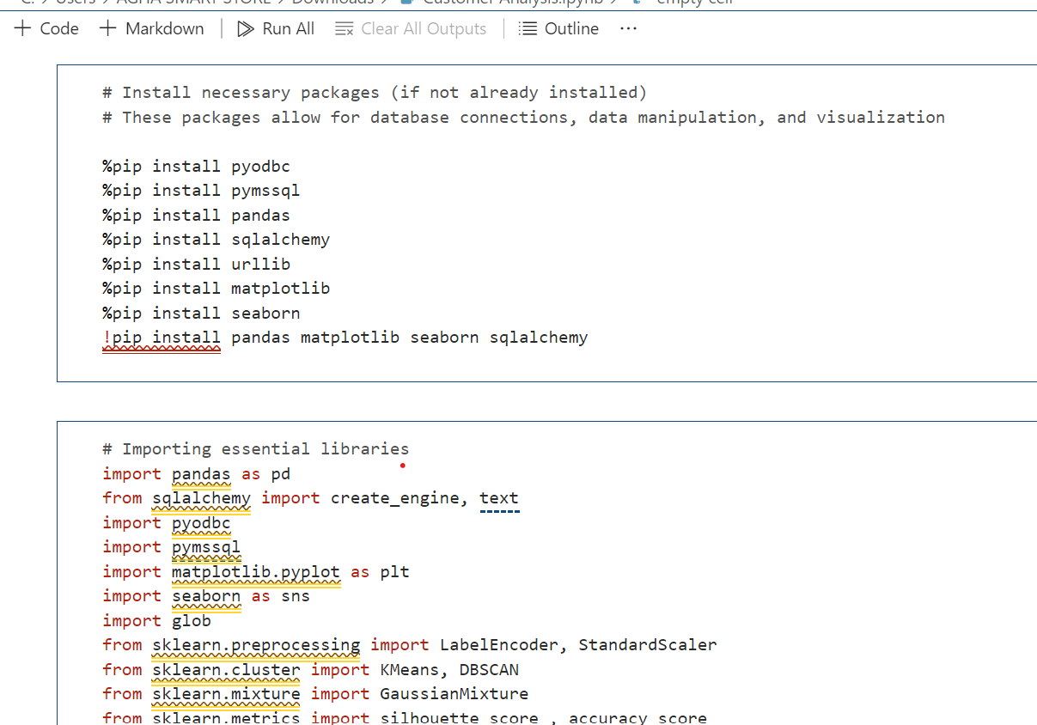
Sql vs Python analysis

Slide 14
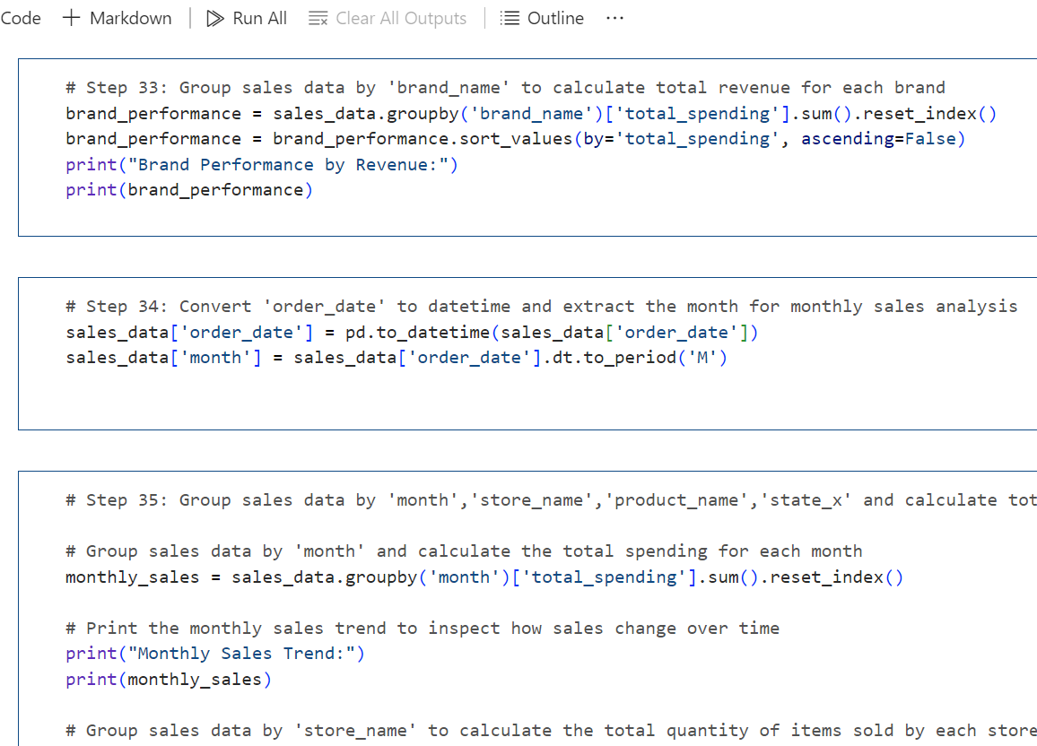
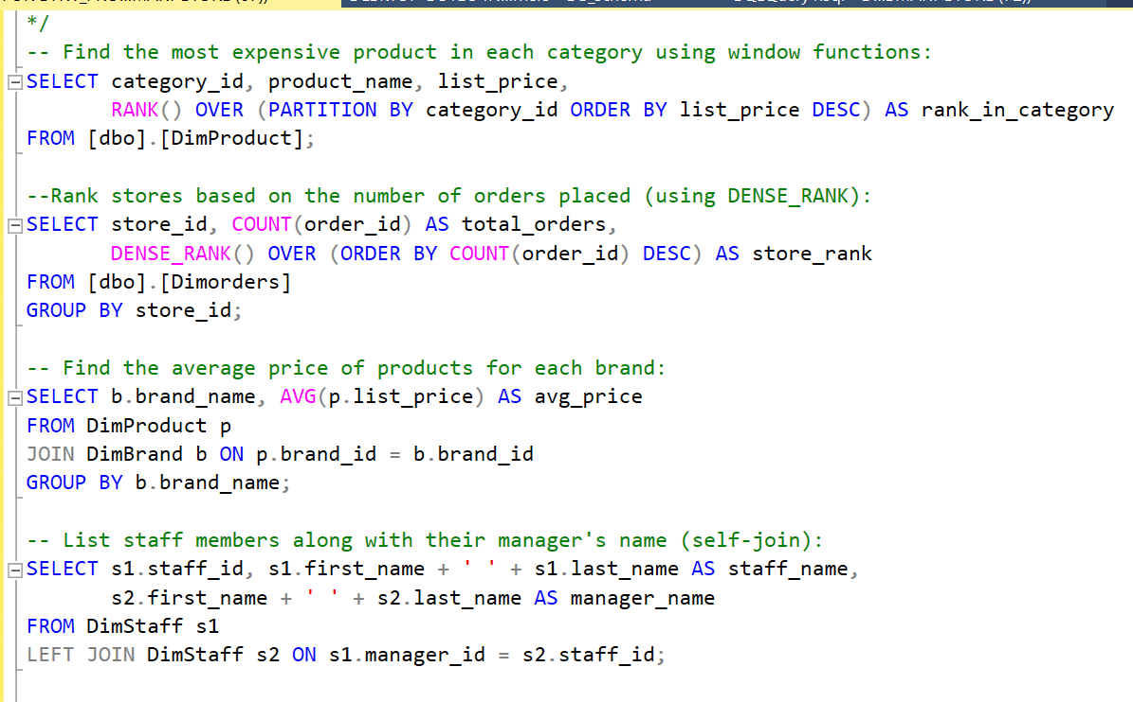

Slide 15
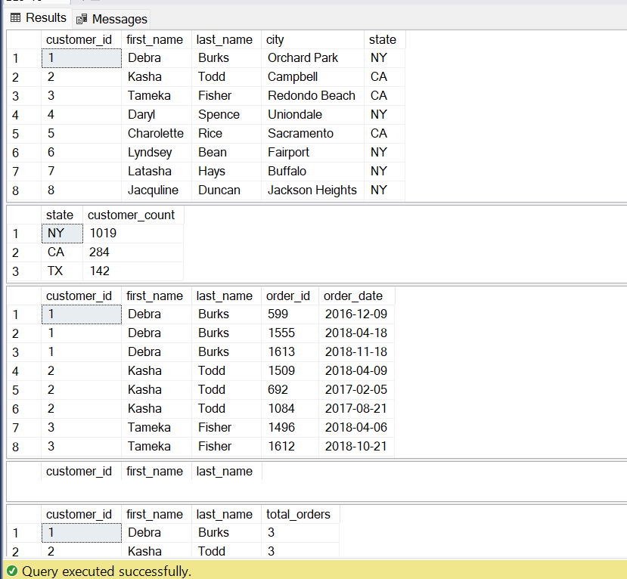
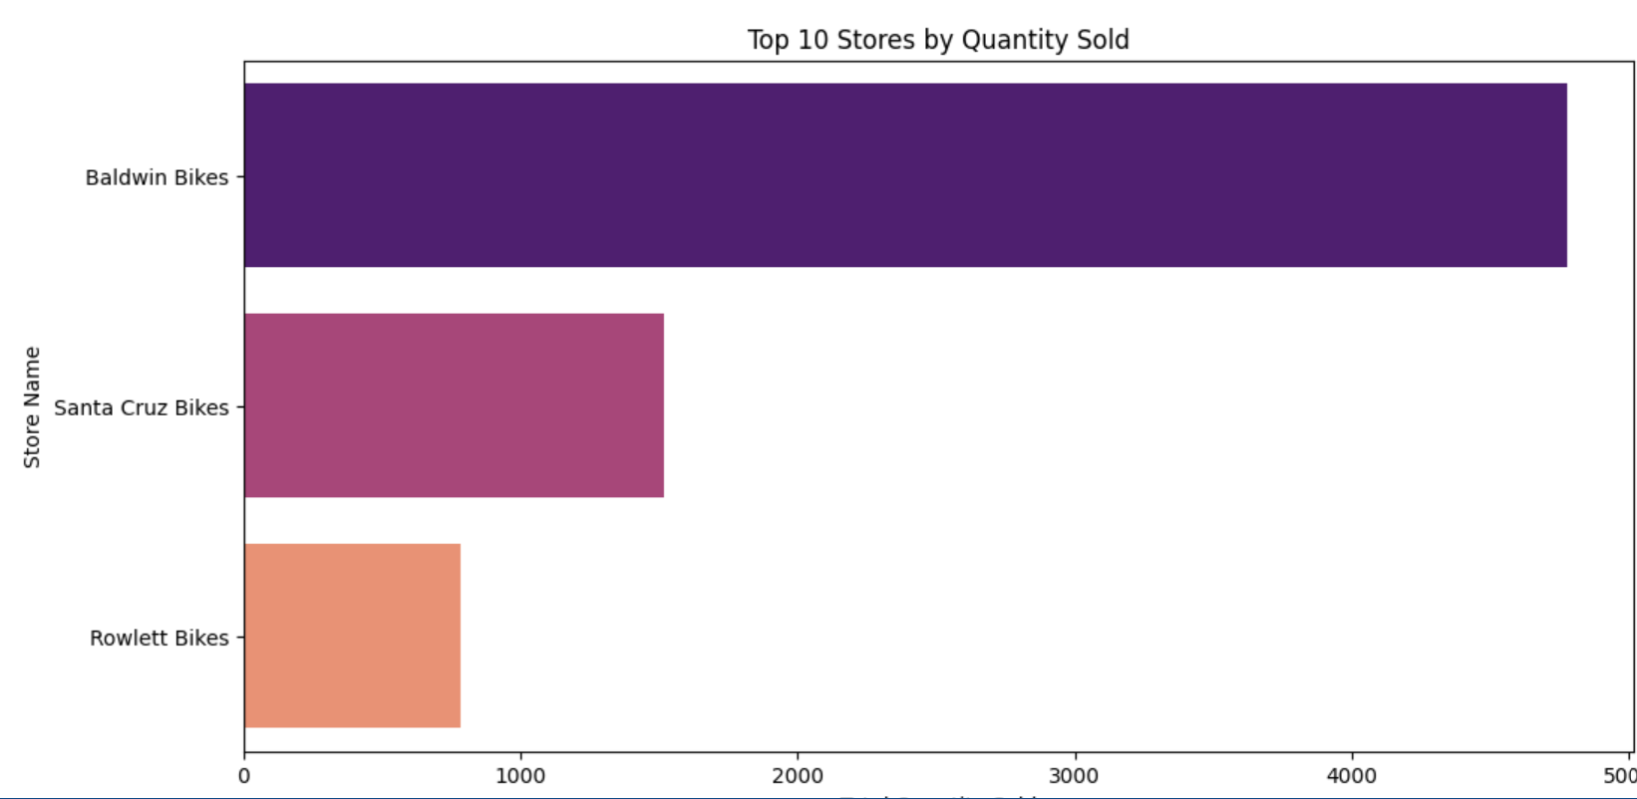

Slide 16
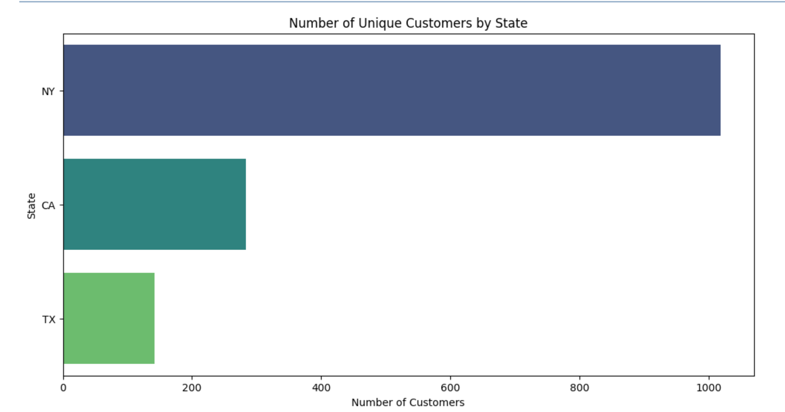
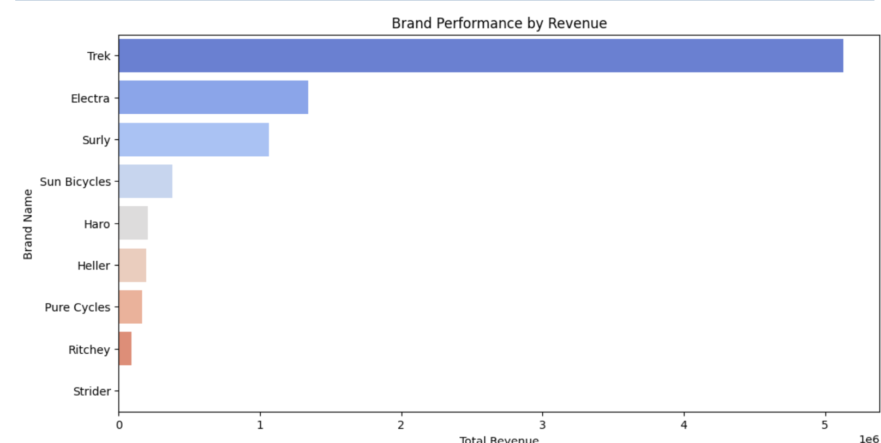

Slide 17
Conclusion
This project provided a comprehensive analysis of customer sales data, revealing critical patterns, trends, and opportunities across customers, products, stores, and operations. By leveraging data exploration, clustering analysis, and key performance indicators (KPIs), we identified actionable insights that can drive better decision-making across several business domains.
Such :
Customer Segmentation and Personalization
Product and Inventory Optimization
Store and Staff Performance
Impact of Discounts

Slide 18
Customer Lifetime Value (CLV) Prediction:
Use machine learning models to forecast CLV, helping prioritize resources toward high-potential customers.
Real-Time Inventory Monitoring:
Implement real-time dashboards to track stock levels and sales trends, ensuring optimal stock availability.
Continuous Performance Evaluation:
Regularly update KPIs and re-cluster customers, products, and stores to adapt to changing trends and business needs.
Automation of Reporting:
Automate the generation of reports and insights using Python or SQL scripts, reducing manual effort and increasing efficiency.
Future Recommendation

Slide 19
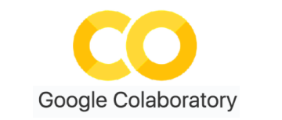


reference
Python analysis code
Dataset

Slide 20
THANK YOU

