Slide 1




Long-Range-Arena Benchmarking on Pathfinder Dataset
CHOUKRI Zakaria
ARNAOUI Basma
AIT MAGOURT Adnane
Supervised By:
Hamza ALAMI
Issam AIT YAHIA
1

Slide 2
The Datasets
Pathfinder
Pathfinder-X
32x32 pixels (1024 pixels).
Binary task: Connected points
via dashed path.
Includes distractors.
Sequence length: 1024 tokens.
128x128 pixels (16K pixels).
Same binary task, larger images.
Tests extreme sequence lengths.
Sequence length: 16K tokens.
2

Slide 3
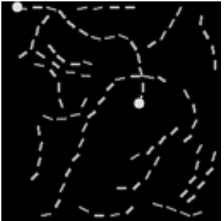
We worked on
Pathfinder 32x32
200K images
Binary task: Connected points
long contours (length 14)
Split: 80% train, 10% validation, 10% test.
3

Slide 4
Models evaluated
AIT MAGOURT Adnane
Model | # Parameters | Accuracy | Training time | Efficiency
CNN model | 543490 | 0.5009 | 1291.06 s | 0.0053
ViT model | 1983650 | 0.5005 | 1428.65 s | 0.0048
Transformer | 3359426 | 0.5017 | 2926.44 s | 0.0042
4

Slide 5
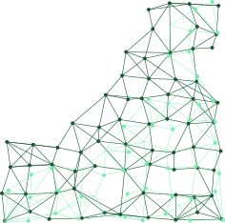
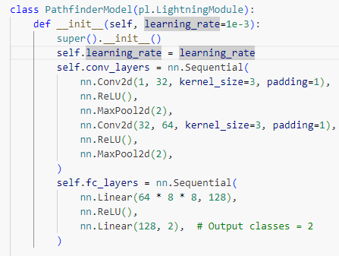
CNN Model Overview
Framework
Extends pytorch_lightning.LightningModule.
CNN-based classification model.
Optimizer
Adam optimizer with learning rate of 0.001
Loss function
Cross entropy loss
5

Slide 6
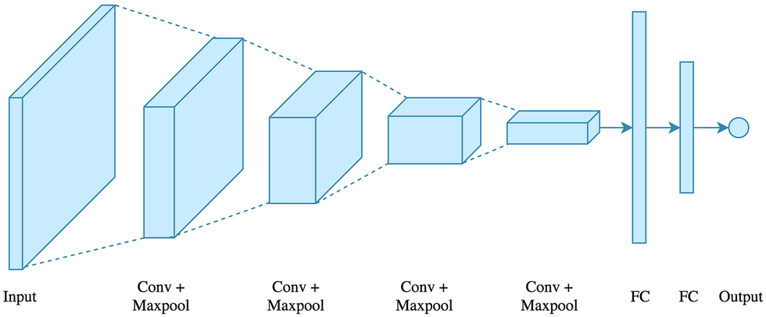
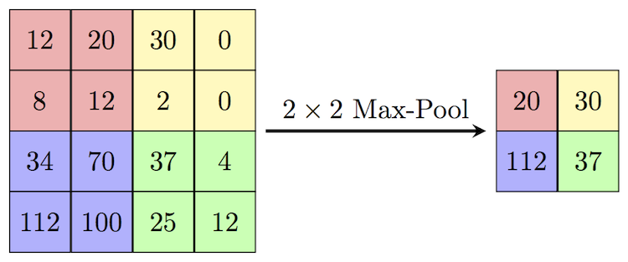
CNN Model Architecture
Convolutional Layers
Two blocks of:
Convolution.
ReLU activation.
Max pooling.
Extracts hierarchical spatial features.
Flattening
Reshapes tensor to feed into linear layers after convolutional feature extraction.
Fully Connected Layers
Classifier with two dense layers.
Final output size of 2 (binary classification).
6

Slide 7

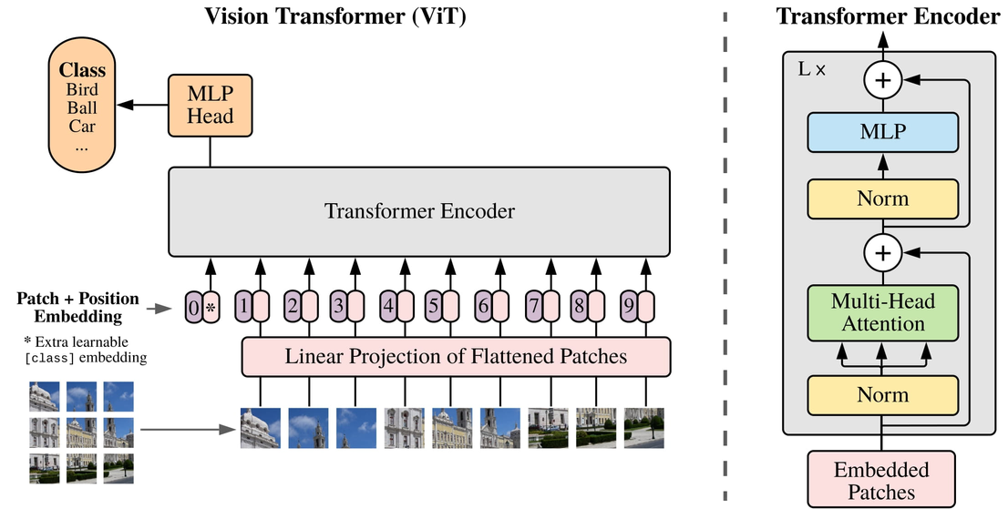
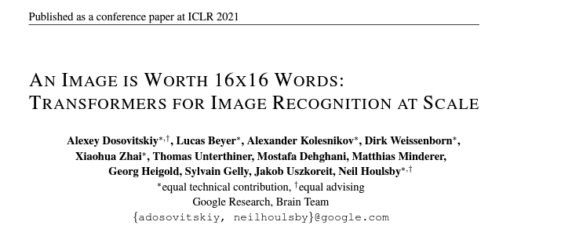
ViT Model Overview
From the paper:
7

Slide 8
ViT Model
Architecture Details
Patch Processing:
Patch size: 4×4.
Divides each 32×32 image into 8×8=64 patches.
Embeds each patch for processing.
Transformer Encoder:
Embedding dimension (dim): 128.
Number of layers (depth): 6.
Multi-head self-attention with 8 heads.
Feed-forward layer dimension (mlp_dim): 256.
Output:
Classification via a linear layer.
8

Slide 9
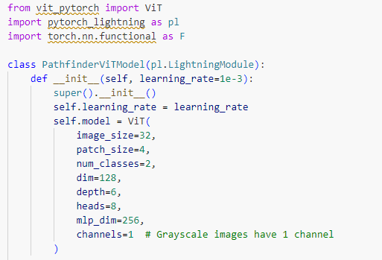
ViT Model
Framework
Uses the ViT class from the vit_pytorch library.
Processes input images using a transformer encoder.
9

Slide 10
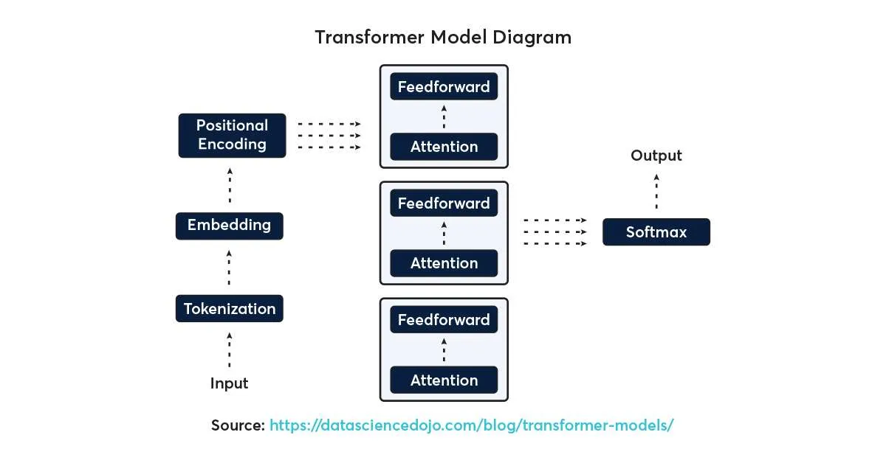

Transformer-based Model Overview
10

Slide 11
Transformer-based Model Architecture
FEATURE EXTRACTION
POSITIONAL ENCODING
TRANSFORMER ENCODER
CLASSIFICATION HEAD
Three convolutional layers:
Reduce spatial dimensions.
Increase feature depth.
Batch normalization and ReLU after each convolution.
Learnable sinusoidal encoding.
Preserves positional information.
Helps Transformer understand sequence and spatial structure.
Built using nn.TransformerEncoder with 4 layers.
Each layer:
Multi-head attention.
Feedforward sub-layers.
Dropout regularization (0.1) to prevent overfitting.
Global mean pooling of encoded features.
Fully connected network reduces features to 2 logits (binary classification).
Loss: Cross-entropy loss.
11

Slide 12
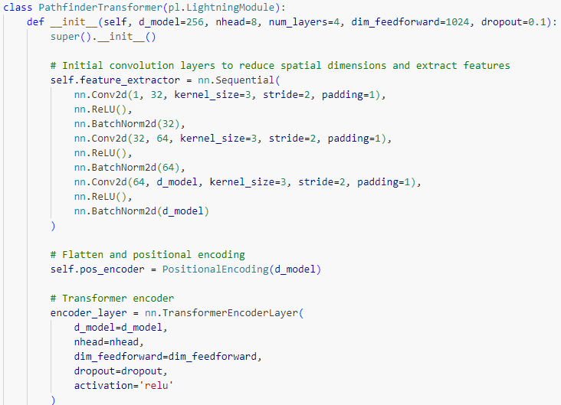
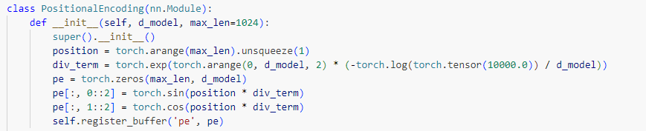
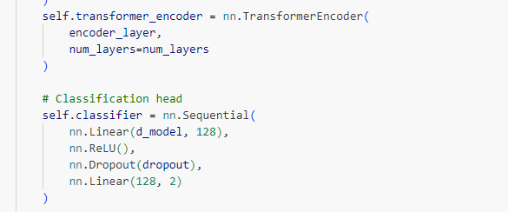
Transformer-based Model Architecture
12

Slide 13
Models evaluated
ARNAOUI Basma
Model | # Parameters | Accuracy | Training time | Efficiency
Mobile Vit Model | 191298 | 0.4975 | 1291.06 s | 0.0046
EfficientFormer Model | 11393724 | 0.9727 | 5107.9s | 0.0072
Swin Transformer | 86745274 | 0.5023 | 16384.67s | 0.0028
13

Slide 14
Shifted Window (Swin) Transformer
Size
224x224 pixel images
swin_base_patch4_window7_224
4x4 patches
7x7 windows
14

Slide 15
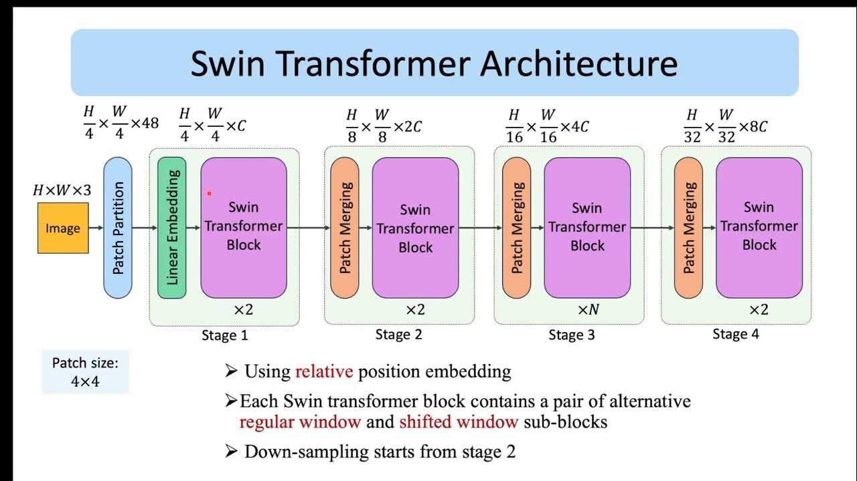
Architecture
15

Slide 16
Key Functions
Divides images into 4x4 patches converts them into tokens.
Applies Shifted Window Attention to capture both local and global patterns.
Constructs a multi-level image representation by merging tokens progressively.
Generates predictions to classify images into two distinct categories.
16

Slide 17
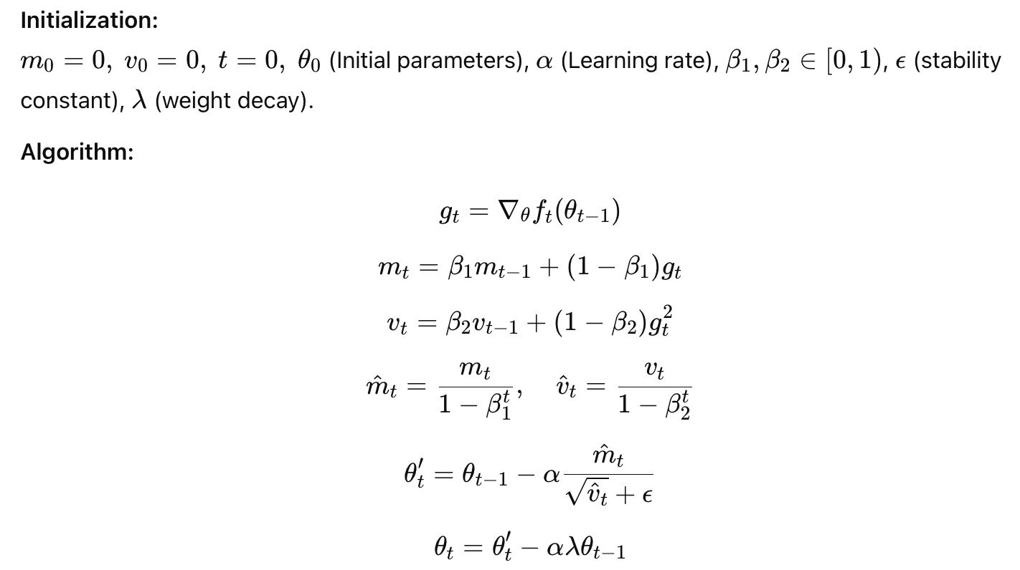
Optimizer: AdamW
17

Slide 18
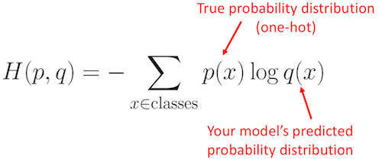
Loss Function: Cross Entropy Loss
18

Slide 19
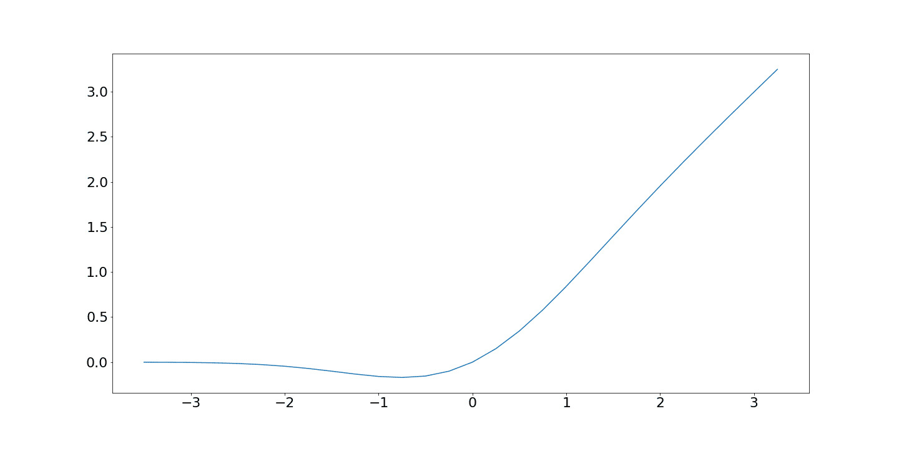
Activation Function: GeLU
19

Slide 20
Efficient Former Model
My best performing Model!
20

Slide 21
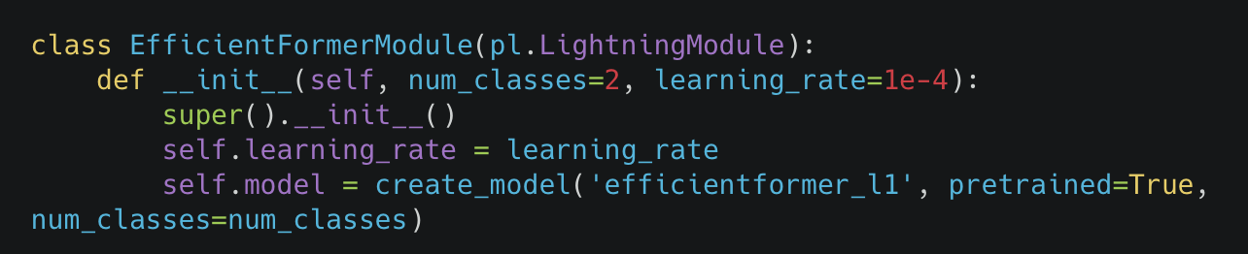
Efficient Former Model
Loads pretrained weights from ImageNet, allowing faster convergence and improved performance.
Binary Classification
Initializes the EfficientFormer-L1 architecture
21

Slide 22
Why Efficient Former?
Efficiency of CNN + Flexibility of Transformers
Low latency + High accuracy.
22

Slide 23
Same Optimizer as the Swin
Same Loss function
23

Slide 24
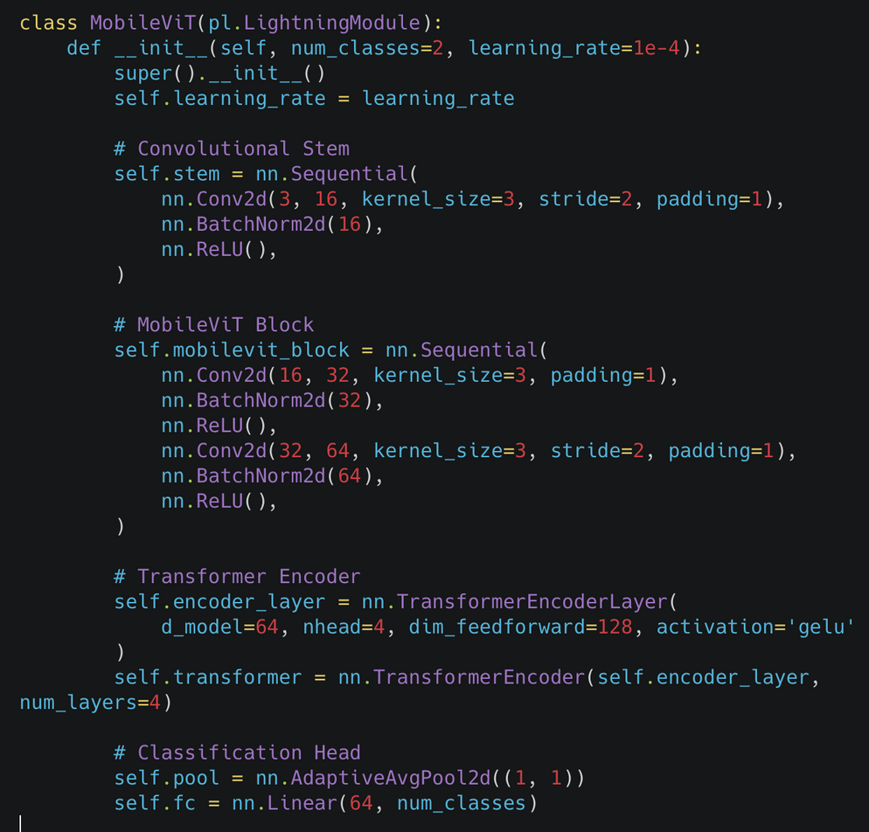
Mobile Vit Model
MobileNet-like convolution with a Vision Transformer (ViT)
Extracts initial features by downsampling the input image using convolution layers.
Enhances local and global feature extraction through lightweight convolution and normalization layers
Applies self-attention to capture long-range dependencies and improve feature representation.
Pools features to a fixed size and predicts class probabilities through a fully connected layer.
24

Slide 25
Why Mobile Vit?
Local Feature Retention + Global Representation Learning
Efficiency of CNN + Power of Transformers
Real-time Inference + Low Computational Cost
25

Slide 26
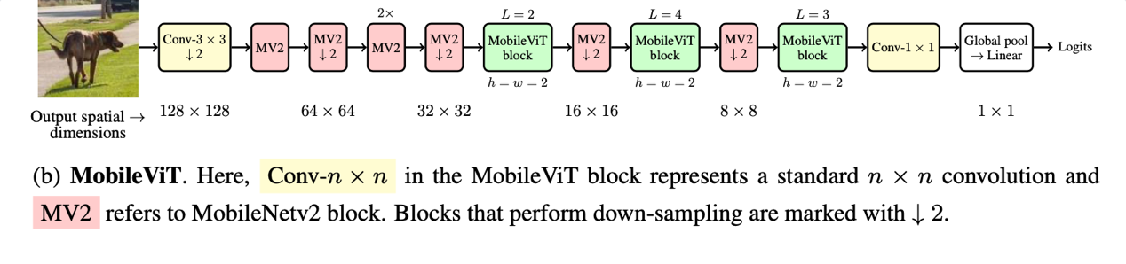
Mobile Vit Architecture
From Paper :MobileViT: Light-weight, General-purpose, and Mobile-friendly Vision Transformer
26

Slide 27
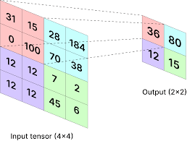
Global Average Pooling Used:
27

Slide 28
“Pure” Transformer Model
28

Slide 29
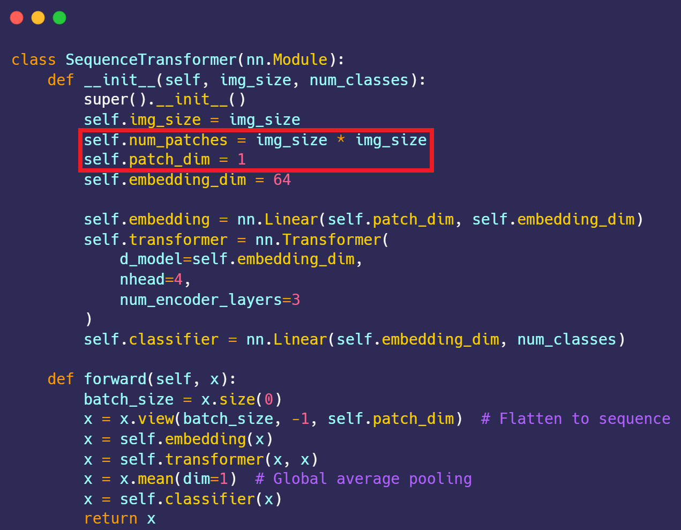
Transformer
model
Model Architecture:
Input Embedding Layer
Transformer Encoder: Consists of multiple layers of multi-head self-attention and feedforward neural networks.
Classification Head
29

Slide 30
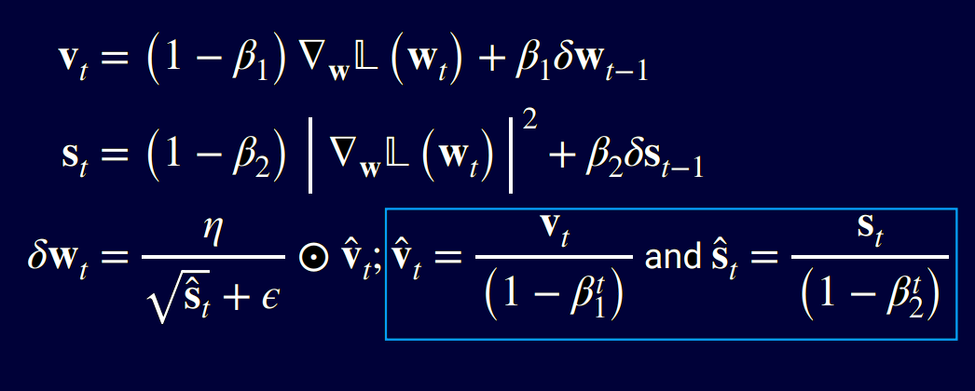
Optimizer: Adam
30

Slide 31
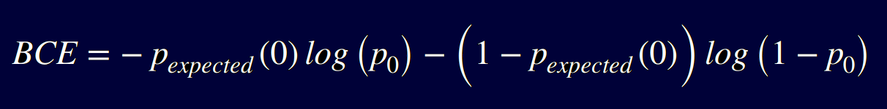
Loss function:
Binary Cross Entropy
31

Slide 32

Metrics:
Training time
number of parameters
accuracy
efficiency score
32

Slide 33
The other two
models
33

Slide 34
These models are pre-trained but we fine tuned them
34

Slide 35
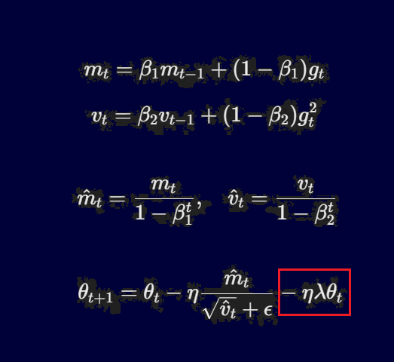
Optimizer: AdamW
35

Slide 36
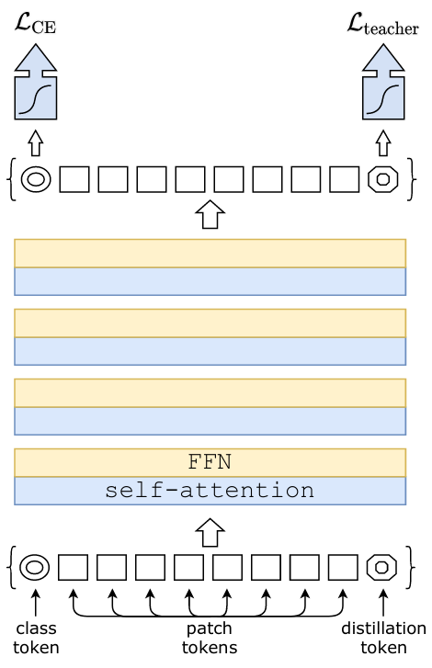
DeiT model
Model Architecture:
The input image of size 224x224 is divided into non-overlapping patches of size 16x16
These patches are flattened into vectors and projected through a linear embedding layer
Transformer layers
Final Classification Head
This is actually also a transformer model, but I did not include it with the “pure” transformer because this one first scales the input to become 224x224 then takes patches of length 16x16 = 256 pixels, contrary to the previous one that takes the whole 32x32 = 1024 pixels as a sequence and treats it pixel by pixel.
36

Slide 37
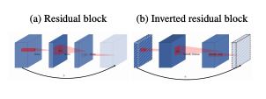
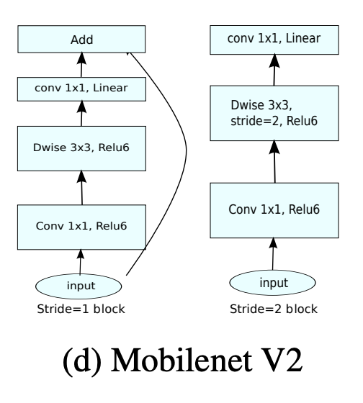
CNN model
Model Architecture:
MobileNetV2 consists of a series of inverted residual blocks, with each block typically having three components:
Expansion layer (1x1 convolution): Expands the input channels.
Depthwise separable convolution: Applies convolution over individual channels (rather than all channels simultaneously).
Linear bottleneck: Reduces the channel size at the output of the block.
37

Slide 38
Models evaluated
CHOUKRI Zakaria
Model | # Parameters | Accuracy | Training time | Efficiency
CNN model | 2226434 | 0.7968 | 3193.16 s | 0.0068
DEIT model | 21666434 | 0.7883 | 10064.90 s | 0.0051
Transformer model | 2631490 | 0.5011 | 10138.11 s | 0.0037
38

Slide 39
Conclusion
the pure transformer model did not perform as well as the other two. But it is expected, since the long sequence length of 1024 is something that stress tests the model’s attention mechanism.
39

