Slide 1














Secure File Synchronization Tool with Version Management
Foundation of computer programming
Omar Alfarouq Bouhadi
Zakaria Choukri
Ayman Youss

Slide 2

Introduction.
The project revolves around creating a local version control system inspired by Git, incorporating essential commands like add, commit, push, and pull for effective code management and enhancing version tracking.

Slide 3

Technologies used.
In the development of the project, we primarily utilized C++ for the core functionality and Qt for the graphical user interface (GUI) aspects. C++ provided the necessary power and flexibility for building a robust local version control system, while Qt simplified the creation of an intuitive and user-friendly interface, enhancing the overall user experience.

Slide 4
Getting started.
01
02
03
04
Execute the provided shell script: compile.sh to build the project. This script creates the myprogram.exe executable, a key component of our system.
After successful compilation, run the myprogram.exe executable. This step initializes the program and sets the stage for command input.
The program opens a command prompt, providing an interactive environment for users to input commands. Familiarize yourself with the supported commands to navigate and utilize the features of our local version control system.
Enter supported commands in the command prompt to perform various actions, such as git add, commit or pull.

Slide 5
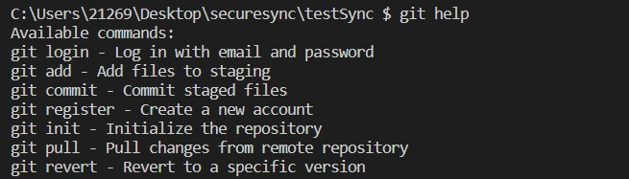
Command line interface (CLI).
Help command that displays the different commands supported by the system.

Slide 6
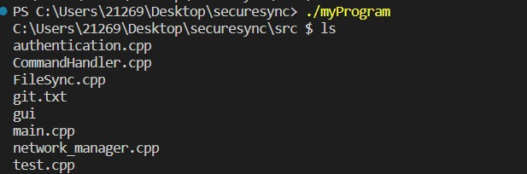
Command line interface (CLI).
ls command that displays the content of the current directory

Slide 7
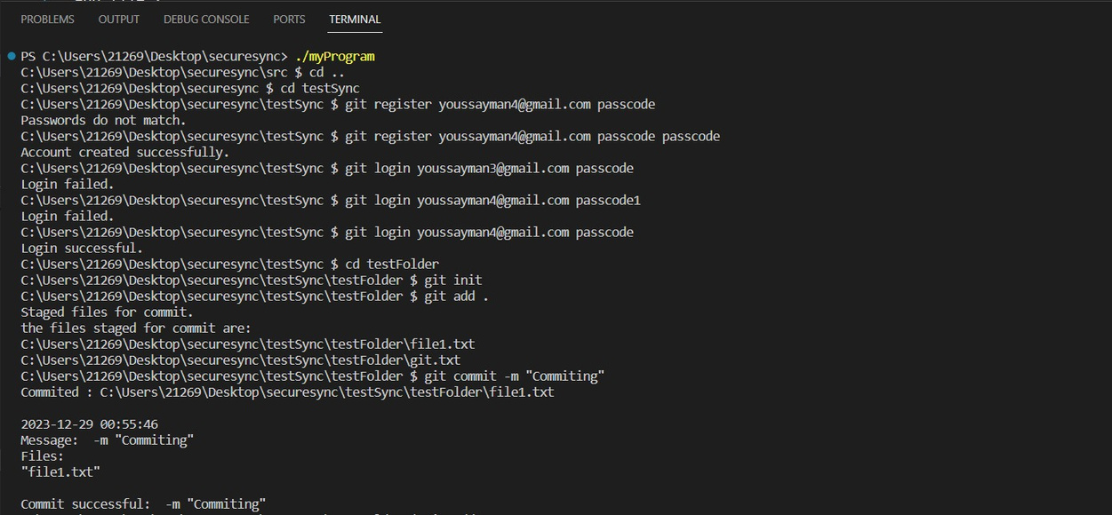
Command line interface (CLI).
Navigating to the desired directory using the cd command.
Register and log in using the user’s credentials.
Using git init to initialize the repository.
Using git add to add desired files to the stage for a commit later.
Using git commit with a message to commit the files in the stage.

Slide 8
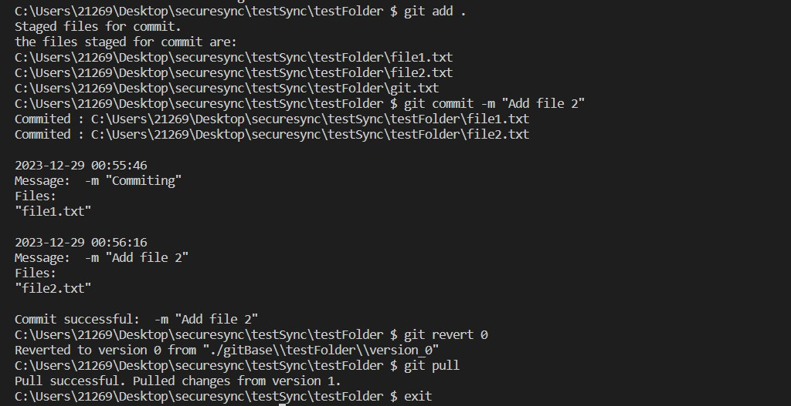
Command line interface (CLI).
Using git revert 0 to come back to version 0 of the repository.
Using git pull to get the up-to-date version of the repository.
Using exit to close the command line interface.

Slide 9
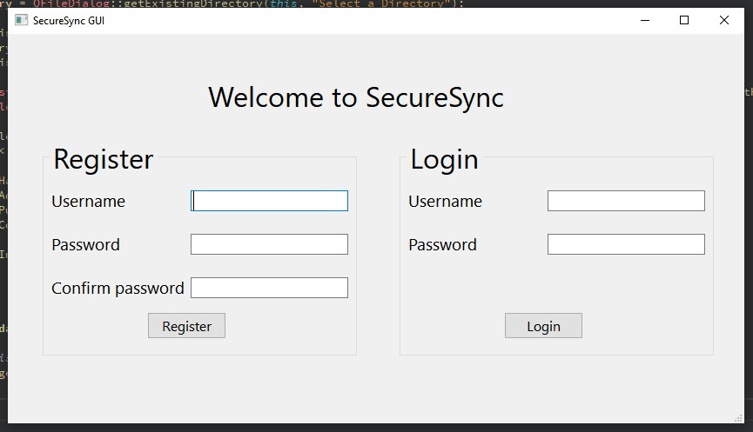
Graphical user interface (GUI).
User Registration:
New users can create accounts by providing a valid email and password.
Login Feature:
Existing users can log in using their registered email and password.

Slide 10
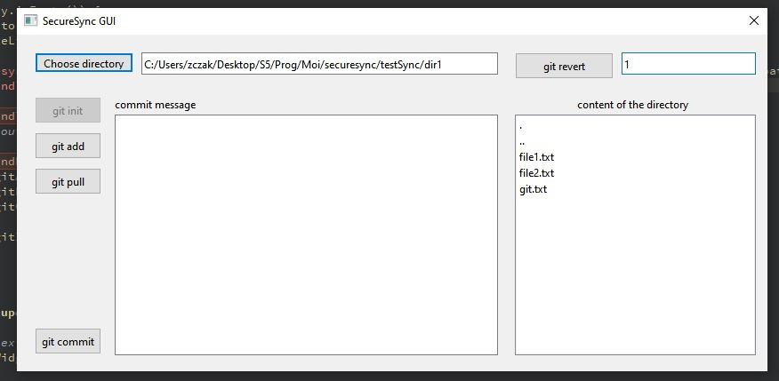
Graphical user interface (GUI).
Git Operations:
The user interface presents buttons for essential Git commands.
Init: Set up a new Git repository.
Add: Stage files for commit.
Commit: Save staged changes with a descriptive message.
Pull: Pull changes from last version.
Revert: Roll back to a previous version, providing version number.
Intuitive Navigation:
Simplified buttons ensure a user-friendly experience for version control tasks.
Users can easily navigate and select directories using a dedicated button, enhancing flexibility in managing repositories.

