Slide 1
Introduction Of Python3
Unit One

Slide 2
Unit one Part one outline
About Python ?
Versions of Python
Preparing coding environment for Python
Print Hello World
basic calculations
Variable

Slide 3
About Python
Python is a well-liked programming language. Python was introduced by Guido Van Rossum in 1989.
Van Rossum started developing the new script in the late 1980s and finally introduced the first version of that programming language in 1991. This initial release has module system of Modula-3. Later on, this programming language was named ‘Python’.

Slide 4
Cont…
Often people assume that the name Python was written after a snake.
Back in the 1970s, there was a popular BBC comedy tv show called Monty Python’s Fly Circus and Van Rossum happened to be the big fan of that show. So when Python was developed, Rossum named the project ‘Python’.
Python can works on dissimilar stands (Windows, Mac, Linux, Raspberry Pi, etc).

Slide 5
Conti..
Python has syntax that permits developers to jot down programs with less lines than some other programming languages. Python runs on an explainer system, meaning that code can be executed as soon because it is written. this means that prototyping can be very fast. Python can be treated in a method way, an object-orientated way or a efficient way.

Slide 6
Cont.
Use of python : data analytics, data science, machine learning, artificial intelligence, web development (server-side), software development , mathematics, system scripting etc.

Slide 7
filename extensions
filename extensions are .py, .pyc, .pyd, .pyo. It enables the straight and easy programming for both small and large applications.
It mainly emphasizes on code reusability, readability and using white space.
Python uses expressions mainly similar to C language and its methods and typing.
Python supports multiple programming paradigms like functional programming, imperative and procedural as well.

Slide 8
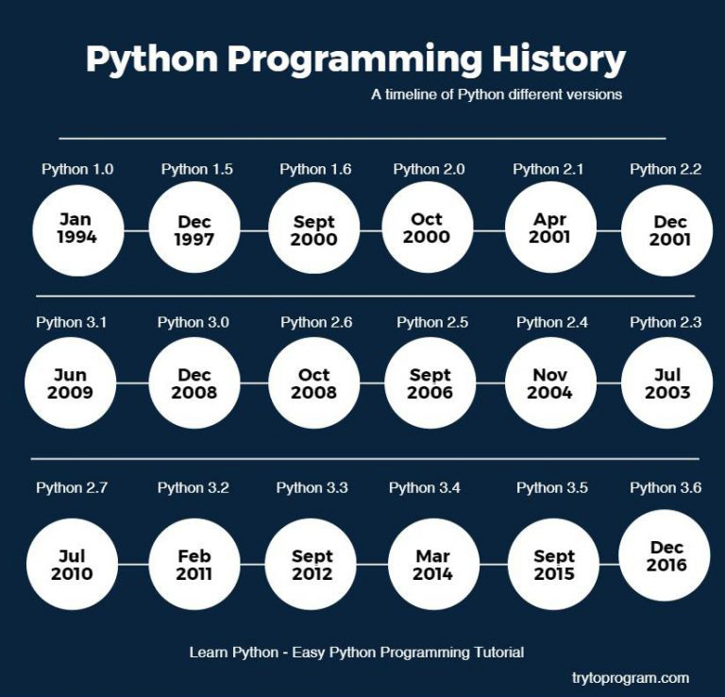
History Python

Slide 9
Python 2 vs Python 3
There are plenty of differences between these Python programming versions, but here are five of the main ones.
1. Python 2 is legacy, Python 3 is the future.
Since Python 2 has been the most popular version for over a decade and a half, it is still entrenched in the software at certain companies.

Slide 10
Cont
However, since more companies are moving from Python 2 to 3, someone who wants to learn Python programming for beginners may wish to avoid spending time on a version that is becoming obsolete.

Slide 11
Cont..
2. Python 2 and Python 3 have different (sometimes incompatible) libraries
Since Python 3 is the future, many of today's developers are creating libraries strictly for use with Python 3.
Similarly, many older libraries built for Python 2 are not forwards-compatible.

Slide 12
Cont…
3. There is better Unicode support in Python 3
In Python 3, text strings are Unicode by default. In Python 2, strings are stored as ASCII by default–you have to add a “u” if you want to store strings as Unicode in Python 2.x.

Slide 13
Cont..
4. Python 3 has improved integer division
In Python 2, if you write a number without any digits after the decimal point, it rounds your calculation down to the nearest whole number.
For example, if you’re trying to perform the calculation 5 divided by 2, and you type 5 / 2, the result will be 2 due to rounding. You would have to write it as 5.0 / 2.0 to get the exact answer of 2.5.

Slide 14
Cont…
However, in Python 3, the expression 5 / 2 will return the expected result of 2.5 without having to worry about adding those extra zeroes.
This is one example of how Python 3 syntax can be more intuitive, making it easier for newcomers to learn Python programming.

Slide 15
Cont..
5. The two versions have different print statement syntaxes
This is only a syntactical difference–and some may consider it trivial–so it doesn’t affect the functionality of Python. That said, it is still a big and visible difference you should know about.
Essentially, in Python 3, the print statement has been replaced with a print () function.
For example, in Python 2 it is print “hello” but in Python 3 it is print (“hello”).
If you're going to learn Python programming for the first time, it shouldn't affect you much. But if you started with Python 2, the change may trip you up a few times.

Slide 16
Preparing Python 3 Development Environment
need material :-
Laptop
Anaconda framework
And dedication from student.

Slide 17
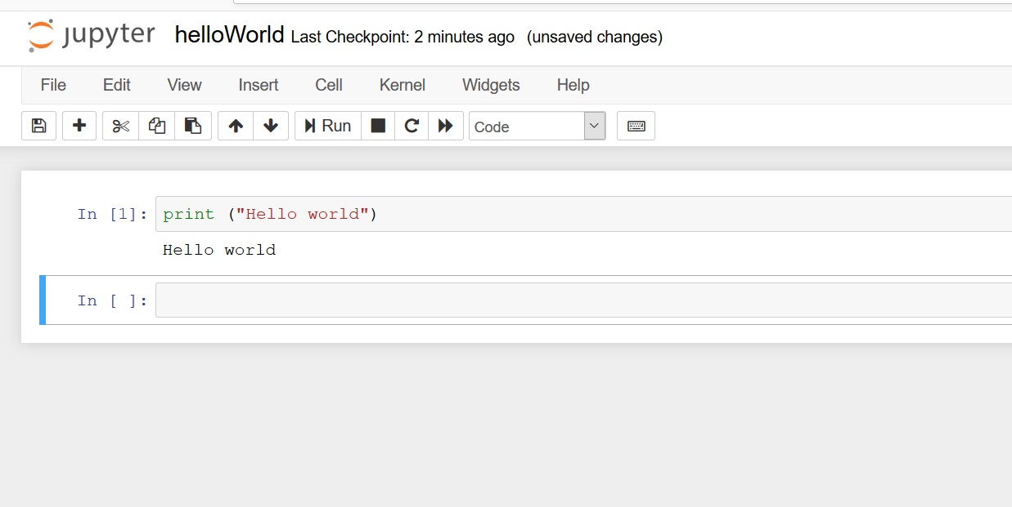
Hello world

Slide 18
Summary for Last Lecturer
Python introduced 1989, release 1991 and first version for public release 1994 by Guido Van Rossum
Difference between python 2 and python 3
A. python 2 is legacy and python 3 is future
B. incompatibilities libraries
C. Unicode python 3 support by default and python 2 need to add ‘u’

Slide 19
Conti..
D. division improvement
E. Print statement (print ‘hello” and print (“Hell0”)

Slide 20
Numbers in Python!
In this lecture, we will learn about numbers in Python and how to use them.
We'll learn about the following topics:
1.) Types of Numbers in Python
2.) Basic Arithmetic
3.) Differences between classic division and floor division

Slide 21
Basic Calculations
Operator | Operation | Example | Evaluates to...
** | Exponent/power | 2 ** 3 | 8
% | Modulus/remainder | 22 % 8 | 6
// | Integer division/floored quotient | 22 // 8 | 2
/ | Division | 22 / 8 | 2.75
* | Multiplication | 3 * 5 | 15
- | Subtraction | 5 - 2 | 3
+ | Addition | 2 + 2 | 4

Slide 22
Precedence
The order of operations (also called precedence) of Python math operators is similar to that of mathematics.
The ** operator is evaluated first; the *, /, //, and % operators are evaluated next, from left to right; and the + and - operators are evaluated last (also from left to right).
You can use parentheses to override the usual precedence if you need to.

Slide 23
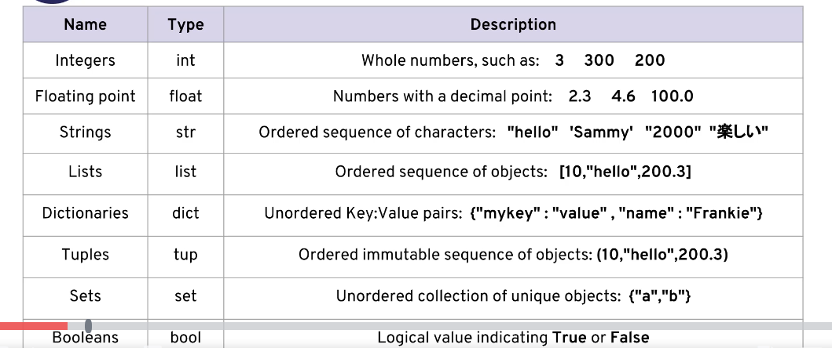
Data types In Python 3

Slide 24
Rules of Assigning Variables
The names you use when creating these labels need to follow a few rules:
1. Names can not start with a number.
2. There can be no spaces in the name, use _ instead.
3. Can't use any of these symbols :'",<>/?|\()!@#$%^&*~-+
4. It's considered best practice (PEP8) that names are lowercase.
5. Avoid using the characters 'l' (lowercase letter el), 'O' (uppercase letter oh),
or 'I' (uppercase letter eye) as single character variable names.
6. Avoid using words that have special meaning in Python like "list" and "str"

Slide 25
Dynamic Assigning
In python you can reassignment variable to other data type
My_friends = 5
In C++ this is not possible you have define like
Int my_friends = 5

Slide 26
Examples in Anaconda

Slide 27
String
Python programs can also have text values called strings, or strs, Always surround your string in single quote (') characters (as in 'Hello' or 'Goodbye cruel world!’) or double quotes “Hello” so Python knows where the string begins and ends. You can even have a string with no characters in it, '', called a blank string.

Slide 28
String
Strings are used in Python to record text information, such as names. Strings in Python are actually a *sequence*, which basically means Python keeps track of every element in the string as a sequence. For example, Python understands the string "hello' to be a sequence of letters in a specific order.
To create a string in Python you need to use either single quotes or double quotes. For example:

Slide 29
Let go to anaconda
Variable
Strings

Slide 30
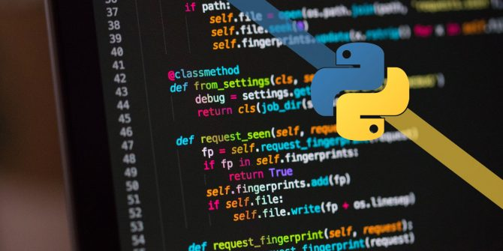
Let go to Anaconda Framework

Slide 31
Pop Quiz
Rules :
No smart phones
No talking
In 5 minutes I have to have your quiz in my table.
Leave the class immediately

Slide 32
End

