Slide 1
101 World of ICT
Zakaria Hujale

Slide 2
About Me
Name : Zakaria Ali Sh. Ibrahim hujale
Education: Master Of IT from Amity India
Bach Degree Of IT from Unisel Malaysia
Work : Head Of IT, Consultant and Lecturer

Slide 3
About You
What is your Name ?
Why IT ?

Slide 4
Your Guide To ICT World
Computer Science will teach you everything about applications, software, and programs while information technology teaches how to use and control those things

Slide 5
Career
There's no doubt in your mind that you want to work in the exciting field of technology when you're done studying. And with the fast career growth and exciting salary potential, who could blame you?
The average salaries of professionals in the technology sector (e.g. Software Developer, Web Developer, System Administrator, Database Developer, etc) are significantly higher than most other professions. The following table shows the annual average salaries for Software Developer in different countries.

Slide 6
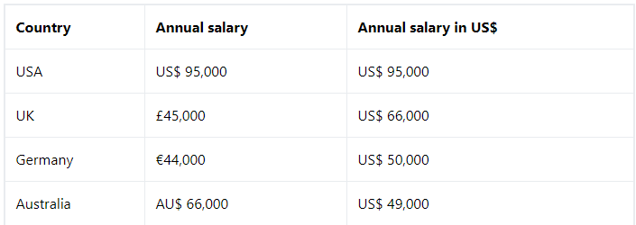

Slide 7
You made a Good Choice
With the world becoming increasingly more digital, the number of such jobs and salaries are certain to grow in the future. Considering these factors, it's no wonder that you consider studying Computer Science or Information Technology degree.

Slide 8
Here is why?
Here are five reasons why you should do an information technology course.

Slide 9
1. Variety of career choices
Information technology is incredibly diverse and it’s not just about fixing computers or laptops. This course will allow you to take your career in a number of different directions. Careers vary from a System Developer, Web Developer, Database Administrator, Server Administrator, Network Administrator and much more. IT graduates will also be prepared to specialize in far wider areas of interest. The job market in computing and information technology is growing. These jobs require skill, training and a logical thinking process. Many of these careers are demanding and stressful but most offer a hefty financial reward.

Slide 10
2.You can see what you’re studying
The biggest part of studying information technology is practical. Doing an information technology course, you won’t just learn the theoretical part but also get the opportunity to make things. With that, you can change or adjust things and implement what you’ve learned. Knowledge is important to any career field. It’s sometimes better to see what you’re learning by actually doing it. That way you’ll remember things quicker and longer and become successful in your field.

Slide 11
3.Flexible work style
When you’re looking for a job, your personal preferences count. If you prefer working on your own, there are jobs out there in information technology allowing you to do so. You’ll be able to work according to your own schedules. Being flexible will also lead to better teamwork. For instance, when you have a doctor’s appointment you’ll have enough time to attend it. You’ll also be a more happy and satisfied employee as you’ll feel empowered through being able to structure your work and personal life according to your needs. The opportunity to work for yourself might also present itself. Many information technology professionals have a full-time position at an established company while also running their own business after hours. By doing that you’ll grow your skills faster as you’ll be doing more than the usual amount of work.

Slide 12
4. You’ll earn good money
Your choice to pursue a career in information technology is influenced by a number of factors. But without a doubt, one of the most positive factors is the amount of money you’ll make.

Slide 13
5.Always in demand
As mentioned earlier, there are many careers to follow when specialising in information technology. As technology progresses the need for information technology professionals will only increase. And the better your skill set the more in demand your expertise will be.

Slide 14
Choosing One OF these Career
Software and web Development
Database Development and Administration
systems and Network Administrator

Slide 15
Software Developer
Software developers create the applications or systems that run on a computer or another device.
You Most be good one of the major programming languages
Python, Java, Php or .Net
Also know front end development (HTML5, CCS and JS)
And little bit about Database

Slide 16
Database Dev and Administration
A database is a collection of information that is organized in tables and stored on a computer system. This information can be Deleted, updated or modified as required.

Slide 17
Database administrators control the development of a company's databases to keep vital data available only to users with authorized access. DBAs work closely with information systems managers to customize database solutions to corporate needs.

Slide 18
Oracle RDBMS
Microsoft SQL Server
MySQL
SQLite
PostgresSQL
MongoDB

Slide 19
network administrator
A network administrator is responsible for installing, maintaining and upgrading any software or hardware required to efficiently run a computer network
Network administrators are rarely involved in direct user support like help desk duties. Instead, they engage in high-level technological support, such as maintaining network hardware and software equipment, and monitoring equipment to ensure overall network operations.

Slide 20
Network administrators may also technically take part in the management and maintenance of desktop computers, servers, printers, switches, routers, firewalls, software implementations, security updates, VPN gateways, file servers, intrusion detection systems and a wide range of additional technologies associated with both software and hardware within the network.

Slide 21
Cont..
Certificates related to network administration are offered by well-known organizations like Microsoft, Cisco, Redhat and Juniper.

Slide 22
Have You change your mind
Which Field you can be focus on?

