Slide 1
Introduction Of Python3
Unit One Part 2

Slide 2
Unit one Part one outline
More about String
list

Slide 3
String In Python
A string is a sequence of characters
A string literal uses quotes 'Hello' or “Hello”
For strings, + means “concatenate”
When a string contains numbers, it is still a string
We can convert numbers in a string into a number using int()

Slide 4
>>> str1 = "Hello”
>>> str2 = 'there'
>>> bob = str1 + str2
>>> print bob
Hellothere
str3 = '123'
str3 = str3 + 1 (error)
x = int(str3) + 1
print x
124

Slide 5
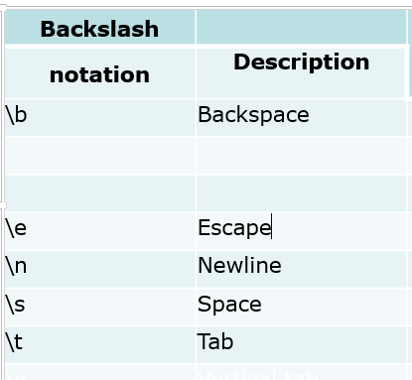
Escape Characters

Slide 6
Lets to notebook and anaconda

