Slide 1
Tabular Synthetic Data Generation
Hoffner Marcell (CH4BMX)
Kilyénfalvi Zsófia Kata (RD7Z7P)
Nagy Zsuzsanna (X8O30D)
Zakariás Anna (DLNQ2V)

Slide 2
Overview and Motivation
Goal: Create rerealistic-looking synthetic tabular examples with data quality similar to provided data to protect sensitive data and mitigate bias. Then compare 4 models (GANs, VAEs, Gaussian Copula and Bayesian Network)
Why It Matters:
enables safe data sharing in sensitive fields (e.g., healthcare, finance)
solves the problem of lack of data, privacy, privacy regulations (GDPR, HIPAA)
supports robust model development and testing
Characteristics of Tabular Data:
structured rows and columns
mixed data types (categorical, numerical, datetime)
complex inter-column dependencies

Slide 3
Methods and Challenges
Generation Techniques:
GANs, VAEs, Copulas, Bayesian networks
Challenges:
handling mixed data types and dependencies
ensuring privacy, fairness, and statistical fidelity
evaluating synthetic data quality
Applications:
fraud detection
medical patient data simulation
recommendation systems
clinical research of rare diseases

Slide 4
Dataset
Purpose: Predict whether a person earns more than $50K/year based on census data.
Source: UCI Machine Learning Repository URL: https://archive.ics.uci.edu/ml/datasets/adult
Rows: around 32,000 after cleaning
Columns: 15
Encoding Needed: Label/One-hot encoding for categorical columns

Slide 5
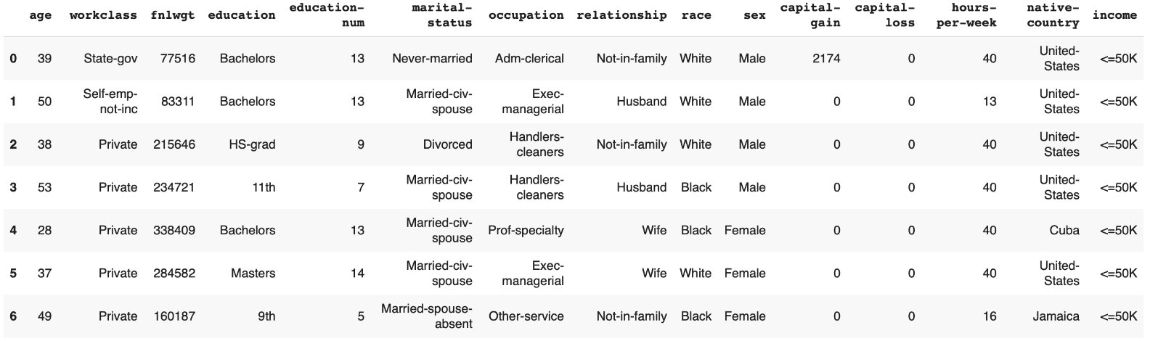

Slide 6
Bayesian Network
Used Bayesian Networks to model probabilistic relationships in data. Captured conditional dependencies using graph structure & CPTs. Implemented using pgmpy with real-world or synthetic datasets.
Key Steps
aata preprocessing & discretization
structure learning (constraint- or score-based)
parameter estimation (MLE or Bayesian)
sampling synthetic data from the learned model
Outcomes
generated synthetic data consistent with Bayesian structure
maintained interpretable probabilistic dependencies
flexible to use in causal inference & decision-making
Benefits
transparent and explainable
handles missing data naturally
strong fit for risk modeling, healthcare, and diagnostics

Slide 7
Gaussian Copula
used Gaussian Copula method to capture marginal distributions and dependencies
SDV & SDMetrics for generation and evaluation
Key Steps:
data preprocessing & metadata setup
Gaussian Copula-based synthesis
quality & diagnostics evaluation
visual comparisons (distributions & correlations)
Outcomes:
high-quality synthetic data that mimics real data well
preserved statistical structure & relationships
suitable for secure ML training and testing
Benefits:
reproducible & scalable
useful with variables that have Gaussian distribution

Slide 8
Generative adversarial network - GANs
Key Steps
data loading and preprocessing
Loading and training two GAN modell: CTGAN, TabFairGAN
TabFairGAN: fairness configuration
Generated data saved as csv files
Evaulation
Outcomes
high-quality synthetic data that mimics real data well
Closely preserved statistical structure & relationships
Benefits
Enabled unsupervised learning of structured features
Generates similar synthetic data to the real data
High-quality generation for complex distributions

Slide 9
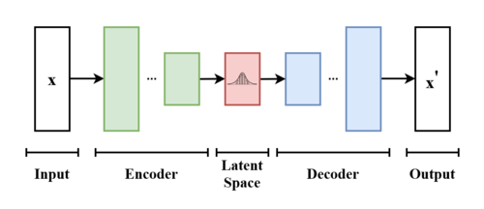
Variational autoencoder - VAEs
Key Steps
data loading and scaling
encoder and decoder neural network construction
MSE + KL divergence loss definition
model training with combined loss optimization
Outcomes
encoder learned compact latent representations
decoder successfully reconstructed input data
smooth latent space enabled meaningful interpolation
reduced overfitting via regularized latent encoding
Benefits
intuitive introduction to probabilistic generative models
enabled unsupervised learning of structured features
strong base for advanced models like VAEs + GANs or β-VAEs

Slide 10
Used evaluation metrics
Cosine similarity
compare the overall feature vectors of real and synthetic data points
Quality Report
checks how well synthetic data replicates statistical properties of the real dataset
Distance to Closest Record (DCR)
how close each synthetic record is to its nearest real record
if synthetic data is too similar can leak private information
k-Anonimity
measures if the data points in a dataset can be differentiate from at least k-1 other data points with respect to the quasi-identifiers
Visual comparision – Data distribution, PCA
can provide insights into how accurate was the synthetic data generation
Notes:
Quasi-identifier: A variable that can be used to identify an individual through association with another variable.

Slide 11
Conclusion – Model comparison
Gaussian Copula
Stable, interpretable, ideal for mixed tabular data
Assumes Gaussian-like dependencies
Bayesian Network
Causal relationships, interpretable
Requires feature ordering; scales poorly with high dimensions
VAEs
Learns latent structure, flexible
Reconstruction loss can blur discrete data fidelity
GANs
High-quality generation for complex distributions
Hard to train, especially on discrete or categorical data

Slide 12
Task Division
Statistical Methods (Bayesian Networks, Gaussian Copula): Marcell, Anna – Explored traditional tabular data generation techniques with interpretable models.
Deep Learning Approaches (GANs, VAEs): Zsuzsanna, Zsófia – Investigated advanced generative models for complex data synthesis.
The project's Github repository: https://github.com/zakarias00/synth_tabular_data_gen.git

