Slide 1
COURSE 2 MODULE 5 PROGRAMMING ASSIGNMENT ASSIGNMENT IS TO ETL MIMIC DATA INTO THE OMOP CONDITION_OCCURRENCE TABLE BY/ zakaria abrabri

Slide 2
Assignment is to ETL MIMIC data into the OMOP CONDITION_OCCURRENCE table
ETL Steps
Understand source/target data models
Profile source tables
Create ETL mappings
Write transformation code
Execute transformation
Perform data quality assessment
Package documentation
Notes:
<number>

Slide 3
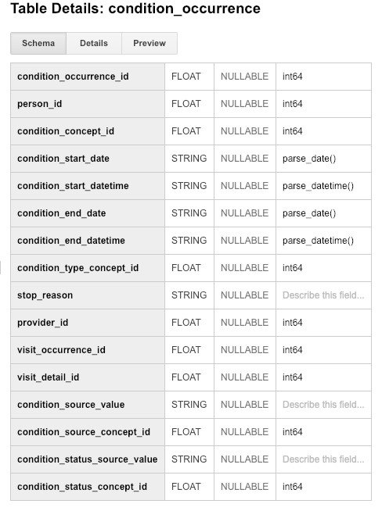
Step 1: Understand source/target data models
CONDITION_OCCURRENCE is the TARGET OMOP table.
Notes:
<number>

Slide 4
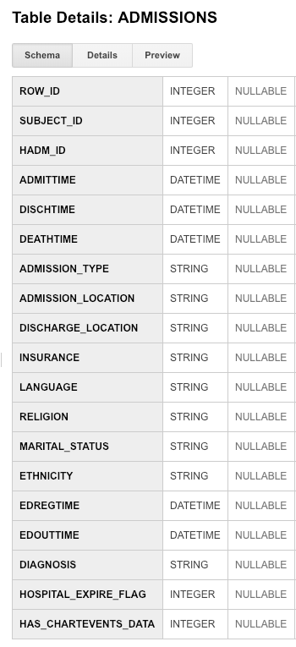
ADMISSIONS is the SOURCE MIMIC table.
Notes:
<number>

Slide 5
Step 2: Profile source table or tables
MIMIC Value | OMOP Value
SUBJECT_ID | Person_id
HADM_ID | Visit_occurence_id
DIAGNOSIS | Condition_source_value
Distribution of the SUBJECT_ID field
MIMIC Admissions table
Out of the 100 admissions, 15 belonged to one patient (Subject_id # 41976).
The most frequent cause of admission was Sepsis (10 admissions) followed by Pneumonia (8 admissions).
Notes:
<number>

Slide 6
Step 3: Create ETL mappings

Slide 7
Step 4: Write transformation code
WITH person1 as (select distinct mp.subject_id as person_id,
from WhiteRabbit_ScanReport_MIMIC_DEMO.ADMISSIONS mp),
person2 as (select distinct p1.person_id, mp.hadm_id as visit_occurance_id,
from WhiteRabbit_ScanReport_MIMIC_DEMO.ADMISSIONS mp),
from person1 p1 join WhiteRabbit_ScanReport_MIMIC_DEMO.ADMISSIONS mp on p1.person_id = mp.subject_id),
person3 as (select distinct p2.person_id, mp.diagnosis as condition_source_value,
from WhiteRabbit_ScanReport_MIMIC_DEMO.ADMISSIONS mp),
rom person2 p2 join WhiteRabbit_ScanReport_MIMIC_DEMO.ADMISSIONS mp on p2.condition_source_value = mp.diagnosis),
select . from person3
Notes:
Paste the SQL statements that transform data in one or more MIMIC tables to the correct column or columns in OMOP CONDITION_OCCURRENCE into the Coursera Submission Site.
<number>

Slide 8
Step 6: Perform data quality assessment
For DQA we can calculate the average admission/person to ensure no data was lost during the ETL process.
select avg(visit_occurence_id) as AVG_Admission from person3
Notes:
<number>

