Slide 1
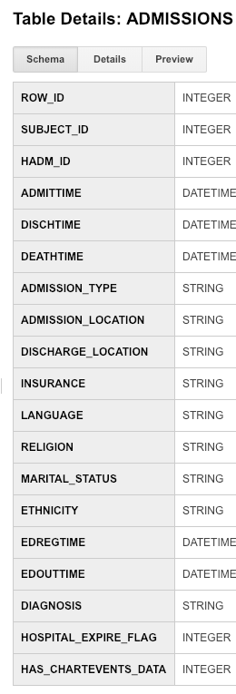
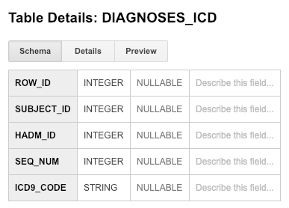
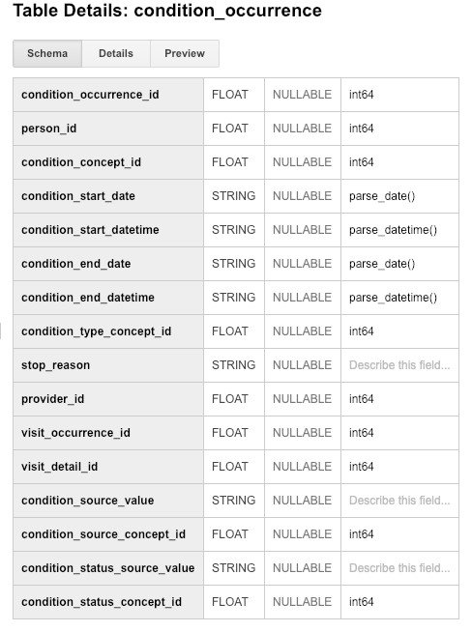
Step 1: Understand source/target data models
Notes:
Paste into one or more slides, the key table or tables from MIMIC that hold data that can be used to fill in the OMOP CONDITION_OCCURRENCE table.
Choose the MIMIC table screenshots from this slide to indicate which MIMIC table or tables would be used in the ETL process. Delete the MIMIC tables that you will not use.

Slide 2
Step 2: Profile source table or tables
The admissions table contains 129 entries. Since the table contains records for only 100 unique patients, some patients have more than one record in the table. For example, the White Rabbit output indicates that subject_id 41976 has 15 entries in the table.
The diagnoses_icd table contains 1761 entries. Many subjects have multiple entries in this table. For example, the White Rabbit output indicates that subject_id 41976 has 266 entries in the table. This means that a total of 266 diagnoses were applied to subject 41976 over the course of one or more stays at the hospital.
From the diagnoses_icd table, the most common diagnoses was code ‘4019’, or hypertension NOS (not otherwise specified). It was applied 53 times.
Notes:
Use the White Rabbit data profiling Excel spreadsheet that is linked to the assignment to describe key profiling findings from the table or tables you identified in ETL Step 1. See rubric for the types of topics to include here.

Slide 3
Step 3: Create ETL mappings
Each record in the diagnoses_icd table will have a corresponding record in the condition_occurrence table with person_id matching subject_id and condition_source_value matching icd9_code.
Notes:
For each MIMIC table or tables (one table per slide) from Step 1, paste the screenshot of the MIMIC table on left side. Show field mappings from the MIMIC table to the OMOP CONDITION_OCCURRENCE table using arrows. Only provide mappings to the OMOP person_id, visit_occurrence_id, and condition_source_value. One MIMIC table may provide a mapping to all three OMOP tables as shown here.
Provide an explanation for each mapping why the MIMIC field relates to the OMOP field you selected on the slide

Slide 4
Step 3: Create ETL mappings
OMOP visit_occurrence
visit_occurrence_id
The visit_occurrence_id field in the condition_occurrence table is a foreign key and must be obtained from the OMOP visit_occurrence table
Notes:
For each MIMIC table or tables (one table per slide) from Step 1, paste the screenshot of the MIMIC table on left side. Show field mappings from the MIMIC table to the OMOP CONDITION_OCCURRENCE table using arrows. Only provide mappings to the OMOP person_id, visit_occurrence_id, and condition_source_value. One MIMIC table may provide a mapping to all three OMOP tables as shown here.
Provide an explanation for each mapping why the MIMIC field relates to the OMOP field you selected on the slide

Slide 5
Step 4: Write transformation code
ALTER TABLE visit_occurrence ADD COLUMN hadm_id (NUMBER)
INSERT INTO visit_occurrence (person_id, hadm_id)
SELECT admissions.subject_id, admissions.hadm_id
FROM admissions
INSERT INTO condition_occurrence (person_id, condition_source_value, visit_occurrence_id
SELECT diagnoses_icd.subject_id, diagnoses_icd.icd9_code, visit_occurrence.visit_occurrence_id
FROM visit_occurrence INNER JOIN diagnoses_icd ON
visit_occurrence.hadm_id = diagnoses_icd.hadm_id
ALTER TABLE visit_occurrence DROP column hadm_id
I used Microsoft Access to do this exercise. These are the sql commands used to first insert records into the visit_occurrence table so that a visit_occurrence_id could be generated, then select and insert values from the diagnoses_icd table and the visit_occurrence table into the appropriate fields of the condition_occurrence table, then finally delete the ‘hadm_id’ column that had been created in the visit_occurrence table in step 1.
Notes:
Paste the SQL statements that transform data in one or more MIMIC tables to the correct column or columns in OMOP CONDITION_OCCURRENCE into the Coursera Submission Site.

Slide 6
Step 6: Perform data quality assessment
Data Quality assessment for the visit_occurrence table
visit_occurrence_id |  | person_id |  | hadm_id
Min: | 1233 | Min: | 10006 | Min: | 100375
1st Qu: | 1265 | 1st Qu: | 10088 | 1st Qu: | 128293
Median | 1297 | Median | 40310 | Median | 157235
Mean: | 1297 | Mean: | 28010 | Mean: | 152343
3rd Qu: | 1329 | 3rd Qu: | 42135 | 3rd Qu: | 174739
Max: | 1361 | Max: | 44228 | Max: | 199395
nrow(visit_occurrence[visit_occurrence$person_id=='41976',]
[1] 15
The table to the left shows a summary of the data added to the visit_occurrence table. Since 129 records were added from the admissions table, we would expect that the difference between the min and max of the visit_occurrence_id to be 129, which it is. Also, the number of rows for person_id is shown to be 15 which matches the White Rabbit summary for the admissions table.
Notes:
Paste the output from your data quality SQL executed on the OMOP CONDITION_OCCURRENCE table generated in Step 5 into this slide.
OK to paste link to a GoogleDoc instead.

Slide 7
Step 6: Perform data quality assessment
Data Quality assessment for the condition_occurrence table
visit_occurrence_id |  | person_id |  | condition_source_value
Min: | 1233 | Min: | 10006 | 4019: | 53
1st Qu: | 1265 | 1st Qu: | 10088 | 42731: | 48
Median | 1297 | Median | 40310 | 5849: | 45
Mean: | 1297 | Mean: | 28010 | 4280: | 39
3rd Qu: | 1329 | 3rd Qu: | 42135 | 25000: | 31
Max: | 1361 | Max: | 44228 | (other): | 1545
nrow(condition_occurrence[condition_occurrence$person_id=='41976',])
[1] 266
The table to the left shows a summary of the data added to the condition_occurrence table. We expect 129 new visit_occurrence_id values added, since all the diagnoses contained in the ETL data were the result of 129 visits. The summary for the visit_occurrence_id field shows that indeed, 129 new id’s were added. Also, the top 5 condition_source_values shown are consistent with those summarized by the White Rabbit report on the diagnoses_icd table. Finally, the total number of diagnoses, or conditions, belonging to person_id = 41976 is 266, which again is consistent with the White Rabbit report for the diagnoses_icd table.
Notes:
Paste the output from your data quality SQL executed on the OMOP CONDITION_OCCURRENCE table generated in Step 5 into this slide.
OK to paste link to a GoogleDoc instead.

