Slide 1

How to tackle fuel efficiency of a car
By: Seid Ahmed
:

Slide 2

What is reliable information?
Reliable information is information that is true or can be backed up by data.

Slide 3
What is the problem?
The project is aimed at investigating the miles per gallon(mpg) for cars with a number of features.
mpg, cylinders, displacement, horsepower,
weight,acceleration,model yean, origin, car name(unique for each instance)

Slide 4
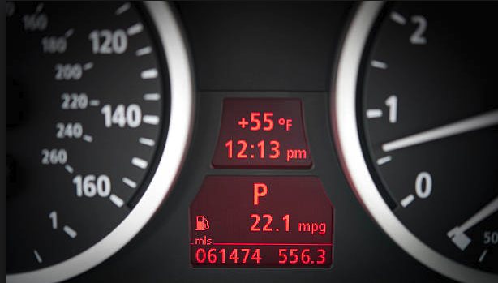
What does mpg mean?
A car’s mpg figure will tell you approximately how far it’ll travel using a gallon of fuel.
For example, a car capable of 45mpg will drive for around 45 miles on a single gallon before
spluttering to a halt.

Slide 5


Who is affected by this problem?
The business profit is affected if the cars are intended for the business.

Slide 6
How should I go about solving this problem?
The dataset was downloaded from the university of California website and saved as a .csv file and investigated if there are any missing values.
Any irrelevant data types are coerced to make sense for the data analysis.
We could also use more detailed datasets related to engines to get more insight.

Slide 7
Data Source
Source:https://archive.ics.uci.edu/ml/datasets/Auto+MPG
Statistics:
Rows:398
Features:9
Primary Feature:MPG

Slide 8
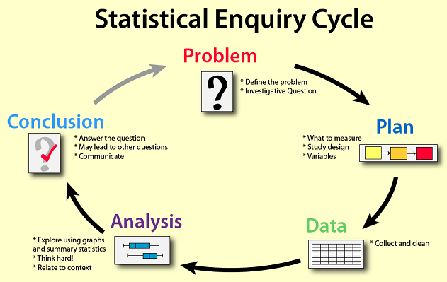
Methodology

Slide 9
Methodology
Machine Learning Algorithm:
Linear Regression
K-Means
Decision Tree
Random Forest
Tools of Disposal:
Jupyter Notebook

Slide 10
Initial Findings
We first investigated the distributions and the skew of each of the features if we can see any pattern.
From the multimodal data visualization we see that efficiency measured by mpg improved over years for different cars of every origin i.e. whether its foreign made or US made.
The measure of efficiency measured by mpg as compared to cylinders shows mpg decreases as the cylinders increase.
When we compare cars of the same year by origin the US cars are less efficient or have less mpg than the foreign made cars. Last but not least, foreign model cars are more efficient as compared to US model cars.

Slide 11
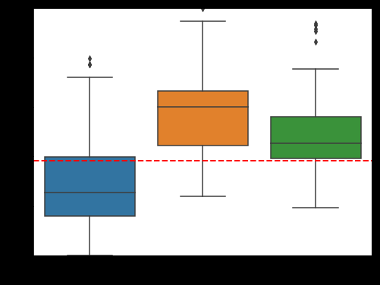
75% of cars from USA have MPG below global average compared to cars from Japan and Europe.

Slide 12
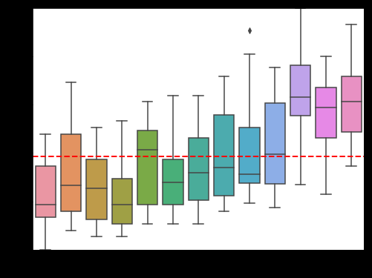
The MPG generally gets better as the year goes by

Slide 13
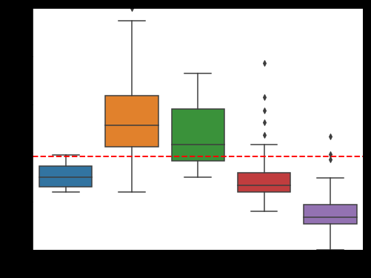
The cylinders 4 and 5 have better MPG

Slide 14
Evaluate Algorithm: Baseline
We use Test options and evaluation metric
num_folds = 10
seed = 42
scoring = 'neg_mean_squared_error’
The algorithms all use default tuning parameters
We will see the mean and standard deviation of MSE for each algorithm

Slide 15
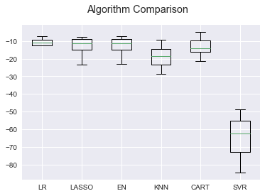
Algorithm Comparison

Slide 16
Standardize the dataset
KNN has a lower error upon standardization.

Slide 17
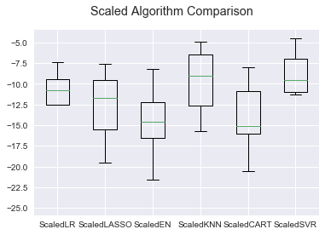
Scaled algorithm comparison

Slide 18
Ensembles
Using ensembles we found that Gradient Boosting Regressor with standardization gives a lower error

Slide 19
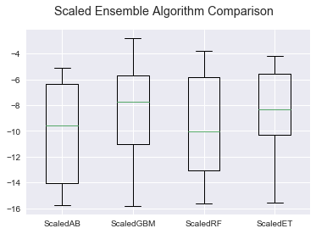
Scaled Ensemble Algorithms

Slide 20
Conclusion
Efficiency measured by mpg improved over years for different cars of every origin i.e. whether its foreign made or US made.
The measure of efficiency measured by mpg as compared to cylinders shows mpg decreases as the cylinders increase.
When we compare cars of the same year by origin the US cars are less efficient or have less mpg than the foreign made cars.
Last but not least, foreign model cars are more efficient as compared to US model cars.

Slide 21

What factors will influence my decision about this problem?
Gas is very expensive. I want a car that gets good miles per gallon (mpg).
I don’t have extra money to fix an older, cheaper, used car.
I have other expenses and don’t want to buy a car that would go over my budget.

