Slide 1

Web Scrapping on the website – Ambition Box
Presented By
Naga Lakshmi
Zakia Tafheem
Sunanda Tadi

Slide 2
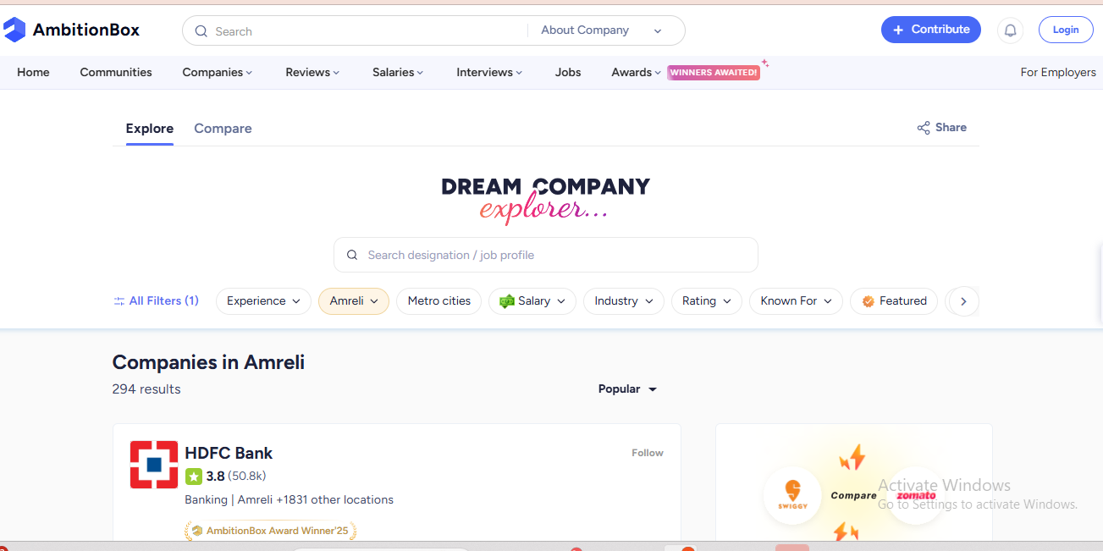
Website - Ambition Box
AmbitionBox is a place we are extracting the company names they rating ,review count and from company sector we are getting locations

Slide 3
Objective of the Project
The main objective of this project is to automatically extract and analyze company data from Ambition Box using web scraping techniques.
Tools & Libraries Used
Python
Jupyter Notebook
BeautifulSoup / Requests (find and find_all)
Pandas & NumPy
Matplotlib / Seaborn

Slide 4
Business Problem
Companies and job seekers require reliable and up-to-date organizational insights to make informed career and hiring decisions.
Key information such as company ratings, salaries, reviews, company sectors, benefits plays a crucial role in decision-making.
This information is often scattered across multiple web pages, making it difficult to access in a structured manner.
Due to the lack of structured insights, users may struggle to compare companies effectively or identify trends. This project addresses the problem by web scraping data from the AmbitionBox website.

Slide 5
Web Scraping – Details
Understanding Website Structure
Sending HTTP Requests(requests.get() to fetch webpage content)
Parsing HTML Content
Data Extracted ( Company_names,Sectors,Salaries,Reviews)
Handling Pagination(Used loops to scrape multiple pages)
Data Storage

Slide 6
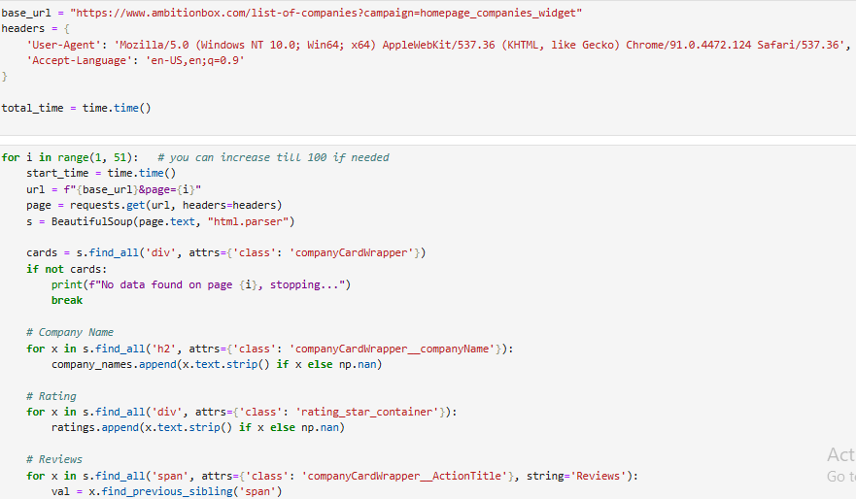
Webscraping
We have performed web scraping on AmbitionBox using requests and BeautifulSoup.
It iterates through multiple pages, extracts company details like name, rating, reviews, and salary information. The extracted data is then structured and stored for further analysis.

Slide 7
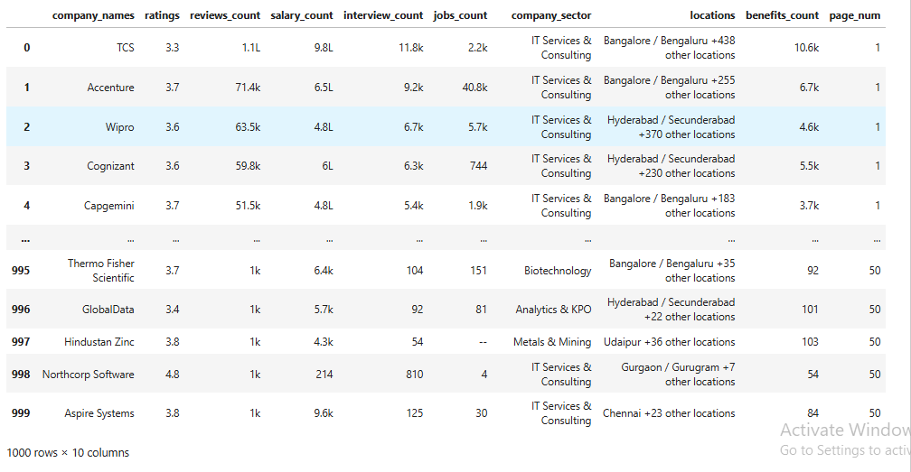
Raw Data

Slide 8
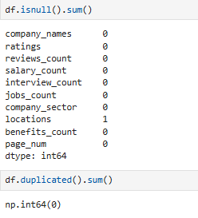
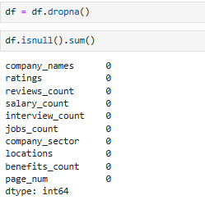
Data Cleaning
Checked missing values using df.isnull().sum().
All columns have 0 missing values except locations (1 missing value).
Dataset is almost completely clean with negligible null data.
Checked duplicates using df.duplicated().sum() — no duplicate records found

Slide 9
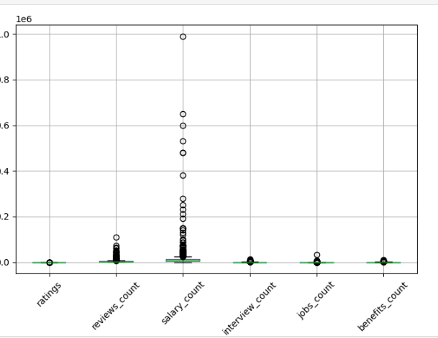
Data Cleaning – Detecting Outliers
Reviews_count also contains several outliers, suggesting some companies have unusually high review numbers.
The salary_count feature shows significant outliers, indicating high variability and extreme values.
Features like ratings, interview_count, jobs_count, and benefits_count show relatively lower spread compared to salary_count.

Slide 10
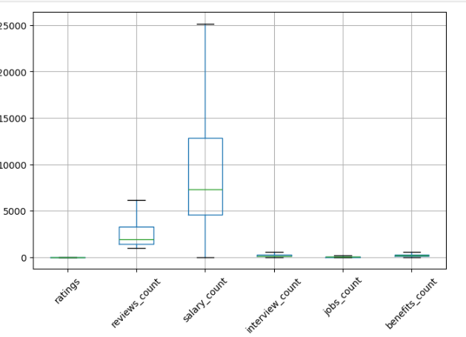
Data Cleaning – Fixed Outliers
After applying IQR-based capping, the variability in salary_count has reduced significantly.
The distributions appear more stable and less skewed.
This preprocessing step ensures that extreme values do not negatively impact model performance.

Slide 11
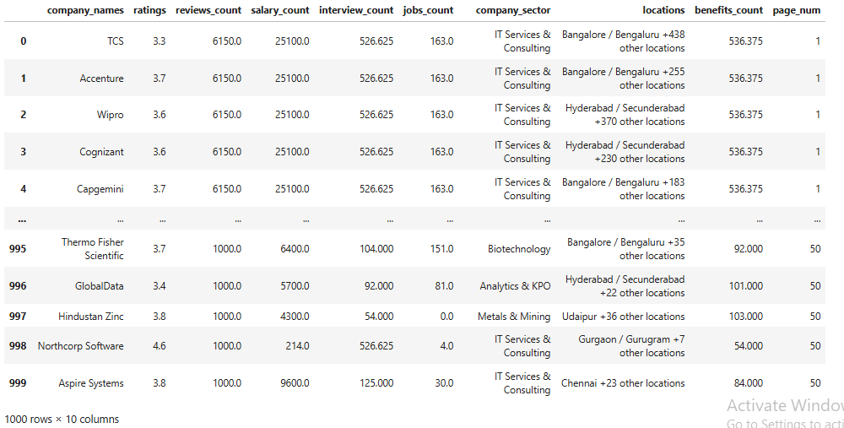
Cleaned data

Slide 12
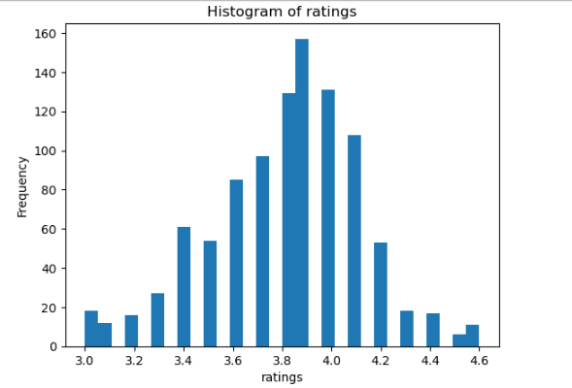
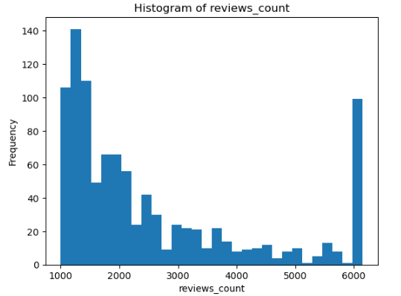
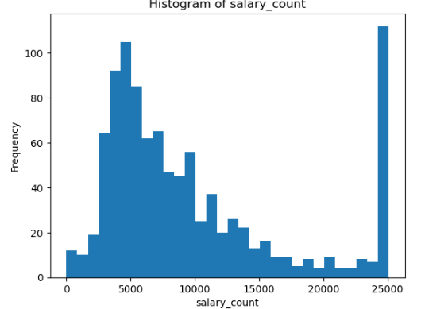
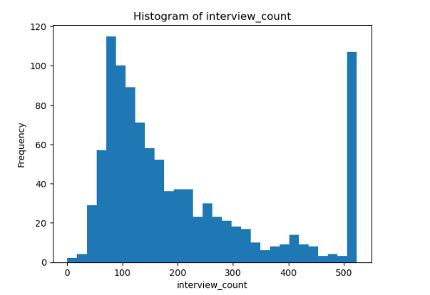
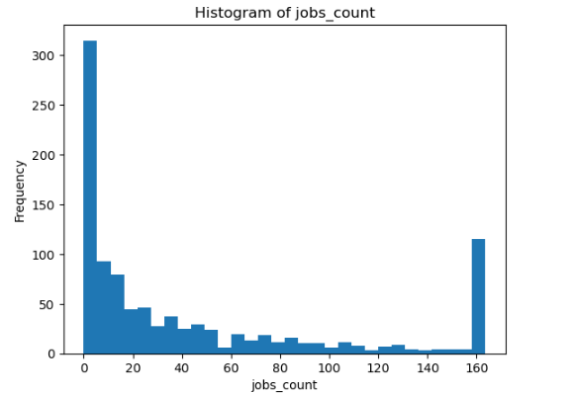
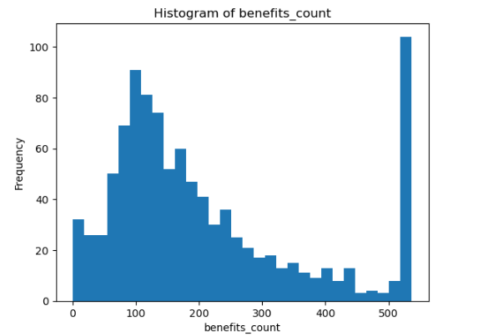
Univariate Analysis – Visualization

Slide 13
Reviews_count – Reviews_count is positively skewed, with most values on the lower side and few high values.
Salary_Ratings – Ratings are mostly concentrated in the higher range, showing a slightly left-skewed distribution.
count – Salary_count is highly right-skewed, indicating many low values and few very high values.
Interview_count – Interview_count shows a right-skewed distribution with most observations at lower values.
Jobs_count – Jobs_count is slightly skewed to the right with majority of data in lower ranges.
Benefits_count – Benefits_count appears moderately right-skewed with fewer high-value observations.

Slide 14
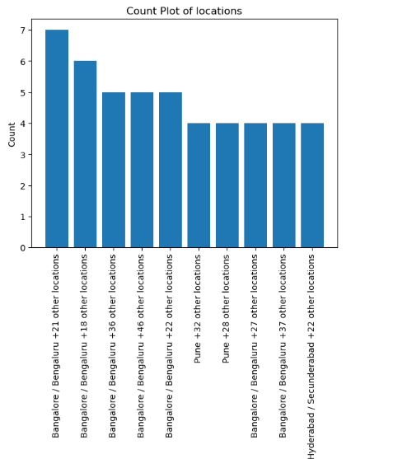
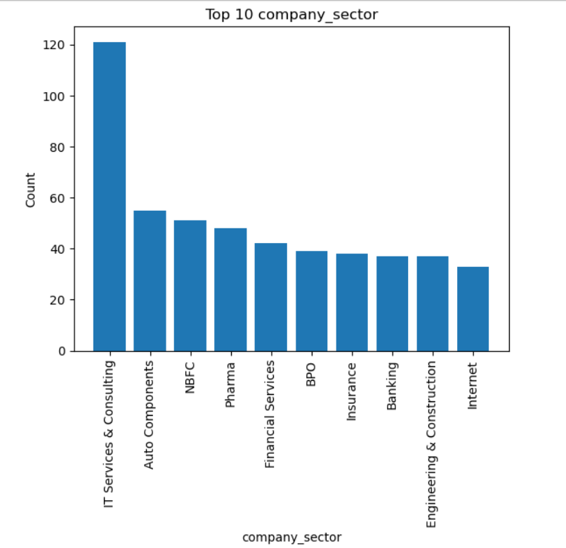
Univariate Analysis – Visualization for categorical variable
The bar chart shows that IT Services & Consulting has the highest count among sectors, followed by Auto Components and NBFC, indicating IT dominates the dataset.”

Slide 15
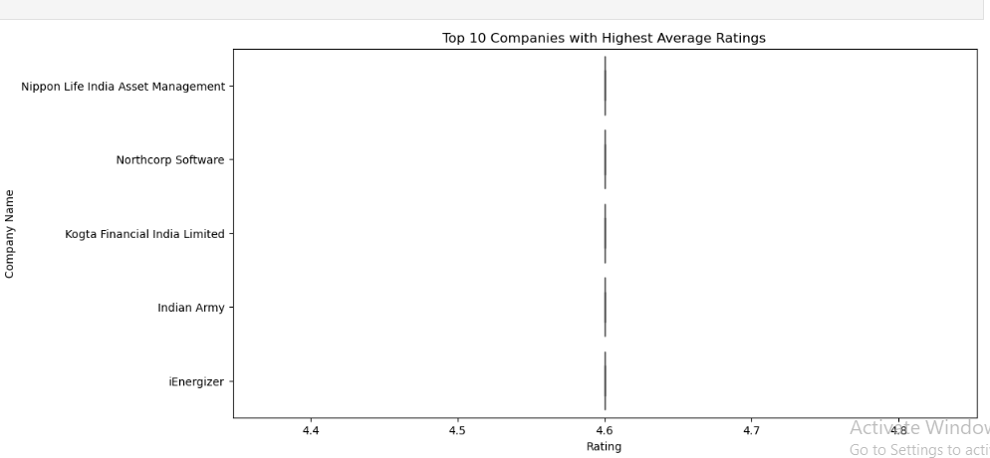
Bivariate Analysis – Visualization (Num-Cat)
Calculates average rating per company
Selects top 5 highest-rated companies
Creates a boxplot showing rating distribution

Slide 16
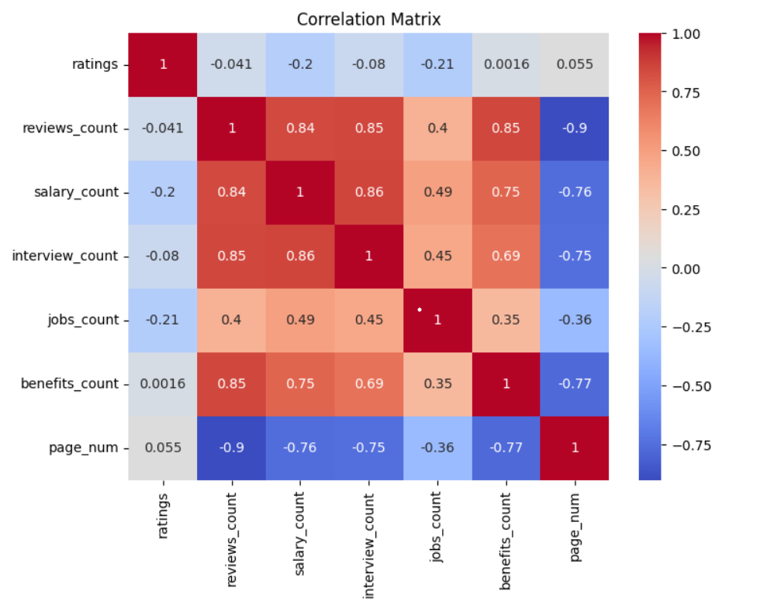
Bivariate Analysis – Visualization for (Num-Num)
Strong positive correlation exists between reviews_count, salary_count, interview_count, and benefits_count , indicating these engagement-related features move together.
page_num shows strong negative correlation with most count features , suggesting higher page numbers are associated with lower counts.
ratings have very weak correlation with other variables, indicating ratings are relatively independent of review, salary, and job-related counts.

Slide 17
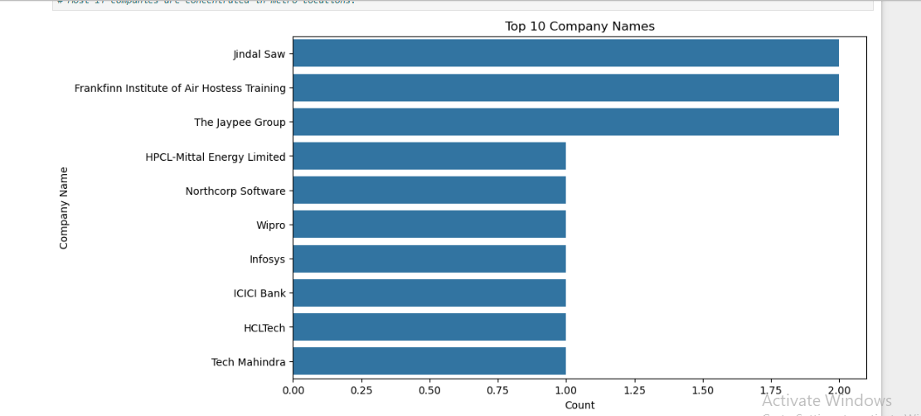
Bivariate Analysis – Visualization for (cat-cat)
Displays the most frequent 10 companies in the dataset.
Helps identify dominant companies.
Useful for detecting market concentration.

Slide 18
Conclusion
Successfully scraped company data from the AmbitionBox website using Python.
Converted raw HTML data into a structured dataset (CSV/DataFrame).
Cleaned the data by handling missing values, duplicates, and inconsistent formats.
Analyzed company ratings, reviews, salaries, interviews, and jobs.
Identified trends, variations, and outliers across different companies.
Gained hands-on experience in web scraping, data manipulation, and EDA.

Slide 19

THANK YOU

