Slide 1
Bringing Together Paradox, Counting, and Computation To Make Randomness!
Great Theoretical Ideas In Computer Science
Ω
Lecture 21
CS 15-251

Slide 2
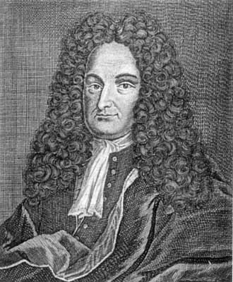
Gottfried Wilhelm von Leibniz
There is almost no paradox without utility

Slide 3
BERRY PARADOX:
“The smallest natural number that can’t be named in less than fourteen words.”

Slide 4
Java is an unambiguous language where each program denoted exactly one output. What happens when we express the Berry paradox in Java?

Slide 5
Counting
A set of binary stings is “prefix-free” if no string in the set is a prefix of another string in the set

Slide 6
Theorem: If S is prefix-free and contains no strings longer than n, then S contains at most 2^{n} strings.
For each string x in S, let S_{x} be the set of all length n strings with x as a prefix. The S_{x} are mutually disjoints sets, so the number of elements in S is bounded by the number of length n stings.

Slide 7
Binary Java is Prefix-Free
We will represent Java in binary (using ASCII codes for each character). We will allow only java programs where all the classes are put in one big class delimited by { }.

Slide 8
Storing Poker Hands
I want to store a 5 card poker hand using the smallest number of bits (space efficient). The naïve scheme would use 2 bits for a suit, 4 bits for a rank, and hence 6 bits per card and 30 bits per hand. How can I do better?

Slide 9
Order the Poker hands lexicographically
To store a hand all I need is to store its index of size ⎡log(2,598,560) ⎤=22 bits. Notice that in your programming assignment you made a fast way to go back and forth between this compressed representation and a poker hand.

Slide 10
22 Bits Is OPTIMAL
2²¹ < 2,598,560
There are more poker hands than there are 21 bit strings. Hence, you can’t have a string for each hand.

Slide 11
Incompressibility
We call a binary string x incompressible if the shortest Binary Java program to output x is at least as long as x.

Slide 12
Th: Half the strings of any given length are incompressible
Java is prefix-free so there are at most 2^{n-1} programs of length n-1 or shorter.
There are 2^{n} strings of length n, and hence at least half of them have no smaller length program that outputs them.

Slide 13
A compressible string
0101010101010101… a million times ..01
public class Counter
{
public static void main(String argv[])
{
for (int i=0; i<1000000; i++)
System.out.print("01");
}
}

Slide 14
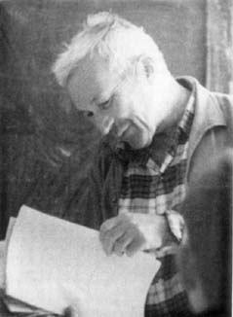
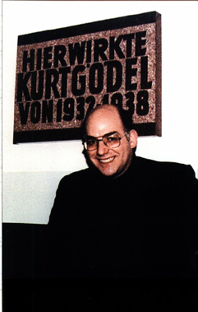
It is possible to define randomness in terms of incompressibility
Chaitin
Kolmogorov

Slide 15
If a string x is incompressible, then there is nothing atypical that you can say about it.
Suppose D is some atypical, computable predicate that is true of x. Since D is atypical, it is not true of many n bit strings. So compress x by referring to x by its index i in the enumeration of strings of length n that have property D.

Slide 16
When we notice a “pattern”, we always mean something atypical

Slide 17
So when you see a “pattern” in a sufficiently long string it allows you to compress it. Hence, incompressible strings have no pattern.

Slide 18
BERRY PARADOX:
“The smallest natural number that can’t be named in less than fourteen words.”

Slide 19
Java Berry
The shortest incompressible string that is longer than this Java program

Slide 20
Java Berry
The shortest incompressible string that this program can certify is longer than this program

Slide 21
Let INCOMPRESSIBLE be a JAVA routine whose program length is n.
INCOMPRESSIBLE(x) = “yes” means x is definitely incompressible
INCOMPRESSIBLE(x) = “not sure”, otherwise

Slide 22
BERRY
BERRY will contain INCOMPRESSIBLE as a sub-routine. BERRY will do the following: use the self-printing trick to measure its own length k. Then it will loop through strings of length k+1 to infinity and output the first one for which INCOMPRESSIBLE answers “yes”. Notice: There is a constant c such that the length of BERRY is n+c.

Slide 23
BERRY can’t output anything, or else there would be a real paradox
Theorem: There exists a c, such that no program INCOMPRESSIBLE of length n outputs “yes” on any string of length n+c or greater.

Slide 24
Let Π be a formal system with n bits of axioms
There exists a constant (independent of the formal system) such that all true sentences of the form “x is incompressible” (where x has length n+c) are NOT PROVABLE in the system.

Slide 25
Chaitin’s
Ω

Slide 26
Ω is the “halting probability”.
Flip a fair coin until you get a sequence that represents a program. Run the program.
Omega is the probability that this process halts.

Slide 27
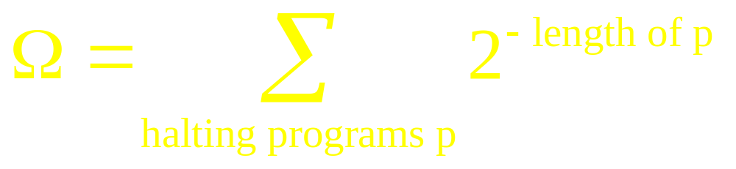

Slide 28
Ω is a maximally unknowable number

Slide 29
Ω is the optimally compressed form of the halting oracle.

Slide 30
The first n bits of Ω give enough information to solve the halting problem for any program with length bounded by n.
L:=0
Timeshare each program
When a program of length a halts, add 2^{-a} to L.
When the first n bits of L equals the first n-bits of Ω, any length <= n program that is going to halt will have halted.

Slide 31
From n-bits of Ω we can find all incompressible strings of length n+1
Determine all the programs of length n that halt. Run them and cross off any (n+1)-bit strings they output. The strings that are left are incompressible.

Slide 32
n bits of axioms can only help you know n + c bits of Ω
Or else you could prove that strings longer than your axiom system were incompressible

Slide 33
Ω Is not compressible by more than a constant.
Suppose you could compress n bits of Ω by more than a constant to get a string X. Decompress X and use it to find an incompressible strings of length n+1 and output it. This method has the length of X plus a constant which is still less than n+1. Contradiction.

