Slide 1
ServiceNow FSM capabilities
By– Mohamed Zakir

Slide 2
Creation of Work Order from Incident- (Slide 2)
Work Order Form – (Slide 3)
Work Order Journey (Slide 4)
WO & WO Task transition – (Slide 5-14)
Service Management Incidentals – (Slide-15)
OOB Values – (Slide 16-19)
WO & WO Task States – (Slide 20-21)
Field Service Personas –(Slide 22)

Slide 3
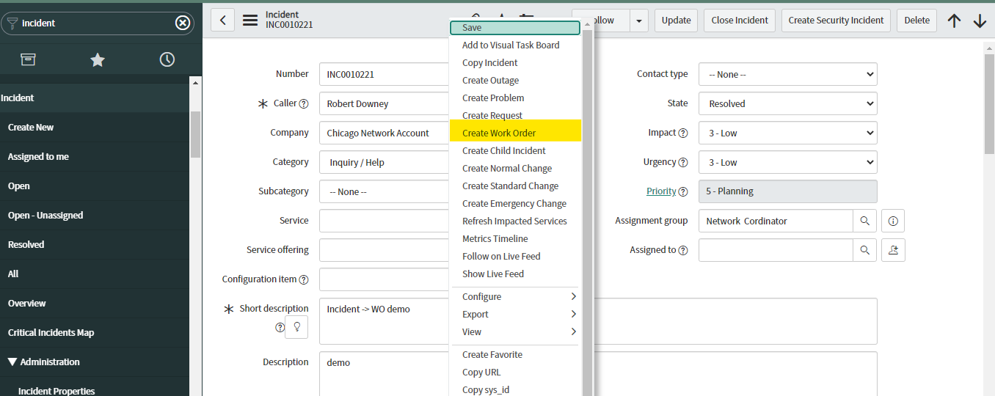
Work order is created when off-site work is requested
Here in this example, Workorder is created from Incident form
Right click on Incident Header and select Create Work Order option to create a work order (shown below)

Slide 4
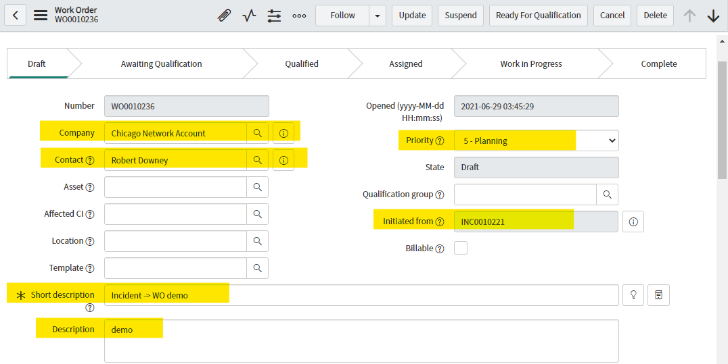
Work Order created from Incident
After following steps carried out in (slide 3), a new Work order is created from the incident.
The incident related information is included in Work Order form as highlighted below

Slide 5
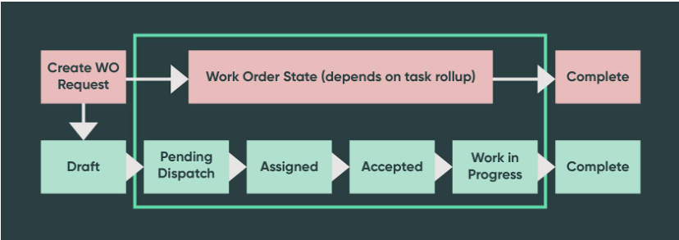
WORK ORDER JOURNEY
Work orders and work order tasks move through several states from creation to completion.
Different user roles/persona are required to move work orders from one state to the next, with each role providing an important part of the process.

Slide 6
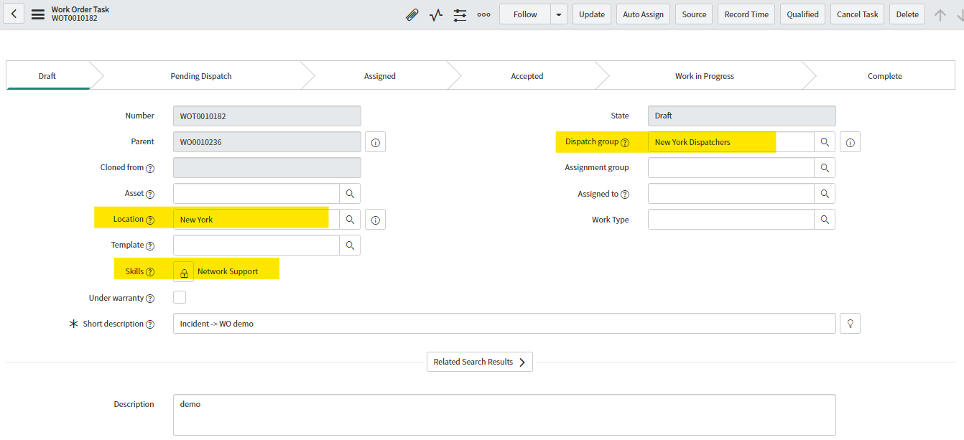
**System Generated WO task Number
**Work order Number
**Refer Slide 18
**Refer Slide 17
**Refer Slide 19
Qualification Group refines the definition of the work to be done such as skills, location, sets Dispatch group.

Slide 7
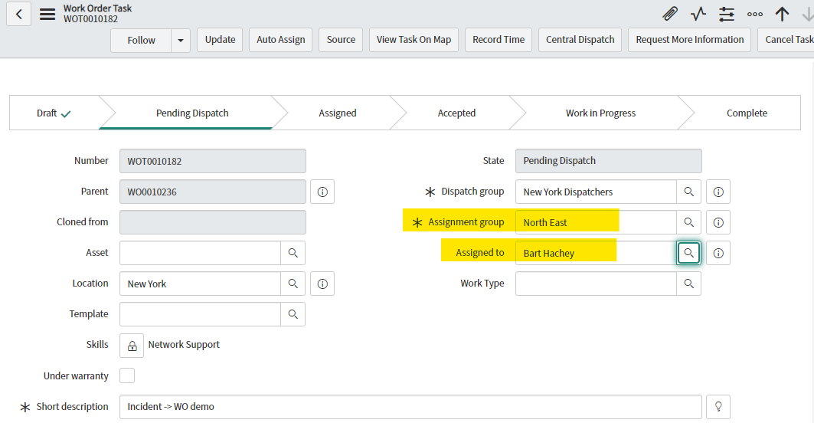
**Refer Slide 19
**Refer Slide 20
**Refer Slide 20
**Refer Slide 18
A dispatch group selects Field agent to complete a work order task.

Slide 8
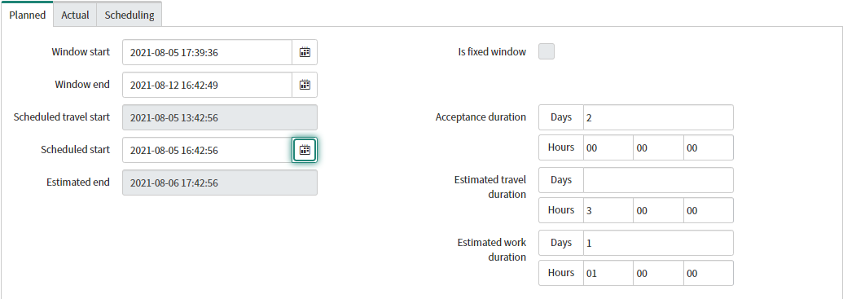
** ( scheduled start – estimated travel duration )
** (scheduled start + estimated work duration)
Qualifier/Dispatcher can plan out when WO task to be carried out
Window start & Window end attributes points to start and end window for task
Scheduled start: Date and time when WO task starts
Scheduled travel : Calculated by system based on (Scheduled start – Estimated travel duration)
Estimated End: Calculated by system based on (Scheduled start + Estimated Work duration)
Acceptance Duration: Task acceptance Duration for Field Agent

Slide 9
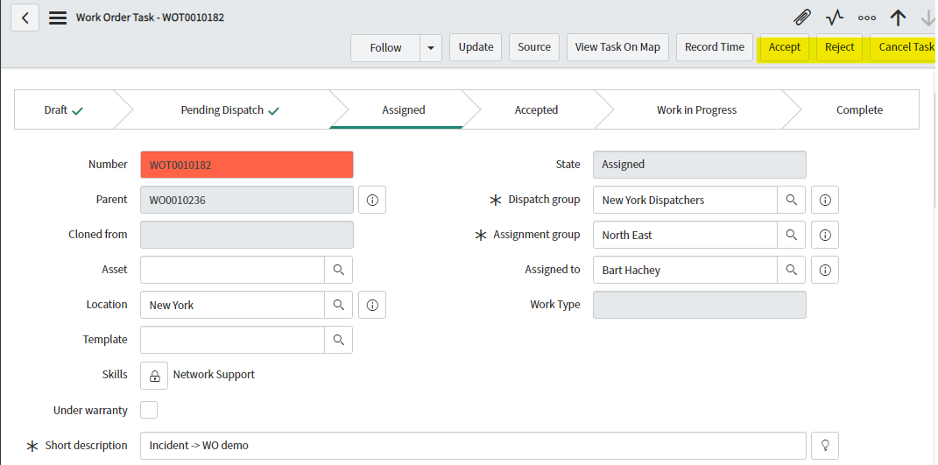
Field Service Agent is the one who performs the work on the site. Once task is assigned to field agent, field agent can accept or reject a task

Slide 10
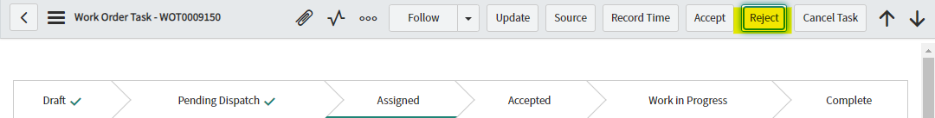
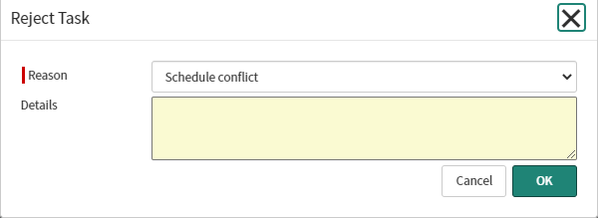
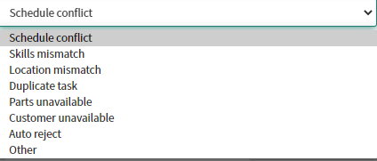
1
If Field agent rejects task assigned by Selecting Reject button (Pic-1), Then Reject Task dialog box appears asking Reason and Details to reject WO task (shown below)
(Pic-2) shows Dialog Box that appears upon click of Reject Button(Pic-1)
(Pic-3) shows OOB options that can be selected as Reason to reject Task
2
3

Slide 11
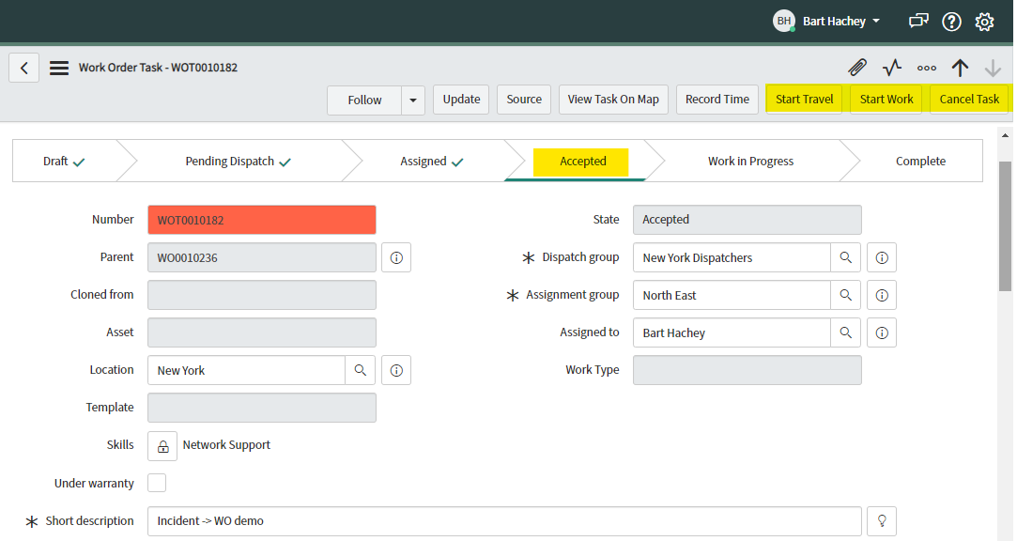
When Task is accepted by Field agent, Field Agent has option to Start travel, Start Work

Slide 12
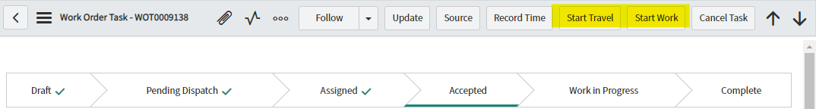
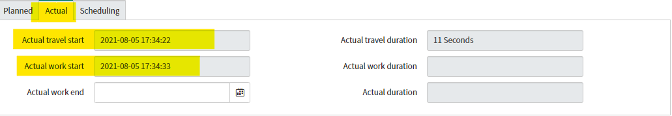
1
If Field agent clicks Start Travel button (Pic-1), the time Field agent started travelling is captured in Actual travel start attribute of WO task form (Pic-2).
If Field agent clicks Start Work button, the time Field agent started working is captured in Actual work start attribute of WO task form (Pic-2)
2

Slide 13
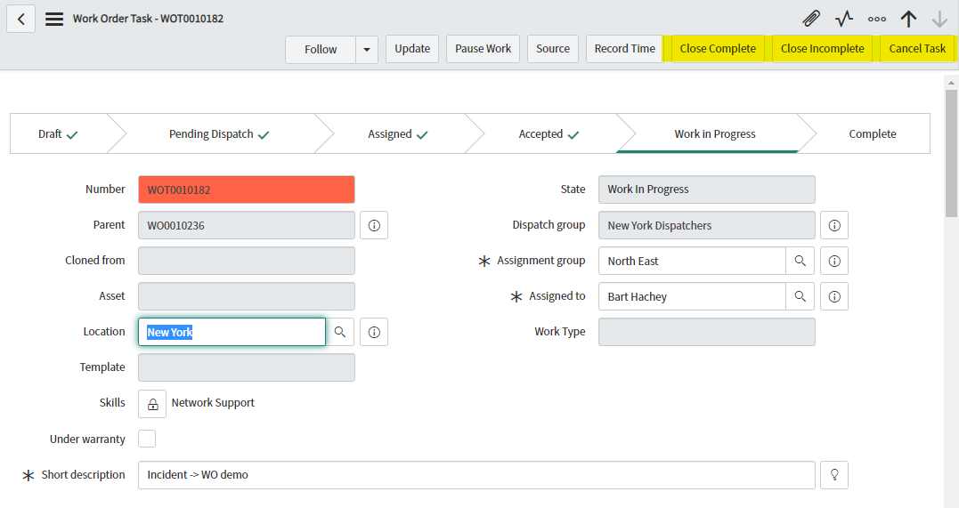
After finishing task, field agent can select close complete/close Incomplete option.
Close Complete/Close Incomplete button actions are detailed out in next slides

Slide 14
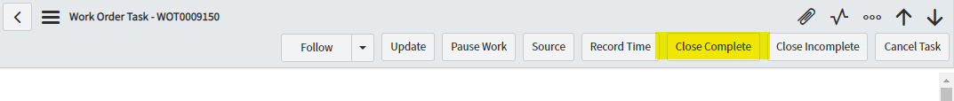
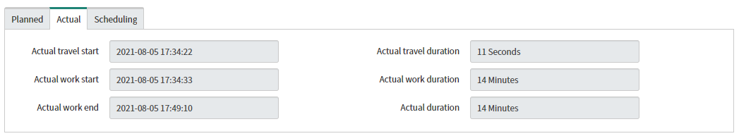
1
If Field agent clicks Close Complete button (PIC-1), Field agent must provide summary of work done in work notes.
After Close Complete button is clicked, The time Field agent completed his work is captured in Actual Work end attribute (Pic-2).
Actual Travel Duration: Calculated by System (Actual work start-Actual travel start)
Actual Work Duration: Calculated by System (Actual work end-Actual work start)
2

Slide 15
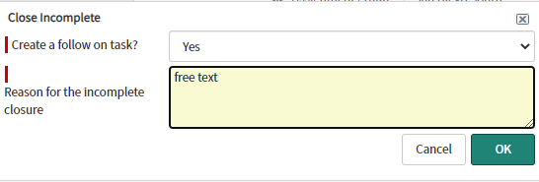
1
If Field agent clicks Close Incomplete button (PIC-1), Dialog Box appears(Pic-2)
If Create a follow on task?(Pic-2) is selected Yes, then NEW WO task will be created and current Wo task will be closed
If Create a follow on task?(Pic-2) is selected No, then current Wo task will be closed
2

Slide 16
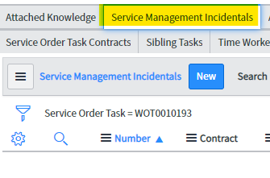
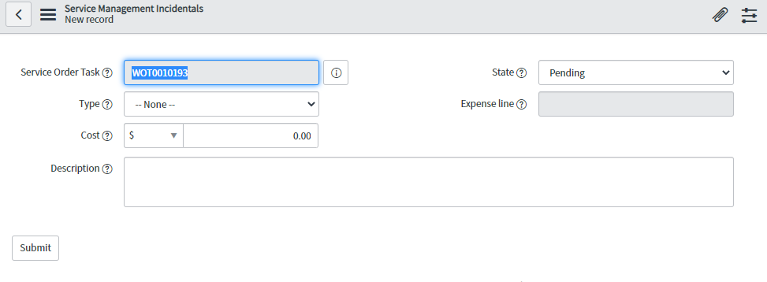
Service Management Incidentals (Optional OOB functionality)
Record incidental expenses associated with your business travel through the Field Service application to execute work order tasks.
Procedure
Navigate to Field Service > Work Order > All Work Order Tasks.(Pic-1)
Open a work order task for which you want to log incidentals.
In the Service Management Incidentals related list, click New. (Pic-2)
Fill in the fields (Pic-2)
1
2

Slide 17

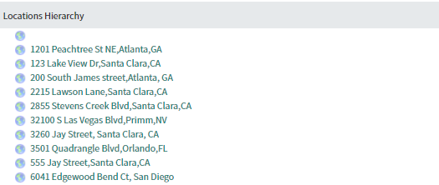

A Choice Field list is a type of field that lets the user select from a pre-defined set of choices. It is identified by drop down arrow beside it
A Reference field stores a reference to a field on another table in ServiceNow. It’s identified by (magnifying glass icon) beside it
Field on Incident Form | Field Type | Description | Reference to another Table
Location | Reference Field (Referencing to location table in ServiceNow) | Area where the work must be done. If not entered manually, the field is filled automatically based first on the Affected CI field and then the location of Caller.

Slide 18
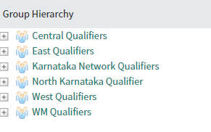

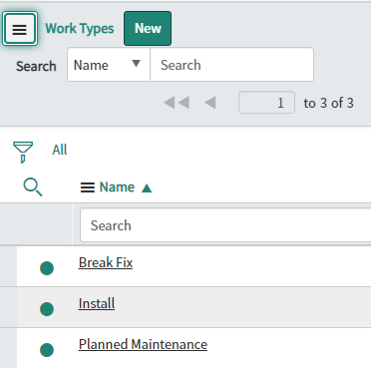

Field on Incident Form | Field Type | Description | Reference to another Table
Qualification Group | Reference Field. (Referencing to Group table in Snow. Will filter out groups with dispatch role associated to it) | Group that can specify the technical details of the work order. The lookup list shows only the qualification groups associated with the selected Location
Work Type | Reference Field. (Referencing to Work Type table in Snow) | The type of work to be performed to complete the task

Slide 19
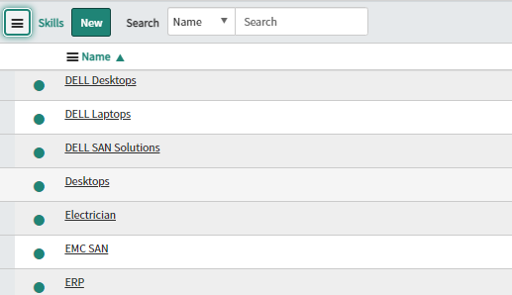
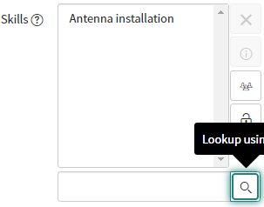
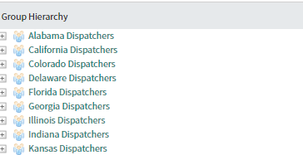

Field on Incident Form | Field Type | Description | Reference to another Table
Skills | Reference Field. (Referencing to Skills table in Snow) | Abilities necessary to execute the task
Dispatch Group | Reference Field. (Referencing to Group table in Snow. Will filter out groups with dispatch role associated to it) | Group that can select an agent to complete the task

Slide 20
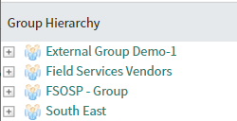

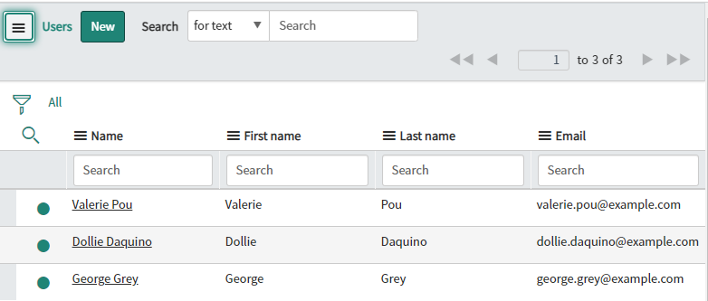

Field on Incident Form | Field Type | Description | Reference to another Table
Assignment Group | Reference Field. (Referencing to Group table in Snow) | Group from which an individual should be selected to complete the task.
Assigned To | Reference Field. (Referencing to User table in Snow) | Select an individual agent who should complete the task, selected from the Assignment group

Slide 21
Work order states
Work order state | Description
Draft | The initiator creates a work order and adds information to the work order form about the work to be done.
Awaiting Qualification | The work order is ready to be reviewed by the qualifier.
Qualified | The qualifier has added any necessary technical information to the work order, created tasks, added part requirements, and assigned a dispatch group.
Assigned | The dispatcher assigns one or more of the work order tasks to a field service agent.
Work in Progress | The agent accepts the assigned work order task and begins work.
Closed Complete | The agent completes the work in the assigned task. Once all of the tasks for a work order are complete, the state of the work order is set to complete.
Closed Incomplete | The agent does not complete the work in the assigned task. If one or more tasks for a work order are closed incomplete, the state of the work order is closed incomplete.
Canceled | The work is no longer necessary, or the work order is a duplicate. A reason for canceling the work order must be added to the Work notes field.

Slide 22
Work order task states
Work order task state | Description
Draft | The qualifier creates a task for a work order.
Pending Dispatch | The qualifier assigns a dispatch group to the work order task.
Assigned | The dispatcher assigns the work order tasks to a field service agent.
Accepted | The field service agent accepts the assigned task. The agent can also reject a task. If rejected, the task state returns to Pending Dispatch.
Work in Progress | The field service agent clicks Start Travel on the Work Order Task form, followed by Start Work, and begins the work described in the task.
Closed Complete | The field service agent completes the work for the assigned task, adds a description in the Work notes field, and clicks Close Complete on the Work Order Task form. The agent can also click Close Incomplete and add a reason for the incomplete closure.
Closed Incomplete | The field service agent cannot complete the work for the assigned task, adds a reason for the incomplete closure in the Work notes field, and clicks Close Incomplete.
Canceled | The work order task is no longer necessary or is a duplicate of another task. The field service agent adds a reason for the cancellation in the Work notes field and clicks Cancel

Slide 23
Field Service Management Persona
Persona | Description | Role (SNow)
Field Service administrator | Field Service administrator has full control over all Field Service data and is responsible for configuring and maintaining field service application | wm_admin
Field Service Agent | Field Service Agent performs works at site/customer location and record details in work order form | wm_agent
Field Service Dispatcher | Dispatcher schedules tasks and assign tasks to Field Service Agents | wm_dispatcher
Field Service Initiator | Creates a work order and assigns to a qualification group | wm_initiator
Field Service Manager | Field Service Manager manages field agent schedules, skills and timecards of their groups. | wm_manager
Field Service Qualifier | Qualifier reviews and qualifies work order request by creating work order tasks and validating skills and location. | wm_qualifier

