Slide 1
Selenium
Java
API
Manual
Actions Class
Alerts
Annotations In Test-NG
Assert and Verify
Cucumber Advantages
Cucumber Flow
Cucumber Hooks & BackGround
Cucumber Scenario vs Scenario Outline
Data-Provider Annotation
Exceptions in Selenium
Find all Links in A page
Frames
Locators in Selenium
Page Object Model
Quit vs Close
Select Class
Select Class – Last but one value
Stale Element How to Fix
Waits
WebDriver driver = new ChromeDriver();
What is Web Driver
Xpath
Abstraction
Array List
Collection Framework
Compile Time Polymorphism
Constructors
Encapsulation
Final Finally Finalize
Final Vs Static Key Word
Hash Map
Inheritance
List Vs Set
List vs Set Vs Map
OOPS Concepts
Polymorphism
Run Time Polymorphism
ZAKIR
What is API
Methods in API
Status code in API
Rest Assured
Alpha Beta Testing
Boundary Value , Equivalence Class, Decision Table
Defect Life Cycle
Defect Logged last one
Defect vs Error vs Bug
Developer is Not Accepting Defect
JIRA
JIRA- Defect Screen
No Time for Testing What to Do
Priority of Defect
Regression , Smoke and Sanity, Retesting
RTM
Severity of Defect
STLC Life Cycle
Stubs and Drivers
Test Case vs Test Scenario
Test Plan
White ,Black and Gray Box Testing

Slide 2
General
PEGA
PEGA
Worklist vs Work basket
Clipboard Tool
Tracer Tool
PEGA Access Groups
PEGA Urgency
PEGA SLA
PEGA Report Definition
PEGA pyWorkPage
PEGA Vs Manual Testing-Part 01
PEGA Vs Manual Testing-Part 02
PEGA Roles & Roles Based Testing
PEGA – Work Group
Pega – Case Management
PEGA
Worklist vs Work basket
Clipboard Tool
Tracer Tool
PEGA Access Groups
PEGA Urgency
PEGA SLA
PEGA Report Definition
PEGA pyWorkPage
PEGA Vs Manual Testing-Part 01
PEGA Vs Manual Testing-Part 02
PEGA Roles & Roles Based Testing
PEGA – Work Group
Pega – Case Management
PROJECT – IAM
Project – PLM
Project- SPS
Project – Retrieval Operational Workflow
FRAMEWORK
Roles & Responsibilities
AGILE SCRUM
Tools and Technologies
Challenges Faced
Any Questions at last
Why you want to join
Daily Task

Slide 3
Tell Me About Yourself Automation
Hi Good Evening…(With a smile on face)---
Myself <YourName> I have total 3+ Years of experience into testing. Here it’s a kind of both Automation and Manual Testing.And…With regards to Automation, we are using Selenium tool with Java as our coding language
We are using JIRA for Project Management and I have also worked with HP ALM tool
We are following SCRUM Methodology in our project where we have each sprint for a period of 2 weeks
Also… I have idea on SQL as well. Using basic queries to retrieve data from data base
And…Coming to our Automation framework…. Ours is basically a Data Driven Framework where we will be passing the test data from the excel sheet. On top of that we are also using TestNG framework.
Coming to my roles and Responsibilities it’s a kind of combination for both Manual and Automation testing
I have worked with Health care and IAM Domain
In my current roles, I have involved in Smoke Testing, Sanity Testing , Regression testing and also Automation testing depending on the project's requirements. Also…. I have worked with frameworks such as Selenium , TestNG, Cucumber for automation.
The application which I have worked on was build on PEGA BPM tool . Which is version of 8.7
As part of PEGA Testing we have worked with PEGA clipboard, Tracer Tool tracer, SLAs, Worklist , Work basket Access Groups validation and functional features as well.
Also initially I have worked on API testing for one of the project. So that’s on high Level about me.

Slide 4
Automation Framework
Ours is basically a Data Driven frame work. Where we will be passing the test data from the Excel sheet
On top of that we are also using the TestNG framework in our project.
We are using this Page Object Model design pattern for maintaining the elements. In Page Object Model, We will consider each web page of an application as a class file and add all the elements in that page into the java class.
And…For Reporting we are using Extend Reports
And…We are yet to implement the CI CD in our project we are working on that. Currently we are executing our test cases in our local machine
In Order to read data from the Excel sheet we are using QAFDataProvider annotation from the Qmetry framework
And…This QAFDataprovider annotation will take in the workbook location , sheet name and key in order to read data from the Excel—its part of qmetry
We are using java for coding and IDE as Eclipse. For now we are running test case using testNG.xml file.
We have used Data driven frame work because we need to run same scripts with different sets of data. So for that very reason we have opted for the data driven framework
I have written new business functions which are needed for our application. I have involved in framework building and also written test cases

Slide 5
Roles And Responsibilities
Coming to my roles and Responsibilities it’s a kind of combination for both Manual and Automation testing. Predominantly its <Manual> testing and whenever we have bandwidth, We are trying to automated our regression suite
Actually we are following SCRUM methodology in our project. Like We are having each Iteration for a period of 3 months. That period is again in turn divided into each sprint of 2 weeks. We will have calls like sprint planning and sprint grooming
In the PI planning we discuss and decide and place the user stories in the sprints. And then We get the Sprint Backlog for each sprint. And at the starting of each sprint our lead will assign them to us from the Sprint Backlog.
We start analyzing them and if we have any questions we get clarified with our team lead or dev team. We have daily scrum as well where we tell our updates LIKE.. what I have done and what I will be doing today
All the test case design will happen in the first week of the sprint. Then In the second week we get the code deployed to QA Environment and start of the test execution. If we have any defect we log and get them resolved.
And the end of sprint we show case our work to product owner. And we also Collaborate with our developers, product owner, and other team members to understand requirements, discuss defects, and provide testing updates in the stand up calls.
We also perform Sanity testing when ever the code is moved to the UAT environment and also when there is production deployment.
At the end of the Iteration and before the production release we also do the Regression Testing to ensure that changes or fixes made by developers have not introduced new defects or broken existing functionality
I would say 70% of Automation and 30% of Manual work that is what we are doing here in our current project.
We will be Designing and Execute test cases. Understanding the requirements( Like user stories), designing the test cases and test scenarios
Log reported problems, track defects and their resolution. Create automation whenever available for regression testing
Involved in execution of the test cases using written on Selenium Automation tool. We are using HP ALM to log defects and execute our test cases
We are Using JIRA for Project Management

Slide 6
Project IAM
The project which I am working on is IAM – That is Identity and access Management system. This is basically used to grant access or revoke access for a user.
We have four modules in this
- 1. Form Builder ,2. Access Request ,3. Access Approval ,4. Access Workflow
On High level Form Builder module (which is accessible only to Business users) is a place where we create/configure the form that is required for the user to raise a request for that AD Group. We have different type of AD Groups. Once the form is ready and it will be made active by publishing it to the end users.
Any one across the organization can access the Access Request tool and raise a request for resource. This resource can be anything like access to data base, access to any application or access to any item in the organization
Once the request is raised a unique tracking ID will be generated for that request . The same tracking ID will be routed to the Manger of the requestor. Then the Manager can either Approve/Decline your request
If the manger approves the request, then it will be routed to the Workflow application. In the workflow an Analyst will provision the request and then grant or revoke the access for that end-user.If the Manager declines the request, then it will be cancelled
From Testing perspective we used to check all the flows and check whether the application is working as per the given acceptance criteria .
We used to check the routing.. Emails. For approvals and cancellation. We Used to automate our regression testing whenever we got the band width
Request Module is accessible by everyone across the organization and a user can raise a request for the resource.
Approval module is accessible by only Managers or Resource owners and the request raised in the Request module will be displayed to the appropriate approvers based on the Reporting to manager and resource that has been selected by the user
Finally in the Work Flow Module analyst will provision the request based on the Approvals from Manger and resource owners.

Slide 7
Collections Made Easy (CME)
The project which I am working on is IAM – That is Identity and access Management system. This is basically used to grant access or revoke access for a user.
We have four modules in this
- 1. Form Builder ,2. Access Request ,3. Access Approval ,4. Access Workflow
On High level Form Builder module (which is accessible only to Business users) is a place where we create/configure the form that is required for the user to raise a request for that AD Group. We have different type of AD Groups. Once the form is ready and it will be made active by publishing it to the end users.
Any one across the organization can access the Access Request tool and raise a request for resource. This resource can be anything like access to data base, access to any application or access to any item in the organization
Once the request is raised a unique tracking ID will be generated for that request . The same tracking ID will be routed to the Manger of the requestor. Then the Manager can either Approve/Decline your request
If the manger approves the request, then it will be routed to the Workflow application. In the workflow an Analyst will provision the request and then grant or revoke the access for that end-user.If the Manager declines the request, then it will be cancelled
From Testing perspective we used to check all the flows and check whether the application is working as per the given acceptance criteria .
We used to check the routing.. Emails. For approvals and cancellation. We Used to automate our regression testing whenever we got the band width
Request Module is accessible by everyone across the organization and a user can raise a request for the resource.
Approval module is accessible by only Managers or Resource owners and the request raised in the Request module will be displayed to the appropriate approvers based on the Reporting to manager and resource that has been selected by the user
Finally in the Work Flow Module analyst will provision the request based on the Approvals from Manger and resource owners.

Slide 8
Project IAM
The project which I am working on is IAM – That is Identity and access Management system. This is basically used to grant access or revoke access for a user.
We have four modules in this
- 1. Form Builder ,2. Access Request ,3. Access Approval ,4. Access Workflow
On High level Form Builder module (which is accessible only to Business users) is a place where we create/configure the form that is required for the user to raise a request for that AD Group. We have different type of AD Groups. Once the form is ready and it will be made active by publishing it to the end users.
Any one across the organization can access the Access Request tool and raise a request for resource. This resource can be anything like access to data base, access to any application or access to any item in the organization
Once the request is raised a unique tracking ID will be generated for that request . The same tracking ID will be routed to the Manger of the requestor. Then the Manager can either Approve/Decline your request
If the manger approves the request, then it will be routed to the Workflow application. In the workflow an Analyst will provision the request and then grant or revoke the access for that end-user.If the Manager declines the request, then it will be cancelled
From Testing perspective we used to check all the flows and check whether the application is working as per the given acceptance criteria .
We used to check the routing.. Emails. For approvals and cancellation. We Used to automate our regression testing whenever we got the band width
Request Module is accessible by everyone across the organization and a user can raise a request for the resource.
Approval module is accessible by only Managers or Resource owners and the request raised in the Request module will be displayed to the appropriate approvers based on the Reporting to manager and resource that has been selected by the user
Finally in the Work Flow Module analyst will provision the request based on the Approvals from Manger and resource owners.

Slide 9
PROJECT - PLM
Provider Life Cycle Management.
On High Level this application is used to add/ update/ delete data that is related to the Providers. When I say providers. Providers can be any thing like
Individual Doctor.. That is Practitioner
Hospital .. That is Facility
Health Group.. That is Group of Hospitals
This application acts as single active directory for the whole of the Insurance Purpose.
This application acts like the bridge between end user and the SPS application to update any data related to the providers.

Slide 10
PROJECT - SPS
SPS stands for Strategic Provider System
This application is basically used to manage the Provider data in the Network.
When we say provider we have like two type of providers
Individual Provider
Organization
Individual provider can be a single doctor who has opened his clinic at a given address and also he can give his services at different hospital depending the linkages to those respective organizations
And Organization is a hospital where they have multiple locations and addresses and they have different specialities
On High level this application is used to Add/Update/Terminate data that is related to providers it can be Individual or Organization

Slide 11
Why You Want to Join
It been like close to 4 years and here things are fine. But in order to grow in my carrier and in order to learn new domains and new technologies I felt like it would be good to make a move. So that’s the primary reason
I have one offer with SA Technologies Bangalore with 7.5 LPA to 8.5 LPA
But I am not planning to go there
I see job security and growth in your company
I am looking for anything between 7 to 8 LPA
Any joining bonus would be really great As I am looking for long term commitment

Slide 12
Agile Scrum Methodology
We are following Agile Methodology in our project we have like….
The entire work is divided into sprints where each sprint lasts for 2 weeks. We have like
Sprint Grooming : Here in this we work on refinement of the stories
And Sprint planning where we discuss and decide which work to complete in upcoming sprint
And …*Daily Scrum Calls This is basically used to get progress on work assigned. Here we will be talking about
What you have done yesterday
What you be doing today.
And we have *Sprint Review to discuss what was completed during the sprint.
*Sprint Retro : This usually happens after every sprint where we discuss
what went well
what could have gone better
Action Items

Slide 13
Tools And Technologies Used
I have worked in
PEGA Testing
Automation Testing
Selenium
Playwright
API Testing
Postman - Manual
Rest Assured – For Automation
JIRA
Java
HP ALM
Manual Testing,
Automation Testing,
SQL Queries

Slide 14
Challenges Faced
As we are following agile methodology few of the times the requirements can change frequently. So for this again we need to quickly update test cases and test plans.
And also most of the times we get the code deployed to QA in the ending of the sprint. So in that case Balancing thorough testing timelines is a constant challenge.
Incomplete project requirements like not having acceptance criteria which is clear also one of the challenge As it is difficult to create effective test cases. In those cases we may need to seek clarification from developers or product owner.
In our application we have integration with two other applications. So integration testing is also one of the challenge. As its bit difficult for us to get hold of them and get the work done.
One of the biggest challenges was to make a shift from Manual to Automation. It was really tough for me as I was directly put into Automation without prior time for training.
Somehow are the other I managed to cope with the phase by learning on my own from YouTube, Google and Udemy.
And integrating sql is biggest challenge currently which we are working on that to get the jdbc connection and all
And there are many windows in project.. That also was one of the challenge…
We had issues with login and we used robot class for that
There is team hear called Core Automation team from which I took help and got all the set up ready on my office laptop. That helped to save time during the installation process.
Also like … Maintaining accurate and up-to-date documentation, like we need to have updated test plans, test cases, and defect reports, All these can be time-consuming but is requited for effective testing.

Slide 15
Daily Tasks
Actually we are following SCRUM methodology in our project. We get our user stories from product back log.. From that we get the Sprint BackLog and our lead will assign them to us from the Sprint Backlog…
We start analyzing them and if we have any questions we get clarified with our team lead or dev team
We have daily scrum as well where we tell our updates what I have done and what I will be doing today
All the test case design will happen in the first week of the sprint
Then In the second week we get the code deployed to QA Environment and start of the test execution
And the end of sprint we show case our work to product owner
And in middle if we have any defect we log and get them resolved.
And we also Collaborate with our developers, product owner, and other team members to understand requirements, discuss defects, and provide testing updates.
We also perform Sanity testing when ever the code is moved to the UAT environment and also when there is production deployment.
At the end of the Iteration and before the production release we also do the Regression Testing to ensure that changes or fixes made by developers have not introduced new defects or broken existing functionality

Slide 16
How to select without select class
https://www.browserstack.com/guide/handling-dropdown-in-selenium-without-select-class

Slide 17
Locators in Selenium
In selenium we have like on high level 8 types of locators . Like.. We can find the element….
By CSS ID:
By CSS class name:
By name attribute:
By Xpath: Again in Xpath we have two types like Absolute and Relative Xpath
by tagName:
By link text:
By partial link text:
By HTML tag name:
And if we use .find_elements() it will return single web element and if we use .find_elements() it will return a list of elements.

Slide 18
Xpaths
Basically there 2 types of Xpath. One is Absolute Xpath and the other is Relative Xpath
Absolute XPath:
It is the direct way to find the element, but the disadvantage of the absolute XPath is that if there are any changes made in the path of the element then that XPath gets failed.
Absolute Xpath begins with the single forward slash(/) ,which means you can select the element from the root node.
Relative Xpath:
This starts from the middle of HTML DOM structure. It starts with double forward slash (//). And we can search elements anywhere on the webpage,
Relative Xpath is always preferred as it is not a complete path from the root element.

Slide 19
Frames
Frames are used to divide a web page into multiple sections or windows, each of which can contain its own HTML document. Frames are used for different purposes, like displaying content from external sources.
And basically in order to interact with elements present in a frame using Selenium, we need to switch the WebDriver to that particular frame. And in selenium we can do that by using like..
driver.switchTo.Frame();
We can switch to frame by Using three different ways. We can switch to the frame by using
By Index: If frames are indexed, Then we can switch to a frame using its index (0-based).
driver.switchTo().frame(IndexNumber);
By Name or ID: If a frame has a name or ID attribute, you can switch to it using the name or ID.
To swith by Name we can use -> driver.switchTo().frame("frameName");
To swith by ID we can use -> driver.switchTo().frame("frameId");
By WebElement: In this case First, We need to the locate the frame element and then switch to it.
WebElement frameElement = driver.findElement(By.id("frameId"));
driver.switchTo().frame(frameElement);
If we want to come back to the original content where we were we can make use of driver.switchto.DefaultContent();

Slide 20
Annotations In Test-NG
@BeforeSuite - This method will run before the execution of all the test methods in the suite.
@BeforeTest - This method will be executed before the execution of all the test methods of available classes belonging to that
@BeforeClass - The @BeforeClass annotated method will be executed before the first method of the current class is invoked.
@BeforeMethod – The @BeforeMethod annotated method will be executed before each test method will run.
@Test - This is treated like a test case
@AfterMethod - The @AfterMethod annotated method will run after the execution of each test method.
@AfterClass - The @AfterClass annotated method will be invoked after the execution of all the test methods of the current class.
@AfterTest - The @AfterTest annotated method will be executed after the execution of all the test methods of available classes belonging to that folder.
@AfterSuite - The @AfterSuite annotated method will run after the execution of all the test methods in the suite.
@BeforeGroups The @BeforeGroups annotated method run only once for a group before the execution of all test cases belonging to that group.
@AfterGroups The @AfterGroups annotated method run only once for a group after the execution of all test cases belonging to that group.

Slide 21
Exceptions in Selenium
NoSuchElementException: Webdriver is not able to determine the elements during runtime, i.e., the FindBy method cannot find that element
ElementNotVisibleException: In spite of the element being present in the DOM, it is not visible (can not be interactive). For example, elements defined in HTML with type =”hidden”. It is a subclass of the ElementNotInteractableException
ElementNotSelectableException: An element is disabled means (it can not be clicked/selected) evn though is if present in the html DOM
ElementNotInteractableException: An element is not in a state, where it can be interacted with (can not be clicked or able to send keys) in spite of it being present in the DOM
NoSuchFrameException: Webdriver attempts to switch to an invalid frame, which is unavailable
NoAlertPresentException: Webdriver is trying to switch to an invalid alert, which is unavailable
NoSuchWindowException: Webdriver is trying to switch to an invalid window, which is unavailable
StaleElementReferenceException: The referenced element is no longer present on the DOM page (a reference to a component is now Stale). For example, the item belongs to a different frame than the current one or the user has navigated away to another page
SessionNotFoundException: Webdriver is acting immediately after ‘quitting’ the browser
TimeoutException: The command did not complete in the specified time. For example, the element didn’t display at the specified time. This is especially encountered when working with waits
WebDriverException: Webdriver is acting immediately after ‘closing’ the browser

Slide 22
Assert and Verify
There are two type of Assertions
Hard Assertion
Soft Assertion
Soft Assertion mean if the given condition is failing. Then also the execution will continue
Hard Assertion In this if the given condition is failing. Then the the execution will stop

Slide 23
Find all Links in A page
We can find all the links inside a give page by finding the elements with the Tag Name ‘a’ Anchor tag
Because all link has tag of ‘a’
We can use findelements here and that will return list of all the elements which has tag ‘a’

Slide 24
Actions Class
If we want to perform Mouse Actions, Then in that case we can make use of Actions Class in selenium class
To perform ‘Right Click’ we use ContextClick() Method;
To perform ‘Double Click’ we user DoubleClick() Method;
To Perform “Drag and Drop” we use From and To Method
To Perform “Mouse Hover” Action -----------------MoveToElement();
**Syntax:
Actions objectName = new Actions(driver);

Slide 25
Waits
Selenium waits are….
Implicit wait
Explicit wait
Fluent wait
Implicit :
This is a Global wait
And …WerThis is applicable for all the elements inside a web page
And Syntax for the implicit wait is
Driver.manage.timeout.Implicitlywait(Integer, TimeUnits.Sec/min/days);
Explicit Wait
This is applicable for a single WebElement
And…Syntax for the Explicit wait is
WebDriverWait object = new WebDriverWait(driver, 30);
Object.until(ExpectedCondition.ElementToBeClickable(search);
Fluent Wait
Here in this wait we can define the polling time…. Polling time sets the time period at which selenium can go search the element inside the dom.
To be honest we have not used Fluent Wait.

Slide 26
Page Object Model
Is a basically a Design pattern
It acts like a Repository where we can store all the web elements
In this we will be creating a java class for each web page and add all the elements of that web page into the java class
It will b easy for code re usability and also easy update the xpaths

Slide 27
Alerts
We can handles alerts in selenium by using alerts interface
If you want to Accepts--- we can use driver.switchTo.Alert.accept();
If you want to Cancel---- we can use driver.switchTo.Alert.Dismiss();
If you want to getText()--we can use -driver.switchTo.Alert.getText();
If you want to enter text in the textbox --- we can use driver.switchTo.Alert.sendkeys();

Slide 28
Stale Element How To Fix

Slide 29
Select Class – Last but one value

Slide 30
Select Class
Select Class
In selenium we can make use of select class in order to select values from the drop down list
We can select the values
By Value
By Index
By VisibleText
We create a object for select class and pass the drop down list WebElement in the select class. The syntax is like
Select object = new Select(WebElement);

Slide 31
Quit vs Close

Slide 32
DataProvider Annotation

Slide 33
Cucumber Flow

Slide 34
Cucumber Scenario vs Scenario Outline

Slide 35
Cucumber Hooks & BackGround
Hooks
What ever code is present inside the Hooks will run before every scenarios that is present across all the feature files. Basically the Scope of hooks is for all the features
Background
The code will run before only those scenarios that is present in that particular feature file. Basically the Scope of background it only for the scenarios that are present in that feature.
Order of Execution
#Before Hook-> Back Ground->Scenario->After Hook
#Before Hook (Specific to that Tag if present)-> Before Hook(Common to all. No Tag defined)->Back Ground->SCENARIO-> After Hook(Common to all)->After Hook(Specific to that Tag)

Slide 36
Cucumber Advantages

Slide 37
What is Web Driver

Slide 38
JAVA OOPS Concepts
In java we have oops concepts like
Inheritance
Abstraction
Polymorphism
Encapsulation

Slide 39
Encapsulation
Encapsulation is like the process of wrapping code and data together into a single unit
In Java we can achieve encapsulation.. by making all the data members of the class private. Now we can use setter and getter methods to set and get the data in it.
This is used for data hiding in Java.. because other class will not be able to access the data through the private data members.
In our project while adding the webelement we have added them as private method to set the value and getter to read the element from method
public class Student{
//private data member
private String name;
//getter method for name
public String getName(){
return name;
}
//setter method for name
public void setName(String name){
this.name=name
}

Slide 40
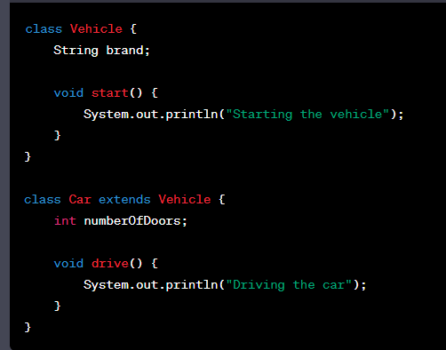
Inheritance
Basically Inheritance in java allows us to define a new class that inherits attributes and behaviors (i.e., fields and methods) from an existing class (known as a superclass or base class).
The subclass can then extend the superclass by adding its own fields and methods or by overriding the inherited methods.
Benefits of inheritance in Java are like code reusability and the ability to create a hierarchy of related classes. And also It allows us to create relationships between objects and helps for a more organized and structured codebase.
In Java, we use the keyword extends for inheritance relationship between classes. Like for example:
In our application we have used the base class and extends the same

Slide 41
Polymorphism
Polymorphism is …Performing a same action in different ways.
In java we can achieve polymorphism by two ways
Method Overloading
Method Overriding
Method Overloading
It happens within the same class.
The names of the methods should be same.
Whereas the count or type of the parameters should be different.
Depending upon the parameters that you pass that method will be called.
In our project we have created a method with the same name called formsubmission
Basically in our project there are Two types of forms
User Base form (formName , EMployeeID)
Non User Based form(formName)
So as per the requirement we pass the parameters inside the form submission method
Method Overriding
This happens across two classes. Parent class and child class
We need to use extend key word here.
Here Count/Type/return type of parameters are same i.e. signature of the method is same for a method present in both parent and child class
If you are calling a method in child class. It will override the method in parent class
This is method overriding in java

Slide 42
Abstraction
Abstraction
It is nothing but Hiding of the implementation of code. It shows what it does rather than how it does. In Java we can achieve abstraction (hiding of code) in two ways in Java
1. Abstract class
2. Interface class
Abstract Class
Using abstract class we can achieve 0 -100 % abstraction(hiding of code)
You need to declare a class with Abstract key word
Abstract class can contain both
Implemented Methods(which has code in it)
Unimplemented Methods (which do not have code)
We will use l the Unimplemented Methods will be implemented in separate class
extends(Inheritance) key word
We can extend only single abstract class
Interface Class
We achieve 100% of abstraction using Interface class
Use Interface key word to create a interface class
Interface class contains only Unimplemented Methods
And …These Unimplemented methods will be implemented in a separate class
And…We use implements key word here
And…We can Implement multiple interface classes

Slide 43
Constructors
It’s similar to method. But the name of this method is same as the class name.
It is used to set the initial values of the variables
Constructors does not have any return type
It is called whenever an instance of the class is created
Every time an object is created using new() keyword at least one constructor is called.
If you are not creating a constructor. Default constructor will be called by java and it will set the initial values
There are two types of constructors
Non Parameterized
Parameterized

Slide 44
Final Key Word
Static key work
Basically Final key word is a Non-Access Modifier. I mean we cannot change them. An we can user the Final key word with
Variable, method, class
If we make any variable as final, we cannot change the value of final variable. In our project we have created a set of constants like location of test data, properties file, resource file and made them as final.
And…If we make any method as final, Then We cannot override it.
If you make any class as final, you cannot extend it.
Static keyword is used for memory management mainly. We can apply static keyword with variables, methods, blocks and nested classes
. The static keyword belongs to the class than an instance of the class.
The static can be:
Variable (also known as a class variable)
Method (also known as a class method)
Block
Nested class

Slide 45
Final
Finalize
Finally
Basically Final key word is a Non-Access Modifier. I mean we cannot change them. An we can user the Final key word with
Variable, method, class
If we make any variable as final, we cannot change the value of final variable. In our project we have created a set of constants like location of test data, properties file, resource file and made them as final.
And…If we make any method as final, Then We cannot override it.
If you make any class as final, you cannot extend it.
Finally is the block in Java Exception Handling to execute the important code whether the exception occurs or not.
Finally block is always related to the try and catch block in exception handling.
Finally block runs the code even if exception occurs or not. Finally block cleans up all the resources used in try block
Finalize is the method in Java which is used to perform clean up processing just before object is garbage collected..
Finalize() method is used with the objects.
Finalize method performs the cleaning activities with respect to the object before its destruction.
Finalize method is executed just before the object is destroyed.

Slide 46
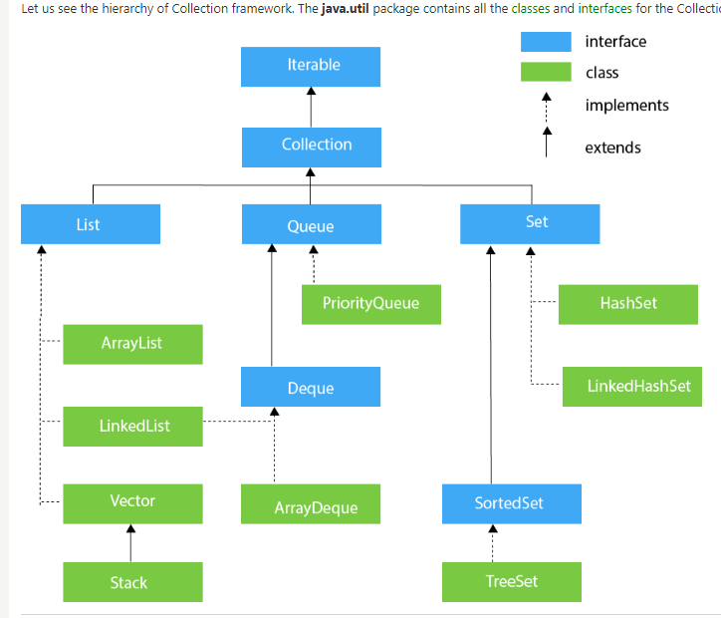
Collections Framework
The Collections framework in Java basically provides us an ready made kind of architecture that helps us to store and manipulate the group of objects.
With the Java Collections we can achieve all the operations that we perform on a data such as searching, sorting, insertion, manipulation, and deletion.
Java Collection means a single unit of objects. Java Collection framework provides many interfaces (Set, List, Queue, Deque) and classes (ArrayList, Vector, LinkedList, PriorityQueue, HashSet, LinkedHashSet, TreeSet).
Before the Collection Framework(or before JDK 1.2) was introduced, the standard methods for grouping Java objects (or collections) were Arrays or Vectors, or Hashtables. All of these collections had no common interface. Therefore, though the main aim of all the collections is the same, the implementation of all these collections was defined independently and had no correlation among them. And also, it is very difficult for the users to remember all the different methods, syntax, and constructors present in every collection class.

Slide 47
List vs Set Vs Map
List | Set | Map
The list interface allows duplicate elements | Set does not allow duplicate elements. | The map does not allow duplicate elements
The list maintains insertion order. | Set do not maintain any insertion order. | The map also does not maintain any insertion order.
We can add any number of null values. | But in set almost only one null value. | The map allows a single null key at most and any number of null values.
List implementation classes are Array List, LinkedList. | Set implementation classes are HashSet, LinkedHashSet, and TreeSet. | Map implementation classes are HashMap, HashTable, TreeMap, ConcurrentHashMap, and LinkedHashMap.
The list provides get() method to get the element at a specified index. | Set does not provide get method to get the elements at a specified index | The map does not provide get method to get the elements at a specified index
If you need to access the elements frequently by using the index then we can use the list | If you want to create a collection of unique elements then we can use set | If you want to store the data in the form of key/value pair then we can use the map.
To traverse the list elements by using Listlterator. | Iterator can be used traverse the set elements | Through keyset, value, and entry set.

Slide 48
Compile Time Polymorphism
Compile-time polymorphism is also known as static polymorphism or early binding. Compile-time polymorphism is a polymorphism that is resolved during the compilation process.
Overloading of methods is called through the reference variable of a class. Compile-time polymorphism is achieved by method overloading and operator overloading.

Slide 49
Run Time Polymorphism

Slide 50
Array List
Like … ArrayList is basically a Java class that is implemented using the List interface..
Java ArrayList provides us with the functionality of a dynamic array like… where the size is not fixed as an array. Also as a part of the Collection framework, it has many features not available with arrays.
Important Features of ArrayList in Java
ArrayList inherits AbstractList class and implements the List interface.
ArrayList is initialized by size. However, the size is increased automatically if the collection grows or reduces… if the objects are added or removed from the collection.
We can to randomly access the list items in the Arraylist.
And we can not be used it for primitive types, like int, char, etc. We need to have a wrapper class for such cases.
ArrayList is not Synchronized.

Slide 51
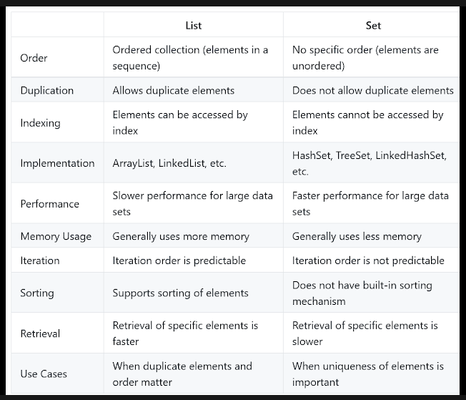
List Vs Set

Slide 52
Hash Map
A HashMap is Basically used to store and retrieve values based on keys.
Stores key-value pairs: Each element in a HashMap consists of a key-value pair. The key is used to look up the associated value.
Supports null keys and values: HashMaps allow for null values and keys. This means that a null key can be used to store a value, and a null value can be associated with a key. And also like.. HashMap allows us to store one null key and many null values
Not ordered: HashMaps are basically not ordered, So the order in which elements are added to the map is not preserved. However, LinkedHashMap preserves the insertion order.
Allows duplicates: HashMaps allow for duplicate values, but not duplicate keys. If a duplicate key is added, the previous value associated with the key is overwritten.
Fast access time: HashMaps provide constant time access to elements, which means that retrieval and insertion of elements are very fast, usually O(1) time complexity.
Uses hashing function: HashMaps uses a hash function to map keys to indices in an array. This allows for a quick lookup of values based on keys.
Thread-unsafe: HashMaps are not thread-safe, which means that if multiple threads access the same hashmap simultaneously, it can lead to data inconsistencies. If thread safety is required, ConcurrentHashMap can be used.
Capacity and load factor: HashMaps have a capacity, which is the number of elements that it can hold, and a load factor, which is the measure of how full the hashmap can be before it is resized.

Slide 53
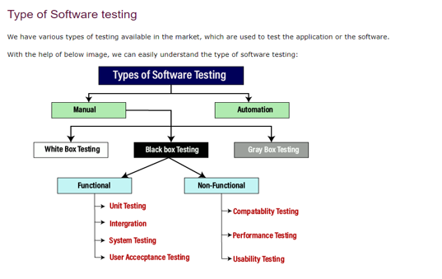
Types of Software Testing

Slide 54
STLC Life Cycle
There are following six major phases in every Software Testing Life Cycle Model (STLC Model):
Requirement Analysis
Test Planning
Test case development
Test Environment setup
Test Execution
Test Cycle closure
Requirement Analysis − Here we try to understand and analyze our story and If we have doubts we get them cleared with Product Owner or Development Team
Test Planning − Test Team plans the strategy and approach.
Test Case Designing − Here we Develop Test scenarios and the test cases.
Test Environment Setup − When integrated environment is ready to validate the product.
Test Execution − Real-time validation of product and finding bugs.
Test Closure − Once testing is completed, metrics , reports, results are documented in this phase.

Slide 55
White ,Black and Gray Box Testing
White-box testing
The white box testing is done by Developer, where they check every line of a code before giving it to the Testing team. Since the code is visible for the Developer during the testing, that's why it is also known as White box testing.
Black box testing
The black box testing is done by the Testers, where they can check the functionality of an application or the software according to the requirement. In this, the code is not visible while performing the testing; that's why it is known as black-box testing.
Gray Box testing
Gray box testing is a combination of white box and Black box testing. It can be performed by a person who knew both coding and testing. And if the single person performs white box, as well as black-box testing for the application, is known as Gray box testing.

Slide 56
Regression , Smoke and Sanity, Retesting
What is Regression Testing?
REGRESSION TESTING is to confirm that a recent program or code change does not have negative impact on the existing features.
This testing is done to make sure that new code changes should not have side effects on the existing functionalities. It ensures that the old code still works once the latest code changes are done.
Smoke Testing
Smoke Testing determines whether the deployed software build is stable or not.
Smoke testing is also known as "Build Verification Testing" or “Confidence Testing.”
Smoke testing is a confirmation for QA team to proceed with further software testing. Basically smoke test suite consists of a minimal set of tests run on each build to test software functionalities.
Sanity Testing
Sanity Testing is a subset of regression testing.
Sanity testing is generally performed on build where the production deployment is required immediately like after a critical bug fix.
Sanity testing is performed to ensure that the code changes that are made are working as properly.
Smoke testing ensures that very critical functionalities of a program are working fine, sanity testing checks that the proposed or newly implemented functionality works as expected.
What is Retesting???
Testing the defect alone Only like Defect Fix.

Slide 57
Defect Life Cycle
In the Defect Life Cycle we have different statuses like New, Assigned , Open, Fixed , Retest, Reopen ,Closed, Rejected , Deferred
When a new defect is logged and posted for the first time. It is assigned a status as NEW.
Defect is assigned to the developer who is working on that module and then the status is marked as Assigned
And….The developer starts analyzing and works on the defect fix and the status would be updated as Open
And the next status would be like Fixed When a developer makes a necessary code change and verifies the change, he or she can make bug status as "Fixed.“
And the status would be moved to Retest where the Tester does the retesting of the code to check whether the defect is fixed by the developer or not and changes the status to "Re-test.“
Closed: If the bug is no longer exists then tester assigns the status "Closed."
And… we have Reopen: If the bug persists even after the developer has fixed the bug, the tester changes the status to "reopened". Once again the bug goes through the life cycle.
Duplicate: If the defect is repeated twice or the defect corresponds to the same concept of the bug, the status is changed to “Duplicate."
Rejected: If the developer feels the defect is not a genuine defect then it changes the defect to “Rejected."
Deferred: If the defect is not of a prime priority and if it is expected to get fixed in the next release, then status will be marked as "Deferred“.

Slide 58
Defect Life Cycle
Defect
It is nothing but Deviation from the requirement document. In defect we have
Summary:
Step to Reproduce:
Expected
Actual
Severity of Defect:
Priority of Defect:
Defect Life Cycle
We have status in Defect life cycle. All these are configurable in ALM by admin
New -- When a tester find the defects for the first time.
Assigned Once the defect is found and it’s valid then it is assigned to developer
Open He has started to fix/work on this defect
Fixed The developer had made all the changes and defect is fixed
Test Defect is ready to test and as a tester you need to test the defect
Verified Verify the defect and make sure its working fine
Closed This defect is working fine
Deferred: It is valid defect; A defect will be marked as Deferred when there is not time for developer to fix it. I will fix in coming release

Slide 59
Severity of Defect
Severity of Defect
Defect Severity is a degree of impact on the software application .
A higher effect of defect on system functionality will lead to a higher severity level.
We the testers usually determines the severity level of a defect.
Types of Severity
We have like critical, major, medium and low severity
Critical: This defect indicates complete shut-down of the process, nothing can proceed further
Major: It is a highly severe defect and collapses the system. However, certain parts of the system remain functional
Medium: It causes some undesirable behavior, but the system is still functional
Low: It won't cause any major break-down of the system

Slide 60
Priority of Defect
Priority defines the order in which a defect should be fixed. Higher the priority the sooner the defect should be resolved.
It is mostly set my developer or Product owner
Priority Types
We have like three Priorities in the defect
High: The defect must be resolved as soon as possible as it affects the system severely and cannot be used until it is fixed – Typically SLA(Service Level Agreement) is 2 Days
Low: The Defect is an irritant but repair can be done once the more serious Defect has been fixed
Medium: During the normal course of the development activities defect should be resolved. It can wait until a new version is created

Slide 61
Defect Logged last one
In our project we have like AD group. In order to access any application
We need to have our id tagged to that AD group
Previously in our project I have logged a very tricky bug. I would say
There were leading spaces in the AD Group. For that reason when a user is raising a request and even after approval and provisioning of the request , the user did not get the access. It was due to the leading spaces in the Data base. That was the defect. So, What happened was when new AD group created by business team they have given spaces by mistake .. And that lead to all the issues

Slide 62
Alpha Beta Testing
Alpha Testing is a type of software testing performed to identify bugs before releasing the product to real users or to the public. Alpha Testing is one of the user acceptance testing.
Beta Testing is performed by real users of the software application in a real environment. Beta testing is one of the type of User Acceptance Testing.

Slide 63
JIRA
It is used for bug tracking, issue tracking, and project management.
An Issue is classified as follows −
Sub-Task − This is the sub-task of an issue. In a logged issue, there can be different tasks to resolve it, which are called as sub-tasks.
Bug −A problem or error. Basically these prevents the functions of the product.
Epic − A big user story that needs to be broken down. Created by JIRA Software - do not edit or delete.
Improvement − An improvement or enhancement to an existing feature or task.
New Feature − A new feature of the product, which is yet to be developed.
User Story − Functionality or a feature expressed as a user goal..
Task − A task that needs to be done to achieve team’s goal.

Slide 64
JIRA- Defect Screen
So first we need to have access in JIRA and after logging to the JIRA application we need to click on the ‘Creat’ Button after that it will open up a window pop up asking all the details related to the defect
Select the Project: Once we create a defect It will ask for the project type in which we want to log the defect. If we have multiple projects, we may need to select the relevant one.
Choose Issue Type: Select the "Issue Type" that corresponds to a defect or bug. This is usually named "Bug," "Defect," or something similar. The available issue types can vary depending on your project's configuration.
Fill in the Details: We need to provide details about the defect. Like:
Summary: Like where we will be giving a brief and descriptive title for the defect.
Description: Here in the Description we need to give the detailed explanation of the issue, including what's wrong, how to reproduce it, and any other relevant information.
Priority: Set the priority level for the defect (e.g., High, Medium, Low).
Assignee: Assign the defect to a specific team member if applicable.
Reporter: By default, this will be name of the person who is logging the defect.
Components: Specify the component or module where the defect is found.
Labels: Add labels for categorization (e.g., "UI,“, Sanity ,Regression, "Backend," "Critical").
Environment: Describe the environment in which the defect was observed (e.g., browser, operating system).
Attachments: You can attach files like screenshots or log files if they are relevant.
Submit the Defect: After filling in the necessary information, click the "Create" button or similar action to submit the defect.
Additional Information: Depending on your project's configuration, there might be additional fields or custom fields to fill out. Ensure you provide as much information as needed to accurately describe the defect.
Notification: Once the defect is created, it will typically generate a notification to relevant team members or stakeholders. They will be able to view, comment on, and work on the defect.
Manage and Track the Defect: You can continue to monitor and manage the defect through JIRA. This includes updating its status as it progresses through the workflow, adding comments, and attaching more information if necessary.

Slide 65
Boundary Value , Equivalence Class, Decision Table
Boundary Value Analysis In this.. We will be testing with the boundary values for a given condition. For a given input variable, we need to identify the minimum and maximum allowable values. And then determine the values just below and above these boundaries. These are the boundary values.
Like for example assume there is text box which accepts value between 18 to 60. Then with the Boundary value analysis we will be testing with the inputs 17,18,19, and 59,60,61. where valid inputs are 18,19,59,60 and Invalid inputs are 17 & 61.
Equivalence Class partitioning: Here in this we divide the input into a set of equivalence classes like valid set and invalid set. Say for example if there is Text box which accepts values in range of 18 to 60. In that case we have like Invalid set: any value less than 18 and greater than 60. And the valid set would be any value between 18 and 60.
Decision Table: Basically in this we test the application behavior for different input combinations. In this we check for different input combinations and their corresponding Output in a tabular form. It is also called as a Cause-Effect table where Cause and effects are captured for better test coverage.
-----------------------------------------------------------------------------------------------------------------------------------------------------------------------------
The main goal of these test case design techniques is to reduce the number of test cases required to test a software application while ensuring that all important scenarios are covered. This techniques is especially useful for testing inputs with a large range of possible values.

Slide 66
Developer is Not Accepting Defect
Yeah … ha..ha… <smile> this happens most of the times…
First thing is like we need to make sure that the defect is well-documented, clear, and also reproducible. And we need to add all the necessary information to
And the best thing is to have a connect with the concerned developer who worked on that module and explain the developer the issue by sharing the screen and also explain them the impact of the defect, such as how it affects functionality or the end-user experience.
We should attach proper screen shots of the of the defects, including screenshots, logs, and also we need to add the step-by-step instructions for reproducing it. The more evidence we can provide, the more easy it will be. And also we need to include the minute details like user with which logged in , Test data used, Access Group details.
And also its good to Keep a record of all communications and actions related to the defect. This can be valuable in case the situation escalates and also it will be easy for future reference.
We can show them the acceptance criteria and tell them that this what is written here but it not working as expected. I mean we can tell them that this is deviation from the requirement and help them understand the issue
And even after all these things and efforts if still the developer is not accepting the defect we can involve our team lead or the best person would be the product owner in this case. And ask them to mediate and help resolve the dispute.

Slide 67
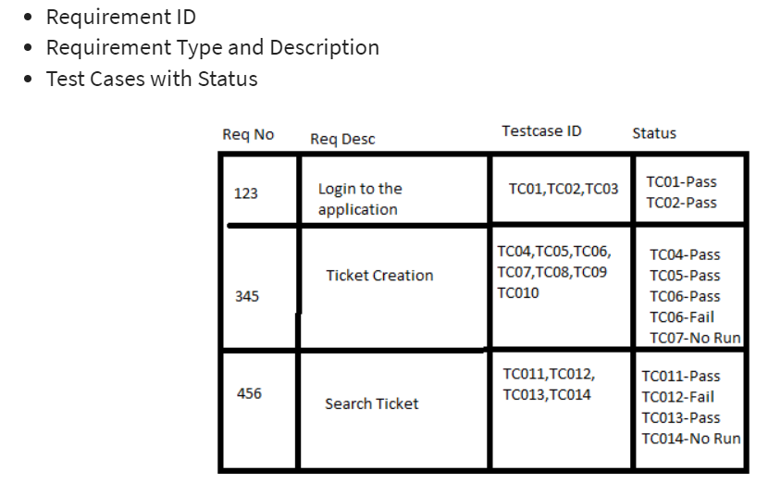
RTM
Requirement Traceability Matrix:
RTM is a document that is basically used to map and traces user requirement with test cases.
Basically in this we capture all requirements and their corresponding test cases in a single document. The main purpose of Requirement Traceability Matrix is to validate that all requirements are checked via test cases such that no functionality is missed during Software testing.

Slide 68
Defect vs Error vs Bug

Slide 69
Test Plan
Please write here

Slide 70
Test Case vs Test Scenario
Please write here

Slide 71
No Time for Testing What to Do
Please write here

Slide 72
Stubs and Drivers
Stubs
Stubs are developed by software developers to use them in place of modules, if the respective modules aren’t developed, missing. In developing stage or unavailable currently while Top-down testing of modules.
Stubs are mainly used in Top-Down integration testing while the Drivers are used in Bottom-up integration testing increase the efficiency of testing process
Drivers Drivers serve same purpose as stubs serve, but drivers are used in Bottom-up integration testing and also more complex than stubs.
Drivers are also used when some modules are missing and unavailable at time of testing of a specific module because of some unavoidable reasons to act in absence of required module.

Slide 73
What Is Pega
PEGA is a one of the most popular Business Process Management (BPM) tool created on Java concepts that allow users to create applications at faster phase.
And also, Pega Platform allows us to quickly and easily build applications. It is like Complete visual-driven application development that lets us to deliver develop applications at faster phase, with no coding required. It’s a kind of drop with no coding required in that.
PEGA is basically an application development tool for BPM Applications. It does not require programming/coding knowledge to develop applications.
And this created in Java and uses OOPS concepts.
Most of the companies are opting for PEGA due to its reduce costs and improve business.

Slide 74
Work-List & Work-Basket
Work Basket
A workbasket basically contains open assignments and any user who has access to that work basket can take a assignment from that and can work on that. A workbasket can be linked to an organization unit, or a work group, and a calendar. And also items in the workbasket are not associated with an operator.
Assignments can leave a workbasket in three ways:
Users who are access to that workbasket can pick an assignment from the workbasket and work on it
Also, application can automatically route assignments in a workbasket to users based on work schedules, due dates, skills, workloads, and as per the configurations made.
Managers can transfer assignments from a workbasket to user worklists.
Work List
Work list means the items in that can be worked by only that particular user.
And Basically a work List will contain open, outstanding Requests.. Like I mean which are not Resolved and user need to perform action on them.

Slide 75
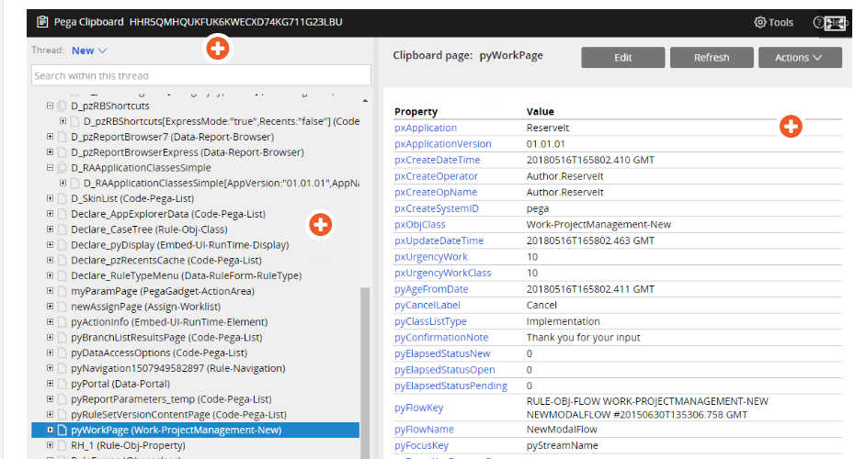
Clipboard Tool
Clipboard tool is used to display data in memory. And it organizes and presents all the pages in memory
And basically it displays all the properties on each page and the value of each property.
And also the clipboard has a hierarchical structure, consisting of nodes that are known as pages, most of which have a name and also an associated class to the same.
In Clipboard, we have 4 categories of pages viz .
1. User Pages, 2. Data Pages, 3. Linked property pages and 4. System pages.
And we use this for debugging and troubleshooting aid for application.
In our application we use to update the termination date using the clipboard tool for testing purpose.

Slide 76
Tracer Tool
Tracer
Basically the Tracer tool allows us to capture and view the events that occur during case processing.
And also tracer presents a complete log of the events that occur during case processing.
This log allows you to identify the source of execution errors, such as Java exceptions or incorrect property values.
Where as in the Clipboard tool, clipboard presents the current value of properties in memory.
And this is mostly used by the Developers.
Remote Tracer
We can also can trace another session by using the Remote Tracer. The Remote Tracer lists every requestor that is connected to your Pega Platform server.
The first letter of the session ID identifies the requestor type:
H – Internet Explorer-based users
B – Background users such as agents, service requestors other than for Service Portal rules, and daemons
A – External applications
P – Access through Service Portlet rules

Slide 77
PEGA Access Groups
Basically an access group in pega identifies the types of cases that members of the group can create and process.
Here in this we identify the case types that members can create, you identify one or more work pools for the access group on the Advanced tab of the access group record.

Slide 78
PEGA Urgency
Urgency
In PEGA we have Urgency which is a numeric value that brings visibility to unresolved work in your application.
An assignment has a default urgency of 10. For each interval, you define a value between 10 and 100 by which to increase the initial urgency. The maximum urgency is 100.
The higher the value, the higher the urgency. Typically, the urgency increases as an assignment advances to the next interval.

Slide 79
PEGA SLA
SLA stands for Service Level Agreement
Actually SLA stand for service-level agreement (SLA) a defines specified time in which that assignment needs to be completed.
Each service-level agreement has few intervals of time that will let us know how long we have time to perform a task or resolve a case.
We have like Start Time, Goal Time and Deadline Time Line In SLA in PEGA
Start: This is where the service level time starts.
Goal: The goal time is to specify how long each assignment should take. This step is calculated from the start of the assignment or case.
Deadline: The term "deadline" relates to the amount of time a case or process can take before being late. It starts when the job or case starts.
Passed Deadline: When the deadline for an assignment or case has passed, the term "passed deadline" indicates when further action should be taken. It calculates how much time has passed since an assignment's deadline.

Slide 80
PEGA Report Definition
Basically a report definition rule defines a report definition report. Because of the ease-of-use of report definition rules,. Any user like managers can create, share, modify, and schedule report definition reports with little or no assistance from application developers.
Pega gives us the provision to define the Reports. Basically a report definition rule defines a report definition report.
There are two types of report definition reports.
Summarized report
List Report.
Summarized reports: These Reports display summary counts, totals, or averages, and you can drill down to supporting information. Summarized reports can also contain charts.
List reports: These Reports display unsummarized or detailed data about individual cases or other data instances.
Any user like managers can create, share, modify, and schedule report definition reports with little or no assistance from application developers.
Summarized reports contain two types of columns. At least one column must be a summarized column, which contains data that is summarized by using one of the following built-in functions:
COUNT(), COUNT DISTINCT(), SUM(), AVG(), MIN(), MAX()

Slide 81
PEGA pyWorkPage
pyWorkPage stores data that is generated during case creation and processing.
pyWorkPage is a specific page on the clipboard and stores data such as the case creation date or the case ID. All these details are like Embedded pages within pyWorkPage that store sets of case data.
When we open a child case, the clipboard also contains the page pyWorkCover. pyWorkCover contains the case data for the parent case.
The page enables us to copy data between the parent case and the child case and confirm that any data mapped from the parent case to the child case is correct.

Slide 82
PEGA Vs Manual Testing-Part 01
Pega testing is specific to applications built on the Pega platform, whereas normal testing can be applied to a wide range of applications build on the technologies other than PEGA.
Pega testing requires specialized knowledge of the Pega platform, while the other normal testing can be performed by testers with knowledge on software testing and quality assurance like that.
As a PEGA tester we need to have the idea of Clipboard, Tracer, Report Definition , Activities , Work list , SLA, Urgency ,Work baskets and frameworks, whereas in the normal tester all these are not required.
To make it simple Pega testing is a special form of testing for applications built on the Pega platform, while the normal testing is a applied to software applications which are built on the different technologies.
Pega testing primarily involves testing applications built using the Pega platform. This can include testing various components such as workflows, user interfaces, business rules, and integrations.
Also like,… Pega testing may involve specialized roles like Pega Business Analysts, Pega Developers, and Pega Testers who have expertise in Pega applications.

Slide 83
PEGA Vs Manual Testing-Part 02
Normal testing, also known as traditional software testing, refers to the broader practice of testing software applications developed using various technologies and frameworks. Traditional testing encompasses various testing levels and types, including unit testing, integration testing, system testing, and acceptance testing, among others. Testing can be performed on applications developed using different programming languages, platforms, and frameworks (not limited to Pega). Manual and automated testing tools, such as Selenium, JUnit, and TestNG, are commonly used for traditional software testing. Traditional testing can be applied to web applications, mobile applications, desktop applications, and more, across different industries and domains.
Moreover, a PEGA tester should also know the following things before getting into testing the apps through this Testing feature. These skills are-
Operator ID
Rule Setting skills
Accessing Group data
Declarative Statements Like- Table for Decision making, Decision-making Trees, and so on.
Concept of Work-list
Concept of Work-Basket
Service Stage Agreements (SLAs) and so on.
These things will help any tester and developer to test the apps easily and effortlessly.

Slide 84
PEGA Roles & Roles Based Testing

Slide 85
PEGA – Work Group

Slide 86
Pega – Case Management

Slide 87
What is an API
API stands for Application Programming Interface, is a set of rules and protocols that allows different software applications to communicate and interact with each other. It defines the methods and data formats that developers can use to request and exchange information between different systems or components, enabling them to work together seamlessly.
APIs are used to enable the integration of different software systems, allowing them to share data and functionality. They serve as intermediaries that allow one software application to access the features or data of another application or service. APIs are essential for building web and mobile applications, as they allow developers to leverage existing functionality and data from other services and platforms without having to recreate everything from scratch.
APIs come in various forms, including web APIs, which are commonly used for communication over the internet. Web APIs are typically accessed using HTTP requests and can provide a wide range of functionalities, such as retrieving data from a database, making payments, sending emails, or interacting with social media platforms.
APIs can be public, where they are open for any developer to use, or private, where access is restricted to authorized users or applications. They play a crucial role in modern software development and are integral to the interconnected digital world we live in today.

Slide 88
Status Code in API
HTTP status codes are basically used in APIs to indicate the outcome of a client's request to a server. These status codes provide information about the result of the request, helping both the client and the server understand what happened during the interaction.
1xx (Informational): These status codes indicate that the server has received the request but hasn’t
2xx (Successful): These status codes indicate that the request was successfully received, understood, and accepted.
200 (OK): The request was successful, and the server is returning the requested data.
201 (Created): The request has resulted in the creation of a new resource.
204 (No Content): The request was successful, but there is no data to return.
3xx (Redirection): These status codes indicate that further action is needed to complete the request. The client may need to follow a redirect or take some other action.
301 (Moved Permanently): The resource has been moved to a different URL permanently.
302 (Found): The resource has been temporarily moved to a different URL.
4xx (Client Error): These status codes indicate that there was an issue with the client's request.
400 (Bad Request): The client's request is malformed or invalid.
401 (Unauthorized): The client needs to authenticate itself to access the resource.
403 (Forbidden): The client is authenticated but doesn't have permission to access the resource.
404 (Not Found): The requested resource could not be found on the server.
5xx (Server Error): These status codes indicate that there was an issue on the server's side.
500 (Internal Server Error): A generic error message indicating a problem on the server.
502 (Bad Gateway): The server, while acting as a gateway, received an invalid response from an upstream server.

Slide 89
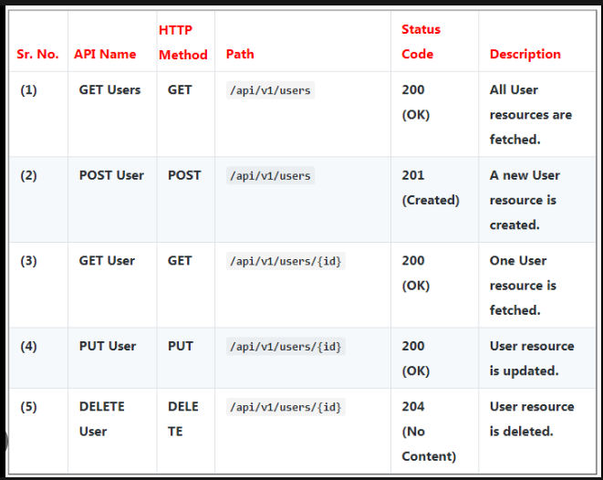
API Methods

Slide 90
Array List Vs HashSet
Sr. No. | Key | ArrayList | HashSet
1 | Implementation | ArrayList is the implementation of the list interface. | HashSet on the other hand is the implementation of a set interface.
2 | Internal implementation | ArrayList internally implements array for its implementation. | HashSet internally uses Hashmap for its implementation.
3 | Order of elements | ArrayList maintains the insertion order i.e order of the object in which they are inserted. | HashSet is an unordered collection and doesn't maintain any order.
4 | Duplicates | ArrayList allows duplicate values in its collection. | On other hand duplicate elements are not allowed in Hashset.
5 | Index performance | ArrayList uses index for its performance i.e its index based one can retrieve object by calling get(index) or remove objects by calling remove(index) | HashSet is completely based on object also it doesn't provide get() method.
6 | Null Allowed | Any number of null value can be inserted in arraylist without any restriction. | On other hand Hashset allows only one null value in its collection,after which no null value is allowed to be added.

Slide 91
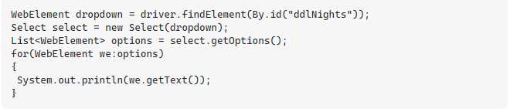
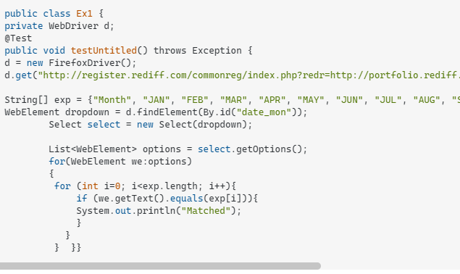
Verifying drop down values using WebDriver

Slide 92
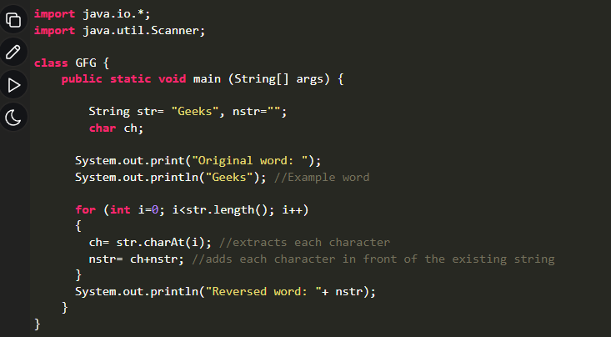
Reverse A String

Slide 93
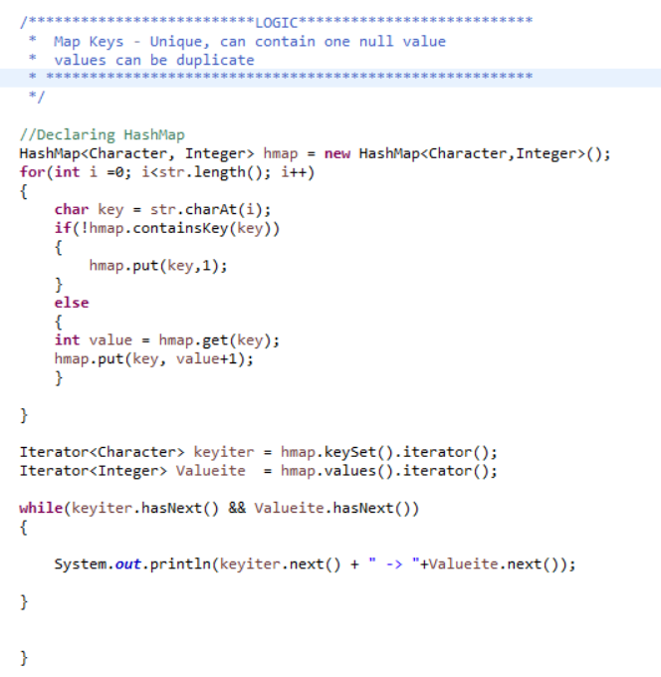
Count Of Characters In Given String

Slide 94
Any Questions At Last
Sure.. Ok.. Thank you for your time.
Is it totally into Automation or Manual?
It was more of a conversation than an interview. Thank you for making it easy for me
If allowed to …May I know what will be the domain of the project?
I mean whether it will be Banking or Healthcare.
-----------------------------------------------------------------------------------------------------------------------
Ok Sure. Thank you so much
Of. Thanks you so much. For letting me know..
That would be a new learning for me. I am really looking forward for this..

