Slide 1
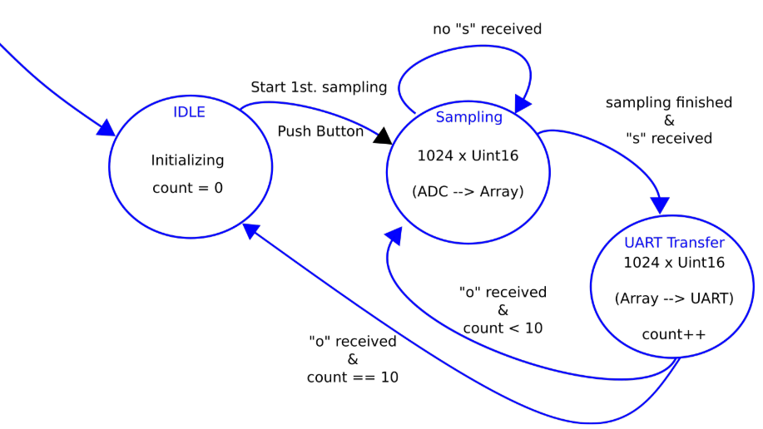
Movement Detector using State Machine

Slide 2
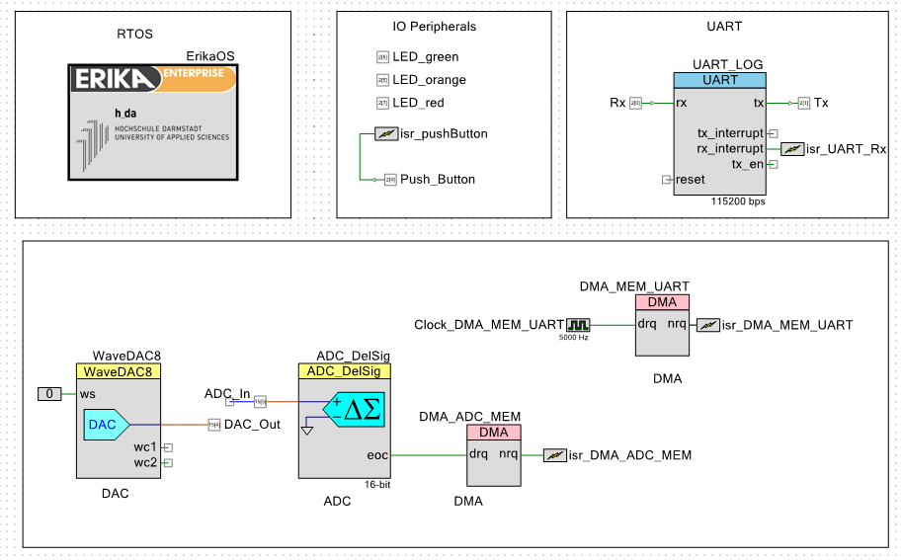
Top Design

Slide 3
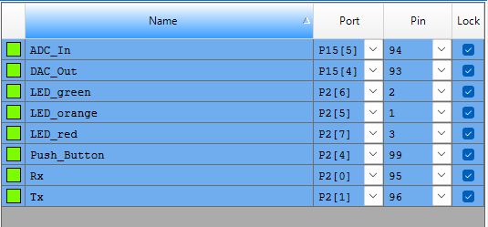
Pin Configuration

Slide 4
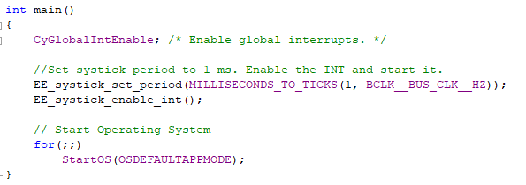

Initializing the OS
Global Object and Macro

Slide 5
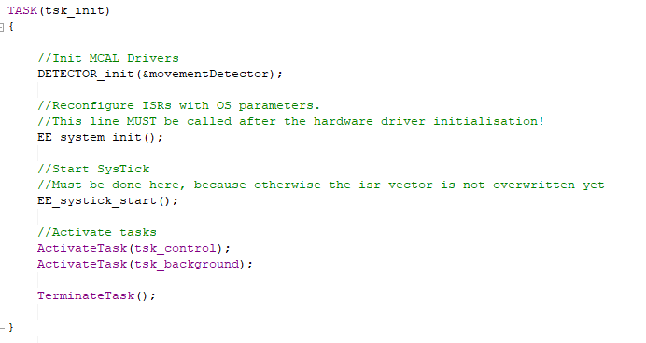
Initializing Low Level Drivers and Activating the Required Tasks

Slide 6
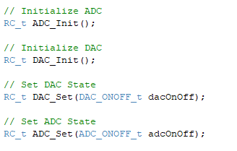
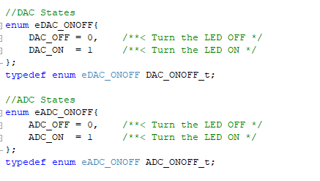
DAC and ADC BSW Functions

Slide 7
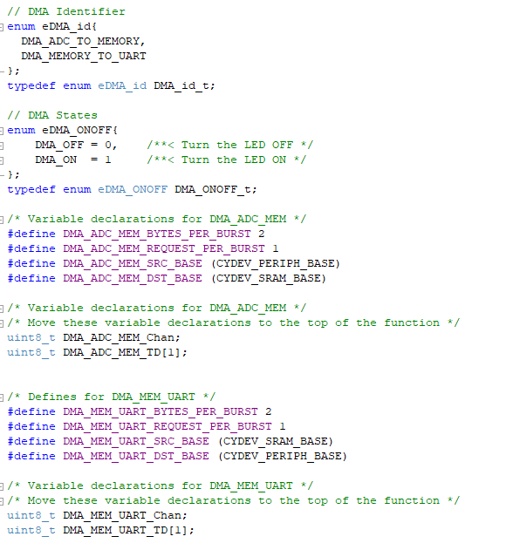

DMA BSW Functions

Slide 8
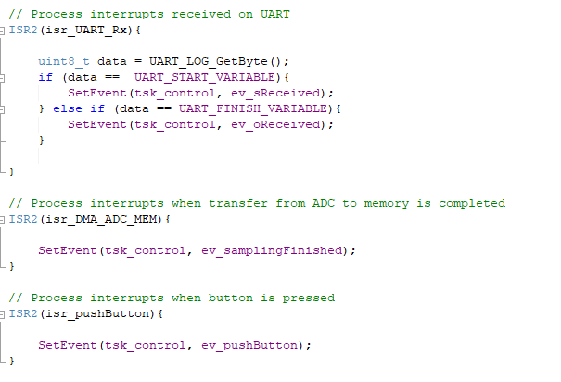
ISRs

Slide 9
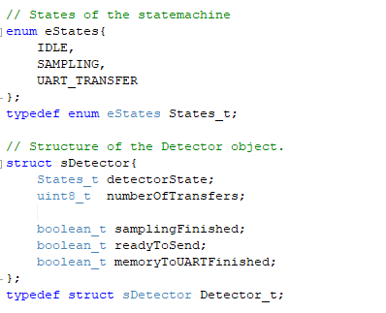
Structure and States of the Application

Slide 10

Helper Functions

Slide 11
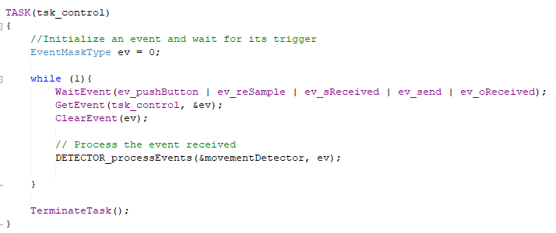
Control task waits for the event and calls the function that processes it

Slide 12
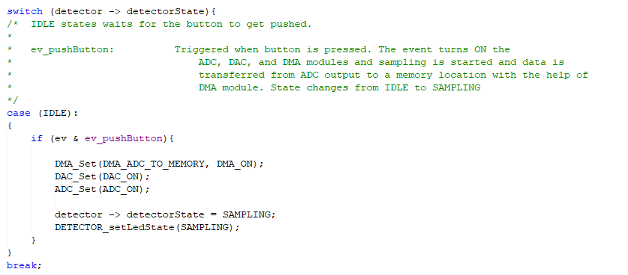
IDLE State

Slide 13
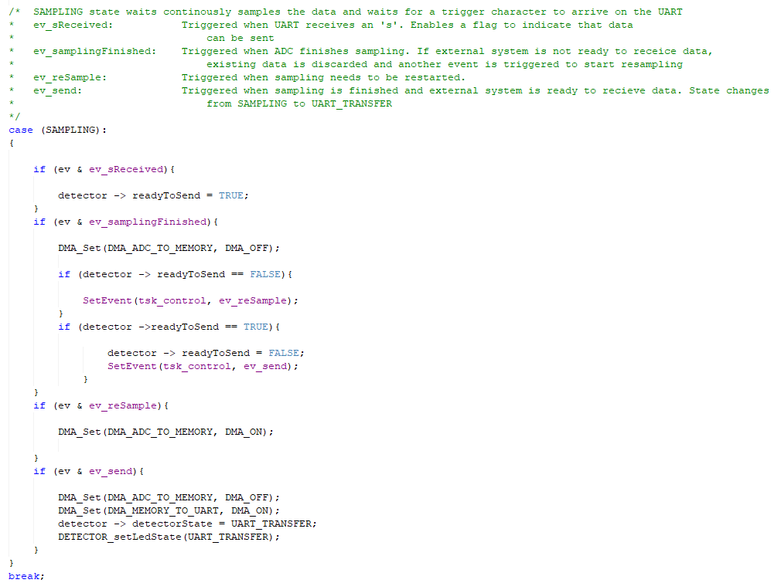
SAMPLING State

Slide 14
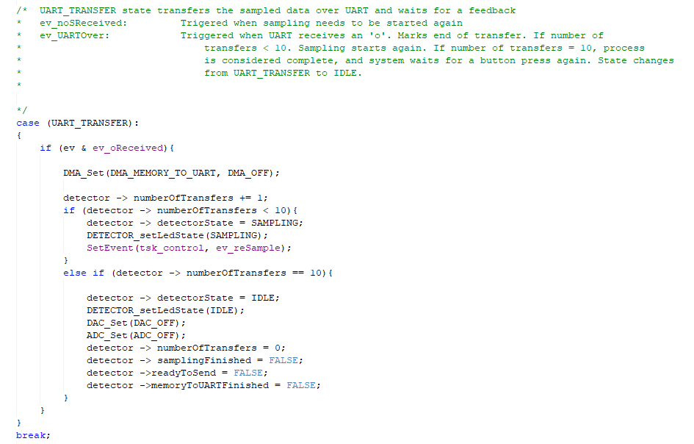
UART_TRANSFER State

Slide 15
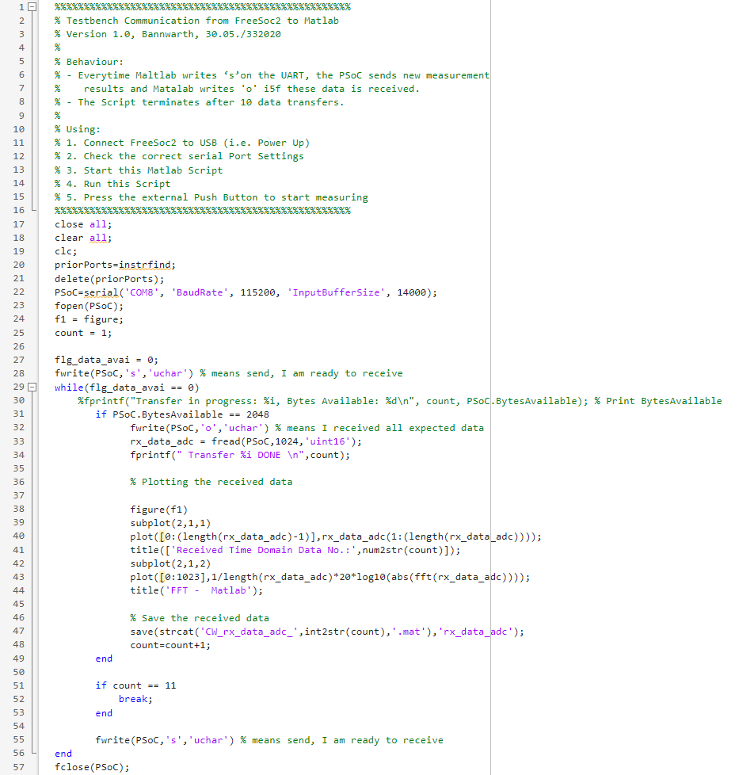
MATLAB Script

Slide 16
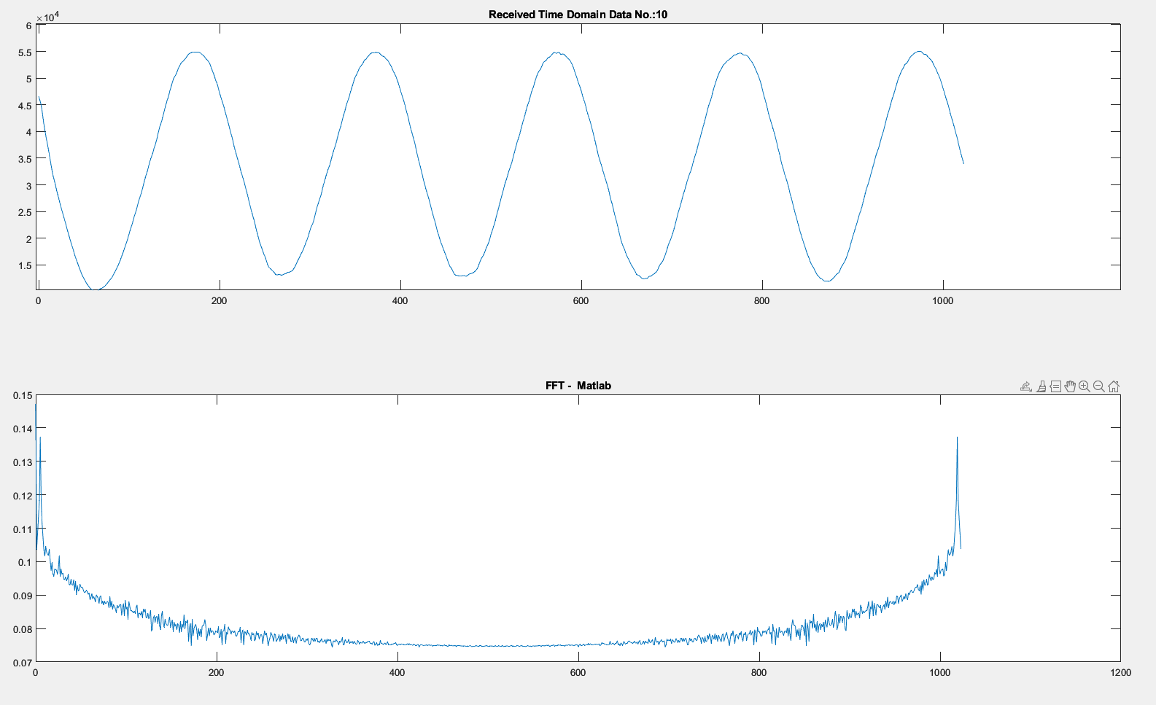
MATLAB Output

