Slide 1

CAVITE STATE UNIVERSITY · CEIT · DEPARTMENT OF COMPUTER STUDIES
VenueVue: System Background & Architecture
An Internet-Independent, Offline-First Point-of-Sale with Remote Online Option & Recipe-Driven Inventory
Industry Partner: Nearby Café — Legaspi St., Intramuros, Manila (Adjacent to Lyceum of the Philippines University - LPU)
PROJECT DEVELOPMENT TEAM — CTRL + STAY
Zaki Zapico
Project Manager / Lead Developer
Full-Stack Architecture & Database
John Vincent Libao
Systems Analyst
System Modeling & Workflow Analysis
Jenny Lyn Roquid
Systems Analyst
Requirements & Business Traceability
Rhea Mae Gregorio
QA & Testing Lead
Quality Assurance & Test Automation
Notes:
Good day, professors, panelists, and fellow classmates. We are group CTRL + STAY from Cavite State University, presenting our Software Engineering project: VenueVue. Today, we will present the background of the system—specifically why we are building VenueVue, the real problems faced by our industry partner Nearby Café in Intramuros, and how our offline-first, recipe-driven architecture with a remote online option provides a complete solution. Our team consists of Zaki Zapico as Project Manager and Lead Developer, John Vincent Libao and Jenny Lyn Roquid as our two Systems Analysts, and Rhea Mae Gregorio as our Quality Assurance and Testing Lead.

Slide 2
PROJECT OVERVIEW
VenueVue at a Glance: Purpose & Innovation
Bridging the gap between counter speed, offline resilience, remote client visibility, and recipe inventory.
DUAL-MODE CLOUD & LAN
Offline + Online Portal
Operates 100% independently over a local Wi-Fi LAN at the counter, with a secure online cloud portal (HTTPS) for remote owner monitoring from anywhere.
GRAM & ML PRECISION
Recipe-Driven FIFO
Deducts exact espresso beans, milk, and syrups per cup size (12oz, 16oz, 22oz). Solves the invisible profit loss of untracked raw ingredients.
UNIVERSITY RUSH TUNED
15-Sec Checkout
Fast preset cash bills, automatic change, and instant GCash/Maya reference capture designed for rapid student turnover between class breaks.
DRAWER ACCURACY
BIR & Financial Z-Read
Separates physical cash in drawer from digital e-wallets. Automates 12% VAT calculations and outputs pre-formatted Excel Z-readings with zero third-party dependencies.
Notes:
To summarize VenueVue in one sentence: it is a high-speed, local-first POS and micro-inventory system engineered specifically for the unique operational constraints of Nearby Café in Intramuros. Notice our four core innovations: First, 100% offline-first operation. Second, true recipe-driven inventory down to grams and milliliters. Third, high-speed 15-second counter transactions for university student rushes. And fourth, strict financial accountability separating cash from e-wallets.

Slide 3
INDUSTRY CLIENT PROFILE
Nearby Café: Context & Physical Relocation
Understanding the physical environment and operational profile of our industry partner.
THE BUSINESS PROFILE
• From Pop-up to Brick-and-Mortar: Formerly operated as TravelBean MNL (pop-up/event model). The business has permanently transitioned into Nearby Café, an established physical coffee shop.
• Strategic Intramuros Location: Situated along Legaspi St. in Intramuros, Manila, immediately adjacent to Lyceum of the Philippines University (LPU Manila) and near Mapúa University.
• Target Customer Demographic: High-density university student body, faculty, administrative personnel, and heritage tourists in the historical district.
• Product Lineup: Espresso-based coffees (Spanish Latte, Americano), matcha, specialty refreshers, and artisanal pastries tailored to student budgets.
THE PHYSICAL & OPERATIONAL REALITY
• The 'Intramuros Signal Black Hole': Centuries-old stone architecture and thick heritage walls severely attenuate cellular signals (4G/5G) and cause frequent commercial fiber outages.
• University Bell Schedule Rushes: Order volume is not evenly distributed; it arrives in explosive 10-minute spikes aligned with class dismissals (e.g. 10:30 AM, 12:00 PM, 3:00 PM).
• Dual-Payment Culture: Students predominantly pay using Philippine mobile e-wallets (GCash, Maya, QR Ph) alongside cash, requiring split-second reference verification.
• Lean Barista Staffing: Shifts are run by 1 to 2 baristas who must simultaneously operate the cash register and handcraft beverages without screen friction.
Notes:
Let's look at the client profile. Nearby Café was previously TravelBean MNL. They moved from a pop-up setup into a permanent brick-and-mortar storefront along Legaspi Street in Intramuros, Manila, right beside LPU. This relocation changed everything: they now face explosive rushes when classes dismiss. More importantly, Intramuros has thick Spanish-era stone walls that destroy wireless internet signals. Standard cloud POS solutions regularly drop connections here, proving that an offline-first system is not a luxury—it is an absolute necessity.

Slide 4
PROBLEM ANALYSIS
The Core Operational Pain Points ('Bakit Dinidevelop?')
Four critical operational bottlenecks that caused financial leakage and counter delays.
1. Cloud POS Vulnerability & Downtime
Standard cloud POS systems (e.g. Loyverse, Shopify) fail when internet drops. In Intramuros, cellular data frequently drops to 3G or cuts completely. A frozen register during student rush causes lost sales and furious queues.
CONSEQUENCE: Lost revenue, manual paper receipts, and delayed class attendance for students.
2. The 'Invisible' Raw Ingredient Loss
Conventional retail POS only tracks finished goods (e.g. '1 Iced Latte sold'). They completely ignore how many grams of espresso beans, milliliters of whole milk, or pumps of vanilla syrup were consumed or spilled.
CONSEQUENCE: Stockouts in the middle of a rush, untracked spillage, and unexplained profit margins.
3. Counter Bottlenecks & Mental Math
Calculating change manually (e.g. ₱1,000 bill for a ₱140 coffee = ₱860 change) during a crowd creates cashier anxiety, slow queues, and frequent short-cash errors at the counter.
CONSEQUENCE: Customer abandonment, slow transaction speeds, and end-of-day cash drawer shortages.
4. Chaotic E-Wallet vs. Cash Reconciliation
Staff mixed GCash and Maya transaction screenshots with actual paper cash bills. At the end of the shift, the drawer didn't match the sales totals because digital money was treated as drawer cash.
CONSEQUENCE: Disputed barista shortages, inaccurate Z-readings, and non-compliance with BIR 12% VAT auditing.
Notes:
Here are the four big problems that answered 'Bakit dinidevelop ang VenueVue?'. First, internet cuts in Intramuros freeze cloud POS registers. Second, coffee shops don't just sell cups; they consume beans, milk, and syrup. Normal POS systems don't track raw ingredients. Third, counter delays caused by mental math during student rushes. And fourth, staff mixing GCash screenshots with drawer cash, making end-of-day accounting a nightmare. VenueVue was engineered specifically to solve all four of these pain points.

Slide 5
PROJECT OBJECTIVES
Project Purpose & Measurable Goals ('Para Saan?')
What VenueVue achieves for Nearby Café across operations, inventory, and finance.
PRIMARY SYSTEM OBJECTIVE
To engineer an Internet-Independent, locally networked Point-of-Sale and Recipe-Driven Inventory System that guarantees 100% counter uptime, automates ingredient depletion via FIFO batches, and enforces strict cash/e-wallet financial accountability for Nearby Café.
ZERO-LATENCY LAN OPERATION
SO-1: 100% Counter Uptime
Establish a zero-WAN architecture hosted on local shop hardware. Client tablets operate over local Wi-Fi with automatic IndexedDB offline queues to survive network dropouts.
AUTOMATED INGREDIENT ACCOUNTING
SO-2: Recipe-Driven FIFO Depletion
Link each cup variant (12oz, 16oz, 22oz) to precise ingredient quantities. Deduct from active batch containers first (FIFO) and monitor opened container shelf life.
UNDER 15S PER TRANSACTION
SO-3: Rapid Checkout & Split Tender
Provide 1-click cash shortcuts (₱100, ₱200, ₱500, ₱1,000) with automatic change calculation and dedicated reference logging for GCash, Maya, and QR Ph.
AUDIT-READY FINANCIAL CLOSE
SO-4: BIR 12% VAT & Excel Z-Reading
Automatically extract 12% VAT and generate pre-formatted, styled Excel (.xlsx) Z-readings separating Drawer Cash from E-Wallets without third-party software dependencies.
Notes:
This slide defines 'Para saan dinidevelop?'. Our primary objective is to guarantee that Nearby Café never stops operating, even when internet fails, while automating ingredient depletion and balancing the cash drawer with complete financial transparency. We have four measurable specific objectives: 100% counter uptime, FIFO ingredient depletion, rapid checkout under 15 seconds, and automated BIR 12% VAT Excel reporting.

Slide 6
ARCHITECTURAL PILLAR 1
Hybrid Architecture: Offline-First LAN + Online Client Option
Guarantees 100% counter uptime locally in Intramuros while providing remote online visibility for the Owner.
LOCAL AREA NETWORK (LAN) HOSTING (PRIMARY)
The entire system (Apache HTTP + MariaDB + PHP API) runs directly on the shop's local computer. Client tablets connect over local Wi-Fi with ZERO external internet required. Sub-50ms transaction speed immune to ISP fiber cuts.
CLIENT ONLINE OPTION: REMOTE CLOUD ACCESS
• Remote Executive Web Portal (HTTPS):
Hosted online portal (e.g. nearbycafe.infinityfreeapp.com) allows the Owner to securely log in from home, a laptop, or a smartphone to review real-time sales and stock metrics.
• Remote Z-Readings & Inventory Auditing:
The Owner can download end-of-day Excel Z-Readings, audit staff void logs, and inspect remaining milk/bean container levels without needing to be physically present at the shop counter.
• Dual-Mode Architectural Independence:
The local physical register and the online cloud portal maintain independent database layers. If Intramuros suffers an ISP blackout, counter cashiering continues without interruption.
• Best of Both Worlds:
Nearby Café enjoys the zero-lag speed and reliability of an on-premise register, combined with the 24/7 remote visibility of modern cloud management.
BROWSER INDEXEDDB OFFLINE QUEUE
If a tablet temporarily steps out of Wi-Fi range, orders queue locally in the browser's IndexedDB. Each order carries a cryptographic UUID and SHA-256 idempotency key to prevent duplicate stock deductions when reconnecting.
Notes:
Pillar 1 represents our hybrid architectural advantage: Offline-First Local LAN plus a Client Online Option. At the physical counter in Intramuros, VenueVue runs on the local shop PC over Wi-Fi, completely independent of the internet. This gives baristas sub-50ms ringing speed with zero outage risk. At the same time, we provide an Online Option for the client: the owner can open our hosted cloud web portal from home or on their smartphone to check live sales, download Z-readings, and audit inventory in real time. The two environments are isolated so an internet cut will never stop the physical register from ringing sales.

Slide 7
ARCHITECTURAL PILLAR 2
Recipe-Driven FIFO Inventory Management
Micro-level ingredient tracking down to grams and milliliters per cup size.
BOM (BILL OF MATERIALS) RECIPE MAPPING
Example: Selling 1x 'Iced Spanish Latte 16oz' automatically triggers simultaneous depletion of 4 raw ingredients:
✔ Espresso Beans: 18 grams (extracted from active batch)
✔ Fresh Whole Milk: 150 mL (poured from opened 1,000mL carton)
✔ Condensed Milk: 30 mL (measured syrup blend)
✔ Packaging Assets: 1x 16oz Cold Cup + 1x Dome Lid + 1x Straw
If raw ingredients drop below recipe requirements, the Register instantly badges the drink as unavailable to prevent taking orders that cannot be served.
FIFO BATCH ALLOCATION & CONTAINER SEALS
• First-In, First-Out (FIFO) Enforcement:
Ingredients received earlier (e.g. Batch LOT-20261101) are automatically depleted before newer deliveries. Prevents spoilage of dairy and roasted beans.
• Container Tracking (Opened vs. Sealed):
Distinguishes between a sealed 1,000mL milk carton in the chiller vs. an opened 450mL container in active use. Flags open dairy past 48-hour shelf-life.
• 1-Click Viber / Messenger Supplier Reorder:
When stock reaches low-reorder thresholds, VenueVue generates a pre-formatted shopping list ready to paste directly into supplier chat groups.
Notes:
Pillar 2 is our recipe-driven inventory system. Standard retail POS systems cannot handle coffee shops because they only count cups. VenueVue maintains a Bill of Materials for every drink size. When a 16oz Spanish Latte is sold, it deducts 18g of beans, 150mL of milk, and 30mL of condensed milk from the oldest active batch. It also tracks opened vs. sealed milk cartons and warns the owner before items expire or run out.

Slide 8
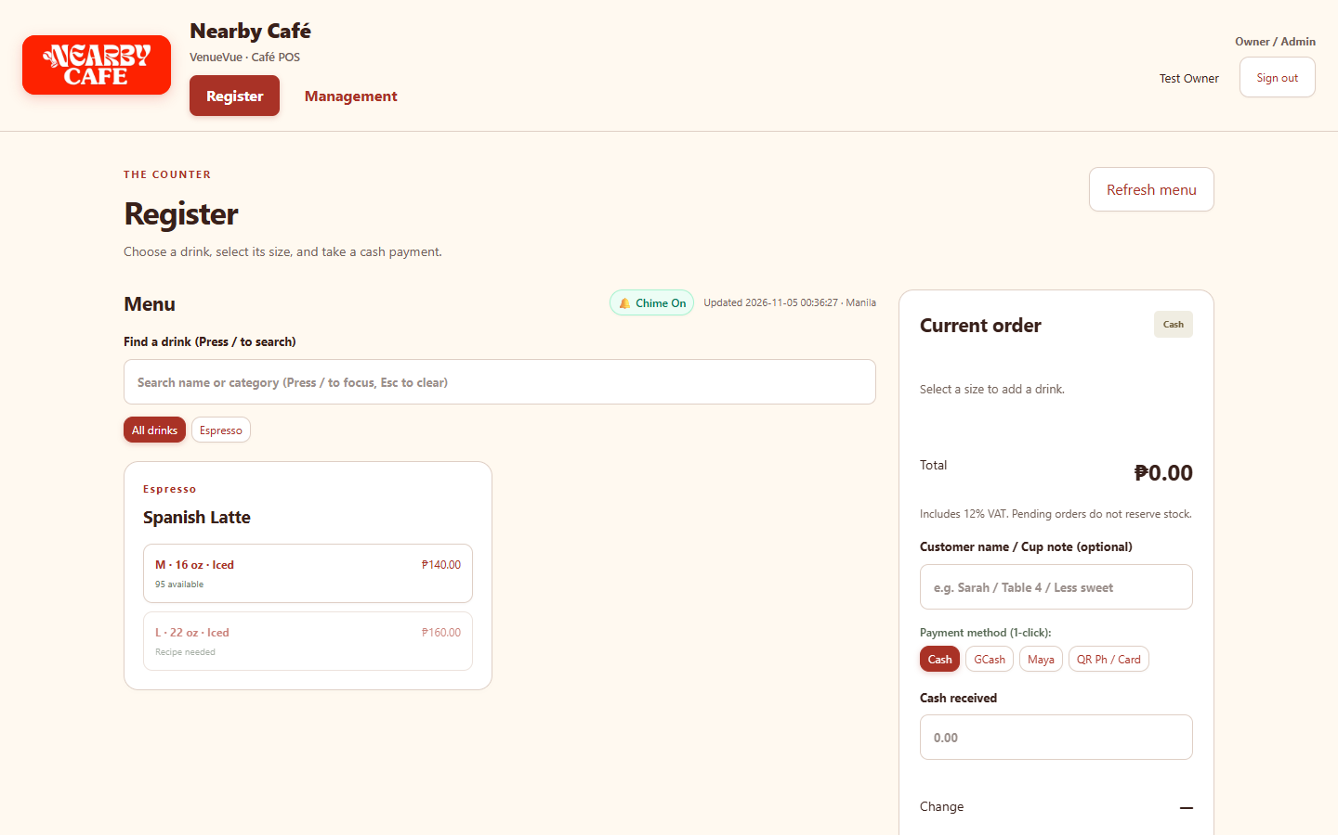
ARCHITECTURAL PILLAR 3
High-Speed Counter Register Interface
Ergonomically designed for rapid student turnover during university rush hours.
CASHIER REGISTER FEATURES
✔ Touch-Optimized Menu Grid
Categories for Espresso, Non-Coffee, and Pastries with dynamic cup size scaling (12oz, 16oz, 22oz).
✔ 1-Click Preset Cash Bills
Preset buttons for ₱100, ₱200, ₱500, ₱1,000, and Exact Tender calculate change instantly without mental math.
✔ Philippine E-Wallet Integration
Dedicated 1-click selection and reference number logging for GCash, Maya, and QR Ph.
✔ Customer Name & Cup Notes
Seamlessly tags orders with student names and custom barista prep notes (e.g. 'Sarah - Less Ice, Oat Milk').
✔ Synthesized Web Audio Chime
Zero-asset sound cue provides immediate tactile confirmation when an order is completed.
Notes:
Here you see the actual Register screen of VenueVue. Notice the clean, touch-friendly layout. On the left is the menu with live recipe availability badges. On the right is the current order tray with one-click cash shortcuts (100, 200, 500, 1000) that instantly display change. It also has dedicated buttons for GCash and Maya reference numbers and cup custom notes. This allows a barista to ring up a drink in under 15 seconds.

Slide 9
ARCHITECTURAL PILLAR 4
Strict Role-Based Access Control (RBAC)
Defending business margins, recipe secrets, and financial integrity through strict role separation.
BARISTA / CASHIER ROLE (REGISTER ONLY)
• Restricted Interface:
Exclusively locked to the `/register` route. No navigation tabs or links to management tools.
• High-Speed Ringing:
Process orders, accept payments (Cash/GCash), print receipts, and call out student orders.
• Zero Financial Visibility:
CANNOT view profit margins, product cost prices, total daily sales, or inventory cost totals.
• No Unauthorized Voids:
Baristas cannot delete sales or manipulate stock counts without Owner PIN verification.
OWNER / ADMINISTRATOR ROLE (FULL CONTROL)
• Full Management Suite:
Complete access to `/management` (PIN and password secured with brute-force rate-limiting).
• Live Executive Dashboard:
Real-time metrics: Gross Sales, Net Sales (VATable), 12% Output VAT, Physical Cash vs. Digital E-Wallets.
• Recipe & Catalogue Control:
Create new drinks, configure BOM ingredient gram/mL amounts, set retail prices, and manage variants.
• Stock Operations & Audit:
Receive new batches, record spillage/waste with justifications, view immutable audit logs, and export Z-readings.
Notes:
Pillar 4 is Role-Based Access Control. In a busy university coffee shop where student baristas work part-time shifts, security is paramount. Baristas are strictly confined to the Register screen. They cannot view how much profit the shop makes, they cannot view cost prices, and they cannot void orders without owner permission. The Owner retains full control over recipes, batch receiving, waste recording, and financial audit trails.

Slide 10
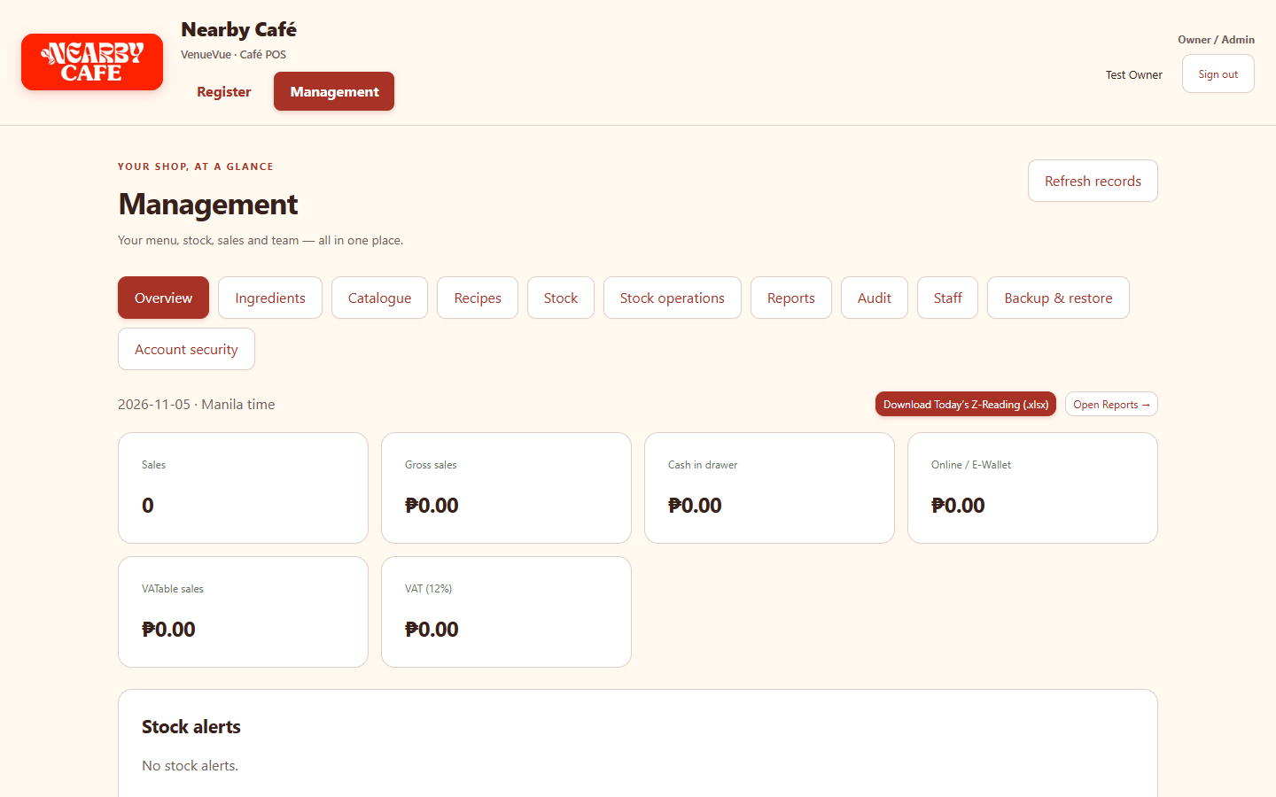
ARCHITECTURAL PILLAR 5
Financial Accountability & BIR Compliance
Automated 12% VAT extraction and end-of-day Excel Z-Readings that isolate cash from e-wallets.
FINANCIAL AUDITING & REPORTS
✔ Automated 12% VAT Breakdown
Separates Total Gross, VATable Net Sales, and 12% Output VAT in real-time per transaction.
✔ Physical Cash vs. E-Wallet Isolation
Solves the biggest cash drawer headache: tells the owner exactly how much physical paper cash must be in the drawer vs. digital GCash/Maya funds.
✔ 1-Click Native Excel Z-Reading (.xlsx)
Generates a fully formatted, styled Microsoft Excel spreadsheet for the day with zero external cloud dependencies.
✔ Comprehensive Structured CSV
Multi-section exports for accountant reconciliation and tax filing.
✔ Tamper-Proof Audit Logging
Every inventory adjustment, price update, and void is recorded with user ID and timestamp.
Notes:
Pillar 5 is Financial Accountability and BIR Compliance. As seen on our Management Dashboard, VenueVue continuously calculates Gross Sales, VATable Sales, and 12% VAT. Crucially, it separates Physical Cash in Drawer from Digital E-Wallets. At closing time, the owner clicks one button to download the official Z-Reading in styled Microsoft Excel format. No more balancing receipts with a calculator at 10 PM.

Slide 11
TECHNICAL ENGINEERING
Full-Stack System Architecture & Technology Stack
Engineered with proven open-source technologies for extreme reliability and low hardware overhead.
PRESENTATION LAYER
REACT 18 + VITE
Touch-optimized SPA, responsive CSS custom properties, Web Audio API chime, fast virtual DOM rendering.
CLIENT STORAGE LAYER
BROWSER INDEXEDDB
Local asynchronous transaction queue with SHA-256 cryptographic idempotency hashing for zero offline data loss.
APPLICATION LAYER
PHP 8.2 MODULAR REST API
Lightweight, session-authenticated REST endpoints handling FIFO allocation, recipe math, and VAT computation.
DATA PERSISTENCE LAYER
MARIADB 10.4+ (INNODB)
ACID-compliant relational database with strict foreign keys, atomic transactions, and zero risk of race conditions.
Notes:
Here is the technical stack powering VenueVue. At the frontend, we use React 18 with Vite for lightning-fast responsive UI. For offline resilience, we use Browser IndexedDB with SHA-256 idempotency hashing. At the backend, PHP 8.2 handles the business logic, FIFO inventory deduction, and VAT math. And for data integrity, MariaDB with InnoDB guarantees ACID-compliant transactions with zero data corruption.

Slide 12
PROJECT BOUNDARIES
System Scope & Engineering Boundaries
Clear definition of deliverables to prevent scope creep and guarantee high-speed counter execution.
IN-SCOPE CORE CAPABILITIES
✔ Offline LAN Point-of-Sale: 100% functional register running locally with cash & GCash/Maya reference tracking.
✔ Recipe-Driven Micro-Inventory: Automatic gram and milliliter ingredient deduction per beverage variant sold.
✔ FIFO Batch & Container Management: Oldest lot depletion, opened vs. sealed container status, and shelf-life expiration alerts.
✔ Strict Role Separation (RBAC): Barista counter isolation and Owner-protected management dashboards.
✔ Compliance & Daily Close-Out: Automated 12% VAT calculations and native Excel Z-reading reports.
OUT-OF-SCOPE (INTENTIONAL EXCLUSIONS)
✖ Third-Party Delivery API Integration: No direct GrabFood or Foodpanda webhook integrations to avoid external internet dependencies.
✖ Dine-In Table Reservation System: Nearby Café operates strictly as a walk-in counter ordering establishment.
✖ Customer Loyalty / Mobile App: Customer points are kept out of scope to prioritize sub-15 second checkout speed.
✖ Automated Card Terminal Hardware Hookup: Credit cards are logged via reference keys without proprietary EFTPOS hardware dependencies.
✖ Multi-Store Enterprise ERP: Optimized for a single high-throughput physical shop rather than complex multi-warehouse logistics.
Notes:
It is vital in software engineering to clearly establish system boundaries. On the left are the features we deliver: complete offline POS, FIFO recipe inventory, container tracking, RBAC, and BIR Excel reporting. On the right are features intentionally excluded by design: like GrabFood integrations or table reservations. By excluding these, VenueVue remains lean, high-speed, and completely immune to internet failures.

Slide 13
PROJECT MANAGEMENT
Development Team Roles & Responsibilities
Team CTRL + STAY — Dedicated engineering division of labor.
Zaki Zapico
PROJECT MANAGER & LEAD DEVELOPER
• Architected full-stack system (React + PHP + MariaDB).
• Implemented offline IndexedDB queue and idempotency logic.
• Designed relational database schema and FIFO batch engine.
• Engineered BIR 12% VAT math and Excel Z-reading generation.
John Vincent Libao
SYSTEMS ANALYST
• Modeled end-to-end system workflows and data flow diagrams (DFD).
• Authored functional requirements and business rule specifications.
• Conducted stakeholder requirement interviews with Nearby Café.
• Mapped entity relationships (ERD) and use case narratives.
Jenny Lyn Roquid
SYSTEMS ANALYST
• Led requirements elicitation and business logic analysis.
• Analyzed menu, recipe BOMs, and ingredient container workflows.
• Maintained requirements traceability matrix across deliverables.
• Drafted end-user operational guidelines for barista workflows.
Rhea Mae Gregorio
QA & TESTING LEAD
• Formulated comprehensive test plans and verification matrices.
• Executed automated Playwright browser and API integration suites.
• Conducted network fault-injection and Wi-Fi disconnect simulations.
• Validated UI ergonomics, change math accuracy, and security policies.
Notes:
Here is our engineering team distribution for CTRL + STAY: Zaki Zapico leads full-stack engineering, offline sync, and database architecture. We have two dedicated Systems Analysts: John Vincent Libao handles system workflow modeling, DFDs, ERDs, and functional requirements, while Jenny Lyn Roquid leads requirements elicitation, menu BOMs, and business acceptance traceability. And Rhea Mae Gregorio leads Quality Assurance and Testing, driving automated test suites, fault-injection simulations, and usability validation.

Slide 14
CONCLUSION & IMPACT
Expected Business Value & Summary
Transforming Nearby Café's daily operations into an efficient, audit-proof, and resilient enterprise.
100% UPTIME
Immunity to Intramuros internet outages via local LAN hosting.
15-20% SAVINGS
Elimination of invisible raw ingredient loss through FIFO recipe deduction.
< 15 SECONDS
Fast counter turnaround per student transaction during morning/lunch rushes.
0 RECONCILIATION DISCREPANCY
Exact separation of drawer cash from digital GCash/Maya funds.
THANK YOU! FLOOR IS NOW OPEN FOR QUESTIONS & LIVE SYSTEM DEMO
VenueVue — Built by CTRL + STAY for Nearby Café, Intramuros, Manila
Cavite State University · COSC 75: Software Engineering II
Notes:
In conclusion, VenueVue transforms Nearby Café from vulnerable manual paper operations into a high-speed, audit-proof, and resilient enterprise. It delivers 100% uptime in stone-walled Intramuros, saves 15 to 20% in raw ingredient loss, processes student orders in under 15 seconds, and completely eliminates cash drawer reconciliation discrepancies. Thank you very much. We are now open for your questions and ready to showcase our live system demonstration.

