Slide 1

AUPP AI Committee, Core Members
First Formal AI Committee Meeting
Today: turn the committee into action.

Slide 2

CHECKPOINT
Today's Objectives
1
Who are we?
NOW
1
2
Tasks to be completed this week
3
Understanding policy
4
Specific roles and task assignment

Slide 3

WHO ARE WE
Hello!
Let's introduce ourselves.
Name. Area of interest. What you want from this committee.
Nine of us. Faces to names first. Then straight into work.

Slide 4
WHO ARE WE, THE PLATFORMS
Canvas: The Official Hub
Our permanent home. Find it here.
M
MEETINGS
D
DISCUSS
W
WHO WE ARE
Recordings, minutes, actions, dates.
Research, articles, opinions, questions.
Profiles, roles, expertise, contacts.
L
LEARN
E
EVIDENCE
K
KEEP UP
In-house and platform training.
Forms, findings, policy work.
Readings, AI news, opportunities.
Find it. Develop it. Discuss it here.

Slide 5
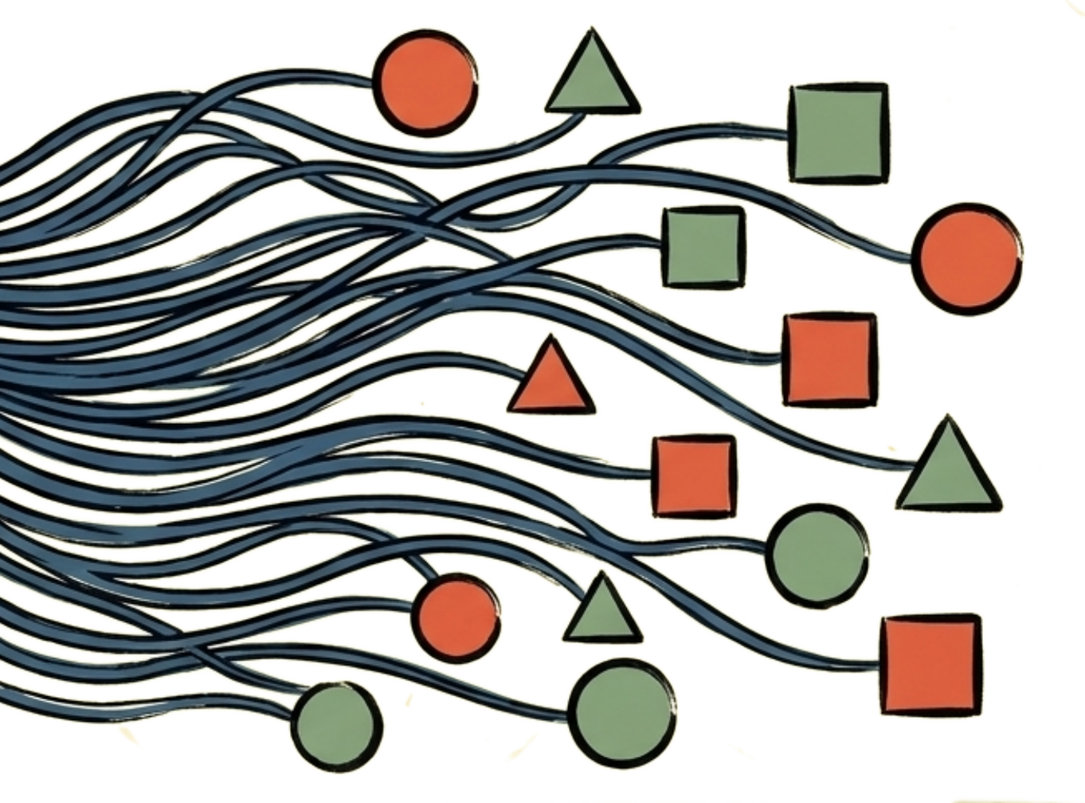
WHO ARE WE, THE PLATFORMS
Telegram: Keep This Thing Alive
The everyday life of the committee.
TALK
Questions, opinions, reactions, debate.
Use the tabs. Jump in. Reply. Start things.
High on your list. Always something happening.
SHARE
Articles, news, opportunities, events.
Not a replacement. Other AUPP groups still matter.
SOLVE
Ask for help. Offer help.
ACT
Reminders, urgent tasks, quick calls.
CONNECT
Ideas don't wait for meetings.

Slide 6
WHO ARE WE, HOW WE OPERATE
How We Work
How we work, and want to be seen working.
E
EVIDENCE-LED
E
EVALUATIVE
A
APPROACHABLE
What we find, not what we assume.
Check results. Adjust if not.
Plain language, open door.
T
TEST IT
I
INFORMED
T
TRANSPARENT
Confirm it, even when unsure.
Look outward before building.
Decisions, written down.

Slide 7
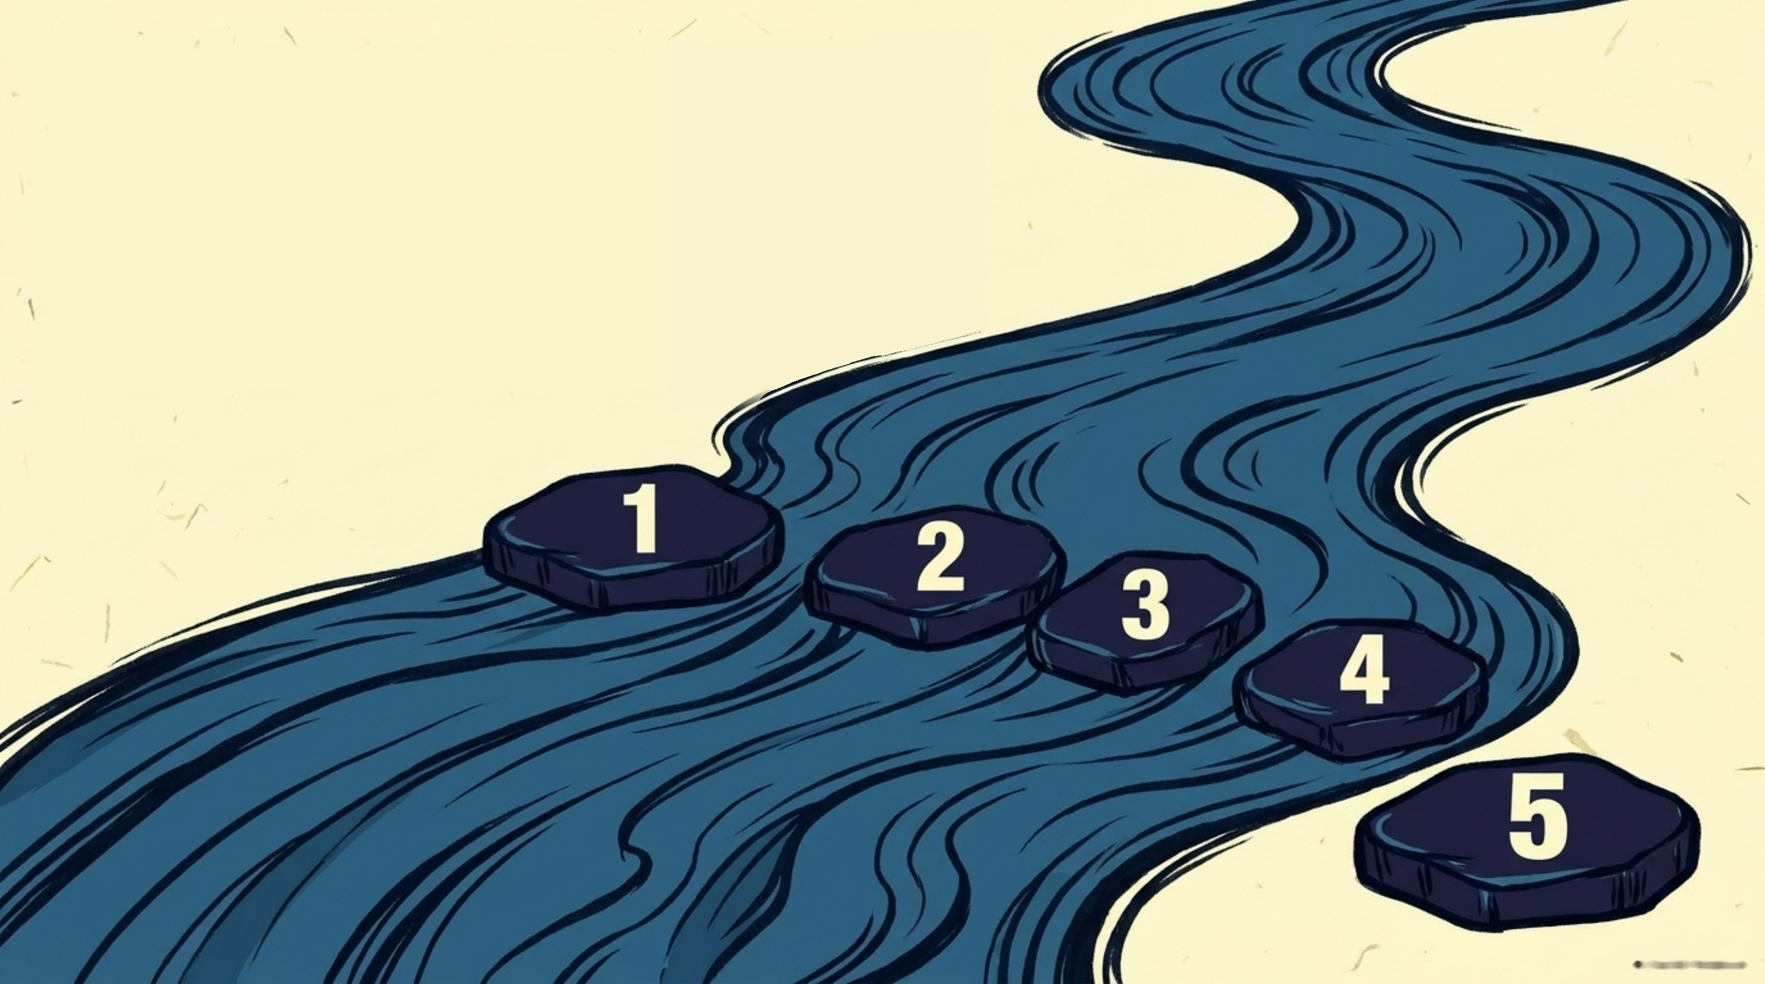
WHO ARE WE, HOW WE OPERATE
Our Decision Rule
1 Discuss → 2 Test → 3 Evaluate → 4 Decide → 5 Record
Discussion isn't a decision.
Decisions and actions get recorded.
Institutional approval gets escalated.

Slide 8
CHECKPOINT
Today's Objectives
✓
Who are we?
2
2
Tasks to be completed this week
NOW
3
Understanding policy
4
Specific roles and task assignment

Slide 9

TASKS TO BE COMPLETED THIS WEEK
Urgent tasks!
We need real evidence, fast.
1
Faculty blueprint
2
Students: attitude and use
3
Build our capability
One at a time.

Slide 10

THIS WEEK, FACULTY
SCAN
TO
OPEN
Faculty Blueprint
Here's the form. What needs changing?
Missing?
Remove?
Adapt?
Unclear?
Open it. Have a look.
Five minutes. Then tell me.

Slide 11
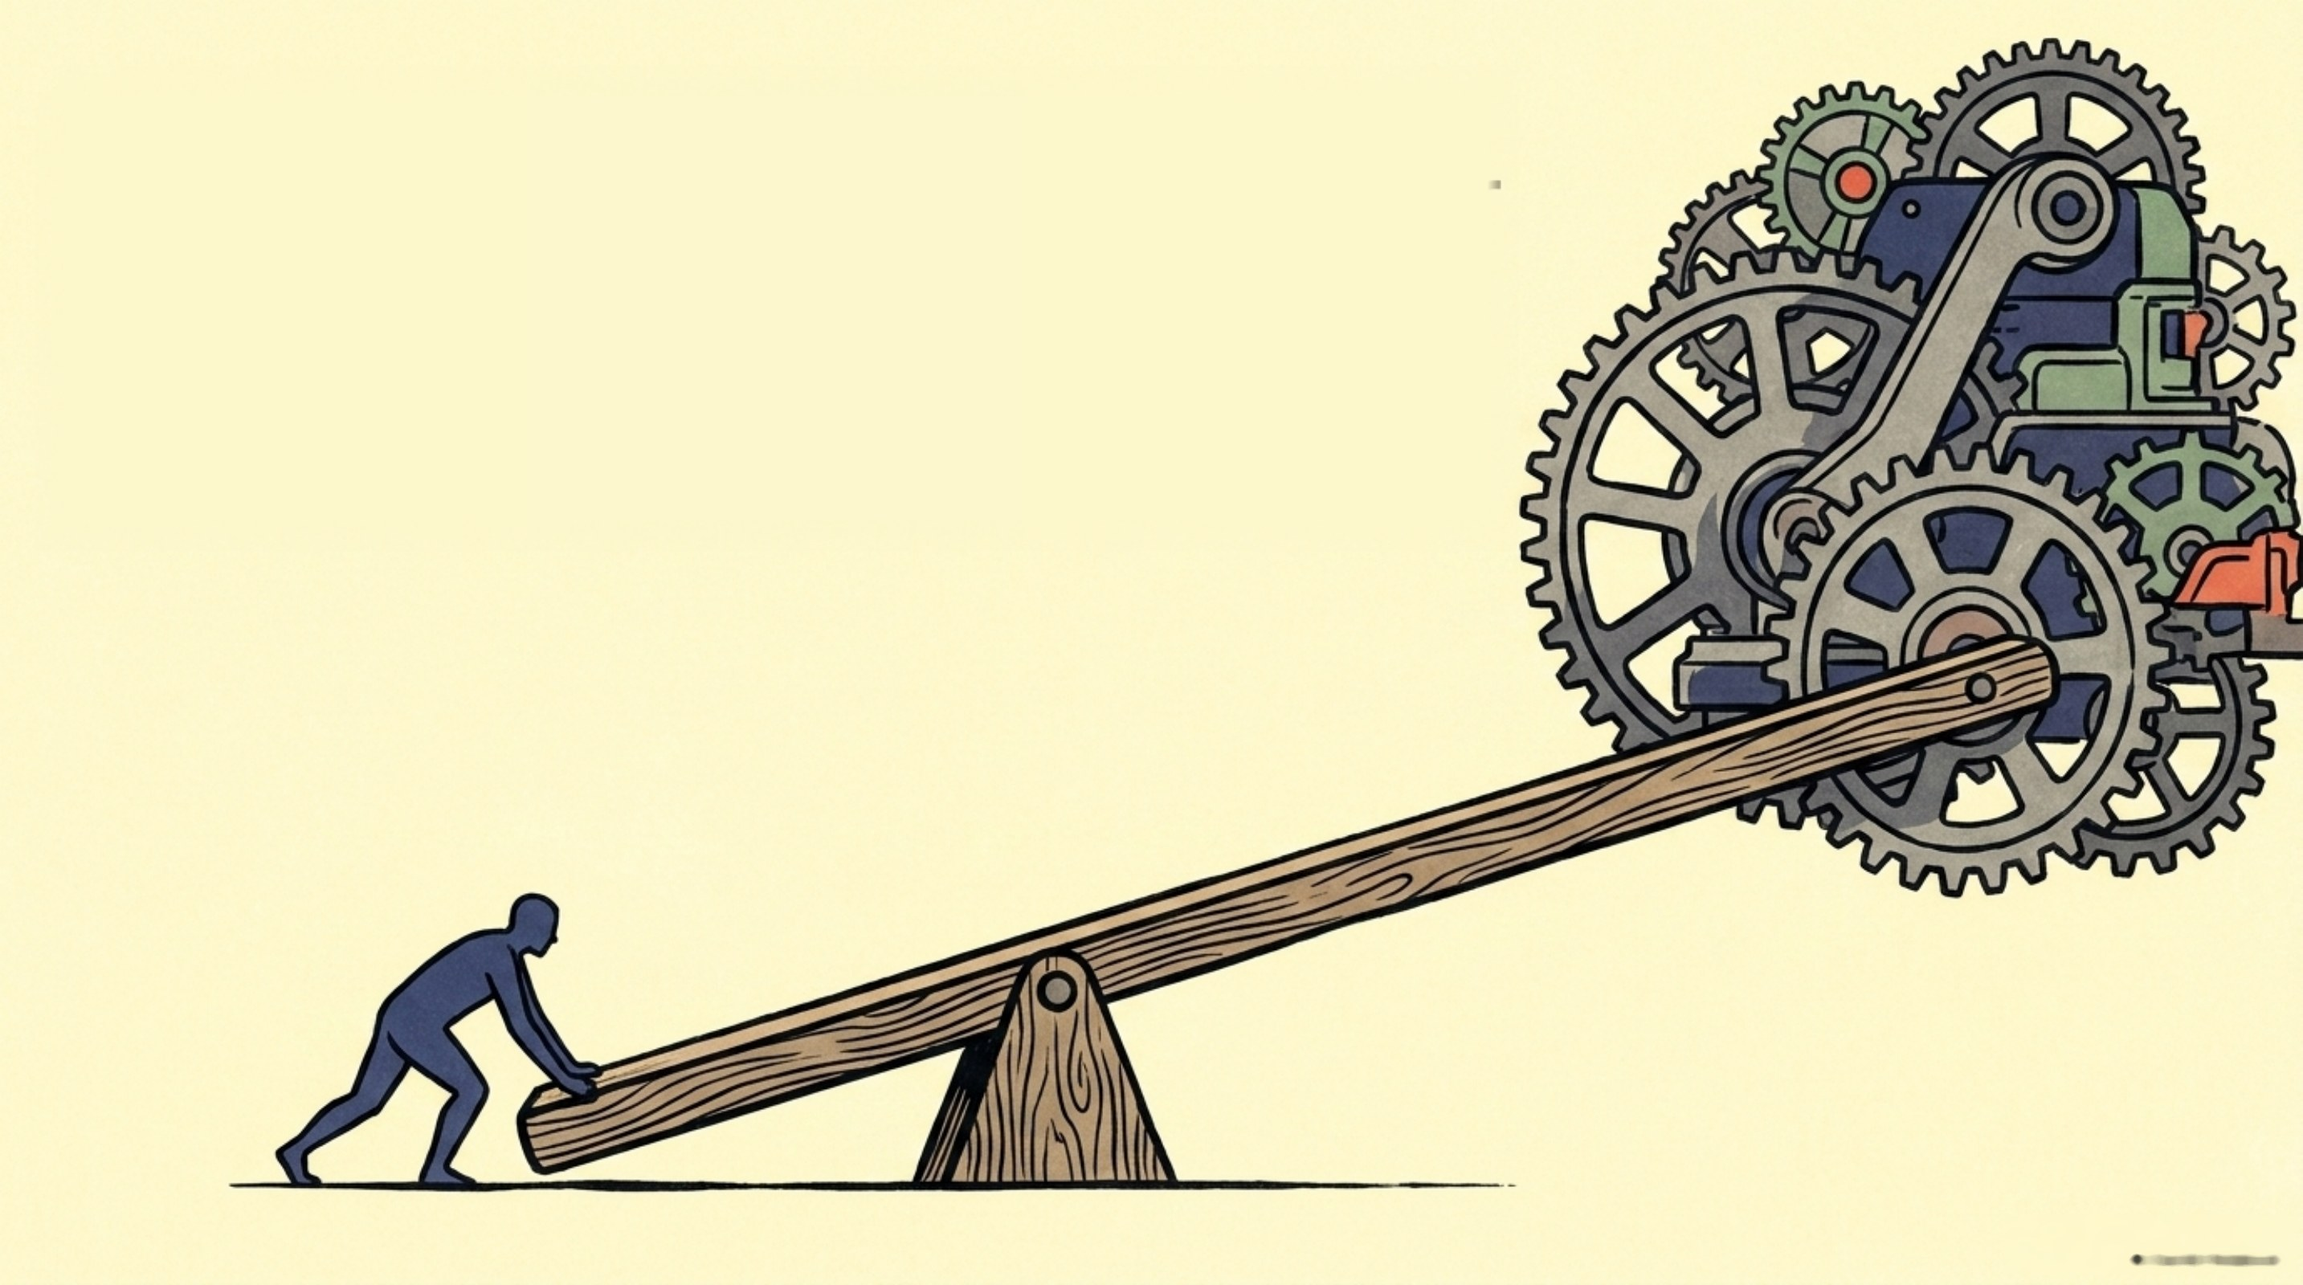
THIS WEEK, FACULTY
Now We Need People to Complete It
This week. More than an email.
How are YOU going to get it out?
Faculty across programmes.
A strong response.
Completed this week.
You know your departments better than I do.
Who can you reach? What can you do?
Leave with a plan: WHAT, WHO, WHEN.

Slide 12

THIS WEEK, STUDENTS
SCAN
TO
OPEN
Students: Attitude and Use
Same process. Add? Delete? Adapt?
Will students answer honestly?
Feeling investigated kills honesty.
Reality, not catching AI use.
What makes this easier to answer honestly?

Slide 13
THIS WEEK, STUDENTS
Students: Getting It Out
We need students students will trust.
1
Get class permission
Everyone here: find two or three students.
Email professors. Keep confirmation.
Students you know. Students you trust. Students who'll do it.
2
Send students in
Quick explanation, plus QR.
3
Message is clear
Anonymous. Nobody's investigated.
4
Honesty matters
What students actually use and think.
Who are your students? Agree names and coverage now.
5
Spread out
Different programmes, different years.

Slide 14
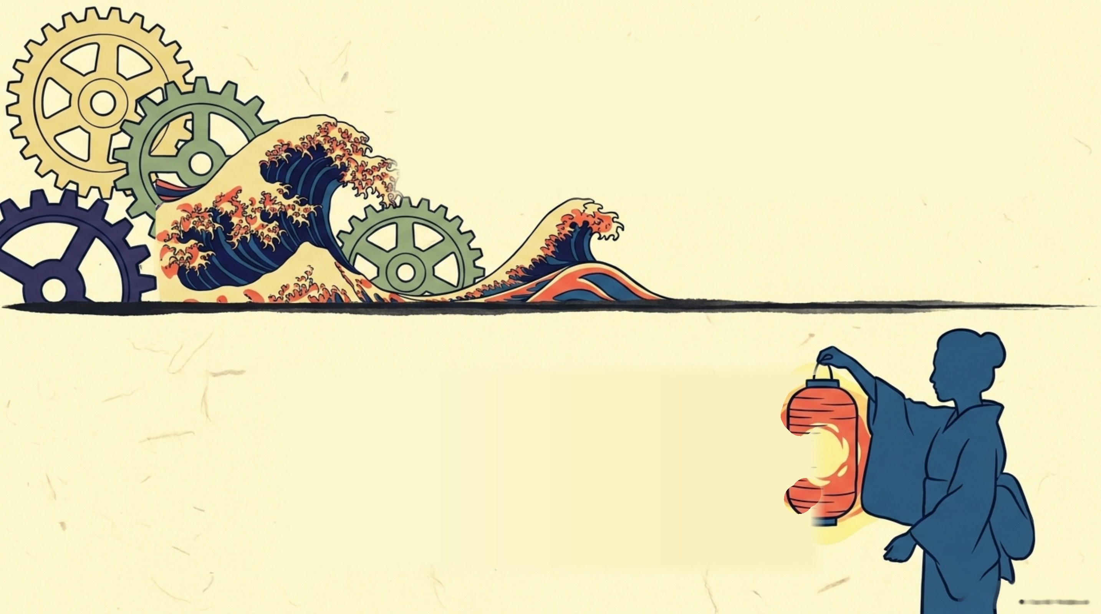
THIS WEEK, CAPACITY
Build Our Capability
TRAINING, TLC
I've contacted TLC. Faculty training and AI capability.
Who else? Tech-savvy faculty, IT, external experts, platform specialists.
RESEARCH, DINESH
Dinesh is involved. Rigorous work that goes somewhere.
Collaborations, publications, Cambodian evidence, international partners, funding.
How desirable can we make this committee as a research contact point?
TLC and Dinesh are starting points. Who else do we need?

Slide 15

THIS WEEK, NEXT STEPS
September 3: Let's Show People Who We Are
6pm, off campus, open to everyone.
This one should be fun. We have the room. Let's monopolise it.
MEET US
TLC
DINESH, RESEARCH
Who we are, what we're building.
Five-minute contribution and collaboration.
Five minutes: where this could go.
SHOW SOMETHING
SHARE SOMETHING
BRING IT UP
Quick, useful mini AI training.
Interesting evidence or research snapshot.
Question, problem, idea. Bring it.
AND AFTERWARDS? Food, drinks, or hang out together.
How do we make this a meeting people are glad they came to?

Slide 16
CHECKPOINT
Today's Objectives
✓
Who are we?
3
✓
Tasks to be completed this week
3
Understanding policy
NOW
4
Specific roles and task assignment

Slide 17

UNDERSTANDING POLICY
Personal Recommendations
One recommendation. What should AUPP consider?
Assessment
AI literacy
Disclosure vs evidence
Faculty expectations
Student expectations
Access and equity
Govt led policy?
Data and privacy
One idea, not a finished policy.

Slide 18

UNDERSTANDING POLICY
Policies Around the World
Steal, adapt, test, or avoid.
Canvas: Policy module. Ten policies, plus extra reading.
Read first. Bring keep, adapt, or reject.

Slide 19
CHECKPOINT
Today's Objectives
✓
Who are we?
4
✓
Tasks to be completed this week
✓
Understanding policy
4
Specific roles and task assignment
NOW

Slide 20



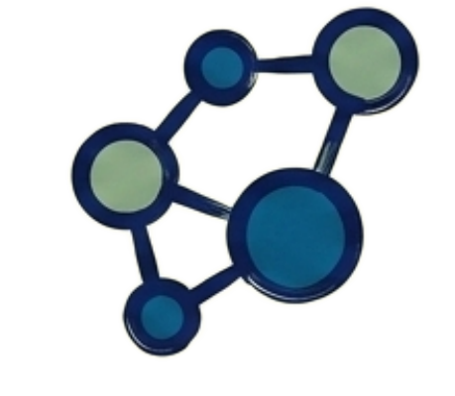

ROLES AND TASK ASSIGNMENT
Your Committee
CHAIR Jay
THE ROLES WE NEED
SECRETARY
POLICY
Minutes, actions, records, Canvas.
Policy development, governance, consultation.
EXTERNAL PARTNERSHIPS
RESEARCH
Connections, collaborators, events, funding.
Projects, evidence, Dinesh, publication.
Consultant: Sovannara
TRAINING
Faculty development, TLC, resources.

Slide 21
ROLES AND TASK ASSIGNMENT
What Would You Like to Do?
Tick the roles you're interested in.
1
2
3
Hand it to me before you leave. Desk B13.
I'll balance: preference, expertise, committee needs.
I'll message you on Telegram by end of day tomorrow.
First choice
Second choice
Third choice
Done.

Slide 22

ROLES AND TASK ASSIGNMENT
Next Committee-Only Meeting
Happy to decide on the 3rd?
We'll lock a date together at the open meeting.
Once tasks are moving, committee-only meetings can become optional and shift online.

Slide 23

Thank you.
Let's get to work.

