Slide 1
Contents
What is Hadoop?
Information retrieval models
Graphical representation
Web interface for search
ZipFileReader
Boolean Retrieval model
Ranked Retrieval model

Slide 2
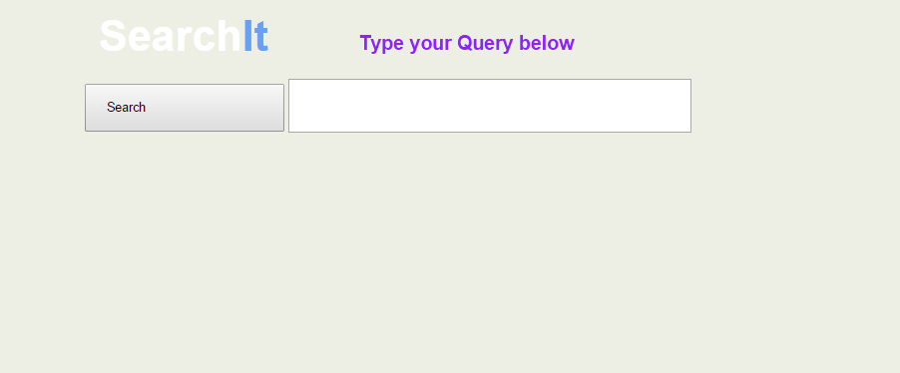
Web Interface

Slide 3
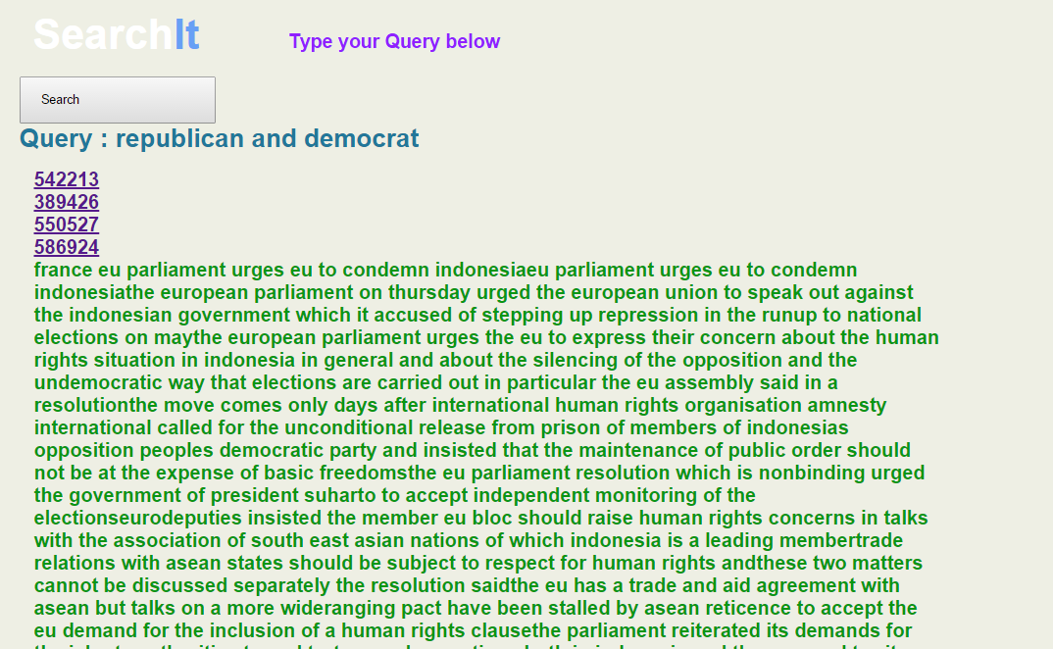
Query Output

Slide 4
ZipFileReader
Extracted Text Files as input
Initially We did the Boolean on extracted data from the zip files where our mappers had to parse the files one by one .
This method proved to be very-very slow as there was On disk IO per file read from the disk hence it was infeasible to use this method to compute the index on entire data set.
Zip File as Input using the ZipFileReader
. In this method we pass the entire zip file to the mapper and then the mapper would explode the zip file and in main memory and extract the data from it. Since here there were far less Disk IO’s compared to the previous method and accessing data in main memory is very fast we were able to compute indexes in a matter of minutes then hours as in previous case.

Slide 5
Boolean retrieval Model
UniWord Index
One Mapper → output {word,docId}
One Reducer → word , docId1,docId2,docId3 ……..
Biword index →
One Mapper → output { word1 word 2, docId}
One Reducer → output { word1 word2 , docId1,docId2,docId3 ……….}

Slide 6
Ranked Retrieval Model
Mappers - Three
Combiner – One Used only in phase 1 of generating the index.
Reducer - Three

Slide 7
Phase 1
Mapper | Reducer
{docId=>[words]} → Output {[word,docId]=>1} | {[word,docId]=>[1,1,1,1,1} → Output{[word,docId],wordCount]}
Phase 2
Mapper | Reducer
Output → {[word,docId],wordCount]} | {[word,docId]=>[wordcount,wordsPerDoc]}
Phase 3
Mapper | Reducer
{[word,docId]=>[wordcount,wordsPerDoc]} Output → { word=>[docId,wordCount,wordsPerDoc] } | {word=>[doc1,wc1,wpd1], [doc1,wc1,wpd1]……..} → intermediate Results : {[word,docId] => [wordCount,wordsPerDoc,docsPerWord]} (Stored in a temporary map) → Final Calculation : {[word,docId]=>tfidf }

Slide 8
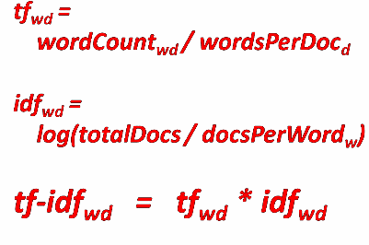
Final Index file format
word@docId, [d/D, n/N, TF-IDF]

Slide 9
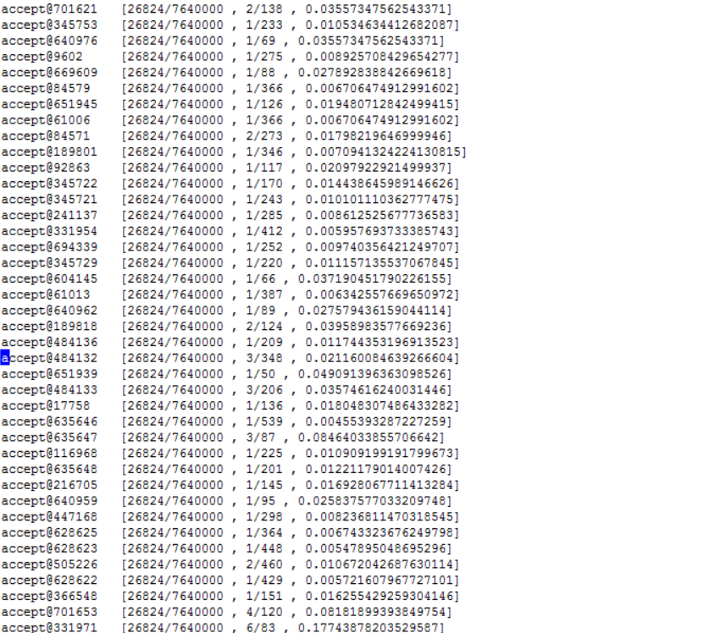

Slide 10
Distributed Search using TfIdf
Mapper → For every word which is in the query the index file is scanned and if a matching entry is found the in file we output the word and the corresponding the tfidf and tf value to the reducer
Reducer → using the output from the Mapper we create an intermediate Map of the following form to help create the document vector.
<word1,<docID1,tfIdf>, <docID2,tfIdf>, <docID3,tfIdf>, <docID4,tfIdf>…………………….>>,
<word2,<docID1,tfIdf>, <docID2,tfIdf>, <docID3,tfIdf>, <docID4,tfIdf>…………………….>>,
<word3,<docID1,tfIdf>, <docID2,tfIdf>, <docID3,tfIdf>, <docID4,tfIdf>…………………….>>,
<word4,<docID1,tfIdf>, <docID2,tfIdf>, <docID3,tfIdf>, <docID4,tfIdf>…………………….>>,
..
..
..
..
Finally we create the query vector and then find the cosine similarity and out the result.

