Slide 1
AWS ASSOCIATE SET-UP
devopsandbeyond

Slide 2
Project
ABC Consulting has hired devopsandbeyond to build a scalable static hosting environment. This environment will use both windows and linux based web servers.
Billing Alerts
IAM configuration
SAND-VPC
https://docs.aws.amazon.com/IAM/latest/UserGuide/tutorial_billing.html

Slide 3
IAM Account Configuration
Tasks
Create accounting group
Create a billing user AWS account.
Create admin User
Create custom URL
Test logins

Slide 4
Steps
Step 1: Enable Access to Billing Data on Your AWS Test Account
Step 2: Create IAM Policies That Grant Permissions to Billing Data
Step 3: Attach Billing Policies to Your Groups
Step 4: Test Access to the Billing Console
Once you’ve completed the core tasks, you’re ready to test the policy. Testing ensures that the policy works the way you want it to.

Slide 5
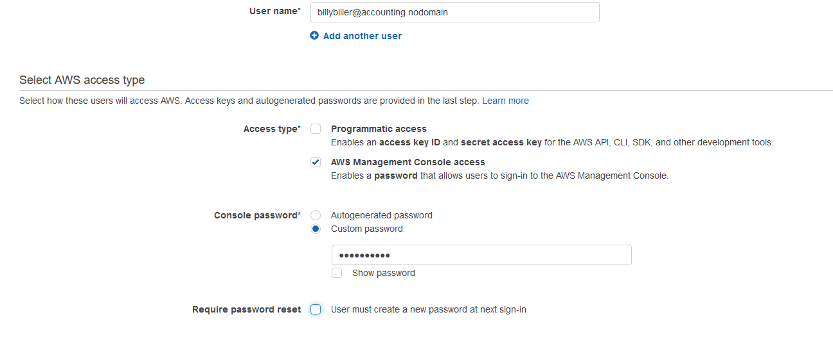
Create billybiller
Notes:
lkdsfjlkasdflkasd

Slide 6
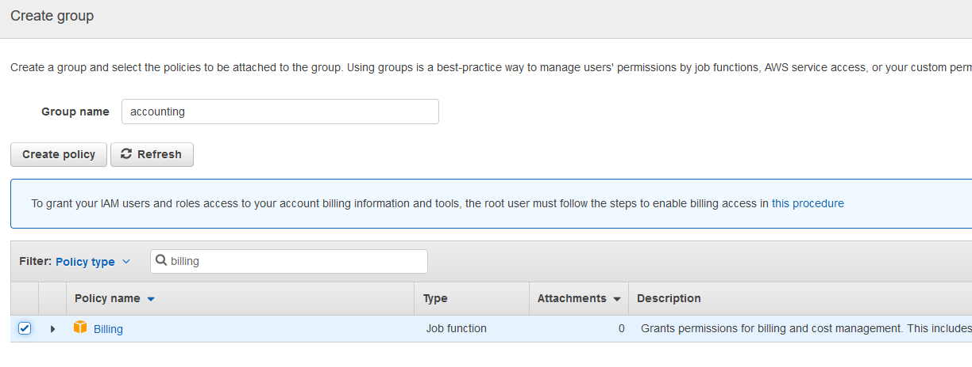
Accounting Group

Slide 7
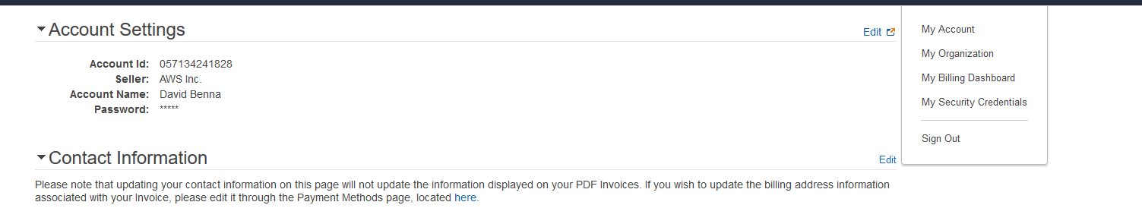
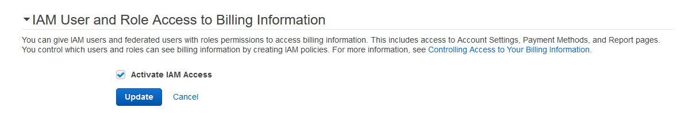
Enable IAM Under Account Settings

Slide 8
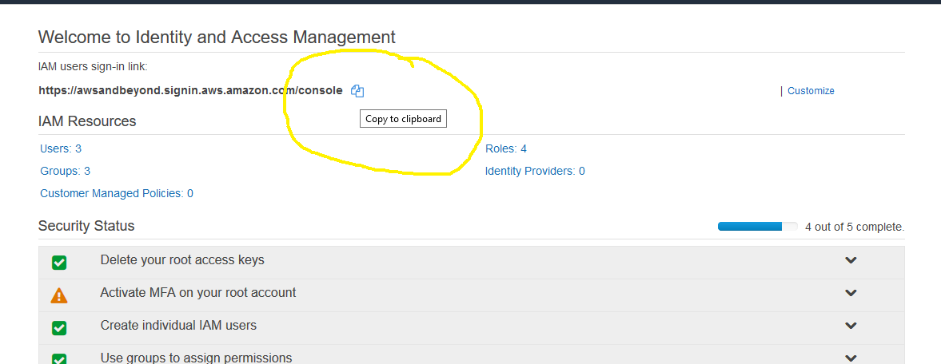
Test Billy Biller

Slide 9
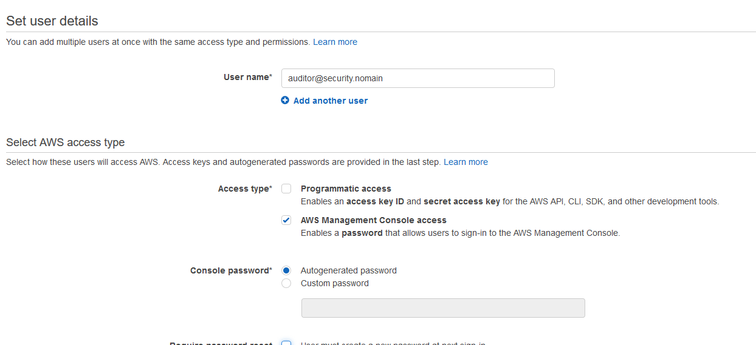
Create auditor@security.nodomain

Slide 10
IAM Study Links
IAM AWS LABS: (each is a link)
Tutorial: Delegate Access to the Billing Console
Tutorial: Delegate Access Across AWS Accounts Using IAM Roles
Tutorial: Create and Attach Your First Customer Managed Policy
Tutorial: Enable Your Users to Configure Their Own Credentials and MFA Settings

Slide 11
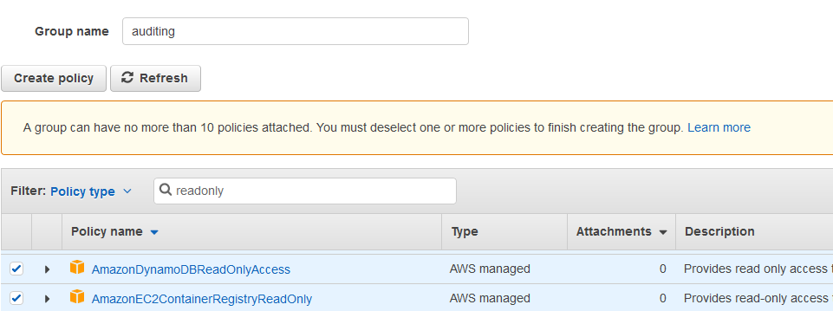
Create auditing group

Slide 12
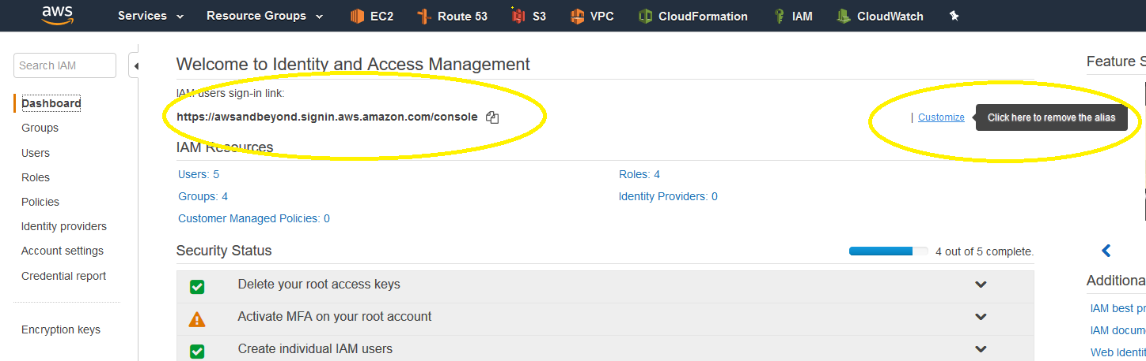
Test Access
Create custom URL
Test billybiller and your gmail login

