Slide 1
CSC 553
Advanced Database Concepts
Lecture 10
Alexander Rasin
College of CDM, DePaul University
June 4th, 2015

Slide 2
Tonight
Take-home final
Finish distributed DB discussion
Streaming databases
Column-store databases
MapReduce/Hadoop

Slide 3
Take-home Final
Similar to homework exercises
Remember -- there is no single “right” answer
Please do not ignore questions
Due date
  Saturday, June 13th
  There is a little flexibility on due date

Slide 4
Project Components
Index Recommender
Design
  Indexes
  MVs / Indexes
  DB Design
  (Extra credit)

Slide 5
Indexes
Focus on large tables (lineorder)
Covering indexes most common
Design a “shared” index
  Identify all relevant attributes
  Remember the foreign keys
  Determine the per-attribute selectivity

Slide 6
Materialized Views
Emulate with tables
Preemptively compute the join
Otherwise, same principle
  Identify all relevant attributes
Allows for multi-table indexes

Slide 7
Pre-aggregated MVs
Pre-compute the aggregate function
Predicates have to be
  Pre-filtered
  Or included in group-by
Can mix and match grouping/predicates
Different aggregate functions?
  Pre-compute multiple aggregates

Slide 8
Shared Physical Design
select sum(lo_extendedprice) as revenue
from lineorder, dwdate
where lo_orderdate = d_datekey and d_year = 1993
and lo_discount between 1 and 3 and lo_quantity < 25;
select sum(lo_extendedprice) as revenue
from lineorder, dwdate
where lo_orderdate = d_datekey and d_yearmonth = 'Jan1994'
and lo_discount between 4 and 6 and lo_quantity between 26 and 35;
select sum(lo_extendedprice) as revenue
from lineorder, dwdate
where lo_orderdate = d_datekey and d_weeknuminyear = 6 and d_year = 1994 and lo_discount between 5 and 7 and lo_quantity between 36 and 40;
0.14
0.27
0.5
0.01
0.27
0.20
0.0025
0.14
0.27
0.10
Notes:
CREATE MATERIALIZED VIEW VIEW2
ENABLE QUERY REWRITE
AS
select sum(lo_revenue), d_year, p_brand1
from lineorder, dwdate, part, supplier
where lo_orderdate = d_datekey
and lo_partkey = p_partkey
and lo_suppkey = s_suppkey
group by d_year, p_brand1
order by d_year, p_brand1;

Slide 9
Indexed MVs
Normally used with lossless MVs
Same principle as with regular indexing
  Select relevant attributes
  Order by combined selectivity
  One clustering index

Slide 10
Design
Put together multiple auxiliary structures given a fixed disk budget
Can use or revise structures from preceding parts
  Queries will use best applicable index
Consider smaller-table indexes here

Slide 11
Concurrency Control
Modify concurrency control schemes for use in distributed environment.
We assume that each site participates in the execution of a commit protocol to ensure global transaction automicity.
We assume all replicas of any item are updated
  Will see how to relax this in case of site failures later

Slide 12
Single-Lock-Manager Approach
System maintains a single lock manager that resides in a single chosen site, say S_{i}
When a transaction needs to lock a data item, it sends a lock request to S_{i} and lock manager determines whether the lock can be granted immediately
  If yes, lock manager sends a message to the site which initiated the request
  If no, request is delayed until it can be granted; then a message is sent to the initiating site

Slide 13
Single-Lock-Manager Approach (Cont.)
The transaction can read the data item from any one of the sites at which a replica of the data item resides.
Writes must be performed on all replicas of a data item
Advantages of scheme:
  Simple implementation
  Simple deadlock handling
Disadvantages of scheme are:
  Bottleneck: lock manager site becomes a bottleneck
  Vulnerability: system is vulnerable to manager site failure

Slide 14
Distributed Lock Manager
In this approach, functionality of locking is implemented by lock managers at each site
  Lock managers control access to local data items
Advantage: work is distributed and can be made robust to failures
Disadvantage: deadlock detection is more complicated
  Lock managers cooperate for deadlock detection
Several variants of this approach
  Primary copy
  Majority protocol
  Biased protocol
  Quorum consensus

Slide 15
Primary Copy
Choose one replica of data to be the primary copy
  Site containing the replica is called the primary site for that data item
  Different data items can have different primary sites
When a transaction needs to lock a data item Q, it requests a lock at the primary site of Q.
  Implicitly gets lock on all replicas of the data item
Benefit
  Concurrency control for replicated data handled similarly to unreplicated data - simple implementation.
Drawback
  If the primary site of Q fails, Q is inaccessible even though other sites containing a replica may be accessible.

Slide 16
Majority Protocol
Local lock manager at each site administers lock and unlock requests for data items stored at that site.
When a transaction wishes to lock an unreplicated data item Q residing at site S_{i}, a message is sent to S_{i} ‘s lock manager.
  If Q is locked in an incompatible mode, then the request is delayed until it can be granted.
  When the lock request can be granted, the lock manager sends a message back to the initiator indicating that the lock request has been granted.

Slide 17
Majority Protocol (Cont.)
In case of replicated data
  If Q is replicated at n sites, then a lock request message must be sent to more than half of the n sites in which Q is stored.
  The transaction does not operate on Q until it has obtained a lock on a majority of the replicas of Q.
  When writing the data item, transaction performs writes on all replicas.
Benefit
  Can be used even when some sites are unavailable
Drawback
  Requires 2(n/2 + 1) messages for handling lock requests, and (n/2 + 1) messages for handling unlock requests.
  Potential for deadlock even with single item - e.g., each of 3 transactions may have locks on 1/3rd of the replicas of a data.

Slide 18
Biased Protocol
Local lock manager at each site as in majority protocol, however, requests for shared locks are handled differently than requests for exclusive locks.
Shared locks. When a transaction needs to lock data item Q, it simply requests a lock on Q from the lock manager at one site containing a replica of Q.
Exclusive locks. When transaction needs to lock data item Q, it requests a lock on Q from the lock manager at all sites containing a replica of Q.
Advantage - less overhead on read operations.
Disadvantage - additional overhead on writes

Slide 19
Quorum Consensus Protocol
A generalization of majority and biased protocols
Each site is assigned a weight.
  Let S be the total of all site weights
Choose two values read quorum Q_{r} and write quorum Q_{w}
  Such that Q_{r} + Q_{w} > S and 2 * Q_{w} > S
  Quorums can be chosen separately for each item
Each read must lock enough replicas that the sum of the site weights is >= Q_{r}
Each write must lock enough replicas that the sum of the site weights is >= Q_{w}

Slide 20
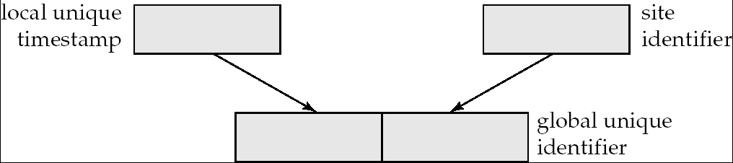
Timestamping
Timestamp based concurrency-control protocols can be used in distributed systems
Each transaction must be given a unique timestamp
How to generate a TS in a distributed fashion?
  Each site generates a unique local timestamp using either a logical counter or the local clock.
  Global unique timestamp is obtained by concatenating the unique local timestamp with the unique identifier.

Slide 21
Timestamping (Cont.)
A site with a slow clock will assign smaller timestamps
  Still logically correct: serializability not affected
  But: “disadvantages” transactions
To fix this problem
  Define within each site S_{i} a logical clock (LC_{i}), which generates the unique local timestamp
  Require that S_{i} advance its logical clock whenever a request is received from a transaction Ti with timestamp < x,y> and x is greater that the current value of LC_{i}.
  In this case, site S_{i} advances its logical clock to the value x + 1.

Slide 22
Replication with Weak Consistency
Many commercial databases support replication of data with weak degrees of consistency (I.e., without a guarantee of serializabiliy)
  Master-slave replication: updates are performed at a “master” site, and propagated to “slave” sites
  Propagation is decoupled from the update transaction
    May be immediately after transaction commits
    May be periodic
  Data may only be read at slave sites, not updated
    No need to obtain locks at any remote site
  Particularly useful for distributing information
    E.g. from central office to branch-office
  Also useful for running read-only queries offline from the main database

Slide 23
Replication with Weak Consistency (Cont.)
Replicas should see a transaction-consistent snapshot of the database
  That is, a state of the database reflecting all effects of all transactions up to some point in the serialization order, and no effects of any later transactions.
E.g. Oracle provides a create snapshot statement to create a snapshot of a relation or a set of relations at a remote site
  snapshot refresh either by recomputation or by incremental update
  Automatic refresh (continuous or periodic) or manual refresh

Slide 24
Deadlock Handling
Consider the following two transactions and history, with item X and transaction T₁ at site 1, and item Y and transaction T₂ at site 2:
T₁: write (X)
write (Y)
T₂: write (Y)
write (X)
X-lock on X
write (X)
X-lock on Y
write (Y)
wait for X-lock on X
Wait for X-lock on Y
Result: deadlock which cannot be detected locally at either site

Slide 25
Centralized Approach
A global wait-for graph is constructed in a single site; the deadlock-detection coordinator
  Real graph: Real, but unknown, state of the system.
  Constructed graph:Approximation generated by the controller during the execution of its algorithm .
the global wait-for graph can be constructed when:
  a new change occurs in a local wait-for graph
  the coordinator needs to invoke cycle-detection.
If the coordinator finds a cycle, it selects a victim and notifies all sites. The sites roll back the victim transaction

Slide 26
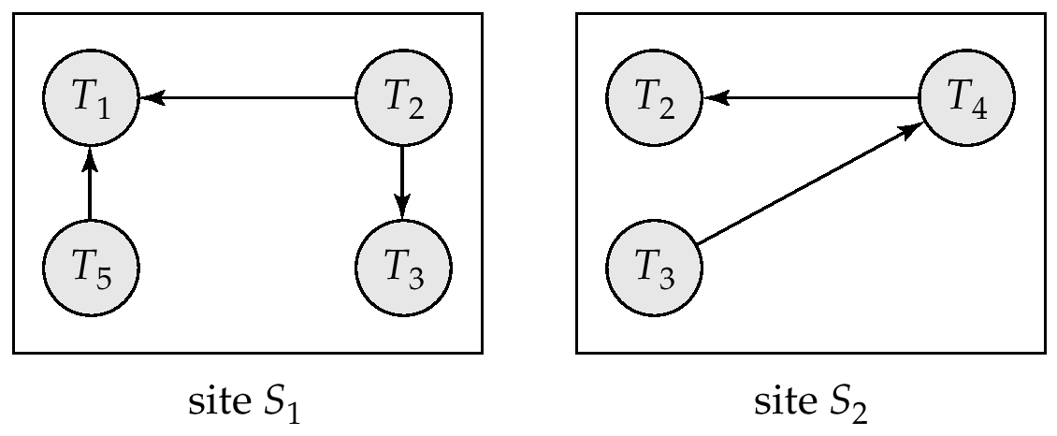
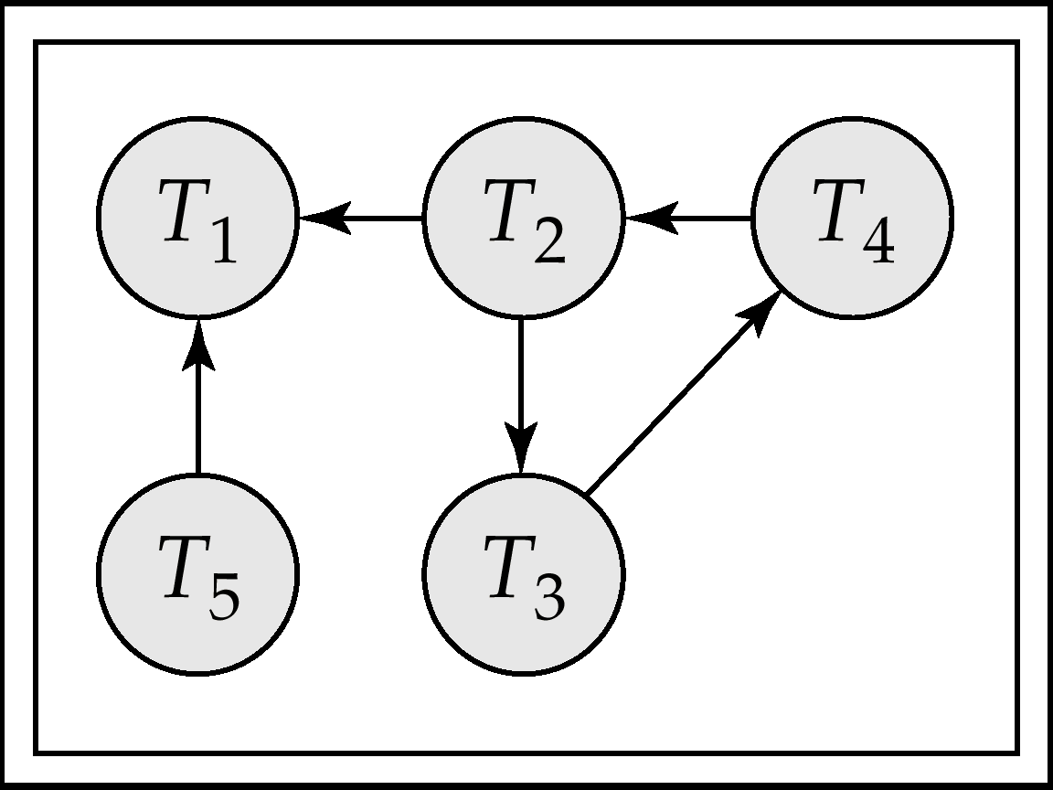
Local and Global Wait-For Graphs
Local
Global

Slide 27
Availability
High availability: time for which system is not usable should be extremely low (e.g. 99.999% availability)
Robustness: ability of system to function despite failures of components
Failures are more likely in large distributed systems
To be robust, a distributed system must
  Detect failures
  Reconfigure the system so computation may continue
  Recovery/reintegration when a site or link is repaired
Failure detection: distinguishing link failure from site failure is hard
  Heartbeat

Slide 28
Reconfiguration
Reconfiguration:
  Abort transactions that were active at a failed site
    Making them wait could interfere with other transactions since they may hold locks on other sites
  If replicated data items were at failed site, update system catalog to remove from list of replicas
    This should be reversed when failed site recovers, but have to be careful bringing values up to date
  If a failed site was a central server for some subsystem, an election is held to replace it
    E.g. name server, concurrency coordinator, global deadlock detector

Slide 29
Reconfiguration (Cont.)
Since network partition may not be distinguishable from site failure, the following situations must be avoided
  Two central servers elected in distinct partitions
  More than one partition updates a replicated data
Updates must be able to continue even if some sites are down
Solution: majority based approach

Slide 30
Site Reintegration
When failed site recovers, it must catch up with all updates that it missed while down
  Problem: updates may be happening to items whose replica is stored at the site while the site is recovering
  Solution 1: halt all updates on system while reintegrating a site
    Unacceptable disruption
  Solution 2: lock all replicas of all data items at the site, update to latest version, then release locks

Slide 31

BREAK

Slide 32

Streaming Databases

Slide 33
Data-Stream Management
Traditional DBMS
  Data stored in finite, persistent data sets
Data streams
  Distributed, continuous, unbounded, time-varying
Data-Stream Management
  Network monitoring
  Data security
  Sensor network
  Financial applications

Slide 34
What is a stream database?
Query data from a stream
  A data feed with a schema
  You can also query conventional relations
Examples
  Sensor data, stock market quotes
  Network monitoring data …
Querying a stream forces changes to the DBMS
  Must use push-based rather than pull-based operators
  Must be able to provide partial answers
    E.g., you never finish the query
  One-pass
    E.g., you cannot (in general) rewind the stream.

Slide 35
Stream Processing
U
Σ
μ
Data
Sources
Client
Apps
U
μ
Σ
Data sources push tuples continuously
Operators process windows of tuples

Slide 36
Operators: Select
Filter the stream (temperature > 100)
Needs an input buffer
Blocking operator?
Projection works the same way

Slide 37
Operators: Aggregation
Aggregate the stream
  E.g., average sensor temperature
  # of cars that entered a garage
Blocking operator?
  How do you know when to send an answer?
  Windows!
Average temperature over the last 5 minutes
# of cars entered per hour (1pm-2p, 2p-3p, …)

Slide 38
Operators: Join
Join 2 streams
  Detect when 2 planes are too close to each other
  Match up “buy” and “sell” requests
Blocking operator?
  Need 2 input buffers
  And specify windows on each side
  Time-stamp windows
  Join only the relevant tuples

Slide 39
Distributed Stream Processing
Node 1
Node 2
U
Σ
μ
Data
Sources
Client
Apps
Node 3
Node 4
U
μ
Σ
Data sources push tuples continuously
Operators process windows of tuples

Slide 40
Fault-Tolerance through Replication
Goal: Tolerate node and network failures
Node 3
U
μ
s₃
Node 1
Node 2
U
Σ
μ
s₁
s₂
s₄
Node 1’
Node 2’
U
Σ
μ
Node 3’
U
μ
s₃’

Slide 41
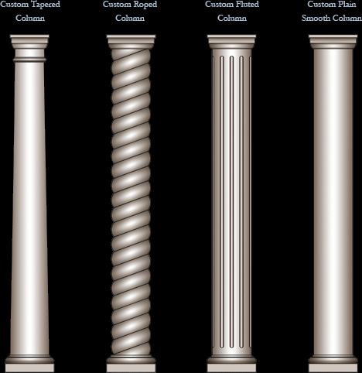

Slide 42
Column-store DBMSes
An idea that resurfaced a few years ago
The idea
  In DBMS, reading a column = scan the entire table
  So, store every table column in a separate file!
  The interface still looks like a regular RDBMS

Slide 43
Row Store vs Column Store DB
RID Name Position FavoriteTown
1
Stan
Professor
Westwood
2
Ugur
Professor
Providence
3
Tom
Professor
Providence
4
Alex
Student
Providence
5
Stan
Professor
Cambridge
Logical
6
Andy
Student
Providence
Physical
Column Store
Row Store
#1
1
Stan
Professor
Westwood
Page 1
Page 2
Page 3
Page 4
2
Ugur
Professor
Providence
1
Stan
Professor
Westwood
2
Ugur
Professor
Providence
Disk
Pages
#2
3
Tom
Professor
Providence
3
Tom
Professor
Providence
4
Alex
Student
Providence
4
Alex
Student
Providence
5
Stan
Professor
Cambridge
5
Stan
Professor
Cambridge
#3
6
Andy
Student
Providence
6
Andy
Student
Providence

Slide 44
Differences in Accessing the Data
SELECT Name
FROM People
WHERE Position = ‘Professor’;
1
Stan
Professor
Westwood
1
Stan
Professor
Westwood
2
Ugur
Professor
Providence
2
Ugur
Professor
Providence
3
Tom
Professor
Providence
3
Tom
Professor
Providence
4
Alex
Student
Providence
4
Alex
Student
Providence
5
Stan
Professor
Cambridge
5
Stan
Professor
Cambridge
6
Andy
Student
Providence
6
Andy
Student
Providence
#1
Page 1
Page 2
Page 3
Page 4
#2
#3

Slide 45
Sorting/Indexing Data for Queries
SELECT Name
FROM People
WHERE Position = ‘Professor’;
Row Store
Column Store
Clustered
Index
Sort Order
Professor
1
Stan
Westwood
Professor
1
Stan
Westwood
Professor
2
Ugur
Providence
Professor
2
Ugur
Providence
Professor
3
Tom
Providence
Professor
3
Tom
Providence
Professor
5
Stan
Cambridge
Professor
5
Stan
Cambridge
Student
4
Alex
Providence
Student
4
Alex
Providence
Student
6
Andy
Providence
Student
6
Andy
Providence
All data columns
sorted the same way

Slide 46
Clustered Column Store (CCS) Compression
Professor
Stan
1
Westwood
Professor
Ugur
2
Providence
Professor
Tom
3
Providence
Professor
Stan
5
Cambridge
Student
Alex
4
Providence
Student
Andy
6
Providence
1
+1
+1
+2
-1
+2
Professor,4
Student,2
Delta Enc.
{West. :0, Prov. :1,
Camb. :2}
Run Length Encoding
Dictionary Enc
0
1
1
2
1
1
RLE
LZO

Slide 47
Fragmentation: Row vs Column
A
B
C
D
A
B
C
D
RLE-d
2 Pages of Data
½ Page
½ Page
½ Page
2 Pages of Data
½ Page
½ Page
½ Page
Seeks
2 Pages of Data
½ Page
½ Page
½ Page
Can not read
less than
1 Page!!
2 Pages of Data
½ Page
½ Page
½ Page
1*(Seek+Page) + 3* (4 seeks + 4 Pages)
= 13 Seeks + 13 Pages
4 Seeks + 8 Pages

Slide 48
Dedicated MV in Row Store
MV = Column Set + Index
SELECT B, Y
FROM Fact, Dim₁
WHERE A in (1,2,3)
AND X in (‘b’,’c’)
Sort and Index
by A,X
Sort and Index
by X,A
A X B Y
X A B Y
Row #1
1
Row #1
a
a
a
a
1
2
3
4
a
b
c
1
1
2
a
b
c
#4M
0.75
2
b
b
b
b
1
2
3
4
2
3
a
b
c
3
0.66
#9M
3
c
c
c
c
1
2
3
4
Usually, only the 1st
sort column can be used
i.e. Sort A,X ≡ Sort A
4
a
b
c
4
Row #12M
4
Row #12M
Notes:
sort order = subset of column subset
Fundamental problem that needs to be addressed and isn’t obvious in a column store

Slide 49
Dedicated MV in Column Store
SELECT B, Y
FROM Fact, Dim₁
WHERE A in (1,2,3)
AND X in (‘b’,’c’)
Sort and Index
by A,X
Sort and Index
by X,A
A X B Y
X A B Y
Row #1
1
Row #1
a
b
c
#1M
a
a
a
a
1
2
3
4
1
1
#3M
2
a
b
c
#4M
#4M
2
b
b
b
b
1
2
3
4
2
#6M
3
a
b
c
#7M
#7M
3
3
#8M
4
#9M
c
c
c
c
1
2
3
4
a
b
c
4
Row #12M
4
#11M
Row #12M
Notes:
Complicated problem that needs to be addressed.
Range of rows.

Slide 50
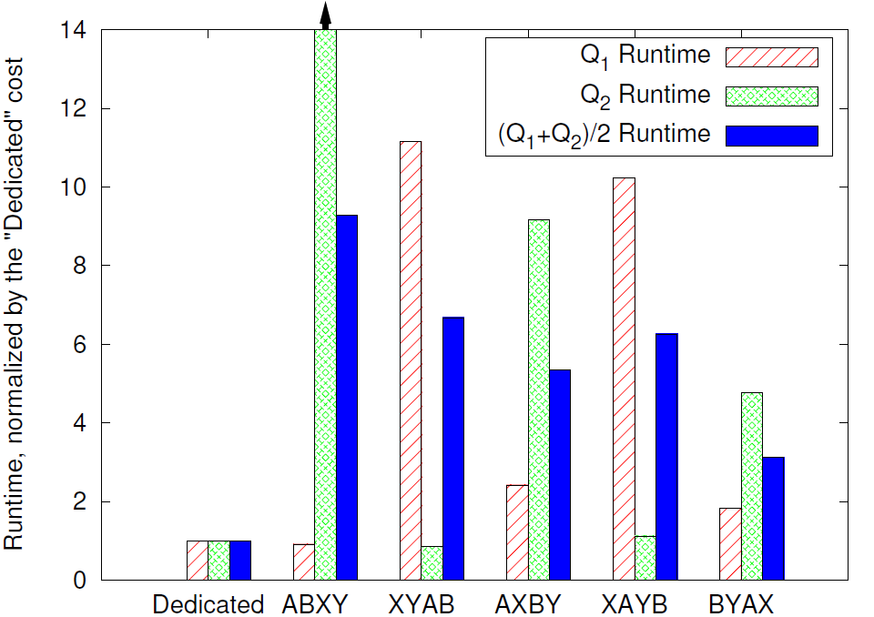

Merging Indexes
Notes:
Index Merging:
SELECT SUM(revenue)
FROM ... WHERE
quantity BETWEEN 25 AND 30 AND
nation BETWEEN 'Germany' AND 'Japan';
SELECT SUM(revenue)
FROM ... WHERE
orderdate BETWEEN 94-05-01 AND 94-06-25
city BETWEEN 'France 0' and 'Japan 0';
A=quantity, B=nation, X=orderdate, Y=city

Slide 51
Column-store Tradeoffs
Benefits
  Restricted read
  Projection operator is free!
  Compression
Penalties
  Columns must be re-joined
  Scattered data (1 row = X values)
  Updates

Slide 52
Hybrid Storage Solution
Store some data in a row-oriented format
Other data in column-oriented format
How to split it up?
  Current/recent data in row-store
    Updates are expensive
  Old/historical data in a column-store
    Compression is great
    Old data rarely changes

Slide 53
In-Memory Databases
Main Memory database system (MMDB)
Data resides permanently on main physical memory
Backup copy on disk
Disk Resident database system (DRDB)
Data resides on disk
Data may be cached into memory for access
Main difference is that in MMDB, the primary copy lives permanently in memory

Slide 54
Questions about MMDB
Is it reasonable to assume that the entire database fits in memory?
  Yes, for some applications
  100 machines x 32GB RAM = 3.2TB RAM
What is the difference between a MMDB and a DRDB with a very large cache?
  In DRDB, even if all data fits in memory, the structures and algorithms are designed for disk access.

Slide 55
Differences in properties of main memory and disk
The access time for main memory is orders of magnitude less than for disk storage
Main memory is normally volatile, while disk storage is not
The layout of data on disk is much more critical than the layout of data in main memory

Slide 56
Copy-based Recovery
Other copies guaranteed to exist
Can recover without relying on persistent storage
  Poll other machines
Doesn’t protect from rack/power failures

Slide 57










Hadoop
Named by Doug Cutting (plush toy elephant)

Slide 58
What is MapReduce?
Parallel programming model meant for large clusters
  User implements Map() and Reduce()‏
Parallel computing framework
  Libraries take care of EVERYTHING else
    Parallelization
    Fault Tolerance
    Data Distribution
    Load Balancing
Useful model for many practical tasks (large data)

Slide 59
Scale-out vs Scale-up
Many smaller servers
Harder to manage
Easier to expand
Easier to tolerate failure (*)
Generally cheaper
Few large servers
Easier to manage
Difficult/expensive to expand
Failure is a serious setback
More expensive

Slide 60
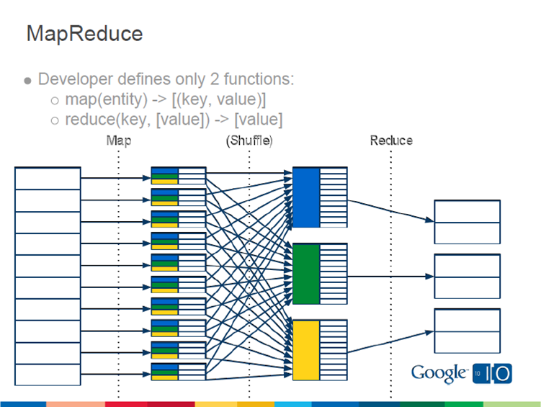
MapReduce Flow

Slide 61
MapReduce
Read the file(s) from HDFS
  Hadoop Distributed File System
Map phase
  Emit (key, value)
(Optional) Combine phase
  Put together same keys (locally, before sending)
Reduce phase
  Receive (key, value) pairs in sorted order
  Aggregate and emit one output per key

Slide 62
Fault Tolerance
Problem Detection
  Heartbeat
Remedy
  Find another copy of data
  Re-compute what had been lost

Slide 63
Redundant (Speculative) Execution
Slow workers significantly delay completion time
  Other jobs consuming resources on machine
  Bad disks may transfer data slowly
Solution: Near end of phase, spawn backup tasks
  Whichever one finishes first "wins"
Dramatically shortens job completion time

Slide 64
Hadoop Ecosystem
Hive
  SQL-like interface for Hadoop
Pig/Pig Latin
  Platform for programming on top of Hadoop
Mahout
  Data mining library for Hadoop

Slide 65
RDBMS vs MapReduce?
Setup
Performance
Scalability
Recovery

Slide 66

FIN

