Slide 1
CSC 553
Advanced Database Concepts
Lecture 5
Alexander Rasin
College of CDM, DePaul University
April 30th, 2015

Slide 2
Tonight
Join size estimation
Indexes
  Composite and covering indexes, bitmap indexes
Materialized views
  Pre-aggregated/pre-filtered
Index and MV maintenance
SSBM Benchmark

Slide 3
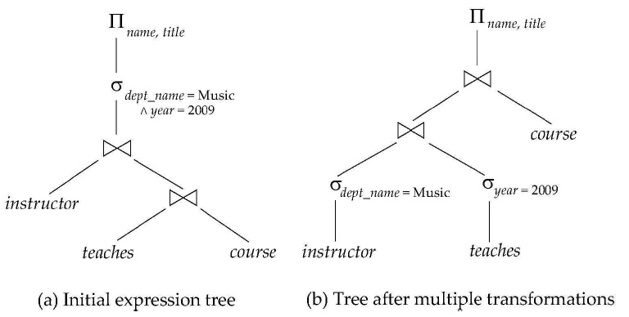
Multiple-Transformation Result

Slide 4
Heuristic Optimization
Cost-based optimization is expensive, even with dynamic programming
Systems may use heuristics to reduce the number of choices that must be made in a cost-based fashion
Heuristic optimization transforms the query-tree by using a set of rules that typically (but not always) improve execution performance
  Perform selection early (reduces number of tuples)
  Perform projection early (reduces the number of attributes)
  Perform most restriction selection and join operations (i.e. smallest result size) before other similar operations
  Some systems use only heuristics, other combine heuristics with partial cost-based optimization

Slide 5
Structure of Query Optimizers
Many optimizers consider only left-deep join orders
  Plus heuristics to push selections and projections down the query tree
  Reduces optimization complexity and generates plans amenable to pipelined evaluation
Heuristic optimization used in some versions of Oracle
  Repeatedly pick “best” relation to join next
    Starting from each of n starting points, pick best among these
Intricacies of SQL complicate query optimization
  Nested sub-queries!

Slide 6
Structure of Query Optimizers
Some query optimizers integrate heuristics selection and the generation of alternative access plans
  Frequently used approach
    Heuristic rewriting of nested block structure and aggregation
    Followed by cost-based join-order optimization for each block
  Optimization cost budget to stop optimization early (if cost of plan is less than cost of optimization)
  Plan caching to reuse previous computed plan if query is resubmitted
    Even with different constants in query
Even with the use of heuristics, cost-based query optimization imposes a substantial overhead
  Typically worth it for expensive queries
  Optimizers often use simple heuristics for very cheap queries, and perform exhaustive enumeration for more expensive queries.

Slide 7


Statistical Information for Cost Estimation
n_{r}: number of tuples in a relation r
b_{r}: number of blocks in relation r
I_{r}: size of a tuple of r
f_{r}: blocking factor of r – i.e. the number of tuples that fit into one block
V(A, r): number of distinct values that appear in r for attribute A, same as the size of ∏_{A}(r)
If tuples of r are stored together physically in a file, then b_{r} = ┌n_{r}/f_{r}┐

Slide 8
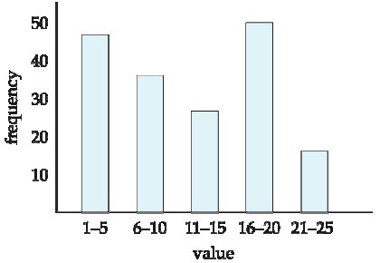
Histograms
Histogram on attribute age of relation person
  Equi-width histograms
  Equi-height histograms

Slide 9
Selection Size Estimation
σ _{A=v} (r)
  n_{r}/V(A,r):
    number of records that will satisfy the selection (assuming uniform distribution)
  Equality condition on a key attribute
    size estimate = 1

Slide 10
Selection Size Estimation
σ _{A≤v} (r) case of (σ _{A≥v} (r) is symmetric)
  Let c denote the estimated number of tuples satisfying this condition
  If min(A,r) and max(A, r) are available in catalog
    c = 0 if v < min(A, r)
    c = n_{r} * ((v-min(A,r)) / max(A, r) – min(A, r))
    If a histogram is available, refine the above estimate
    In absence of statistical information c is assumed to be n_{r}/2.

Slide 11
Size Estimation of Complex Selections
The selectivity of a condition cond_{i} is the probability that the tuple in the relation r satisfies cond_{i}
  If s_{i} is the number of satisfying tuples in r, the selectivity of cond_{i} is given by s_{i}/n_{r}
Conjunction: σ _{cond1 and cond2 and … condn} (r)
  Assuming independence, estimate of tuples in the result is n_{r} * (s₁ * s₂ * … s_{n}) / (n_{r})^{n}

Slide 12
Size Estimation of Complex Selections
Disjunction: σ _{cond1 or cond2 or … condn} (r)
  Estimated number of tuples is:
  n_{r} * (1 - (1 - s₁/n_{r}) * (1 - s₂/n_{r}) * … (1 - s_{n}/n_{r}))
Negation: σ _{not cond1}(r)
  Estimated number of tuples
  n_{r} – size (σ _{cond1}(r))

Slide 13



Estimating Join Cost

Slide 14
Join Operation Example
student ⋈ enrolled
Catalog information:
  n_{student} = 5000
  f_{student} = 50 (meaning that b_{student} = 5000/50 = 100)
  n_{enrolled} = 10000
  f_{enrolled} = 25 (b_{enrolled} = 10000/25 = 400)
  V(ID, enrolled) = 2500 which implies that on average each student is enrolled in 4 courses
    Attribute ID is a foreign key referencing student
    V(ID, student) = 5000 (primary key!)
V(ID, student) = ?

Slide 15
Estimation of the Size of Joins
The Cartesian product r x s contains n_{r}.n_{s} tuples; each tuple occupies s_{r}+s_{s} bytes
  R is the set of attributes of r
  S is the set of attributes for s
If R ∩ S = [Ø], then r ⋈ s is the same as r x s
If R ∩ S is a key for R, then a tuple of s will join with at most one tuple from r
  Therefore, the number of tuples in r ⋈ s is no greater than the number of tuples in s

Slide 16
Estimation of the Size of Joins
If R ∩ S is a foreign key in S referencing R, then the number of tuples in r ⋈ s is exactly same as the number of tuples in s
  The case of R ∩ S being a foreign key referencing S is symmetric
In the example query student ⋈ enrolled, ID in enrolled is a foreign key referencing student
  Hence, the result has exactly n_{enrolled} tuples which is 10000

Slide 17
Estimation of the Size of Joins
If R ∩ S = [A] (set of attributes)
If we assume that every tuple t in r produces tuples in r ⋈ s, the number of tuples in r ⋈ s is estimated to be : (n_{r} * n_{s}) / V(A, s)
  (If the reverse is true, the estimate is (n_{r}*n_{s}) / V(A, r)
Different if V(A, r) ≠ V(A, s) => dangling tuples
  Lower of two estimates is probably more accurate
Can improve on above with histograms…
  Use formula similar to above, for each cell of histograms of the two relations

Slide 18
Estimation of the Size of Joins
Compute size estimates for student ⋈ enrolled (without using information about foreign keys)
  V(ID, enrolled) = 2500 and
  V(ID, student) = 5000
  Two estimates are 5000 * 10000/2500 = 20K
  and 10000* 5000/5000 = 10K
  We choose the lower estimate, which in this case is the same as our earlier computation using foreign keys

Slide 19

Indexes
Many clever ideas
  some DBMS-specific
Composite indexes
  Included columns
  Prefix suppression
Bitmap Indexes

Slide 20
Indexing
A way to lookup rows in the table
Improvement over table scan
Think of a mapping
  Value => Set of rows
  A = 10 => (5)
  A < 25 => (1-10, 100-2000, 7000-7001)

Slide 21
Indexing
select name, department
from employees
where age = 64 or age = 65;
Scan the table employees
Build an index on Age attribute
  Age in (64,65) => (3,200,500, 4,150,250,1000)
  Seek + Read per access

Slide 22
Accessing a Table
Seeks are very expensive
  10-20x cost of the read
What can we do about it?
Sort the row pointers
  (3,200,500, 4,150,250,1000)
  (3,4,150,200,250,500,1000)
Read-ahead

Slide 23
Indexing
select name, department
from employees
where age in (64, 65) and salary < 75000;
Can we use the Age index?
  Age in (64,65) => (3,200,500, 4,150,250,1000)
Do we need an index on salary?

Slide 24
Indexing
select name, department
from employees
where age in (64, 65) or salary < 75000;
Do we need an index on salary?
Yes!
Need rows other than age = 64 or 65
Otherwise have to scan the table to be sure

Slide 25
Union the Predicates
select name, department
from employees
where age in (64, 65) or salary < 75000;
Age in (64,65)
    Row pointers = (3,4,150,200,500,1000)
  Salary < 75000
    Row pointers = (5-15, 199-210, 300,400,498-501)
  (3,4-15,150,199-210,300,400,498-501,1000)

Slide 26
Intersect the Predicates
select name, department
from employees
where age in (64, 65) and salary < 75000;
Age in (64,65)
    Row pointers = (3,4,150,200,500,1000)
  Salary < 75000
    Row pointers = (5-15, 199-210, 300,400,498-501)
  (200,500)

Slide 27

Clustered Indexes
select name, department
from employees
where age in (64, 65) and salary < 75000;
What if either of the indexes was clustered?
  Same query results
  …but sorted attribute values are co-located
  Which is better?

Slide 28
Composite Indexes
select name, department
from employees
where age in (64, 65) and salary < 75000;
Only one sorting possible
  Age or Salary
Can we do better?
  Composite index
  Key = (age,salary) or (salary,age)

Slide 29
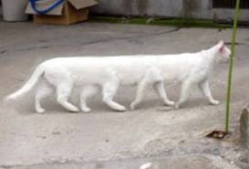
Long Indexes
select name, department
from employees
where age in (64, 65) and salary < 75000 and gender=‘female’ and performance > 5;
Build a composite index on everything
  (gender, age, performance, salary)
…what about “or performance > 5”
Downsides to the composite index approach?

Slide 30

A Break!

Slide 31
Covering Indexes
select name, department
from employees
where age in (64, 65) and salary < 75000 and gender=‘female’ and performance > 5;
Use index (gender, age, salary, performance)
  Lookup the rows positions and sort
  Table could be really, really large
Consider the following index
  (gender, age, salary, performance, name, department)

Slide 32
Covering Indexes
select name, department
from employees
where age in (64, 65) and salary < 75000 and gender=‘female’ and performance > 5;
Use the index
  (gender, age, salary, performance, name, department)
  Do not follow the pointers to the table!
  Read the requested values from the keys

Slide 33
Composite Indexes
Composite/covering indexes keys are large
What is the problem?
Index might be very large
  Come back to that later
B+-Tree performance suffers
  Long keys
  E.g., 900 byte limit in SQL Server

Slide 34
Included Columns
MS SQL Server
Index:
    (gender, age, salary, performance, name, department)
  Alternatively
    Create index Name on Employees (gender, age, salary, performance) include (name, department)
    Benefits of covering index w/out long key!

Slide 35
Prefix Suppression
Oracle
Consider our index with a long key
  gender, age, salary, performance, name, department
  (6 chars)+(3 digits)+(8 dig) + (2 dig) + (21 char)+(10 char)
  Every key takes 50 bytes, and given 512-byte page
    What’s the fan-out of the B+-tree?
What about neighboring keys in the index?
  Values sorted in the leaves

Slide 36
Few-Valued Columns
Few-valued columns partition (sorted) data into “buckets”
  E.g., gender column, performance, age
Few-valued columns also create many opportunities for compression
  Talk about compression later

Slide 37
Using Parts of a Composite Index
Index: (gender, age, salary, performance)
select name, department
from employees
where age in (64, 65) and salary < 75000 and gender=‘male’ and performance > 5;
select name, department
from employees
where age in (64, 65) and salary < 75000 and gender=‘male’;
select name, department
from employees
where age in (64, 65) and gender=‘male’;

Slide 38
Using Parts of a Composite Index
Index: (gender, age, salary, performance)
select name, department
from employees
where age in (64, 65) and salary < 75000 and gender=‘male’ and performance > 5;
select name, department
from employees
where salary < 75000 and gender=‘male’ and performance > 5;
select name, department
from employees
where salary < 75000 and performance > 5;

Slide 39
Skip-Scan
Oracle
  Few-valued attributes as prefix
  Searches every sub-B+-tree to compensate
SQL Server
  Adds predicates for few-valued attribute in prefix
  E.g., index on (year, salary)
  Convert “year > 2009” into “year in (2010,2011)”
    Statistics!

Slide 40
Bitmap Indexes
An index lets us map values to rowIDs
  Age in (64,65)
  Row pointers = (3,4,150,200,500,1000)
What if we just stored the per-value pointers?
  Age = 18 => (1, 333, 555, 1001)
  …
  Age = 64 => (3, 150, 500, 1000)
  Age = 65 => (4, 200)

Slide 41
Bitmap Indexes
Only works on few-valued columns
Oracle and DB2
Two ways of storing the same data
  List of RowIDs
  Dense 0,1 values

Slide 42
Views
A view is a “virtual table”
  create view dept_tot_salary(dept_name, tot_salary) as select dept_name, sum(salary)
  from instructor
  group by dept_name
Does not do much to optimize queries
  Security, convenience, possibly query optimization
    Optimizer may reconstruct
Oracle will even preserve views when instructor table is dropped (how?)

Slide 43
Materialized Views
Views are nearly cost-free
Automatically updated (with table changes)
… but not very useful
Materialized Views
  Compute and store the query
  Use the view directly
  Space cost
  Maintenance cost
Dept_Name | SUM(Salary)
Comp. Sci. | 10M
Music | 2M
Economics | 11M
History | 1M
Comics Studies | 500K
Numerology | 750K

Slide 44
Using Materialized Views
Materialized View (MV) is similar to a pre-computed query
  Simpler language semantics
Best case, Q_{a} = MV_{a}
  Maintenance and disk space limitations
Otherwise a lot of work
  Pre-join
  Pre-filtered
  Pre-aggregated

Slide 45
Pre-joined Materialized View
Consider MV_{a} = r ⋈ s
Can be used to optimize query r ⋈ s ⋈ t₁ ⋈ t₂
  If query plan costs are lower
    Can’t use indexes on s,r with MV_{a}
  MV_{a} needs the right key for join
MV_{a} has indexes of its own
  In some DBs first (clustered) index materializes
  All table-indexing considerations apply to MVs

Slide 46
Pre-filtered Materialized View
Consider MV_{b} = σ_{salary > 75,000} (r ⋈ s)
  Used to optimize query σ_{salary > 75,000} (r ⋈ s)
  Or σ_{salary > 100,000} (r ⋈ s)
  But not σ_{salary > 71,000} (r ⋈ s)
Design a compromise
  Cannot afford all pre-computation
  Find the smallest suitable MV
    E.g., σ_{salary > 70,000} (r ⋈ s)

Slide 47
Pre-aggregated Materialized View
MV_{b} = _{dept_name,gender}G_{sum(salary)}(instructors)
  Optimize query _{dept_name,gender}G_{sum(salary)}(instr)
  Or _{dept_name}G_{sum(salary)}(instructors)
  But not _{dept_name,position}G_{sum(salary)}(instructors)
Design a compromise
  Find the best shared aggregation
  Data cubes

Slide 48
Materialized View Maintenance
The task of keeping a materialized view up-to-date with the underlying data is know as materialized view maintenance
Materialized views using incremental view maintenance
  Changes do database relations are used to compute changes to the materialized view, which is then updated

Slide 49
Index Maintenance
B+trees
  Amortized logarithmic cost of update
  Roughly linear in # of indexes
  Buffer conflicts
Clustered B+trees
  Restructuring table is expensive
  Update every secondary index
  Some DBMSes do not support it
  Others compromise

Slide 50
Materialized View Maintenance
Materialized Views
  Simply propagate the row (or delete the row)
  Update all affected views and indexes
Pre-filtered MVs
  Only update the row if it is relevant
  E.g., MV = σ_{salary > 75,000} (r)
  Only update if new faculty has salary > 75K

Slide 51
Materialized View Maintenance
Pre-joined MVs
  Update all affected MVs
  Execute all necessary joins (may be expensive)
  Then, propagate the updates
Pre-aggregated MVs
  For sum/avg can just add new value
  What about delete?
  What about max/min?

Slide 52
Update Batching
Individual row-inserts are expensive
  Building a query plan per insert
  Caching is unreliable
Batch the inserts
  B+-trees can be bulk-updated
  Similarly, MVs can be bulk-updated
  MyISAM and PostgreSQL batch internally
Updates periodic in data warehouses

Slide 53
Physical Design/Tuning
  Materialized view selection and index selection are based on typical system workload (set of queries and updates)
    The goal: minimize time to execute workload
    Subject to: space constraints (disk budget) and sometimes guarantees for particular queries (boss query)
  Commercial database systems provide tools (called “tuning assistants” or “wizards”) to help the database administrator choose what indices and materialized views to create

Slide 54
Physical Design/Tuning
  Intuition
    Start with “best” answer (MVs and Indexes) to every workload query
    Merge the views
    Combine the indexes
    Smaller/cheaper designs <> less performance
    Fewer indexes <> lower maintenance cost
  Subject to occasional re-design

Slide 55
Star-Schema Benchmark
A simplification of an industrial TPCH benchmark
  Schema significantly simplified (Star-Schema)
  Simplified queries

Slide 56


Star-Schema
“Dimension” table
Products
“Fact” table
pid
name
desc
1
Transactions
2
3
4
LCD Monitor
…
“Dimension” table
tid cid pid date amount
Customers
1
3
4
01-01-10
200.00
cid
name
address
2
1
10
01-01-10
45.95
3
3
9
01-02-10
110.00
1
…
2
…
3
Alex
“Dimension” table
Date
date
day
holiday

Slide 57
SSBM Schema
4 Dimension tables
  Part: manufacturer, name, size, ...
  Supplier: name, address, phone, …
  Customer: name, address, …
  Date: month, year, dayofweek, …
1 Fact table: lineorder
  Composite key (orderkey+linenumber)
  4 foreign keys (one per dimension)
  Orderpriority, quantity, discount, tax, …

Slide 58
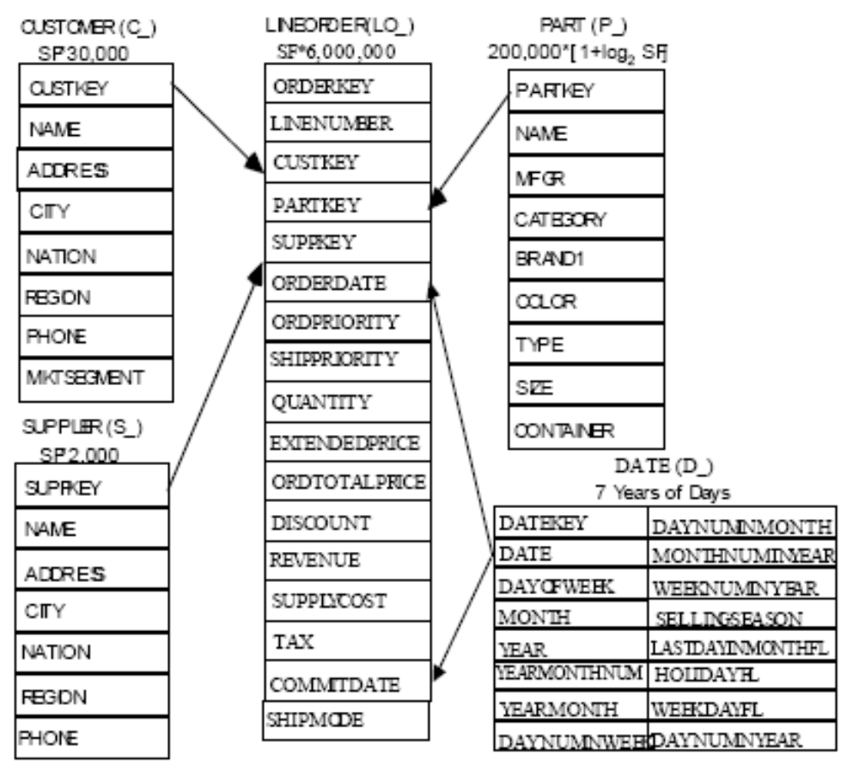


Slide 59
Data Contents
Fact/Lineorder table
  Large (increments of 6M rows)
Customer, Part
  Medium: 120K and 30K row increments
Supplier, dwdate
  Small: 10K increments and 2.5K
How big are the joins?

Slide 60
Queries
13 Different queries
Separated into groups or “flights”
  1.1, 1.2, 1.3
  Etc.
Represent “similar” queries issued by users
Might consider scenarios
  Query frequency / update rate
Notes:
http://cs.brown.edu/people/alexr/CSC553/SSBM_original_queries.sql

Slide 61
Next Time:
Introduction to Transactions
Concurrency Control Algorithms
Recovery and Fault Tolerance
Read: Chapter 20
  Ch20: Physical Database Design and Tuning
(Assignment 4 posted next week)

Slide 62
Query Optimization
select sum(lo_extendedprice) as revenue
from lineorder, dwdate
where lo_orderdate = d_datekey
and d_year = 1993
and lo_discount between 1 and 3
and lo_quantity < 25;
Notes:
rasinsrv01.cstcis.cti.depaul.edu
EXEC DBMS_STATS.delete_table_stats('CSC553','DWdate');

Slide 63
Query Optimization
select c_nation, s_nation, d_year, sum(lo_revenue) as revenue
from customer, lineorder, supplier, dwdate
where lo_custkey = c_custkey
and lo_suppkey = s_suppkey
and lo_orderdate = d_datekey
and c_region = 'ASIA'
and s_region = 'ASIA'
and d_year between 1992 and 1997
group by c_nation, s_nation, d_year
order by d_year asc, revenue asc;

