Slide 1
CSC 553
Advanced Database Concepts
Lecture 6
Alexander Rasin
College of CDM, DePaul University
April 7th, 2015

Slide 2
Tonight
HW2 Review
Views / Indexes
  Maintenance
Database physical design
Transactions

Slide 3
Indexing
Bitmap Indexes
Bitmap Filters
Filtered indexes

Slide 4
Problem 1
Hash function exhibited skew
A number of good ideas:
  Adjust the letter range ([aa-da], [db-f], …
  Use the last number(s) in values
    Some function, MOD 4 (problems?)
  Compute a function over alphanumeric value
General description ok, function is good too

Slide 5
Problem 2
Sorting does not require reserving a memory block for output
  Quicksort generates sorting in-place (all 6 blocks)
  Merging requires an output block
  9 runs (6x8+2) => 2 runs => 1 run
Be careful about assumptions
  You can count “last output” write or not
  So either 50 * 5 = 250 or 50 * 6 = 300

Slide 6
Problem 2: The Cost Formulas
Be sure you understand formulas
Can sketch the merge process
Using the formulas
  Easiest (if pessimistic) log estimate is to round up
    250 or 300, depending on assumptions
  Anything under 50 is suspect

Slide 7
Problem 2: Merging Cost
250/300 is just an upper-bound estimate
Can we do better?
  Yes -- Don’t merge less than 5 runs at once
Notes:
214

Slide 8
Problem 2: Maximum Blocks
Can do the computation and solve
  Log₅ ((x/6)) = 2 (merges)
  x/6 = 25
  x = 150
Can also do an easy estimate
  Test some numbers

Slide 9
Problem 2: Minimum Memory
Again, can do the math
  Log_{x-1} (50/(x)) = 1 (merge)
  50/(x) = x-1
  50 = x * (x - 1) = x^2 - x
  x^2 - x – 50 = 0, x = 7.58
Or, do a simple estimate
  Just try some numbers

Slide 10
Problem 3: BNLJ
Relation r (40) and relation s (100)
Reserve 1 block for output and 1 for inner have 10 memory blocks left
r outer, s inner
  40 / 10 * 100 + 40 = 440 blocks
s outer, r inner
  100/10 * 40 + 100 = 500 blocks

Slide 11
Problem 3: BNLJ
Relation r (40) and relation s (100)
Given 42 memory blocks, reserve 1 block for output and 1 for inner, have 40 left
r outer, s inner
  40 / 40 * 100 + 40 = 140 blocks
  Fit outer relation in memory, cost = 100+40=140
s outer, r inner
  100/40 * 40 + 100 = 220 blocks

Slide 12
Materialized Views
Views are nearly cost-free
Automatically updated (with table changes)
… but not very useful
Materialized Views
  Compute and store the query
  Use the view data directly
  Space cost
  Maintenance cost
Dept_Name | SUM(Salary)
Comp. Sci. | 10M
Music | 2M
Economics | 11M
History | 1M
Comics Studies | 500K
Numerology | 750K

Slide 13
Using Materialized Views
Materialized View (MV) is similar to a pre-computed query
  Simpler language semantics
Best case, Q_{a} = MV_{a}
  Maintenance and disk space limitations
Otherwise a lot of work
  Pre-join
  Pre-filtered
  Pre-aggregated

Slide 14
Pre-joined Materialized View
Consider MV_{a} = r ⋈ s
Can be used to optimize query r ⋈ s ⋈ t₁ ⋈ t₂
  If query plan costs are lower
    Can’t use indexes on s,r with MV_{a}
  MV_{a} needs the right key for join
MV_{a} has indexes of its own
  In some DBs first (clustered) index materializes
  All table-indexing considerations apply to MVs

Slide 15
Pre-filtered Materialized View
Consider MV_{b} = σ_{salary > 75,000} (r ⋈ s)
  Used to optimize query σ_{salary > 75,000} (r ⋈ s)
  Or σ_{salary > 100,000} (r ⋈ s)
  But not σ_{salary > 71,000} (r ⋈ s)
Design a compromise
  Cannot afford all pre-computation
  Find the smallest suitable MV
    E.g., σ_{salary > 70,000} (r ⋈ s)

Slide 16
Pre-aggregated Materialized View
MV_{b} = _{dept_name,gender}G_{sum(salary)}(instructors)
  Optimize query _{dept_name,gender}G_{sum(salary)}(instr)
  Or _{dept_name}G_{sum(salary)}(instructors)
  But not _{dept_name,position}G_{sum(salary)}(instructors)
Design a compromise
  Find the best shared aggregation
  Data cubes

Slide 17
Materialized View Maintenance
The task of keeping a materialized view up-to-date with the underlying data is know as materialized view maintenance
Materialized views using incremental view maintenance
  Changes do database relations are used to compute changes to the materialized view, which is then updated

Slide 18
Index Maintenance
B+-trees
  Amortized logarithmic update cost
  Roughly linear in # of indexes
  Buffer conflict issues
Clustered B+-trees
  Restructuring table is expensive
  Must rebuild every secondary index
  Not every DBMS will support it
    Others compromise

Slide 19
Materialized View Maintenance
Materialized Views
  Simply propagate the row (or delete the row)
  Update all affected views and indexes
Pre-filtered MVs
  Only update the row if it is relevant
  E.g., MV = σ_{salary > 75,000} (r)
  Only update if new faculty has salary > 75K

Slide 20
Materialized View Maintenance
Pre-joined MVs
  Update all affected MVs
  Execute all necessary joins (may be expensive)
  Then, propagate the updates
Pre-aggregated MVs
  For sum/avg can just add new value
  What about delete?
  What about max/min?

Slide 21
Update Batching
Individual row-inserts are expensive
  Building a query plan per insert
  Caching is unreliable
Batch the inserts
  B+-trees can be bulk-updated
  Similarly, MVs can be bulk-updated
  MyISAM and PostgreSQL batch internally
Updates periodic in data warehouses

Slide 22
Compression in MVs/Indexes
One more optimization that is often used in databases
Disk I/O is the dominant cost in a database
Why not compress the data to reduce the size and cost?
  Compression/Decompression overheads

Slide 23
Encoding and Decoding
data
E
N
C
O
D
E
R
Data: binary data set D to compress
  Encode: generate a “compressed” representation D_{c} (hopefully smaller)
  Decode: reconstruct D (or almost D)
Compression ratio: Size(D_{c})/Size(D)
Lossless/Lossy
  Text, files
  Images, MP3, Video, …
compressed
D
E
C
O
D
E
R
data

Slide 24
Dictionary Compression
Eliminate/substitute repeating patterns in data
Consider a database with city names
  Suppose there 223 cities in the database
  Build a dictionary that contains mappings
    {1=>Boston, … 17=>Chicago, … 220 => Los Angeles}
    <255 values means 1 byte per value
  Replace every city with its code
  Store the dictionary separately

Slide 25
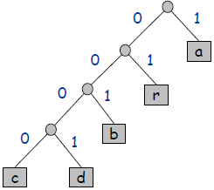
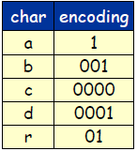
Variable Length Encoding
Fewer bits for frequent letters (E, T, A)
More bits for rare letters (J, Q, Z)
Potential ambiguity
  (E=0, T=01, Z=0001101)?
Use a binary tree
110010000010100011

Slide 26
Compression Quality
Huffman coding/Huffman tree
  Build a tree based on character frequency
All compression algorithms exploit bias in data
  Images have white patches
  Letters E/T/A occur more frequently
Random (or compressed!) data
  High entropy
  Difficult to compress

Slide 27
Compression in MVs/Indexes
Special types
  Index suppression (Oracle)
  Included columns (SQL Server)
Databases support more general compression
  Row-based compression
  Page-based compression
  Both indexes and MVs

Slide 28
Compression in MVs/Indexes
Compress the MV or Index
  Reduced size
  Cheaper to read (fewer pages)
  Less buffer stress
  Faster to process (?)
Maintenance implications
  Decompress to update
  Recompress to write back to disk
  Potentially more difficult to do lookups

Slide 29
Physical Design/Tuning
  Materialized view selection and index selection are based on typical system workload (set of queries and updates)
    The goal: minimize time to execute workload
    Subject to: space constraints (disk budget) and sometimes guarantees for particular queries (boss query)
  Commercial database systems provide tools (called “tuning assistants” or “wizards”) to help the database administrator choose what indices and materialized views to create

Slide 30
Physical Design/Tuning
  Intuition
    Start with “best” answer (MVs and Indexes) to every workload query
    Merge the views
    Combine the indexes
    Smaller/cheaper designs <> less performance
    Fewer indexes <> lower maintenance cost
  Subject to occasional re-design

Slide 31

A Break!

Slide 32
Star-Schema Benchmark
A simplification of an industrial TPCH benchmark
  Schema significantly simplified (Star-Schema)
  Simplified queries

Slide 33


Star-Schema
“Dimension” table
Products
“Fact” table
pid
name
desc
1
Transactions
2
3
4
LCD Monitor
…
“Dimension” table
tid cid pid date amount
Customers
1
3
4
01-01-10
200.00
cid
name
address
2
1
10
01-01-10
45.95
3
3
9
01-02-10
110.00
1
…
2
…
3
Alex
“Dimension” table
Date
date
day
holiday

Slide 34
SSBM Schema
4 Dimension tables
  Part: manufacturer, name, size, ...
  Supplier: name, address, phone, …
  Customer: name, address, …
  Date: month, year, dayofweek, …
1 Fact table: lineorder
  Composite key (orderkey+linenumber)
  4 foreign keys (one per dimension)
  Orderpriority, quantity, discount, tax, …

Slide 35
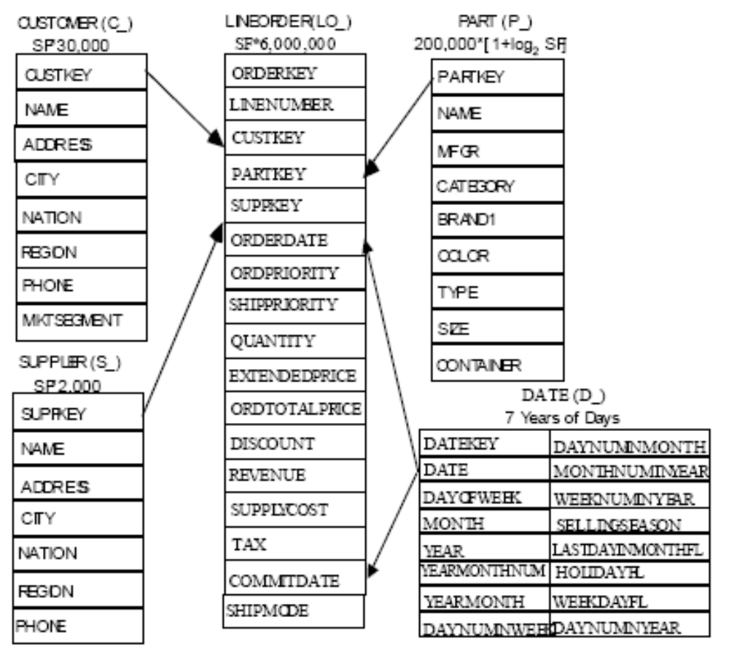


Slide 36
Data Contents
Fact/Lineorder table
  Large (increments of 6M rows)
Customer, Part
  Medium: 120K and 30K row increments
Supplier, dwdate
  Small: 10K increments and 2.5K
How big are the joins?

Slide 37
Queries
13 Different queries
Separated into groups or “flights”
  1.1, 1.2, 1.3
  Etc.
Represent “similar” queries issued by users
Might consider scenarios
  Query frequency / update rate
Notes:
http://cs.brown.edu/people/alexr/CSC553/SSBM_original_queries.sql

Slide 38
Indexes: An Exercise
select min(lo_revenue)
from lineorder
where lo_extendedprice < 100000;
Select max(lo_revenue)
From lineorder
Where lo_discount = 5 and lo_quantity > 33;
Notes:
rasinsrv01.cstcis.cti.depaul.edu
-- COPY the table
-- CREATE TABLE lineorder2 AS SELECT * FROM lineorder
DROP INDEX INDEX1;
CREATE INDEX INDEX1 ON LINEORDER2
(
LO_EXTENDEDPRICE
)
DROP INDEX INDEX2;
CREATE INDEX INDEX2 ON LINEORDER2
(
LO_EXTENDEDPRICE, LO_REVENUE
)
DROP INDEX INDEX3;
CREATE INDEX INDEX3 ON LINEORDER2
(
LO_DISCOUNT, LO_QUANTITY
)
DROP INDEX INDEX4;
CREATE INDEX INDEX4 ON LINEORDER2
(
LO_QUANTITY, LO_DISCOUNT
)
-- Wipe out the stats
EXEC DBMS_STATS.delete_table_stats('arasin', 'lineorder2'); -- OLD
EXEC DBMS_STATS.delete_table_stats('CSC553','DWdate');

Slide 39
Query Optimization
select sum(lo_extendedprice) as revenue
from lineorder, dwdate
where lo_orderdate = d_datekey
and d_year = 1993
and lo_discount between 1 and 3
and lo_quantity < 25;

Slide 40
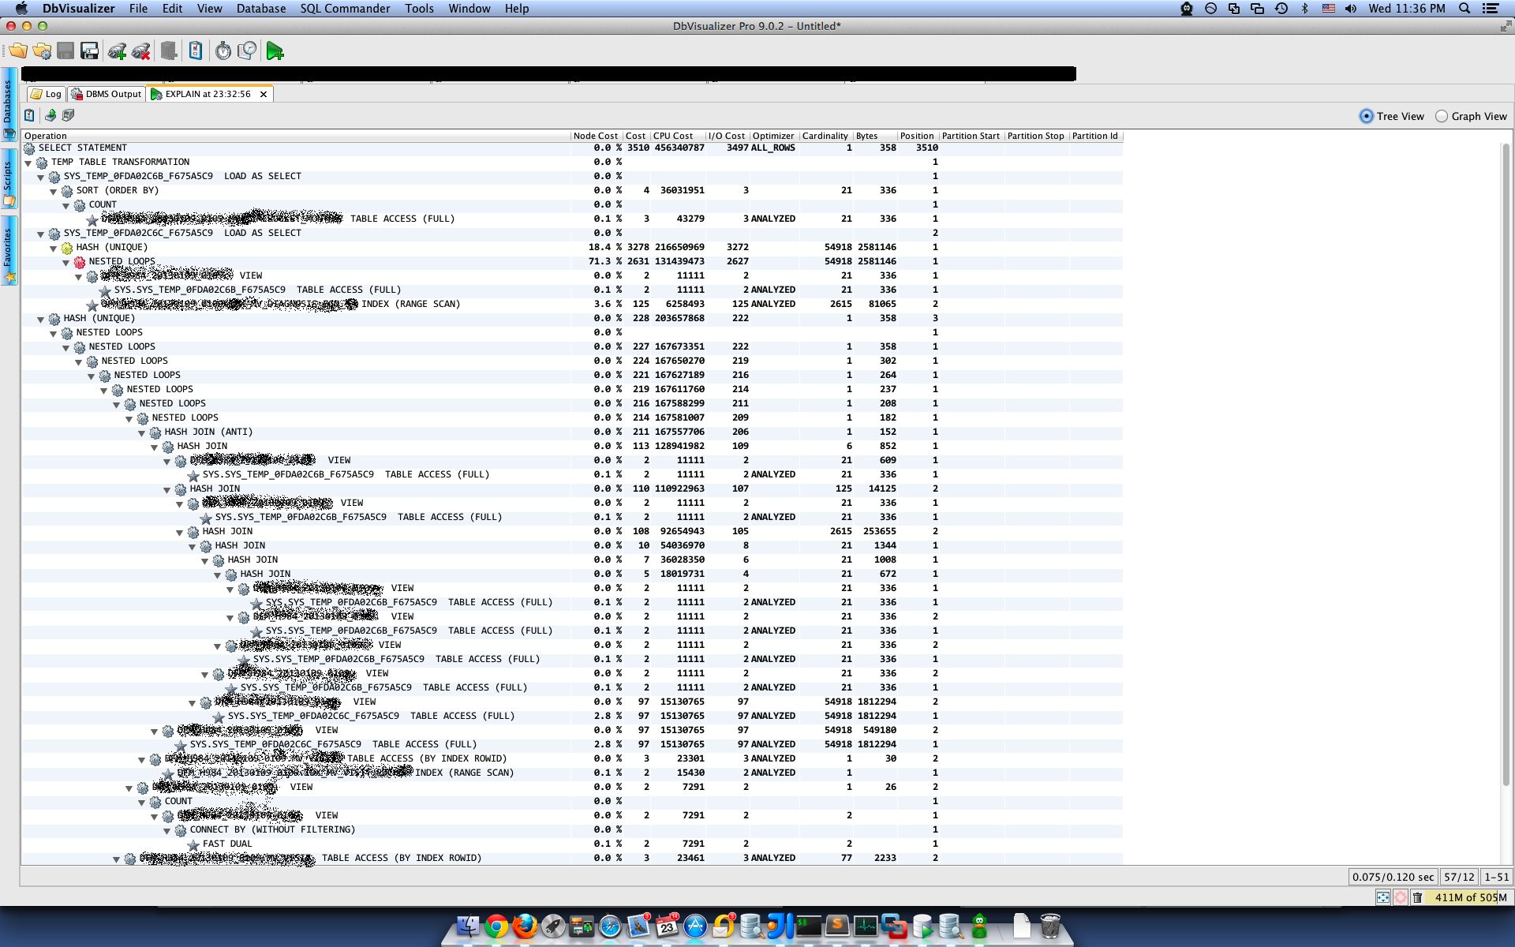

Slide 41


Transaction Processing

Slide 42
Updates in SQL
An example:
UPDATE account
SET balance = balance - 50
WHERE acct_no = A102
What takes place:
memory
…
Disk
Dntn: A102: 300
(1) Read
Dntn: A15: 500
(2) update
account
…
Transaction:
Read(A)
A <- A -50
Write(A)
(3) write
Mian: A142: 300

Slide 43
The Threat to Data Integrity
Consistent DB
Name Acct bal
-------- ------ ------
Joe A-102 300
Joe A-509 100
Joe’s total: 400
Inconsistent DB
Name Acct bal
-------- ------ ------
Joe A-102 250
Joe A-509 100
Joe’s total: 350
transaction
Consistent DB
Name Acct bal
-------- ------ ------
Joe A-102 250
Joe A-509 150
Joe’s total: 400
What a Xaction should
look like to Joe
What actually happens
during execution

Slide 44
Transactions
What?:
  A unit of work
  Can be executed concurrently
Why?:
(1) Updates can require multiple reads/writes in db
e.g., transfer $50 from A-102 to A-509
= read(A)
A ← A -50
write(A)
read(B)
B←B+50
write(B)
(2) For performance reasons, databases permit updates to be executed concurrently.
Concern: concurrent access/updates of data can compromise data integrity

Slide 45
Demonstrating ACID
Transaction to transfer $50 from account A to account B:
  1. read(A)
  2. A := A – 50
  3. write(A)
  4. read(B)
  5. B := B + 50
  6. write(B)
FAILURE!
Consistency: total value A+B, unchanged by Xaction
Atomicity: if Xaction fails after 3 and before 6, 3 should not affect db
Durability: once user notified of Xaction commit, updates to A,B should not be undone by system failure
Isolation: other Xactions should not be able to see A, B between steps 3-6

Slide 46
Threats to ACID
1. Programmer Error
e.g.: $50 substracted from A, $30 added to B
→ threatens consistency
2. System Failures
e.g.: crash after write(A) and before write(B)
→ threatens atomicity
e.g.: crash after write(B)
→ threatens durability
3. Concurrency
e.g.: concurrent Xaction reads A, B step 3-6
→ threatens isolation

Slide 47
Isolation
Simplest way to guarantee: forbid concurrent Xactions!
But, concurrency is desirable:
(1) Achieves better throughput (TPS: transactions per second)
  one Xaction can use CPU while another is waiting for disk to service request
(2) Achieves better average response time
short Xactions don’t get stuck behind long ones
Prohibiting concurrency is not an option

Slide 48
Isolation
Approach to ensuring Isolation:
  Distinguish between “good” and “bad” concurrency
  Prevent all “bad” (and sometime some “good”) concurrency from happening OR
  Recognize “bad” concurrency when it happens and undo its effects (abort some transactions)
  Pessimistic vs Optimistic CC
Both approaches require distinguishing between good and bad concurrency
How: concurrency characterized in terms of possible Xaction “schedules”

Slide 49
Transaction Definition in SQL
Data manipulation languages include a construct for specifying the set of actions that comprise a transaction.
  In SQL, a transaction begins implicitly
A transaction in SQL ends by:
  Commit commits current transaction + begins a new one
  Rollback causes the current transaction to abort.
In some database systems, by default, every SQL statement also commits implicitly if it executes successfully
  Implicit commit can be turned off by a database directive
    E.g. in JDBC, connection.setAutoCommit(false);

Slide 50
Schedules
Schedules – sequences that indicate the chronological order in which instructions of concurrent transactions are executed
  a schedule for a set of transactions must consist of all instructions of those transactions
  must preserve the order in which the instructions appear in each individual transaction
T1
1
2
3
T2
A
B
C
D
T1
1
2
3
T2
A
B
C
D
one possible schedule:

Slide 51
Example Schedules
Transactions:
T1: transfers $50 from A to B
T2: transfers 10% of A to B
Example 1: a “serial” schedule
T1
read(A)
A <- A -50
write(A)
read(B)
B<-B+50
write(B)
T2
read(A)
tmp <- A*0.1
A <- A – tmp
write(A)
read(B)
B <- B+ tmp
write(B)
Constraint: The sum of A+B
must be the same
Before: 100+50
After: 45+105
=150, consistent

Slide 52
Example Schedule
Another “serial” schedule:
T1
read(A)
A <- A -50
write(A)
read(B)
B<-B+50
write(B)
T2
read(A)
tmp <- A*0.1
A <- A – tmp
write(A)
read(B)
B <- B+ tmp
write(B)
Before: 100+50
After: 40+110
Consistent but not the
same as previous schedule..
Either is OK!
=150, consistent

Slide 53
Example Schedule (Cont.)
Another “good” schedule:
T1
read(A)
A <- A -50
write(A)
read(B)
B<-B+50
write(B)
T2
read(A)
tmp <- A*0.1
A <- A – tmp
write(A)
read(B)
B <- B+ tmp
write(B)
Effect: Before After
A 100 45
B 50 105
Same as one of the serial schedules
Serializable!

Slide 54
Example Schedules (Cont.)
A “bad” schedule
T1
read(A)
A <- A -50
write(A)
read(B)
B<-B+50
write(B)
T2
read(A)
tmp <- A*0.1
A <- A – tmp
write(A)
read(B)
B <- B+ tmp
write(B)
Before: 100+50 = 150
After: 50+60 = 110 !!
Not consistent

Slide 55
Serializability
How to distinguish good and bad schedules?
→ previous example: any schedule leaving A+B = 150 is good
Q: could we express good schedules in terms of integrity constraints?
No. In general, won’t know A+B, can’t check value of A+B at given time for consistency
Alternative: Serializability

Slide 56
Serializability
Serializable: A schedule is serializable if its effects on the db are equivalent to some serial schedule.
Hard to ensure; more conservative approaches are used in practice
All schedules
Serializable schedules
“view serializable” schedules
“conflict serializable” schedules

Slide 57
What operations can be swapped?
A. Reads and writes of different data elements
e.g.: T1 T2 T1 T2
write(A) read(B)
=
read(B) write(A)
OK because: value of B unaffected by write of A
( read(B) has same effect )
write of A is not undone by read of B
( write(A) has same effect)
Note : T1 T2 T1 T2
write(A) read(A)
=
read(A) write(A)
Why? In the first case, T1 reads value of A written by T2. May be different value than previous value of A

Slide 58
Swaps
T1 T2 T1 T2
write(A) read(A)
=
read(A) write(A)
How would the above swap affect the database?
Suppose what follows read(A) in T1 is:
read(C)
C ←C+A
write(C)
Unless T2 writes the same value to A,
the first schedule will leave a different value for C compared to the second case

Slide 59
Conflict Serializability (Cont.)
If a schedule S can be transformed into a schedule S´ by a series of swaps of non-conflicting instructions, we say that S and S´ are conflict equivalent.
We say that a schedule S is conflict serializable if it is conflict equivalent to a serial schedule
e.g.
T1
….
read(A)
T2
….
read(A)
.
.
.
T1
….
read(A)
T2
….
read(A)
.
.
.
can be rewritten
to equivalent
schedule

Slide 60
Conflict Serializability (Cont.)
Example:
T1
1. Read(A)
2. A ← A -50
3. Write(A)
4.Read(B)
5. B ← B + 50
6. Write(B)
T2
a. Read(A)
b. tmp ← A * 0.1
c. A ← A - tmp
d.Write(A)
e. Read(B)
f. B ← B + tmp
g. Write(B)
Swaps:
4 <->d
4<->c
4<->b
4<->a
5<->d
5<->c
5<->b
5<->a
6<->d
6<->c
6<->b
6<->a
Conflict serializble
T1, T2

Slide 61
Conflict Serializability (Cont.)
The effects of swaps
T1
read(A)
A <- A -50
write(A)
read(B)
B<-B+50
write(B)
T2
read(A)
tmp <- A*0.1
A <- A – tmp
write(A)
read(B)
B <- B+ tmp
write(B)
Because example schedule could
be swapped to this schedule (<T1, T2>)
example schedule is
conflict serializable

Slide 62
The Swaps we Made
A. Reads and writes of different data elements
4 <-> d
6 <-> a
B. Reads of different data elements: 4 <-> a
C. Writes of different data elements: 6 <-> d
D. Any operation with a local operation
OK because local operations don’t go to disk. Therefore, unaffected by other operations:
4 <-> b 5 <-> a ....
4 <-> c
To simplify, local operations are omitted from schedules

Slide 63
Conflict Serializability (Cont.)
Previous example without local operations:
T1
1. Read(A)
2. Write(A)
3. Read(B)
4. Write(B)
T2
a. Read(A)
b. Write(A)
c. Read(B)
d. Write(B)
Swaps:
3 <->b
3<->a
4<->b
4<->a
T1, T2

Slide 64
Swappable Operations
Swappable operations:
  Any operation on different data element
  Reads of the same data (Read(A))
  (regardless of order of reads, the same value for A is read)
Conflicts:
T2: Read(A) T2: Write(A)
T1: Read (A)
T1: Write (A)
OK
R/W Conflict
W/R Conflict
W/W Conflict

Slide 65
Conflicts
(1) READ/WRITE conflicts:
conflict because value read depends on whether write has occurred
(2) WRITE/WRITE conflicts:
conflict because value left in database depends on which write occurred last
(3) READ/READ : no conflict

Slide 66
Conflict Serializability
Q: Is the following schedule conflict serializable? If so, what’s its equivalent
serial schedule? If not, why?
T₁ T₂
(1) read(Q)
write(Q) (a)
(2) write(Q)
Ans: No. Swapping (a) with (1) is a R/W conflict, and
swapping (a) with (2) is a W/W conflict.
Not equivalent to <T1, T2> or <T2, T1>

Slide 67
Conflict Serializability
Q: Is the following schedule conflict serializable? If so, what’s its equivalent
serial schedule? If not, why?
T1
(1) Read(A)
(2) Write(S)
T2
(a) Write(A)
(b) Read(B)
T3
(x) Write(B)
(y) Read(S)
Ans.: NO.
All possible serial schedules are
not conflict equivalent.
<T1, T2, T3>
<T1, T3, T2>
<T2, T1, T3>
. . . . . .

Slide 68
Next Time:
Concurrency control algorithms
Recovery and fault tolerance
Read: Chapter 21: Introduction to Transaction Processing Concepts and Theory
(Assignment 4 to be posted by Friday)

