Slide 1
Adaptive Partitioning Scheduler
Restricting CPU Resources to Groups of Processes

Slide 2
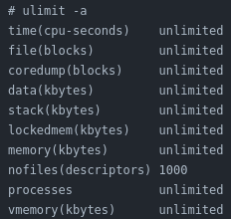
Restricting Process
resources are limited - more so with embedded targets
rlimit is typically used to restrict system resources consumed by processes (i.e. restrict number of processes that can be spawned – prevent fork bombs)
Notes:
As resources are limited, the need to control how much resources a process can consume is an important feature. Malicious users and processes can try to consume all available resources in the system thus denying other users and processes which leads to resource starvation. This control can be done using ulimit or rlimit API. For instance, every shared computing resource I have ever used such as the school labs restrict the number of processes that can be spawned to prevent fork bombs.

Slide 3
Constraining Groups of Processes
Want to restrict resources as a collective group of processes? Try APS
APS – Adaptive Partition Scheduler
  Only restricts CPU resources
  There were talks about adaptive memory but seems to be dead
Notes:
But what if we want something more flexible such as the ability to restrict resources as a collective group of processes? On QNX, APS can be used to control and allocate CPU resources to each group of processes. Unlike Linux which allows you to control a large range of resources, QNX only offers the ability to restrict CPU resources.

Slide 4
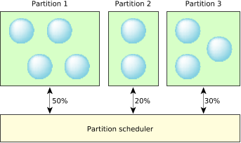
USE CASE Highlights
Avoid any “single point of failure”
  i.e. fork bombs and DDOS
System Recovery
  Prevent being locked out of the system
  Allocate a small amount of resources to emergency recovery shell
Notes:
Some great use case for APS is to avoid any single point of failure in the system by preventing fork bombs and DDOS attacks since they are constrained to their partition. Another use case could be for system recovery. Normally when you have a system that goes haywire, you lose control of the system so you cannot do any emergency procedures to the system since you are locked out of the system. You can allocate a small amount of resources to an emergency shell or to io-pkt and qconn so that you will always have access to the shell. This is a flexible approach that does not compromise on performance because the budget allocated to the partition will be consumed by other partitions when not in use.

Slide 5
Partitions
A virtual “container” where groups of threads run on and are allocated a “minimum” percentage of the CPU referred as a budget [Paraphrased from Brief Industry Paper: Dissecting the QNX Adaptive Partitioning Scheduler]
Attributes:
  partition_name (if not specified, the id is assigned as the name)
  [budget, max_budget] – “min” guaranteed and max CPU budget (unit: %)
  Critical budget: additional budget allocated for critical threads
  critical_priority: any thread with priority greater or equal to critical_priority are designated as critical
Notes:
So what are partitions? A partition is a virtual “container” (read from the slides)
A partition has a name, … (read from slides)

Slide 6
ADAPTIVE
Not fixed (i.e. static) – can be modified dynamically
  modify [-B critical_budget] [-b budget]
  [-m max_budget] partition_id | partition_name
Partitions can share resources if not being used
Can add, remove, and move threads to different partitions
Notes:
What does it mean to be adaptive since it’s in the name. For starters, APS allows system designers to dynamically create and modify properties of the partitions such as the budget
APS allows you to share CPU usage among other partitions if a partition is not using it. This means that no CPU time is wasted
In addition, threads can be added, removed, or moved to different partitions and therefore not fixed into any particular partitions.

Slide 7
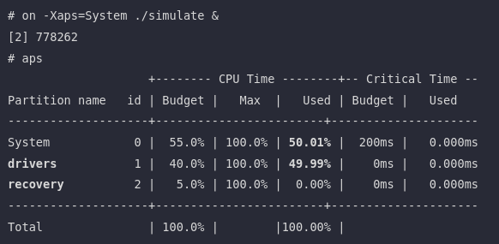
Sample Look
Notes:
Here’s a sample output of APS running on a system. As you can see from the diagram, we can see that the drivers partition is consuming more than it’s allotted budget since not the other partitions have quote on quote left over CPU that it can share.

Slide 8
Start Threads on a Partition
Can use pidin sched to see where each thread belongs to
Can use on utility to start processes on a partition
  i.e. on -Xaps=drivers ./nv-gpu &
Notes:
Pidin provides a way to see which partition each thread on the system belongs to by using the sched option. There are a few ways to start a thread on a particular partition but the simplest way is to use the `on` utility.

Slide 9
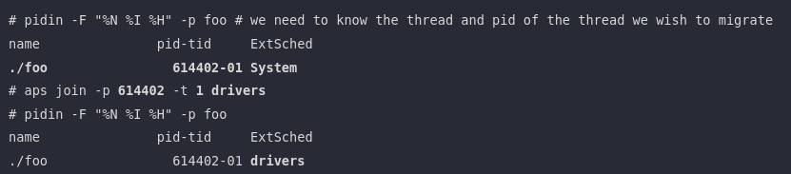
Migrate Threads to a Partition
Can use aps join -p <pid> -t <tid> <partition_name>
Notes:
But what if you didn’t start the thread in the right partition or you wish to move a thread to another partition? You can use the join command in the aps utility.
As you can observe in the diagram, we can see that the thread was initially running on the System partition but is now running in the drivers partition.

Slide 10
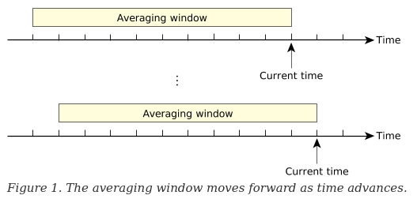
Averaging Windows/Sliding Window (very briefly)
Scheduler calculates average CPU usage over a sliding window
Average CPU time is calculated after some unit of time (usually a tick or 1ms)
APS keeps track of usage history over the duration of the entire window (i.e. wraps around overwriting old value hence sliding window
Notes:
Before I go talk about scheduling, we first need to understand what it means to use some percent of the CPU time. If a partition is reported to use 1% of the CPU, what does that roughly translate in terms of a unit of time? How often does the CPU usage get updated? APS calculates average CPU usage over some interval of time which we call the window size measured in ms to the user in a high level view. The average usage is calculated after some unit of time which is typically a tick or 1ms. The scheduler keeps track of the usage history over the duration of the window. It’s sometimes referred as a sliding window since as time passes, the oldest slot gets overwritten meaning the scheduler never remembers anything older than its window size.
So if our window size is 100ms and a partition is reporting a CPU usage of 1%, then the partition has been using about 1ms of the CPU time in the past 100ms.

Slide 11
Scheduler – Basics (Default Behavior)
Normally the scheduler chooses the highest ready thread to execute
Underload: strict realtime scheduler – i.e. by priority
“Freetime”: by priority
Overload: by “ratio of budgets” i.e. fulfill the partiton’s assigned (normal) budget
  May not guarantee meeting budgets due to realtime requirements (i.e. critical threads)
Notes:
Some basics on how scheduling works. I will be omitting quite a lot of details but hopefully I have enough time to go over it later.
Normally in QNX, the scheduler will choose the highest ready thread to execute. This logic still applies when the partitions are underloaded or when there is freetime.

Slide 12
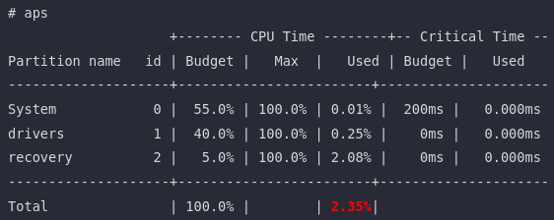
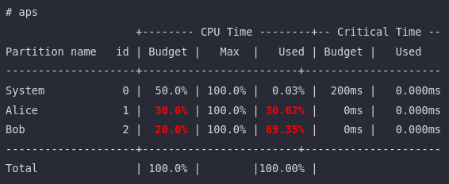
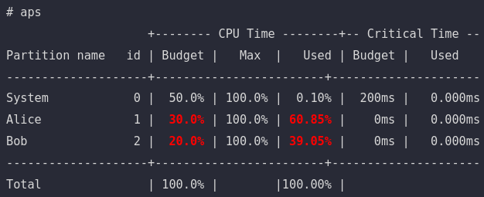
Underload
Freetime with different priorities
Freetime with same priorities
Full Load
Notes:
A partition is underloaded if the threads in the partition has not consumed all of its assigned budget. As you can observe in the first diagram, none of the partitions are using anywhere near its assigned CPU share.
“Freetime” refers to when a partition with a remaining budget in the time window has no thread in READY state so it yields its CPU time to other partitions instead of wasting CPU time. For instance if all threads in a partition goes to sleep, then there is idling in the system if it’s not being used which is why Adaptive partitioning distributes the freetime to other threads.
As you can see from the middle diagram, the System partition has no READY threads so it shares its CPU to other partitions which explains why Alice and Bob used more than its assigned budget. Also notice how Bob is using more of the CPU time than Alice despite Alice having a bigger budget than Bob. This is due to the fact that there are higher priority threads running in Bob like the greedy person he is.
The last diagram illustrates how the scheduler will assign CPU time if the remaining threads all have the same priority. It will be distributed based on the proportion to the normal budget of the partition

Slide 13
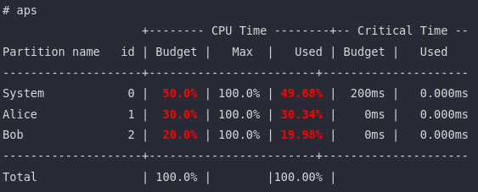
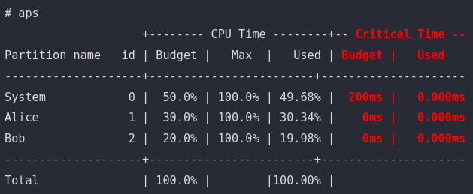
Full Load
Notes:
Overload as the name implies is when all partitions are using their assigned budget so there are essentially no CPU time it can take from other partitions. This means higher priority threads WILL be blocked if the partition ran out of its budget unless it is deemed critical. We will get to this later when we talk about bankruptcy. As you can see, the scheduler tries its best to balance the budgets within 1% of their guaranteeed budget or within some interval of the timeslice or window size but I won’t get into that. You can refer to the patent for more details.
However, when the system is under a full load, how can we still achieve realtime performance? What if there are some critical operations that needs to be worked on? That is where critical threads and critical budget comes in. As seen in the bottom diagram, there is an entire section in the table dedicated to critical time. But to understand what this section means, we first need to understand what are critical threads and how it relates to critical time.

Slide 14
Critical Threads
a thread that have “strict realtime requirements”
Designed to go over the normal budget of partition during a full load (provided they have a critical budget)
Implications: under a full load, if there are critical threads it will cause other partitions to not utilize their entire normal budget
Notes:
QNX is a realtime OS meaning it needs to be able to schedule and complete tasks with the most minimal amount of delay to achieve a realtime performance.
That is where critical threads comes in. A critical thread is a thread that has a strict realtime requirement. This means that the system is designed to go over the normal budget of the partition during a full load to achieve realtime performance.
The implication to this is that under a full load, if there are critical threads running on the system, it will cause other partitions to not utilize their entire normal budget because the critical threads needs to be executed.

Slide 15
Critical Threads – How to define them
is_critical = priority(thread) >= critical_priority
critical_priority set during partition creation
If you forget to set one, use aps modify -P
Notes:
A critical thread can be defined by assigning the priority to be equal or greater than the critical priority that you set during the creation of the partition. If you forget to set one up, you can use `aps modify` with the -P option.

Slide 16
Critical Budget
A critical budget is the number of ms critical threads can run on a partition over sliding window
Critical budget is only billed if partition exhausted its normal budget and is competing with another partition for CPU time
What happens if a partition exceed its critical budget? Bankruptcy
Notes:
A critical budget is the number of ms critical threads in the partition can run on a partition over some average time window
A critical budget is only billed if the partition exhausted its normal budget and is competing with another partition for CPU time. So if there is freetime, a critical thread will be not be billed for it.

Slide 17
Bankruptcy
“ Bankruptcy occurs when the critical CPU time billed to a partition exceeds its critical budget.”
“Recovery options”:
  Basic (default): send bankruptcy notification events and make partition unable to run for the rest of the scheduling window
  Cancel: set partition’s critical budget to 0ms
  Reboot: crash and report offending partition
Notes:
What happens when a business runs out of cash? It goes bankrupt. Similarly, when a partition runs out of critical time, the partition becomes bankrupt. There are three ways to handle bankruptcy:
1. Basic (the default): notify to the system of the bankruptcy and forbid the partition from running for the rest of the scheduling window i.e. till it receives more funding
2. Cancel: remove the partition’s critical budget so it cannot use critical time till either the critical budget is set again either using SchedCtl or the aps utility
3. Reboot is the most appealing option to me because it crashes the system and reports the offending partition. It makes it obvious during testing or when you are playing around with APS that a bankruptcy occurred.

Slide 18
Bankruptcy
If bankruptcy occurs, considered a design error on the application
Note: System partition can never be bankrupt (shown as 200ms in examples but it’s actually infinite i.e. time-window * num_of_cores = 100ms * 2 = 200ms)
Notes:
Similarly to how poor business decisions can lead companies to bankruptcy, if a bankruptcy occurs, it is considered the design error of the application
Some trivia fact is that the system partition can never be bankrupted.

Slide 19
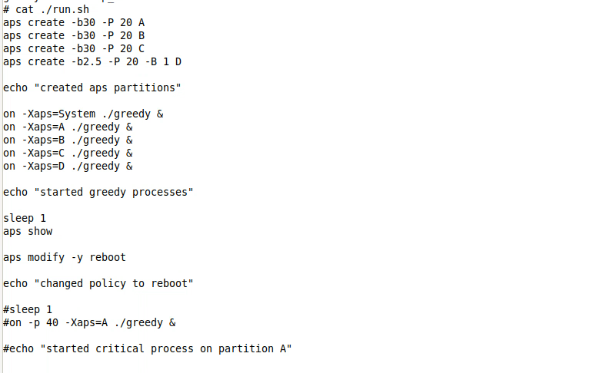
Bankruptcy DEMO
Notes:
Here’s a small demo of causing a bankruptcy. We have 4 partitions named A, B, C, D where we’ll try to bankrupt partition D by having it a very small partition with a critical time of 1ms. The idea is to overload the system such that we force a critical process running on partition D to use its critical budget.

Slide 20
Payback – Nothing is Free
unused CPU are distributed to other partitions
What happens if partition “wakes up” (i.e. a thread becomes ready?)
  Partitions that consumed the sleeping partition’s CPU will not run till the sliding window forgets over cpu usage
  i.e. repay back the borrowed time
  i.e. till scheduler forgets about the debt (it’s memory only lasts for the past window_size ms) so if partition sleeps over two window cycle, other partitions do not need to repay for the previous cycle.
  Issue: increases response time (i.e. if partition is over-budget, needs to repay even if a high priority thread needs to be executed (assuming thread is not critical).
Notes:
Recall that unused CPU from a sleeping partition gets distributed to other active partitions. This behavior can be seen as lending the CPU time to other partitions. For instance, what would happen if a partition wakes up? The scheduler needs to ensure that the partition gets its quote on quote guaranteed CPU time. So any partitions that have borrowed time from the sleeping partition will need to repay it back by yielding its CPU time to the partition. This is all done by the scheduler who keeps track of CPU usage from the past window size ms which by default is 100ms. However, the scheduler is not great at memorizing the debt of other partitions as it only remembers the usage history from the past windows size i.e. 100ms. So partitions do not need to repay their entire debt, only what the scheduler recalls.
A consequence of this feature where unused CPU is lended to other partitions is that it can raise response time which may not be ideal in a realtime operating system. For instance, a higher priority thread may be forced to wait for a long time since the partition needs to repay part of its debt. So system designer will need to consider whether or not this feature should be utilized or not. Forcing a maximum CPU time can be used to disable this feature.

Slide 21
Inheritance (Default Settings)
Message handling: if client sends message, server (receiver) bills the client (i.e. server thread working on behalf of the client thread)
But pulses are billed to the receiving end (i.e. not the client)
Child threads inherit parent’s partition (even if it was spawned from servicing client)
Notes:
Let’s go over how inheritence works with APS. Child threads inherit the parent’s partition. This can be easily seen by spawning a background process on the shell. You’ll notice that the background process spawned by a shell running on the System partition will also run on the System partition.
(Sort of reminds of asking how does call time billing works, is it the sender, is it the receiver or is it both. I think it’s both parties but this was what always made me wonder back when you bought those prepaid phone cards to make calls)
What about message handling? Well in APS, if a client sends a message to the server, the scheduler will bill the client and not the server for the server to handle the client’s message. So the server will inherit the partition of the client temporarily to serve the client from my understanding.
But the same logic does not apply to pulses unfortunately.

Slide 22
Interesting Notes
APS scheduling overhead increases with more partitions but not with the increase of threads
Maximum of 32 partitions
Partitions cannot be deleted once created
Increasing window size can increase response time (extreme example can be found in QNX documentation) - rare
Notes:
Here are some interesting facts that I won’t go over in details

Slide 23
Microbilling
“Micirobilling means accounting for the cpu time used by a thread to much finer resolution than the clock period between tick interrupts.”
Scheduling and keeping track of time is done on every timer tick (i.e. 1ms)
Timestamps are taken when threads enter and leave RUNNING state
  Difference between the two are charged to the thread
Notes:
Microbilling is the finer accounting of the CPU time the thread consumes, much more in detail than what the clock tick provides by keeping track of the timestamps when the threads enter and leave the RUNNING state. The difference between the two are charged to the thread.

Slide 24
Notes
Did not mention security policies
Did not mention about scheduling policies
Did not go over micro-billing (unless time permitted)
Did not go into the C API
Only went over default settings, they can be tweaked
Notes:
There are a lot of details I did not cover and do not know much about. There’s only so much I can cover in a 15 minute presentation and I did not do much research as I should have (I do have an exam on the same day as the presentation :(

Slide 25
Resources to Look At
QNX APS Documentation
Brief Industry Paper: Dissecting the QNX Adaptive (Bosch Paper)
Patent US 9,361,156 B2 - ADAPTIVE PARTITIONING FOR OPERATING SYSTEM
Foundary27 - APS Requirements
Foundary27 - APS How it Works
Notes:
QNX documentation is a great place to start looking into APS. If you want a more detailed explanation, the patent for this technology in QNX provides a great amount of detail. Foundary27 is also a great resource, just ignore the parts on memory partitioning.

