Slide 1
Adaptive Partitioning System
Restricting CPU Resources to Groups of Processes

Slide 2
Restricting Process
resources are limited - more so with embedded targets
rlimit is typically used to restrict a process’s resources

Slide 3
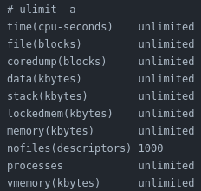
Notes:
Speaker notes go here

